Slide 1


Success by Dual Degrees:
A New Model for
Community College/University
Transfer
College Changes Everything
July 12, 2012
Dual Degree Program

Slide 2








Governors State University and
nine community college partners
share a commitment:
Increase the number of students who
complete their associate degrees and
transfer to complete their bachelor’s degrees.

Slide 3
DDP – A Partnership of Diverse Institutions
Regional Public University: Governors State University
Two Largest Illinois Community Colleges: College of DuPage
Moraine Valley Community College
Largest Illinois Community College District: City Colleges of Chicago
Predominately Rural Community College: Kankakee Community College
Predominantly Black Institutions (PBI’s): Prairie State College
South Suburban College
Hispanic Serving Institutions (HSI’s): Morton College
Triton College
Nation’s Oldest – First! – Community College: Joliet Junior College

Slide 4

Research and Rationale
support each of the
unique components of the
Dual Degree Program

Slide 5

Students must complete their
associate degree prior to
transfer to university.
Dual Degree Program:
Not dual credit or dual enrollment

Slide 6

Students must attend full-time.

Slide 7
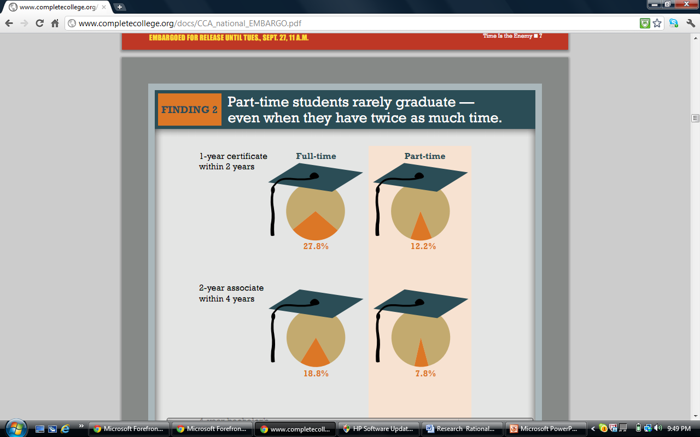
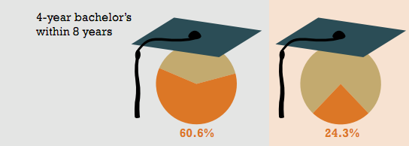
Part-time students rarely graduate --- even when they have twice as much time.
Complete College America, 2011

Slide 8

Students must participate in structured,
intentional, inter-segmental advising
and mentoring.

Slide 9

Students receive academic
and financial incentives and
support.
  Guaranteed university admission

Slide 10
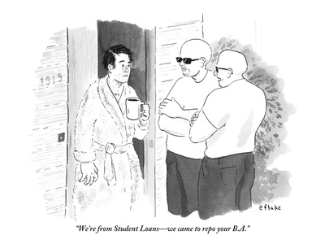
“We’re from Student Loans – we came to repo your B.A.”
The New Yorker, January 16, 2012

Slide 11
Tuition freeze
GSU Promise Scholarships
DDP Honors Scholarships
MAP 2+2 Pilot Program

Slide 12
Preliminary Results
310 students currently enrolled
in DDP Program
44 students projected to arrive at
GSU in Fall 2012

Slide 13

Scholarships Recently Awarded
24 Recipients:
46% African American
8% Hispanic
4% Asian
75% Female
25% Male
71% are Pell-eligible and
54% have an Expected Family Contribution of ZERO!

Slide 14
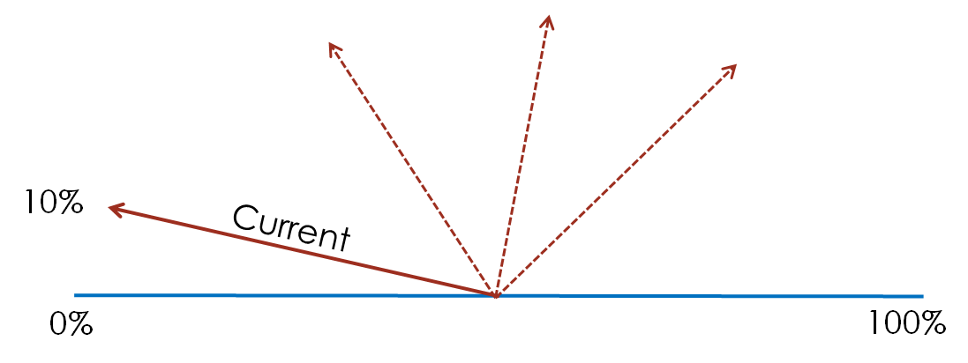

Moving the Needle
Percentage of students entering community colleges who go on to complete bachelor’s degrees in six years

Slide 15
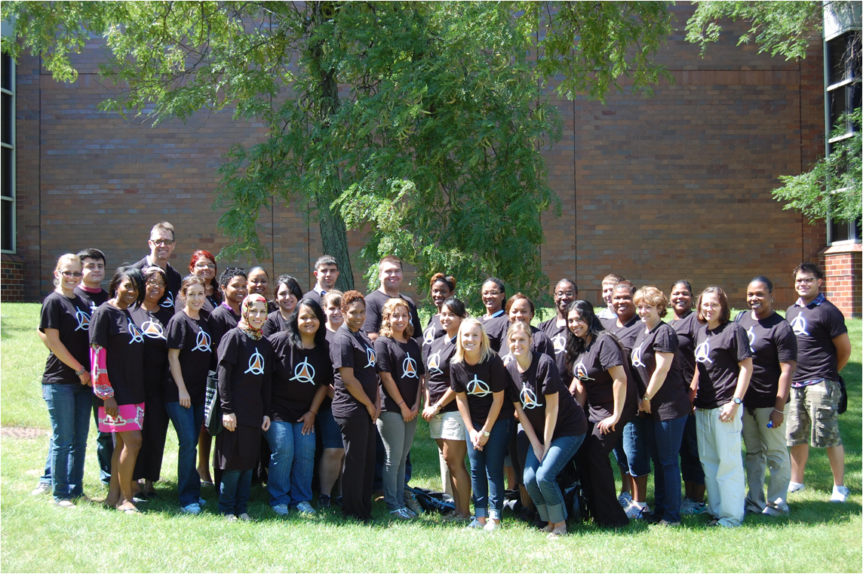
Questions?

