Slide 1
Retention at DePaul University
Yesenia Sánchez-Giancola, Director
First-Year Academic Success Program

Slide 2
DePaul’s 4Ps Retention Framework
4Ps: Institutions need to implement comprehensive integrated efforts, there is no silver bullet.
Profile
Progress
Process
Promise

Slide 3
First-year Academic Performance is the Key Driver of Retention and Graduation Rates
Students who complete the year in the high performance group (earning a 2.5 or higher GPA and 48 or more credit hours) retain at a rate above 90%.
Students in the high performing group graduate within four and six years at substantially higher rates than lower performing students.
Performance Group Key:
High performance:
Grade point average of 2.5 or higher AND
completion of 48 or more credits.
Moderate performance:
Grade point average of 2.5 or higher OR
completion of 48 or more credits.
Low performance: Grade point average
below 2.5 AND completion of less than 48 credits.

Slide 4
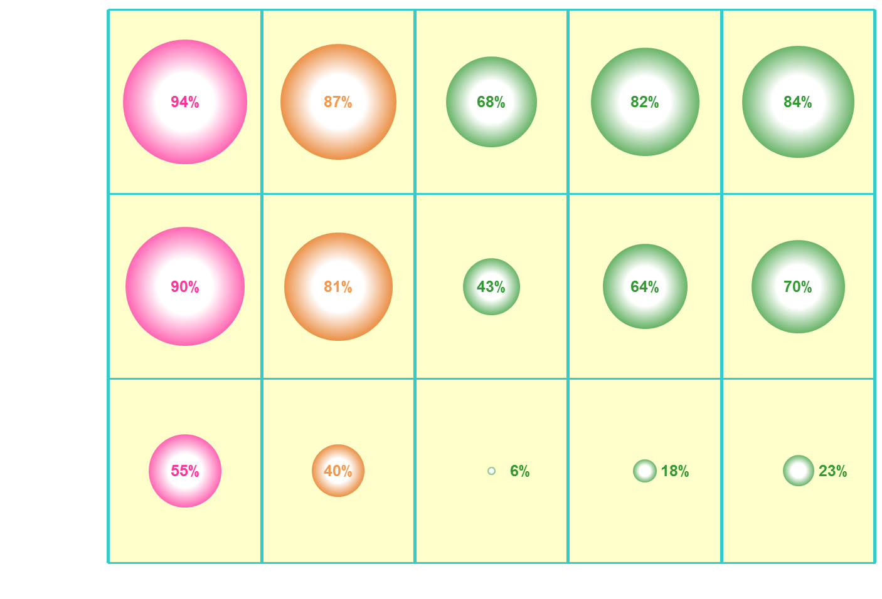
High GPA >= 2.50
Low GPA < 2.50
Retention and Graduation Rates by First Year Performance (Cumulative GPA and Credits Earned)
High Performance
High GPA, High Credits
Moderate Performance
High GPA, Mod Credits
Low GPA, High Credits
Low
Performance
High GPA, Low Credits
Low GPA, Mod Credits
Low GPA, Low Credits
Year 2 Retention
Year 3 Retention
Year 4 Graduation
Year 5 Graduation
Year 6 Graduation
High Credits: >= 48
Mod Credits: 37-47
Low Credits: <= 36
* 2000-2009 Fall cohorts only, excludes Bridge, Fine Arts, BARAT, Athletes, International, & Tuition-Exchange

Slide 5
First-Year Academic Success (FYAS) Recruitment
Identified at Admission based on HS math GPA and/or ACT math score
Invite those who place into Basic Algebra through Pre-calculus, Basic Writing II, and students who could benefit from General Chemistry Techniques
Referred by an Academic Advisor
First-Year, Transfer, & Current Students

Slide 6
FYAS Data
Population Data:
FYAS students are more likely to be first generation, underrepresented students of color, commuters, and are from the city of Chicago.
Coupled with the lower level of academic preparedness, FYAS students may be academically performing at higher levels than would be predicted.
Performance Highlights:
73% made progress to degree at the end of the AQ

Slide 7
Questions & Answers
773-325-7426
fyas@depaul.edu
http://fyas.depaul.edu

