Slide 1
Community-based Workforce Development Synergies Leveraging Higher Education Douglas C. Brauer, Ph.D. Richland Community College July 12, 2012

Slide 2
Sustainability at Richland Community College
$ Value
People
Environment
Getting to what makes sense for College, Community, and Region.

Slide 3
Making Connections with regional partners to let Science and Society meet solutions
Build on existing RCC academic programs
Business & Technology
Agribusiness & Agriculture
Continuing & Professional Education
Community Education
Engineering Technology
Professional Development & Business Training
Mathematics and Sciences…….STEM
Science
Technology
Engineering
Mathematics

Slide 4
CO2 Capture from Biofuels Production and Sequestration into the Mt. Simon Sandstone
The Richland solution will provide academic, development, training, and readiness services to prepare the local and regional workforce to enter “sequestration” careers within emerging CO2 capture, sequestration, and storage recovery industries.

Slide 5
Strategic Partnerships
This project is supported by the U.S. Department of Energy under Award No. DE-FE-0001547. This Industrial Carbon Capture and Sequestration (ICCS) project, which is administered by the DOE’s Office of Fossil Energy and managed by the National Energy Technology Laboratory (NETL), has received funding from the American Recovery and Reinvestment Act of 2009.

Slide 6
RCC Project Role
Construction and establishment of the National Sequestration Education Center (NSEC)
Development of sequestration technologies higher education degree curriculum
Acquisition and development of working laboratories with demonstration technologies
Coordination of community outreach activities for local, regional, and global audiences

Slide 7
Strategic Connections: Richland & Archer Daniels Midland Company
Build on existing Richland and University of Illinois academic and continuing education programs
Engineering Technologies
Agribusiness & Sustainable Agriculture
Earth Science
Geology
Mathematics
Economics
Sociology
Community Education
Professional Development & Business Training
Sustainability

Slide 8
Educational Directions
K-12
Dual Credit
AAS
Workforce Development
Community Education
Dislocated Worker
Trades
New Career

Slide 9
Academic Curricula
Industrial/Mfging Processing
Renewable Energies
Sequestration
Portable Skills leading to Local, Regional, and Global Workforce Development
Engineering Technologies
Associate of Applied Science degree
academic Certificate

Slide 10
National Sequestration Education Center
Innovative educational spaces
Academic Curricula
Community & Industry Workshops
International Seminars/Conferences
Workforce Training Activities
Visitor Center
Sequestration Training & Education Program activities (funded through IBDP project)
K-12, Community & Regional Outreach
Interactive/Entertaining/Educational
Sustainability Walkway
Plants, energy grasses & technology

Slide 11
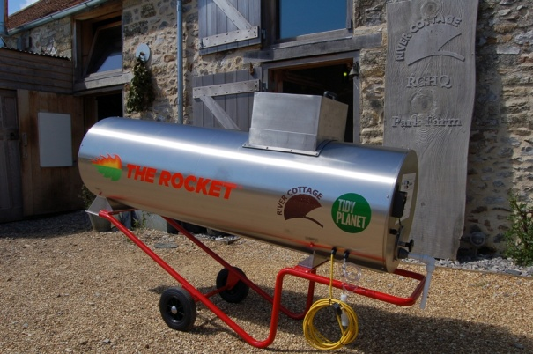
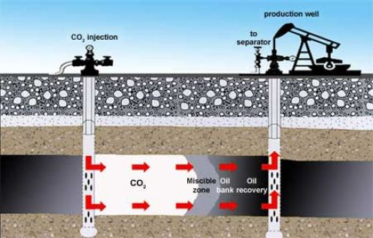
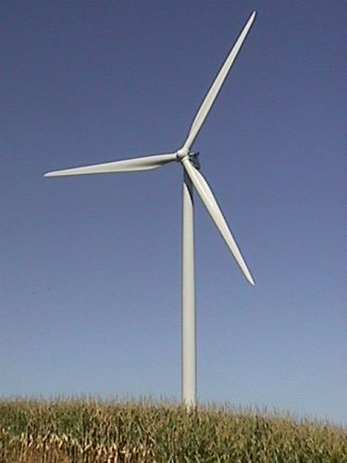
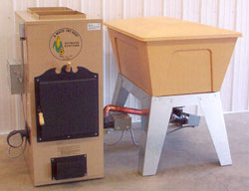
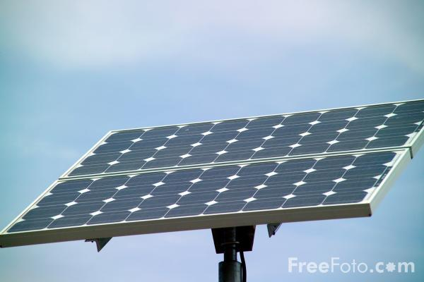
Letting Science and Society Come Together
On RCC campus: 4 wind turbines, 3 solar arrays, 2 biomass furnaces, 1 biodiesel production center, and 2 geothermal systems, 1 accelerated composter, 1 Mobile BioEnergy Lab (biodiesel and ethanol production)
With NSEC: CCUS connects with renewable energy

Slide 12
Leveraging Forward…
K-8…..Camp Connections and SMASH Camp with District 61 & Millikin University
Sustainable Agriculture
Solar Power
Wind Power
Carbon Capture, Utilization & Storage
Recycling
Dual Credit with Heartland Technical Academy
CCS 115
Higher Education with university articulations
Associate of Science with CCS concentration
Associate of Applied Science in Engineering Technology with CCS specialty

Slide 13
How is our outreach over FY2012 ?
Summer Excursion 1100 (students from 3 & 4 grade)
Sustainability Safari 100 (students and parents)
8th Grade Career Fair 1,600 (students from 22 schools)
Agucation 865 (5th grade students)
Saturday Produce Market 3000 (8 Vendors weekly
150-175 weekly customers
20 weeks = 3000 patrons)
CAI events 685 (link to sustainable Ag)

Slide 14
International presentations >100 (at LCES & WCPG presentations)
>1000 (Int’l attendees at each conference)
NSEC site tours 36 (MU environmental science students)
Community presentations 290 (Chambers, ROMEOs…….etc.)
IL-ICCS Community
Meetings 80 (RCC main campus)
IL State Fair 2700 (RCC booth visitors)
900 (asked questions)
NSEC groundbreaking 90 (national attention)
Farm Progress Show 200,000 (visitors over 3 days)
>100 (asked questions including Gov Quinn
WSOY Radio Show 5000 (5 shows with sustainability link)
“Richland Night” (10 shows, avg. 1000 listeners per show)
WAND TV “Making The 1,672,000 viewers (2 x per
World A Little Greener” day= 3,344,000) (44 TV spots, avg 38000
households per viewing) (2 CCS spots)

Slide 15
“Richland’s investments in the future embrace our commitment to enabling sustainable ecological, social, and economic systems. “

