Slide 1
Closing the Gap: The Contribution of Out-of-School STEM Partners
Dr. Lisa Bouillion Diaz

Slide 2
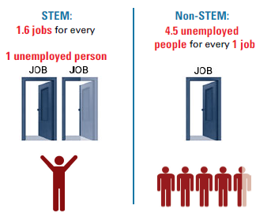
Illinois STEM Skills are In Demand
For the complete state report, methodology, and sources, visit http://vitalsigns.changetheequation.org/
Notes:
Current STEM workforce demands are not being met. If current trends continue, U.S. will lose quality jobs to other nations, lowering our standard of living, reducing tax revenues, and weakening the domestic market for goods and services.
The National Academy of Sciences study, Rising Above the Gathering Storm (2006): Absent a serious and rapid response, the U.S. will lose quality jobs to other nations, lowering our standard of living, reducing tax revenues, and weakening the domestic market for goods and services. Once this cycle accelerates, it will be difficult to regain lost preeminence in technology-driven innovation and its economic benefits. http://www.nap.edu/catalog.php?record_id=11463
The Business-Higher Education Forum (2005) warns that, if current trends continue, more than 90 percent of all scientists and engineers in the world will live in Asia. http://www.bhef.com/sites/g/files/g829556/f/report_2005_commitment_to_americas_future_0.pdf

Slide 3
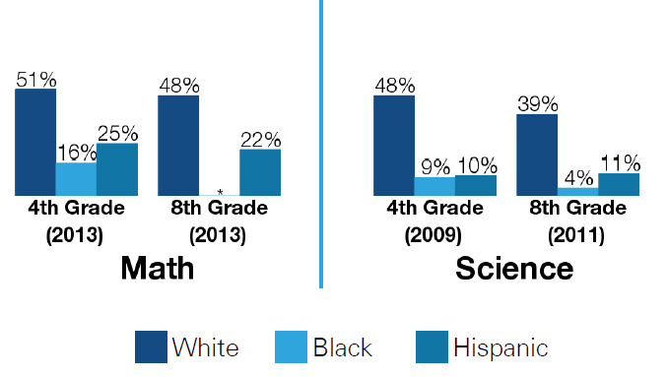
Illinois STEM Achievement Gap Continues
For the complete state report, methodology, and sources, visit http://vitalsigns.changetheequation.org/
Keeping Illinois Competitive: IL Status Report on STEM Education
http://www.keepingillinoiscompetitive.niu.edu/ilstem/
Notes:
Illinois improvement since 2003 (277 scale to 283) but still not proficient (NAEP Report Card)
No state has closed the persistent achievement gaps among racial and ethnic groups
Slightly more than half of Illinois high school students have the requisite mathematics and science skills for postsecondary education or jobs in the emerging new economy.
ACT Report: Only a quarter (26 percent) of ACT-tested 2005 high school graduates achieved or exceeded the ACT College Readiness Benchmark in Science. http://www.act.org/research/policymakers/pdf/ACT_STEM_PolicyRpt.pdf
The low engagement with STEM-related learning is particularly acute among minority, female, and lower-income students, who comprise a growing proportion of the total college-going public. In the 2000 National Assessment of Educational Progress for twelfth grade students, about three out of four white and Asian students scored at or above basic level (which is far below proficient) on the math assessment, while fewer than half of Hispanics and under a third of African American students attained that level (National Science Foundation 2005) http://www.doleta.gov/Youth_services/pdf/STEM_Report_4%2007.pdf
Of the students entering college with plans to major in science or engineering, less than 40 percent graduate with a degree in that field within six years. For underrepresented minorities (African-Americans, Hispanics, and Native Americans), the success rate drops below 25 percent. In 2000, minorities received only 14 percent of the bachelor’s degrees in engineering and mathematics and 17 percent of the computer science degrees. National Science Foundation, Science and Engineering Degrees, by Race/Ethnicity of Recipients: 1991 – 2000, Section B, Tables 4 and 6 http://www.bhef.com/sites/g/files/g829556/f/report_2005_commitment_to_americas_future_0.pdf
According to BEST, 75 percent of our scientists, engineers, mathematicians and technologists are male. We also saw that 45 percent of African American and 48 percent of Hispanic students had an interest in STEM majors or occupations, yet 80 percent of our scientists, engineers, mathematicians and technologists are white. (National Science Foundation, 2011)

Slide 4
Changing Expectations
Interconnected Nature of Science
Next Generation Science Standards
http://www.nextgenscience.org/next-generation-science-standards
Notes:
Research shows that teachers’ content knowledge and teaching experience can affect student performance

Slide 5
Changing Expectations
Interconnected Nature of Science
Connecting to Science in the Real World
Next Generation Science Standards
http://www.nextgenscience.org/next-generation-science-standards
Notes:
Research shows that teachers’ content knowledge and teaching experience can affect student performance

Slide 6
Changing Expectations
Interconnected Nature of Science
Connecting to Science in the Real World
Cross-cutting Concepts
Next Generation Science Standards
http://www.nextgenscience.org/next-generation-science-standards
Notes:
Research shows that teachers’ content knowledge and teaching experience can affect student performance

Slide 7
Changing Expectations
Interconnected Nature of Science
Connecting to Science in the Real World
Cross-cutting Concepts
Science Understanding Builds Over Time
Next Generation Science Standards
http://www.nextgenscience.org/next-generation-science-standards
Notes:
Research shows that teachers’ content knowledge and teaching experience can affect student performance

Slide 8
Changing Expectations
Interconnected Nature of Science
Connecting to Science in the Real World
Cross-cutting Concepts
Science Understanding Builds Over Time
Focus on Application of Understanding
Next Generation Science Standards
http://www.nextgenscience.org/next-generation-science-standards
Notes:
Research shows that teachers’ content knowledge and teaching experience can affect student performance

Slide 9
Changing Expectations
Interconnected Nature of Science
Connecting to Science in the Real World
Cross-cutting Concepts
Science Understanding Builds Over Time
Focus on Application of Understanding
Preparation for College, Career, & Citizenship
Next Generation Science Standards
http://www.nextgenscience.org/next-generation-science-standards
Notes:
Research shows that teachers’ content knowledge and teaching experience can affect student performance

Slide 10
Teacher Preparation and Professional Support
29% 8th graders whose teachers have an undergraduate major in the science subject they teach
56% 8th graders whose science teachers took three or more advanced science courses in college
For the complete state report, methodology, and sources, visit http://vitalsigns.changetheequation.org/
Notes:
Research shows that teachers’ content knowledge and teaching experience can affect student performance

Slide 11
Gap In Access to Tools of the Trade
50% / 66% 8th graders whose teachers say they have all or most of the resources they need to teach science
75% / 88% 8th graders whose schools have science labs
Eligible for free / reduced-price lunch
Not eligible for free / reduced-price lunch
For the complete state report, methodology, and sources, visit http://vitalsigns.changetheequation.org/
Notes:
Research shows that teachers’ content knowledge and teaching experience can affect student performance

Slide 12
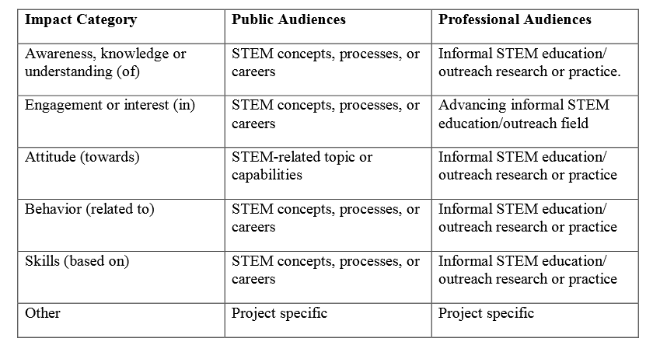
STEM Goals: Beyond “Knowing”
National Science Foundation: Framework for Evaluating Impacts of Informal Science Education Projects http://informalscience.org/documents/Eval_Framework.pdf

Slide 13
Contribution of Out-of-School STEM Programs
Improved attitudes toward STEM fields and careers
Afterschool Alliance Report (2013); Chun & Harris, 2011 - Harvard Family Research Project Report; Bell et al, 2009
Notes:
Holds true for both boys and girls

Slide 14
Contribution of Out-of-School STEM Programs
Improved attitudes toward STEM fields and careers
Increased STEM knowledge and skills
Afterschool Alliance Report (2013); Chun & Harris, 2011 - Harvard Family Research Project Report; Bell et al, 2009
Notes:
Holds true for both boys and girls

Slide 15
Contribution of Out-of-School STEM Programs
Improved attitudes toward STEM fields and careers
Increased STEM knowledge and skills
Higher likelihood of graduating and pursing STEM careers
Afterschool Alliance Report (2013); Chun & Harris, 2011 - Harvard Family Research Project Report; Bell et al, 2009
Notes:
Holds true for both boys and girls

Slide 16
Addressing Decline in Interest
Decline in percent of ACT-tested students interested in STEM majors
Engineering (7.6% 4.9%)
Computer Science (4.5% 2.9%)
150,000 members of U.S. nation’s 2013 graduating class
Interested in STEM
But not pursuing STEM field in college
ACT STEM Policy Report
http://www.act.org/research/policymakers/pdf/ACT_STEM_PolicyRpt.pdf

Slide 17
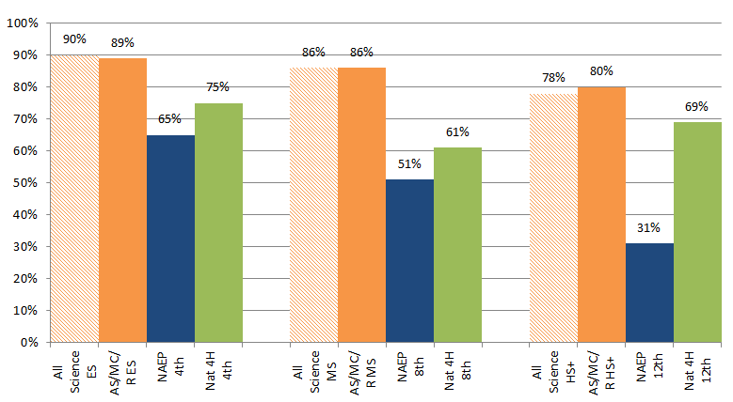
“I like science”
University of Illinois 4-H Science Survey (2012 and 2013)
Notes:
Responses to question “I like science” – national/non-4-H; national 4-H; state 4-H samples by age.

Slide 18
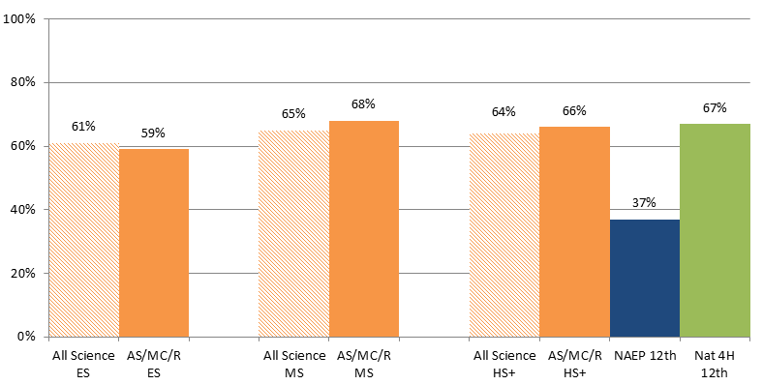
“I’d like to have a career in science”
University of Illinois 4-H Science Survey (2012 and 2013)
Notes:
Responses to question “When I graduate from high school, I would like to have a job related to science” – national/non-4-H; national 4-H; state 4-H samples by age.

Slide 19
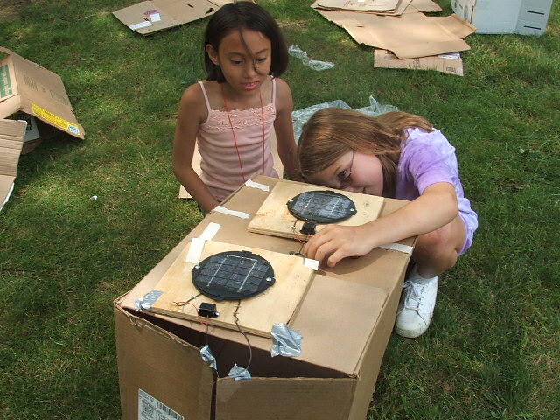
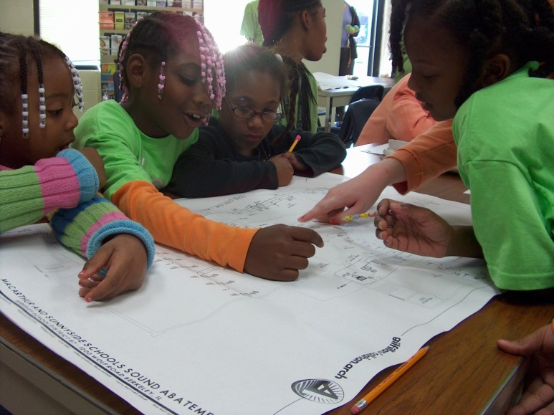
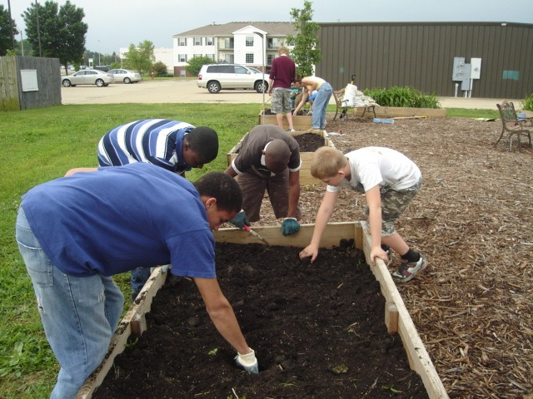
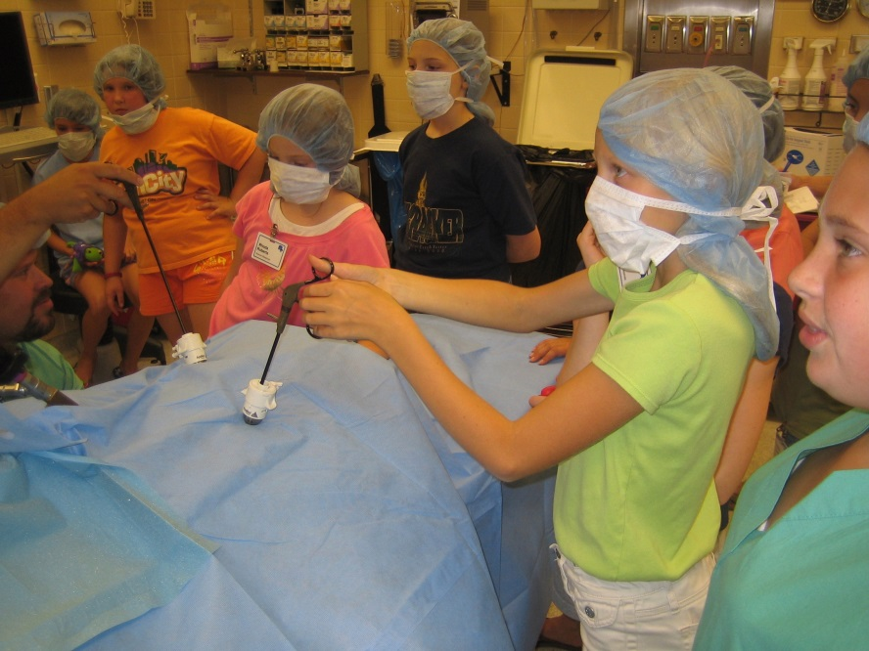
Experiencing Connected / Real World Science

Slide 20
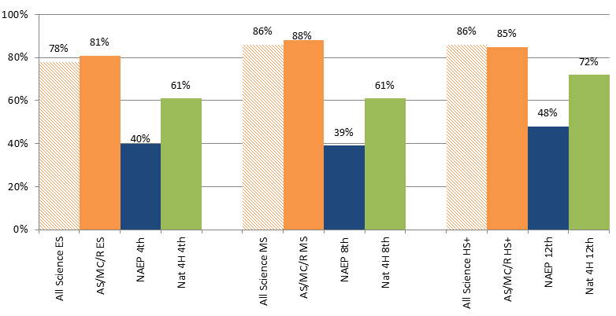
“Science is useful for solving everyday problems”
University of Illinois 4-H Science Survey (2012 and 2013)
Notes:
Responses to question “Science is useful for solving everyday problems” – national/non-4-H; national 4-H; state 4-H samples by age.

Slide 21
Afterschool: Closing the Gap
CURRENT
DESIRED
STEM Aware
STEM Ready
STEM Engaged
Persistent achievement gap
Declining interest
Disconnected from real world
Sparking interest
Building confidence - Experience with success
“Seeing” the value of science careers
Engaging in real-world science
Practicing skills with network of people
(e.g. Calabrese Barton & Brickhouse, 2006; Halpern, Aronson, Reimer, Simpkins, Star & Wentzel, 2007; McCreedy & Dierking, 2013; Archer, Dewitt, Osborne, Dillon, Willis & Wong, 2010)
Notes:
Children’s positive attitudes toward science by age 10 have been shown to significantly decline by age 14 (Archer, Dewitt, Osborne, Dillon, Willis & Wong, 2010).
Many who are academically qualified for postsecondary studies in science and math fields don’t pursue those programs Keeping Illinois Competitive: Illinois Status Report on Science, Technology, Engineering and Mathematics Education http://www.keepingillinoiscompetitive.niu.edu/ilstem/

