Slide 1
April Hansen
Client Relations

Slide 2
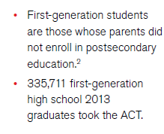
Notes:
Out of 1.8 million

Slide 3
Defining College and Career Readiness
The acquisition of the knowledge and skills a student needs to enroll in and succeed in credit-bearing first-year courses at a postsecondary institution (such as a two- or four-year college, trade school, or technical school) without the need for remediation.
3

Slide 4
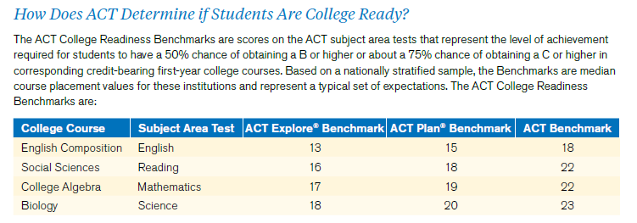

Slide 5
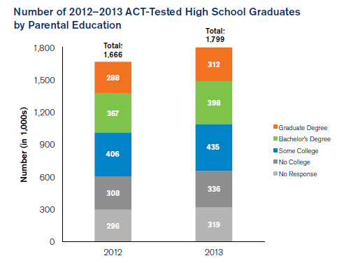
Participation and Parental Education Level

Slide 6
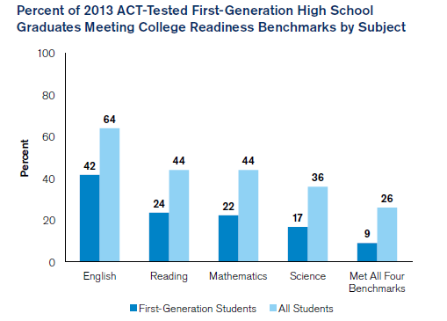

Slide 7
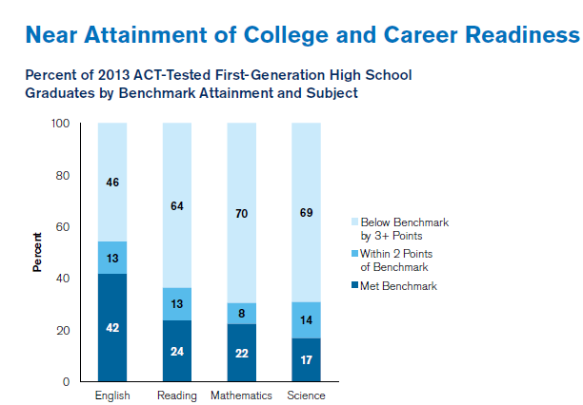

Slide 8
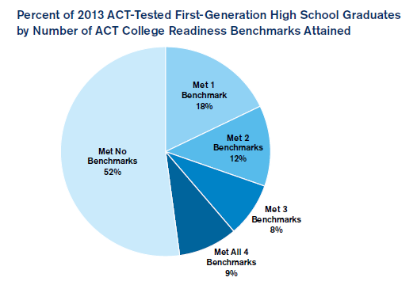

Slide 9
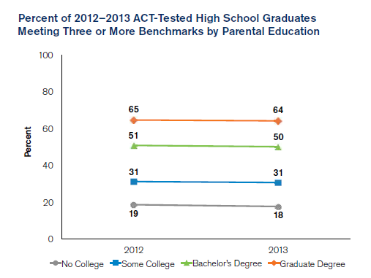

Slide 10
College Success by Number of ACT Benchmarks Met

Slide 11
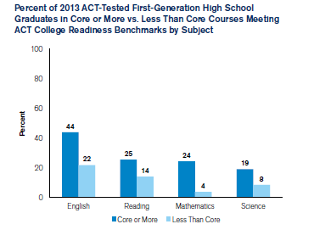

Slide 12
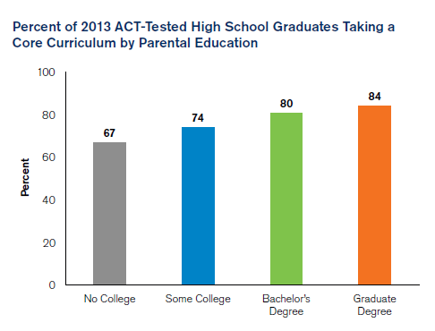

Slide 13
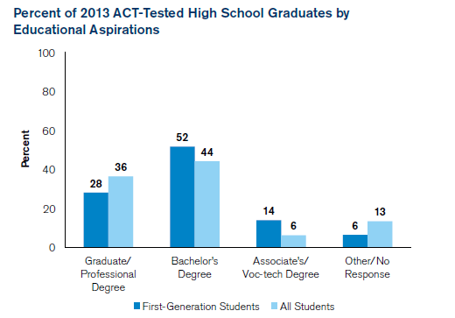

Slide 14
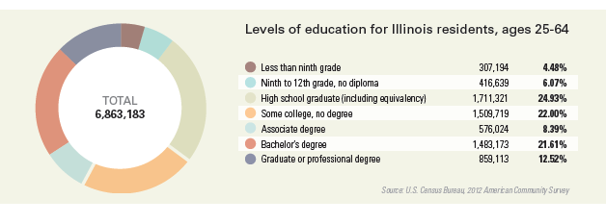
Notes:
6.9 mil. working adults in IL
42.5% in IL have AA or higher.
Nat’l ave. is 39.4.

Slide 15
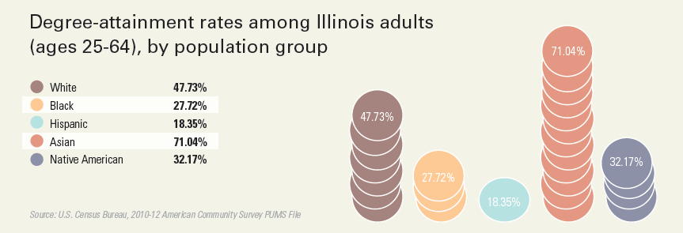

Slide 16
College Success by Race/Ethnicity and Number of ACT Benchmarks Met

Slide 17
College Success by Family Income and Number of ACT Benchmarks Met

Slide 18
How to Increase College Readiness
Essential Standards
Common Expectation
Clear Performance Standards
Rigorous High School Courses
Out of School Support
Early Monitoring and Intervention
Data-Driven Decisions

Slide 19
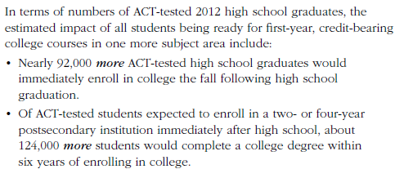
The Impact of Readiness

Slide 20
Research
The Condition of College and Career Readiness in Illinois-2013
http://www.act.org/newsroom/data/2013/states/illinois.html
Readiness Matters
http://www.act.org/research/policymakers/reports/readinessmatters.html
Catching up to College and Career Readiness
http://www.act.org/research/policymakers/reports/catchingup
Mind the Gaps
http://www.act.org/research/policymakers/reports/mindthegaps.html

