Slide 1
Cohort Success: From Start to Finish
Jacqueline Horbrook M.Ed. – Director of Diversity
Dr. Barrington Price – Assistant Vice President for Student Engagement

Slide 2
What is a Cohort Program?
a group of classmates that have a similar academic pathway, vocational calling, or civic engagement interest.
a group of students with shared passion, purpose, or place, who come together to begin their first-year college experience.

Slide 3
Benefits of a Cohort Program
provides collaborative learning communities for students to grow in their knowledge, skills, self-persistence, career interest, and social integration
bring students together to build support, relationships, leadership skills, and intercultural experiences
key way to connect with other students, who venture with you into and through college life

Slide 5
External Cohort Community Partners
Bottom Line Support comes in many forms: academic, career, and personal.
OneGoal supports students through the high school-to-college transition. Participation in this program is coupled with a four-year scholarship.

Slide 6
Internal Cohorts
COMPASS includes interaction with professors, practice using campus resources, and acclimating to the community through planned social events.
Lighthouse offers first-generation college students the tools to develop into urban leaders. They receive advanced leadership and vocational development, academic and personal advising, and additional financial aid.

Slide 7
Program Areas of Focus
Vocational Development
Social Integration
Cohort Development
Academic Success
Notes:
Vocational: exploring and declaring major,
enroll in student success courses
Meet with career development internship office professional development opportunites
Encourage students to apply for leadership opportunities
Social Int:
First year experience ( registration, orientation, cohort seminars)
Participation in campus activites and orgs
Challenenged to explore orgs
Cohort development:
Sense of community
Monthly seminar
Maintaining contact with advisor
Experiental learning
Academic Success:
GPA expectations
Meet with faculty advisor
Regularly attend group tutoring
Monthly one on one

Slide 8
Program Components
Common Intellectual Experiences
Cohort Seminars
College Success Course(s)
Foundations for Academic Success
Topics in Skills Development
Career Planning

Slide 9
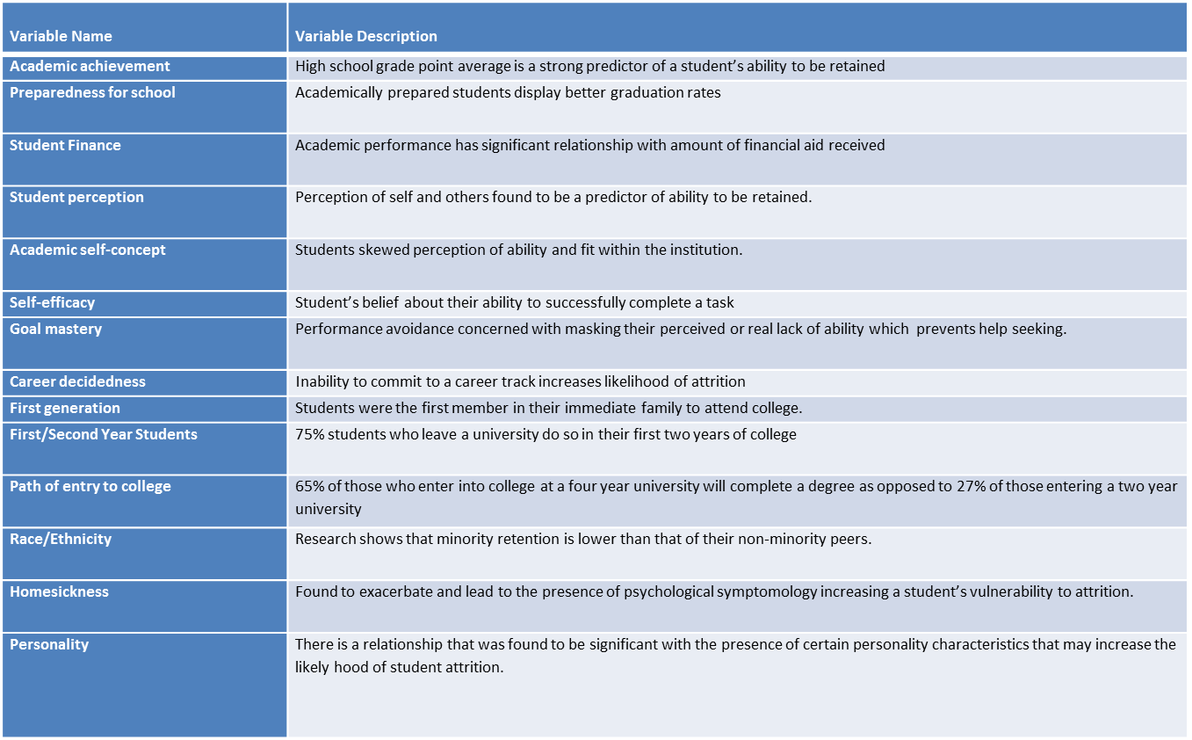

Slide 10
Collaboration
External
Community partnerships
College Student Support Programs
Non-profit Organization
Internal
Admissions
Faculty
Cultural Clubs

Slide 11
Measurable Data Outcomes
Cohort | ACT | HS GPA | Trans. credit | Index | PELL | MAP | EFC | UG Comp Credit | NPU UG GPA | Major Declaration | Residential | Retention | Attrition
Lighthouse (n=12) | 20 | 3.2 | 11 | 134 | 50% ($31,000) | 42% ($21,000) | $6,000 | 31 | 2.86 | 42% | 100% | 100% | 0
Pritzker (n=6) | 22 | 3.24 | 0 | 140 | N/A | N/A | N/A | 30 | 2.95 | > 1% | 100% | 100% | 0
Bottom Line (n=12) | 20 | 3.2 | 0 | 135 | 83% ($55,633) | 75% ($43,421) | $557 | 25 | 2.85 | 42% | 33% | 75% | 25%
Pre-Health Professions Boot Camp (n=10) | 25 | 3.26 | 0 | 149 | 30% ($11,545) | 30% ($14,160) | $21,250 | 34 | 3.1 | 60% | 80% | 100% | 0
COMPASS (n=49) | 17 | 2.6 | 0 | 115 | 61% ($140,271) | 59% ($124,922) | $9,000 | 25 | 2.23 | 29% | 41% | 85% | 15%
ONE GOAL (n=17) | 19 | 3.0 | 6 | 130 | 71% ($54,484) | 82% (55,696) | $4,630 | 24 | 2.34 | 29% | 41% | 76% | 24%
Vocation Exploration (n=20) | 18 | 2.64 | 42 | 123 | 60% ($51,834) | 45% ($36,185) | $5,452 | 29 | 2.8 | >1% | 60% | 80% | 20%
Other | 25 | 3.0 | 30 | 141 | 50% ($3,430) | 25% ($4,720 | $6,721 | 42 | 3.05 | 75% | 75% | 100% | 0

Slide 12
Questions & Comments
Dr. Barrington Price
bprice@northpark.edu
Jacqueline Strapp M.Ed.
jlstrapp@northpark.edu

