Slide 1
Unlocking the Hidden Rules to Success
Carla M. Boyd
AtD Leadership Team
Director, Career Services
Danville Area Community College
-an Achieving the Dream Leader College

Slide 2
History
DACC joins Achieving the Dream in 2009 – adopted data-driven decision-making process
Developed a 3-prong focus for addressing student success
-Equity and Inclusion
-Teaching and Learning
-First Year Experience

Slide 3
Equity and Inclusion Team
Support Group Format
A-MALE
WISE
Classroom Format
Targeted Class incorporating Dr. Payne’s perspectives
Freshmen Orientation
Implementation/Integration/Partnership w/ Housing Authority of the City of Danville

Slide 4
Attaining a Credential within Four Years, by PELL Status

Slide 5
Developmental Placement by PELL Status, 2010SP – 2017SP

Slide 6
Lens of Economic Class:
Helping students claim their future stories and find their voice and power though resource building by understanding poverty and prosperity by focusing primarily on economic information and class issues.
“People Like Us” video…

Slide 7
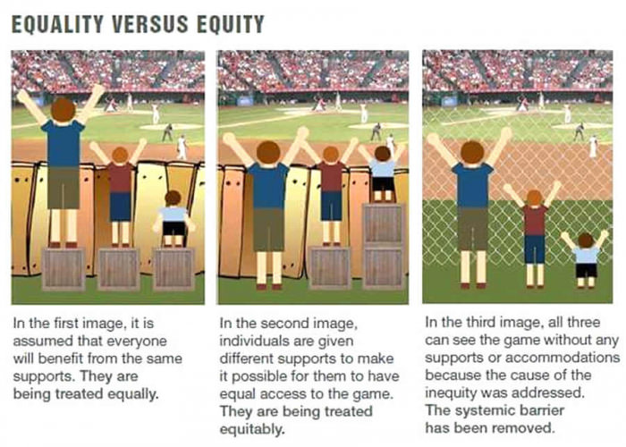
Notes:
The first picture is an illustration of where we used to be as a college…
The second is how we thought our services should be delivered…we evolved from thinking we had to be fair and equal with all students…recognizing that all students aren’t the same and that we can’t be “cookie cutter” in our approach…
The third is where we want to be and are headed… we had to start addressing the inequity within our system, to help all our students be able to achieve their dreams!

Slide 8
Understanding Situations of Daily Instability
Helping our students not only gain prosperity but also to be successful in life by understanding the hidden rules of our society to help them get ahead!
Hidden Rules Quiz

Slide 9
Resources
To better understand people from poverty, the definition of poverty will be:
“The extent to which an individual does without resources”

Slide 10
Resources (cont.)
Financial
Having the money to purchase goods and services.
Emotional
Being able to choose and control emotional responses, particularly to negative situations, without engaging in self-destructive behavior. This is an internal resource and shows itself through stamina, perseverance, and choices.
Mental
Having the mental abilities and acquired skills (reading, writing, computing) to deal with daily life.

Slide 11
Resources (cont.)
Spiritual
Believing in divine purpose and guidance. Having hope or a future story.
Physical
Having physical health and mobility.
Support Systems
Having friends, family, and backup resources available to access in times of need. These are external resources.

Slide 12
Resources (cont.)
Relationships/Role Models
Having frequent access to adult(s) who are appropriate, who are nurturing to the child, and who do not engage in self-destructive behavior.
Knowledge of Hidden Rules
Knowing the unspoken cues and habits of a group.
Formal Register
Having the vocabulary, language ability, and negotiation skills necessary to succeed in school and/or work settings.

Slide 13
Decision-making for school focused driving forces will be based on the class rules they are most comfortable in applying… Money - financial aid Time – class attendance, assignment deadlines Education – is it needed, can success be found in it? Worldview – localized, how is this going to effect change where I live?
Hidden Rules of Economic Class
Notes:
Here are some of the categories of the Hidden Rules where I found tended to affect the educational process of many students…
Think about it…

Slide 14
Where Do We Go from Here?
Working with America’s Job Center
WIOA Dollars; SNAP to Success; HACD
Scaling Up
Sharing

Slide 15
Resources
A Framework for Understanding Poverty
-Dr. Ruby Payne
Investigations into Economic Class in America
-Philip DeVol & Karla Krodel
Getting Ahead…in a just getting by world
-Philip DeVol
Bridges for Businesses
-Ruth Weirich

