Slide 1


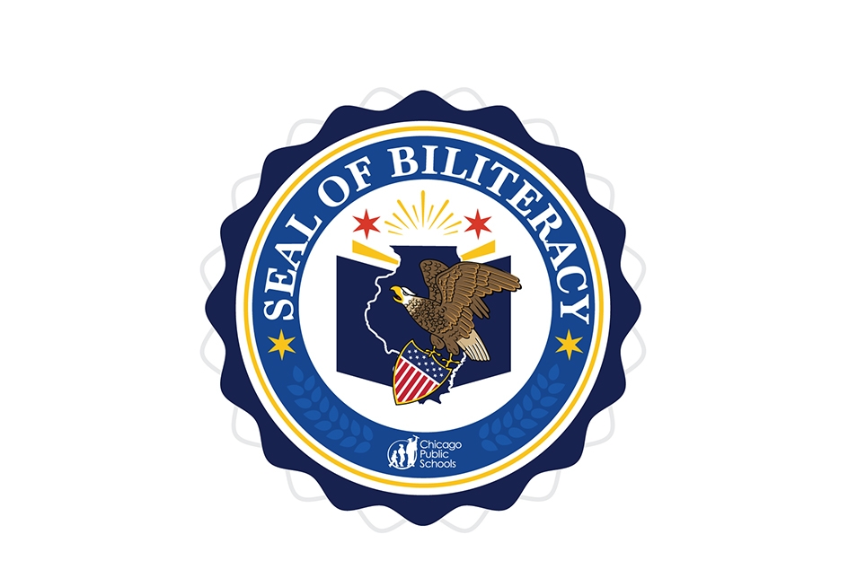
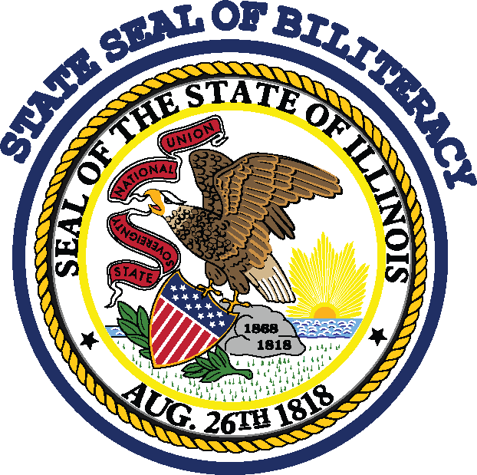
What is the State Seal of Biliteracy and How Does it Award College Credit?
2017 College Changes
Everything Conference
July 20th, 2017
Tinley Park, Illinois

Slide 2
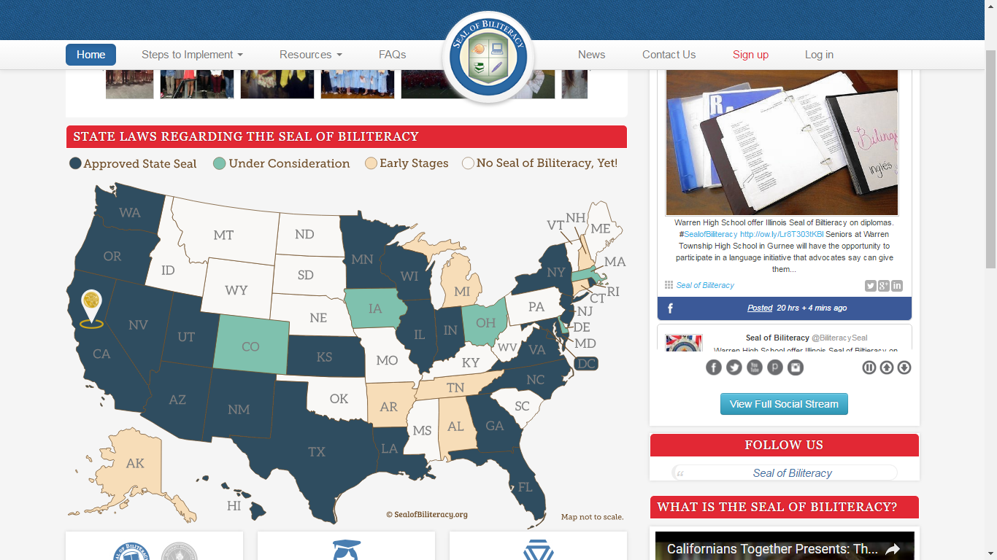
as of Fall 2015

Slide 3


Background: Seal of Biliteracy
2011
2013
2014
California adopts the first State Seal of Biliteracy. New York passed similar legislation in 2012. Other states have since adopted it.
The Seal of Biliteracy was unanimously approved by the Illinois General Assembly.
State Board released guidelines. Adoption by school districts around the state is voluntary.
While similar to efforts of other states, Illinois legislators emphasized the high level of “proficiency” needed in our state to be sufficient for “meaningful use in college and career.”
3

Slide 4
Overview: CPS State Seal of Biliteracy
What is Biliteracy?
The ability to speak, read, and, write in two or more languages at a proficient level.
The State Seal of Biliteracy is intended for all high school students who have mastered standard academic English and any other language by their senior year, with pathways along the way at the 5th and 8th grade levels at the Chicago Public Schools. Students who are native English speakers, English Language Learners (ELs) and/or bilingual speakers will be eligible to apply for and receive the State Seal of Biliteracy.
Who qualifies for the State Seal of Biliteracy?
4

Slide 5
Pathways to Earning the State Seal of Biliteracy
K-5 *Elementary School Biliteracy Attainment Award | 6-8 *Middle School Biliteracy Attainment Award
English Learners: Native language instruction for TBE | English Learners: ELs transitioned from TBE World Language (FLES)
Dual Language: ELs and non-ELs receive instruction in English and another language | Dual Language: ELs and non-ELs receive instruction in English and another language
World Language (FLEX): ELs in TPI and non-ELs | World Language (FLES): ELs transitioned from TPI and non-ELs
State Seal of Biliteracy (incl. Commendation)
World Language Proficiency:
AP
IB
AAPPL
English Proficiency:
ACT ≥ 18 or SAT ≥ 480 in English, ACCESS Composite Score of 5.0 and Reading & Writing Score ≥ 4.2
9-12
World Language
AP/IB Enrollment
ELD Common Core-Aligned Instruction
ELD Common Core-Aligned Instruction
ELD Common Core-Aligned Instruction

Slide 6
OLCE Strategy
MEASURE PROGRESS USING:
Vision Goal:
5,000 students apply for and earn the State Seal of Biliteracy (including Commendation)
Vision
25% of all Graduating
CPS seniors will attain the State Seal of Biliteracy by 2020
Governance Struct
Support
ure and
Priority Goals:
100% of schools rated Established or Exemplary by 2020
Expand Dual Language Schools to 30 by 2020
% of students who meet AP/IB/AAPPL scores to earn State Seal of Biliteracy
Strengthen Bilingual Programs
Strengthen Dual Language Programs
Strengthen World
Language Programs
Priorities
ELD Common Core- Aligned Instruction
ELD Common Core-Aligned Instruction
ELA Common Core-Aligned Instruction
OLCE C
ommunicatio
ns
CPS Dual Language Model
OCL
E Program
s/Events
Initiative Goals:
EL Instructional Integrity
Engage CMPC and BACs
Expand Dual Language Programs
Expand World Language Programs
Increase AP/IB enrollment
Provide PD for WL teachers w/ new
framework
% of EL programs receiving PD and coaching
% of active BAC‘s
Select Common Assessments for Dual Language Schools by 2017-2018
% Increase of AP/IB WL enrollment
% increase of schools offering WL Program
Increase interest and awareness of biliteracy and the benefits in college and careers
Initiatives
OLCE Collaboration with schools, networks, and CPS Offices
OLCE Programs/Events

Slide 7
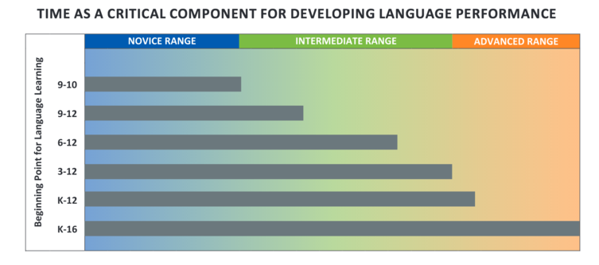
TOMAR CLASES DESDE UNA TEMPRANA EDAD ES IMPORTANTE
SSB
American Council on the Teaching of Foreign Languages (2012).

Slide 8
Let’s turn & talk!
How can we help increase the number of years that students take a world language?
How can we validate student’s native language as an asset for college & career success?
What would you highlight in an elevator speech about the Seal of Biliteracy initiative? What stands out for you?

Slide 9
Steps to Receive the Seal in HS
English
Have
ACT English Subject Score of 18+ or SAT 480 in English/Writing; or
Meeting State proficiency through the ACCESS (for active or former High School ELs)
World Language
Have
AP World Language Score of 4 or above (Chinese, French, German, Italian, Japanese, Latin, and Spanish); 3 for commendation or
Intermediate High (or higher) score on a district-approved assessment tool; Intermediate Low for Commendation*
&
*CPS has identified language assessments that measure students’ WL proficiency in 4 domains in : Arabic, Chinese, French, German, Italian Polish, Portuguese, Russian and Spanish
9

Slide 10
What is a Commendation
For students who come close to meriting the Seal, they will receive the State Commendation toward Biliteracy, demonstrating progress toward full biliteracy in English and another language.
10

Slide 11
AAPPL Proficiency Guidelines

Slide 12
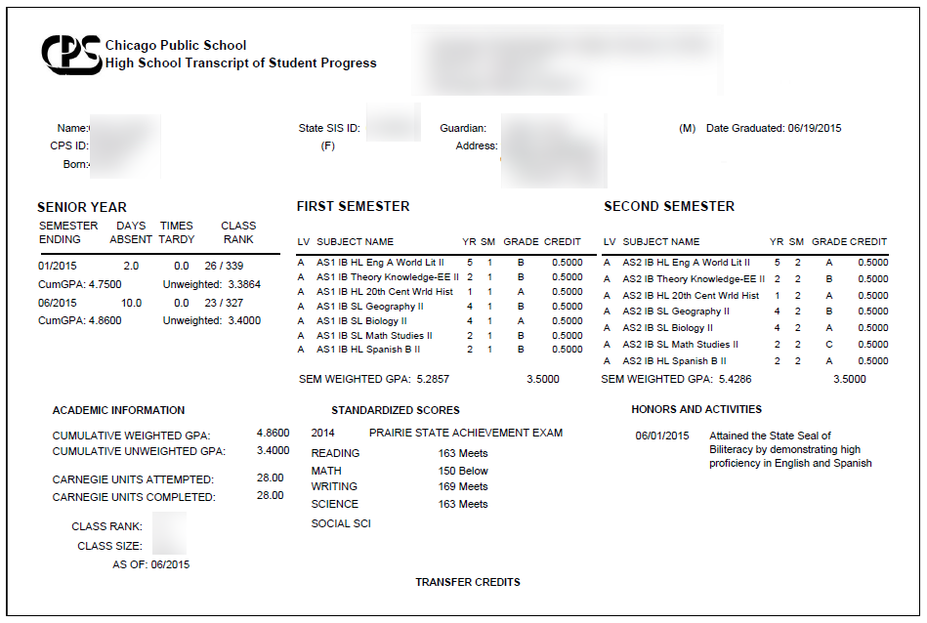
Seal Recognition on a Transcript

Slide 13
Seal of Biliteracy Numbers
2016
2017
1,108 graduating seniors earned the Seal of Biliteracy, with more than half being former ELs (up from 92 in 2015)
1,382 seniors obtained the Seal of Biliteracy; 892 received the State Commendation Toward Proficiency; 446 8th graders & 501 5th graders received the CPS Seal of Biliteracy Pathways Award

Slide 14
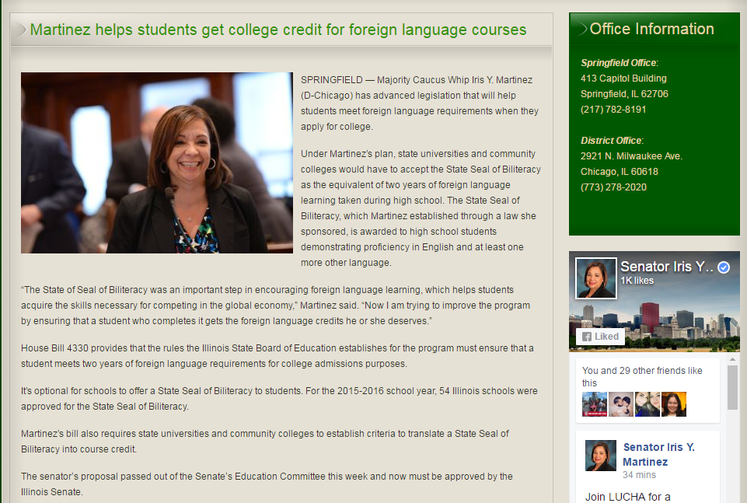
http://www.senatoririsymartinez.com/news/23-news-releases/295-martinez-helps-students-get-college-credit-for-foreign-language-courses

Slide 15
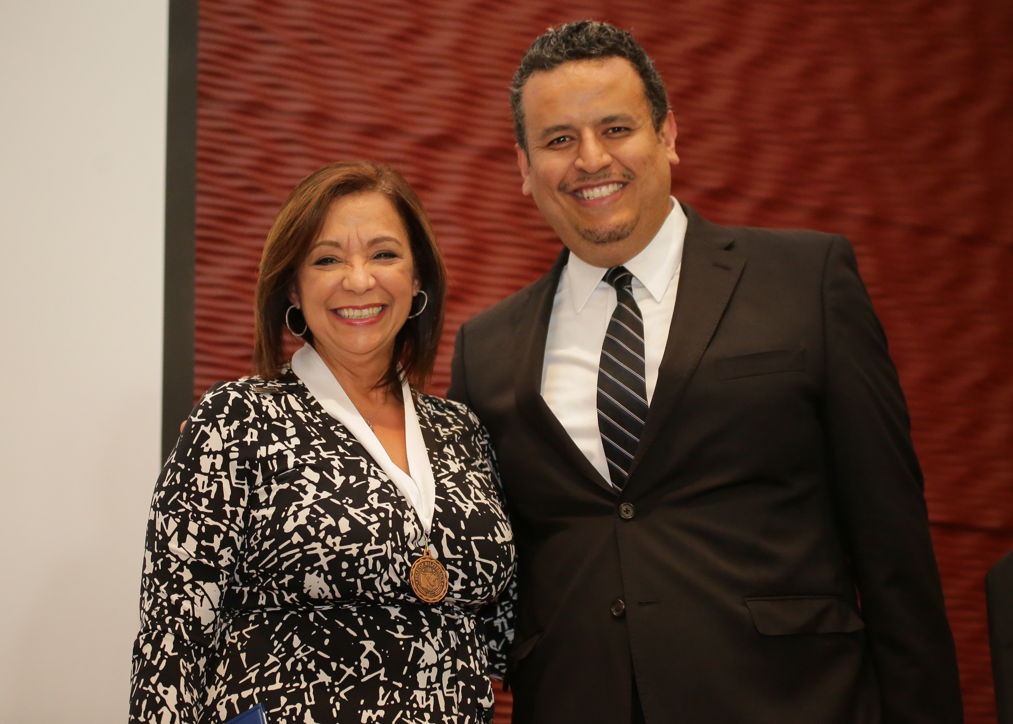

Slide 16
Awarding College Credit—State Law
HB 4330:
For admissions purposes, requires each public university in this State to accept the State Seal of Biliteracy as equivalent to 2 years of foreign language coursework taken during high school if a student's high school transcript indicates that he or she will be receiving or has received the State Seal of Biliteracy.

Slide 17
Awarding College Credit—State Law
HB 4330:
Provides that each public community college and public university in this State shall establish criteria to translate a State Seal of Biliteracy into course credit based on foreign language course equivalencies identified by the community college's or university's faculty and staff and, upon request from an enrolled student, the community college or university shall award foreign language course credit to a student who has received a State Seal of Biliteracy.

Slide 18
Awarding College Credit—State Law
HB 4330:
Requires the State Board of Education's rules to ensure that the criteria that pupils must achieve to earn a State Seal of Biliteracy meet the course credit criteria. Requires students enrolled in a public community college or public university who have received a State Seal of Biliteracy to request course credit for their seal within 3 academic years after graduating from high school.

Slide 19
Samples of What Colleges are Doing to Award Credit
University of Illinois at Urbana-Champaign:
https://citl.illinois.edu/citl-101/measurement-evaluation/placement-proficiency/faqs/ssob-faq
Northern Illinois University:
http://www.niu.edu/u_council/committees/minutes/bc/2016-2017/bc-02-09-17-a.pdf
Illinois State University:
http://registrar.illinoisstate.edu/transfer/biliteracy.shtml

Slide 20
Why Are Students Applying for the Seal?
I am interested in the Seal in order to show that I am bilingual when applying to colleges or pursuing a career.
[It’s] important to be bilingual in today's society.
I want more doors to open for me!
After living several years in Chicago I have still kept in touch with my heritage.

Slide 21


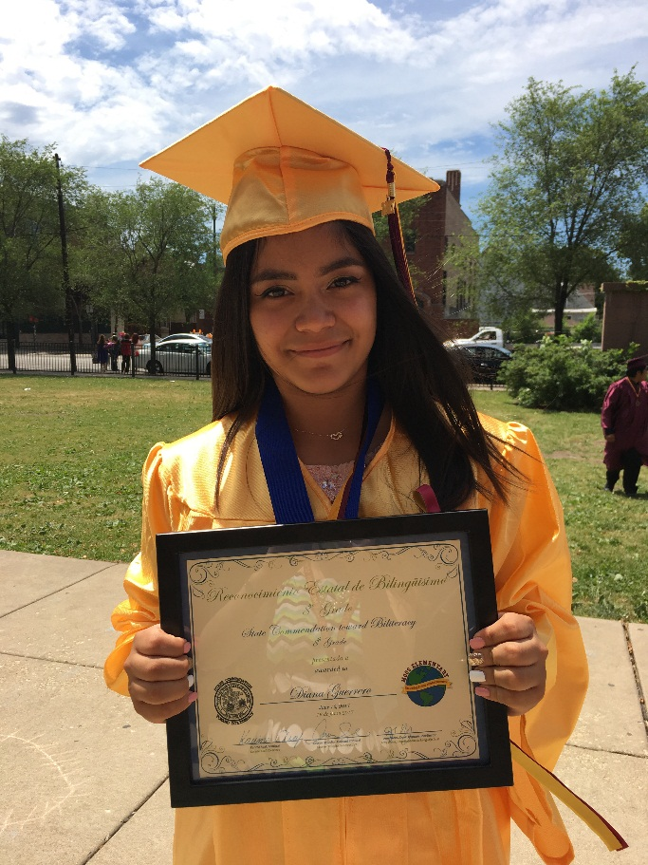
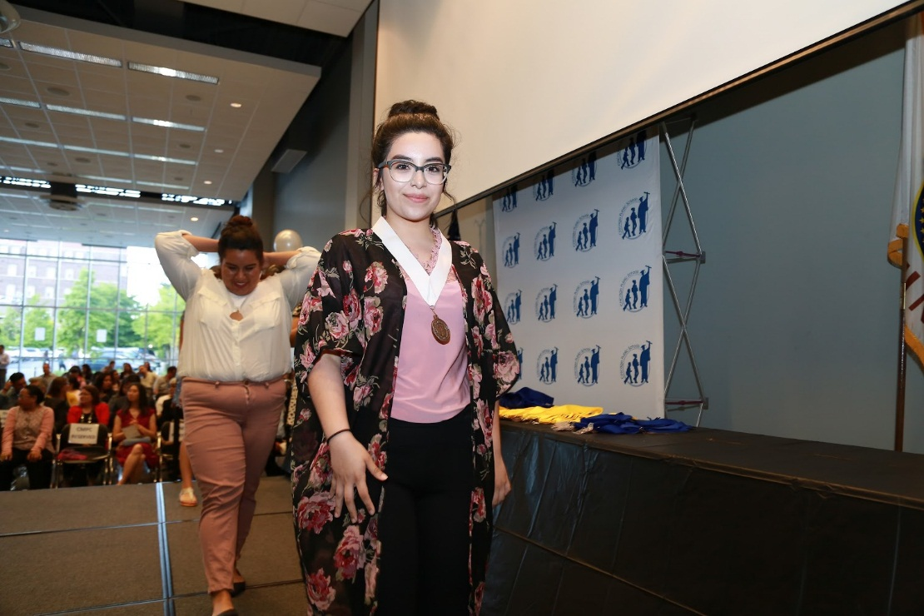
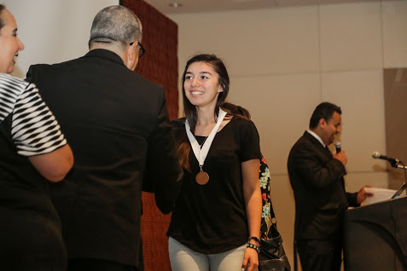
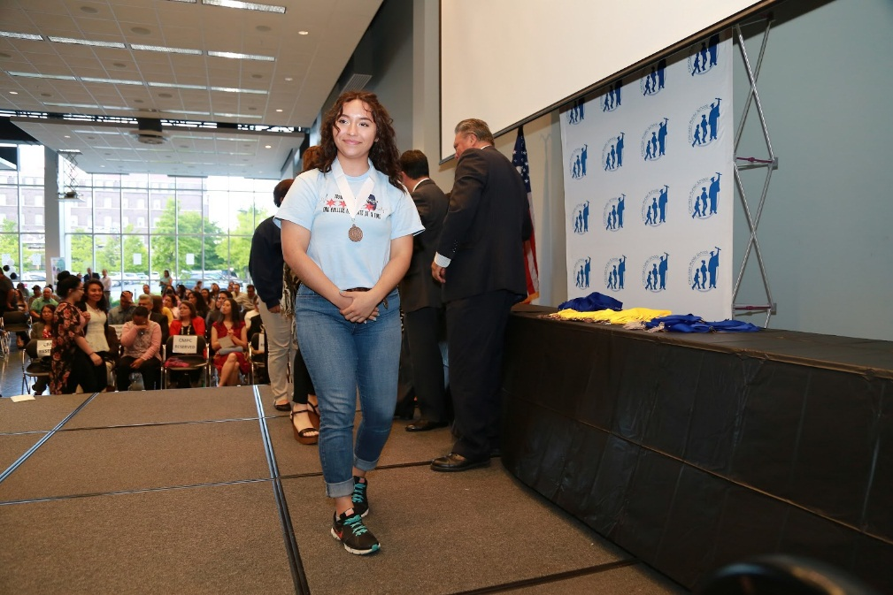

Slide 22
State Seal of Biliteracy Project
Contact Information
Office of Language and Cultural Education (OLCE)
Chicago Public Schools
42 West Madison, 2nd floor, Chicago IL 60602
cps.edu/OLCE
Luis Narváez
Strategic Projects Director
LNarvaez2@cps.edu
(773) 553-2077
22

