Slide 1
Civic Leadership Skills as Workforce Skills
– How Service and Experiential Learning Can Lead to Workforce Development
Natalie Furlett
Marina LoCasto
Illinois Campus Compact

Slide 2
Today’s agenda:
What is Illinois Campus Compact?
Core Skills Sought by Today’s Employers
Community Engagement: What is it and how does it fit in?
How can faculty/staff/teachers help develop these skills within their students?

Slide 3
Illinois campus compact
Illinois Campus Compact advances the public purpose of higher education by cultivating civic skills and learning, integrating community engagement with teaching and research, and building partnerships with communities throughout Illinois.
36 Member Institutions in Illinois, 1000+ national wide
Work to strengthen institutional capacity through best practices, workshops, speakers, conferences, and resource development

Slide 4
What are today’s employers seeking?
According to NACE's Job Outlook 2016 survey, employers are looking for leaders who can work as part of a team. More than 80 percent of responding employers said they look for evidence of leadership skills on the candidate's resume, and nearly as many seek out indications that the candidate is able to work in a team.
http://www.naceweb.org/career-development/trends-and-predictions/job-outlook-2016-attributes-employers-want-to-see-on-new-college-graduates-resumes/

Slide 5
Community engaged learning/Service learning
Community Engaged Learning (CEL) is a course, internship, or program that includes...
an engagement with a community that addresses societal needs not currently being met by governments, markets, or the independent sector
intentional integration of learning objectives and experience with/in the community
student preparation, ongoing reflection, and critical analysis
reciprocal benefits for students, community, and campus partners
opportunities to critically examine public issues or explore one's civic identity
Stanford University

Slide 6
Community engaged learning/service learning

Slide 7
A well designed sl/cel project will allow students to develop critical skills:
Teamwork
Critical Thinking
Problem Solving
Communication (w/ various audiences)
Leadership Skills
Productive Work Habits
CAREER EXPLORATION
(Bowen, 2007)

Slide 8
SERVICE LEARNING/CEL & CAREER DEVELOPMENT
SL contributes greatly to career planning & professional preparation
SL provides students with “real-world” experience, for some for the very first time
Students can clarify values & develop self-awareness & self-efficacy
SL has lead students to change majors & career goals (i.e. “helping professions”)
SL has helped students “get their foot in the door” at a particular employer
Networking/Creating contacts & obtaining references
Resume builder

Slide 9
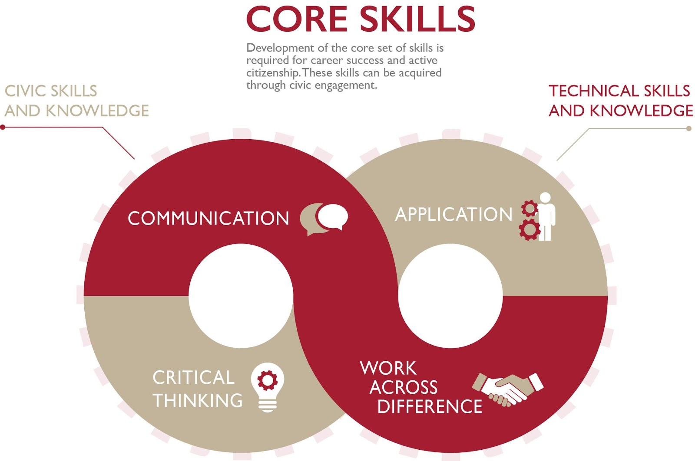
Notes:
Serving the civic mission doesn’t mean we aren’t addressing workforce goals. Community engagement and the civic mission help students develop what are sometimes called soft skills and we call core skills.

Slide 10
How can teachers/faculty/staff help develop these skills in their students?
When designing a CE/SL experience, think of the academic & workforce goals:
How can they reinforce one another?
How does this project develop leadership skills? (even within the students who don’t necessarily see themselves as leaders)
How does this project encourage team work?
Reflection as a key component --- allow students to make connections
Invite Career Exploration --- what are their goals, how have they changed
Celebrate successes!

Slide 11
Examples of cel for high school students
Start small
Get student input—what are they interested in?
Most college-level SL projects can be simplified for younger students
Example:
Invite students to research a local landmark, such as a historical site or community park. After researching the history of the site and touring it in person, encourage students to brainstorm ways your class could improve the landmark for visitors while maintaining its historical integrity.

Slide 12
Examples of cel for college students
Partner w/ local elementary, middle, and high schools, community centers, libraries, recreation centers, parks, senior centers, neighborhood associations, local government, to understand what needs are not being met that your students could work towards.
Make sure it is feasible (are students in this class adequately prepared, what are the time constraints, what resources will it require, is there another course already doing this/working with this partner?)
Allow students to be creative and potentially design their own CEL experiences, if appropriate
https://www.estrellamountain.edu/students/service-learning/service-learning-ideas
http://www2.ccga.edu/ServiceLearning/files/ExamplesSLProjects.pdf
Notes:
My own exmaples: African refugee tutoring, urban garden @ DPS, capstone, grant writing course,

Slide 13
resources
Campus Compact
Science Education for New Civic Engagements and Responsibilities (SENCER)
Higher Education Service Learning Listserv
http://www2.ccga.edu/ServiceLearning/files/ExamplesSLProjects.pdf
https://www.estrellamountain.edu/students/service-learning/service-learning-ideas
http://www2.ccga.edu/ServiceLearning/files/ExamplesSLProjects.pdf

Slide 14
References
http://www.naceweb.org/career-development/trends-and-predictions/job-outlook-2016-attributes-employers-want-to-see-on-new-college-graduates-resumes/
www.illinoiscampuscompact.org
www.iacampuscompact.org
https://www.estrellamountain.edu/students/service-learning/service-learning-ideas
Bowen, G., Dr. (2007). How Service Learning Fosters Synthesis and Prepares Students for Careers. Western Carolina University Career Journal, 5(2).

Slide 15
Questions?
Natalie Furlett, ILCC Executive Director
nfurlett@depaul.edu
Marina LoCasto, ILCC Assistant Director
mlocasto@depaul.edu
www.Illinoiscampuscompact.org

