Slide 1
NIU Engineering @ RVC: A Collaborative Workforce Development Solution in Rockford, Illinois
Kelly Cooper, Executive Director, Engineering Our Future
Rock Valley College
Gina Caronna, Director, P-20 Regional Network
Northern Illinois University

Slide 2
Real Original Rockford, Illinois

Slide 3
Challenges and Opportunities
The Bad News
The Good News
First in, last out of economic downturn
Educational attainment 7% below state average
Per capita income below state average
Relatively high unemployment
Challenged K-12 public school system
Closest 4-year public university (NIU) is 45 minutes away
Center of aerospace and advanced manufacturing excellence
MSA has five Tier One aerospace companies and 90 supporting suppliers
1.5 times national average of engineers per capita
Expansion of global manufacturing company

Slide 4
The problem: Looming engineering talent shortage
100 new engineers needed per year
50% of existing engineering workforce
will turn over in the next 3 to 5 years
Existing talent pool lacks diversity
Local companies have difficulty recruiting and retaining talent
Best and brightest Rockford area students leave town for college and start their careers elsewhere

Slide 5
Solution: Grow our Own Engineering Workforce
Collaborative solution developed by NIU, RVC, industry and community leaders
Community-based, industry-integrated engineering program
Mechanical engineering and engineering technology courses delivered by NIU at RVC

Slide 6
Shared Vision and Rapid Execution
Project partners
Northern Illinois University
Rock Valley College
Woodward
UTC Aerospace Systems
Rockford Area Economic Development Council
Transform Rockford
Notes:
Project planning June 2015
News conference August 2015
Major building renovation to construct new labs at RVC started May 2016
First NIU students started classes at RVC August 2016

Slide 7
Engineering our Future Campaign
Community campaign raised $7.5 million to support building renovations, program faculty and scholarships
First NIU Engineering@RVC student Bradley Robison speaks at campaign kick-off event

Slide 8
NIU Engineering @ RVC Goals
Accelerate the development of the engineering talent pipeline
Assist local companies in recruitment and retention of talent
Enhance the innovation ecosystem
Diversify the regional engineering workforce
Enhance regional wealth and job creation
Develop a culture of education and career achievement in the Rockford area
Create a platform for additional education/career collaborations

Slide 9
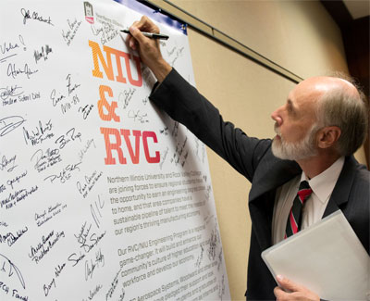
Not Just an Engineering Program
Expression of community understanding and support of a high-value economic cluster and the need to develop the talent needed to sustain and enhance it

Slide 10
Not Just an Engineering Program
Credible option for high-potential students who have previously left the community for school and failed to return, depriving the region of their talents

Slide 11
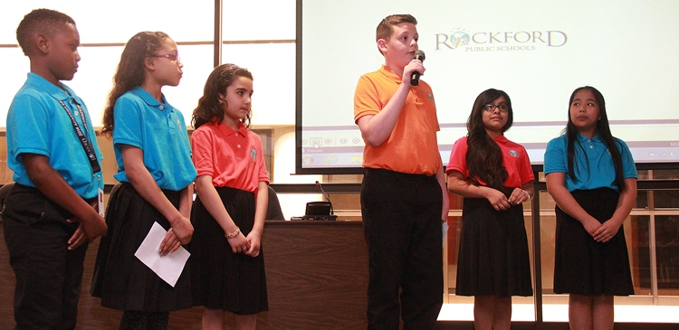
Not Just an Engineering Program
Commitment to creating pathways to careers that can transform the lives of students and their families for generations

Slide 12
RVC Enrollment Statistics
Semesters | EGR-101 Enrollment
Fall 2015 & Spring 2016 | 89
Fall 2016 & Spring 2017 | 140
Fall 2017 & Spring 2018 | 146
Notes:
* Over 130 students in the RVC pipeline in fall 2018

Slide 13
NIU Enrollment Statistics
Semesters | NIU Junior & Senior Enrollment
Fall 2016 | 16
Spring 2018 | 45

Slide 14
Program Statistics
$41,800 in scholarships was awarded to engineering students pursuing the NIU@RVC engineering program in Fall 2017
As of the spring 2018 semester, 40 engineering students had been placed into paid internships at 25 regional employers

Slide 15
Internship Sites (among others)

Slide 16
Program Statistics
First 3 NIU graduates in May 2018
2 graduates had job offers before graduation
1 graduate working for family business

Slide 17
Community Support with Marketing

Slide 18
Additional Marketing Efforts

Slide 19
Additional Marketing Efforts

Slide 20
Next Steps
Engineering Mentoring Program Pilot Fall 2018
Engineering Club Fall 2018
High School Pathway Implementation Fall 2019

Slide 21
Manufacturing/Engineering Pathway
10th Grade
Foundation Class:
EGR 101
Introduction to Engineering and Careers
12th Grade
Dual Credit
12th Grade
Dual Credit
EGR 135
Engineering Graphics/CAD
11th Grade
Articulated Credit
MET 100
Introductory CAD and Print Reading
12th Grade
Dual Credit
MET 110
Manufacturing Process I
12th Grade
Dual Credit
MET 106
Metrology

Slide 22
Discussion Questions
What are the largest workforce needs in your community and who identifies those needs?
What employers are in those sectors?
What programs (both secondary and post-secondary) currently exist to address those needs?
What could be implemented to better address those needs?

