Slide 1
Financial Literacy as a Strategic Tool for College Choice, Readiness and Persistence
Ashley Norwood
Manager of Community Outreach
Evie Peterson
Career Programs Manager, North Park University

Slide 2
2017 ASA Survey
“Many counselors are not comfortable talking about the financial side of college planning.”
“Counselors strongly believe that information on the true cost of college is important to convey to their students, but most feel unprepared and have received little training to do so.”
Notes:
Among other issues, ASA sought to learn:
What priority is ability to pay for college considered?
Are counselors aware of financial circumstances when making college recommendations?
Are counselors comfortable speaking about the financial aid process?
Do counselors have sufficient training about college financing?
What was the counselors’ own experience in the admission and financial aid processes?
Given all the other tasks assigned to school counselors, do they have the time to have these in-depth college planning and financing conversations with every student or is the ratio of counselor to student too high to provide the information in a meaningful way?
The survey revealed that:
Good academic fit.
Know very little about student’s ability to pay.

Slide 3
Right financial fit is NOT equal to right academic fit.
Notes:
Generally, we found that guidance counselors outweigh the right academic fit to the right financial fit when making college recommendations.

Slide 4
Academic Fit Counseling
43%
11%
Notes:
43% would be very or extremely likely to discourage students from a poor financial fit.
11% would not be likely to discourage a student from a poor academic fit.

Slide 5
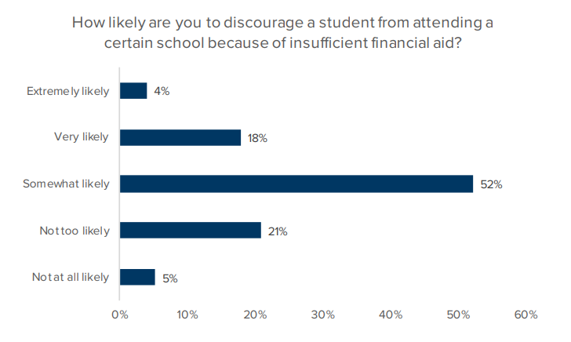
Financial Fit Counseling
22%
26%
Notes:
Only 22% would be very or extremely likely to discourage a student from a poor financial fit. Half as likely to steer a student from a poor financial choice as opposed to a poor academic choice.
26% would not likely discourage a student from a poor financial fit. This is more than twice as likely to not counsel students against poor financial choices about college compared to poor academic choices.

Slide 6
Financial Aid and Student Debt Education

Slide 7
Counselor Overburden
Notes:
Counselors are overburdened and, therefore, are likely unable to provide the highest quality of guidance every student deserves. Despite the ASCA recommended 250: 1 ratio of students to counselor, over half of school counselors in ASA’s survey have a student-to-counselor ratio 300-to-1 or higher and only 20% have a ratio smaller than 199:1.

Slide 8
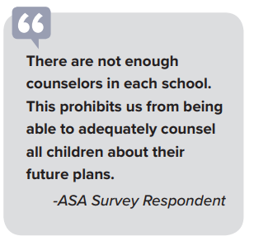
Counselor Overburden
Notes:
Counselors are overburdened and, therefore, are likely unable to provide the highest quality of guidance every student deserves. Despite the ASCA recommended 250: 1 ratio of students to counselor, over half of school counselors in ASA’s survey have a student-to-counselor ratio 300-to-1 or higher and only 20% have a ratio smaller than 199:1.

Slide 9
Recommendation: New & Innovative Methods
Rely on nonprofit or state-funded 3rd party providers.
Boots on the ground
College Advising Corps (CAC)
ISACorps
AdviseMI
School counselors can’t be expected to do it all. Make it a team effort.
Notes:
ncreasing student access to trained college access professionals and provide the one-on-one guidance that they may not get in school. The CAC, which began in 2005 with 14 advisors in Virginia, now boasts 600 advisors in 600 schools nationwide, with roughly one-third of them in rural areas. CAC collaborates with 24 colleges and universities such as Duke and the University of California, Berkeley, whose admissions and financial aid offices recruit the advisors and provide them training.12 CAC employs a similar model to Teach For America; instead of taking recent college graduates and putting them in classrooms in high-need schools as teachers, CAC places recent college graduates in high-need schools as full-time college advisors. Individual states can implement the CAC model through their Student Assistance Commissions and College Access Networks. In 2009, the Illinois Student Assistance Commission (ISAC) started the ISACorps, which trained recent college graduates to operate as mentors in high schools to help students and parents navigate the college admissions and financial aid application processes.13 This both provides a needed resource to families and a support to the already overburdened counselors. In 2015, the Michigan College Access Network (MCAN) launched the AdviseMI program to expand the previously established college advising programs at the state’s two major universities – the University of Michigan and Michigan State University. AdviseMI placed 40 recent college graduates as devoted college advisers in 51 high schools across the state; in 2016, the program grew to 49 advisers serving 62 high schools. Of note, AdviseMI college advisers are recent graduates of the program’s 17 partner institutions.14 While third party providers should be vetted for potential conflicts of interest or neutrality, they can ultimately be an important support for counselors who are often overworked and under-resourced.

Slide 10
Recommendation: Make Financial Literacy Fun!
Engage with students outside of the formal classroom.
5 Principles Program (ASA)
Carnival of Learning (MASFAA)
Claim Your Future (FAME)
Alumni mentoring programs

Slide 11
Recommendation: Don’t Forget the Parents
It’s a family effort. Make trainings, resources, and education available to the parents/guardians.
Redefine the definition of college.
Shift the college first, ask questions later paradigm.

Slide 12
Money Story
Notes:
Worksheet from HEFW Summit
Represents your view (security, scarcity, status, etc) AND value (internal, social, physical, and/or financial)

Slide 13
Views & Values Cultural Context Family Influence Faith-Based Beliefs
Notes:
VIEWS: security, status, power, love/generosity, autonomy (do what I want)
VALUES: financial, internal, social, physical
CULTURAL CONTEXT: where one grew up (pay day loan store fronts vs weekly trips to the local bank), cultural beliefs
FAMILY INFLUENCE: did the family talk about money? In what ways? Is this a resource to be shared? Thoughts on taking out loans?
FAITH-BASED BELIEFS:

Slide 14
7 out of 10 college students feel stressed about their money.
Notes:
Financial Literacy Initiatives are still relevant after students make their college decision!
According to the Federal Student Aid Office “7 out of 10…”
Who has ever felt stressed about money? Therefore, I believe all students experience at least one of those seasons of stress during their time in college. Therefore, this is a primary reason why colleges need to implement financial literacy opportunities for students.

Slide 15
Impact of Financial Stress?
-Lower academic performance
-Course load reduction
-Increased time to graduation
-Increased withdrawal from college to pursue full-time employment
Notes:
How does financial stress impact college students? Several of the largest influences are:
-Lower Academic Performance: in particular for students working 30+ hours/week to afford school
-Course Load Reduction: prolonging their time in college by taking 12 credits/semester instead of 16 or 17
-Increased Withdrawal: cannot afford school and BURNOUT
-Increased Time to Graduation: enrolled in less credits, therefore four years becomes five rather quickly

Slide 16
Impact of Financial Education Programs on College Students:
-Increased financial knowledge
-Decreased financial risk
-More responsible financial behaviors
-Impacts college completion rates
Notes:
Knowing the impact of financial stress, how are financial education programs proven to help students?
-Increased Financial Knowledge: equipped with basic tools and concepts that help them understand paying for college, balancing, etc.
-Decreased Financial Risk: better understanding of their finances, paying for college, persisting
-More Responsible Financial Behaviors: students recognize the importance and little practices that pay off in large ways
-Impacts College Completion Rates: when the stress of finances is less or more controlled students can focus on school and be more successful in their classes.

Slide 17
Implementation Process
IDENTIFY
UNDERSTAND
TIMELINE/EXECUTE
EVALUATE

Slide 18
IDENTIFY: Organizer, Resources & Partnerships
Notes:
Resources: Nerd Wallet, Credit Karma, CashCourse
EXTERNAL:
CashCourse (funding, online resource, continuing education)
Northwestern Mutual (presenter for deep dives and classroom visits)
William Blair (grant for our 1:1 Savings Match Program)
Student Engagement: Housing (dorm events), Student Success (COMPASS and financial need students), SGA (training student leaders), International Office (affording study abroad)

Slide 19
UNDERSTAND: Student Demographics
Academic Load
Employment
Student’s School Year Residence
Socioeconomic
Racial Diversity
Notes:
Mention a couple student cases here?
FY student and paying for college (understanding student loans)
SR with two semesters remaining and sole responsibility for tuition payments.

Slide 20
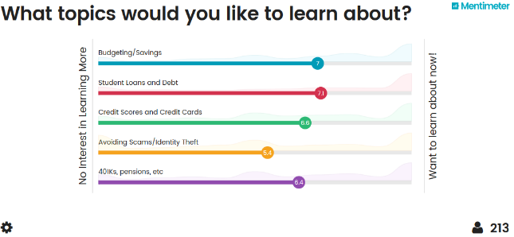
UNDERSTAND: Student Need/Interest
Notes:
Data Collection:
Within CDIO we included a question about financial literacy interests and found out the following information. One small note: students do not like to learn about scams, identity theft, or fraud. Like most people, students also assume they are immune from this happening to them. It is important to teach best practices around identity theft at the very least.
Written Responses:
What else would you like to see? (141 responses) Financial Aid (loans, scholarships, grants, FAFSA, etc): 28%
Stocks/Investments/Retirement/IRA’s: 18% Budgeting and using money wisely: 13%
Saving: 9%
Jobs/Making more money: 9% Taxes: 8%
Mortgages: 4%
Other answers on written responses (with small percentage): checkbooks, immigration forms, changing last name, car loans, job benefits, credit
Classroom visits: very brief survey using Menti that had specific topics and a short answer question to let them identify other topics they wanted to learn about.

Slide 21
TIMELINE (Option 1): By Academic Year
FIRST YEARS:
First Budget
FAFSA
Student Loans
SOPHOMORES:
Identity Theft
Taxes
JUNIORS:
Credit Cards
Credit Scores
Credit Reports
SENIORS:
Salary & Benefits
Investments
Money & Relationships
**Topics are applicable for all students, yet there are topics more relevant and of more interest at different stages.**

Slide 22
TIMELINE (Option 2): Academic Calendar
SEPTEMBER
Budgeting in College
OCTOBER
Paying for College (FAFSA)
NOVEMBER
Investments
FEBRUARY
Identity Theft & Scams
MARCH
Taxes & Student Loans
APRIL
Summer & Grad Budgeting
MAY
Evaluation
Notes:
This was our 2017-2018 calendar of events, the topics vary depending on year and student need.
For example, spring of 2017 we did a session on credit cards and credit reports. During the 2018-2019 year we pushed students to a webinar for this info.

Slide 23
EXECUTE: Summer
FY Students: High Financial Need
Emails regarding:
- Job opportunities and resources
- CashCourse
COMPASS Students
Presentation during their orientation
Notes:
At North Park we recognized two important factors we had to address before establishing our initiatives:
-culturally relevant
-level playing field for underserved students
PARTNERSHIP with Student Success regarding our incoming students
Two groups quickly identified:
High financial need or gap when paying for school (tuition payment exceeding $9,270/academic year)
COMPASS students (students with a potential social and academic need, selected based on cohort, scholarship, or acceptance)
We found it critical to introduce them to resources BEFORE they arrived to campus or at a minimum BEFORE classes start.
High financial need: emails to introduce the CDIO team and resources for job searches and financial education resources
COMPASS: presenting to them during their orientation to campus that stresses the importance of financial knowledge/resources AND fun activities that help them understand small steps that can help. VERY INTERACTIVE!

Slide 24
EXECUTE: School Year Offerings
Spring 2017 | Fall 2017 | Spring 2018 | Fall 2018
Deep Dives (4) | Deep Dives (3) | Deep Dives (3) | Deep Dives (3)
Financial Quizzes | Financial Quizzes | Financial Quizzes | Financial Quizzes
Classroom Visits | Classroom Visits | Classroom Visits | Classroom Visits
CashCourse | CashCourse | CashCourse | CashCourse
 | Get Savvy Webinars | Get Savvy Webinars | Get Savvy Webinars
 |  | Spring Quiz Challenge | SGA Student Leader Training
 |  | 1:1 Savings Match Program | Campus Housing Initiatives

Slide 25
EVALUATE: Student Evaluations
When will you evaluate initiatives?
How will you evaluate?
What feedback is of most importance?
Notes:
HOW: online? Face-to-face? Menti? Forms?
WHEN: After every event? At the end of each semester?
WHAT: are you looking for effectiveness? Relevant content? Future initiatives to consider?

Slide 26
Questions?
This Photo by Unkown Author is licensed under CC BY-SA

