Slide 1
A Strengths-based Approach to Career Development
Jesse Rutschman,
TRiO Student support services
Northeastern Illinois university

Slide 2
ICE BREAKER
Choose a Chiji card image that represents your unique strength(s).
Find a partner.
Discuss with your partner why you chose this card.

Slide 3
Objectives
Overview of the TRIO (@NEIU) strengths-based approach to career development.
Explore your own strengths and values.
Use these tools & resources to help empower your own students in their careers (or other areas).

Slide 4
Factors influencing career Development in fgcs
Social Capital Factors
Social/career network
Access to information
Access to opportunities
Career sponsors/mentors
Student peers
Human Capital Factors
Abilities/talents
Other skills
Knowledge/education
Motivation & interests
Values & beliefs
One’s nature
Peer influences
Family influences

Slide 5
Essential questions
How are we ensuring that our grad-uates find opportunities after college?
How are we ensuring to guide them to paths fitting their strengths/interests?
Approximately 33% of B.A. students change majors (National Center for Education Statistics, 2014)
Very few students end up in jobs remotely related to their majors (27% according to U.S. Bureau of Census back in 2010)
What are we doing with assessments we have students completing?
(e.g. StrengthsQuest, MTBI, other…)
What are your essential questions?

Slide 6
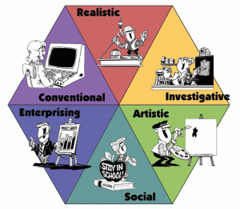
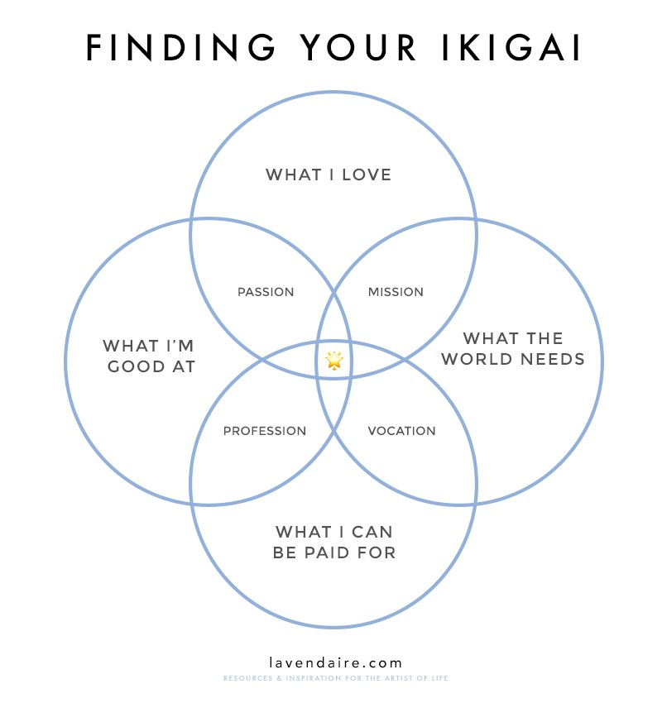
Self-understanding model
Meaningful Work Statement

Slide 7
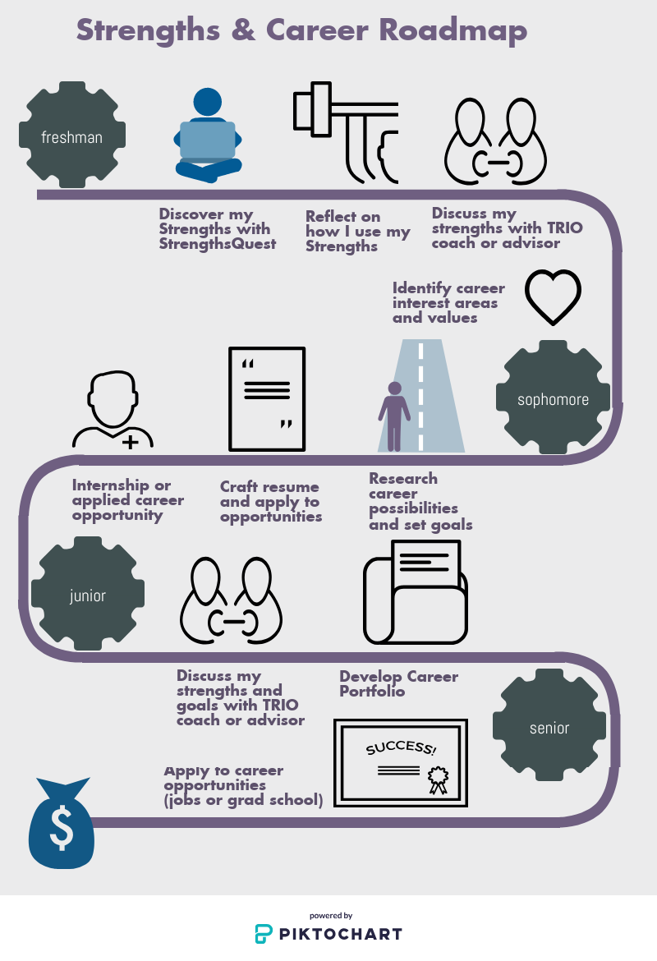
Career development Guide
Online tool guides students through self-paced/self-directed learning OR…
TRIO coaches and advisors use this to facilitate advising process
Process is trackable and dynamic

Slide 8
Two Approaches

Slide 9
Advising model
TRIO uses combined approach of:
Structured self-assessment and self-reflection/narrative-based exercises
One-on-one coaching, including Motivational Interviewing techniques, to facilitate authentic growth

Slide 10
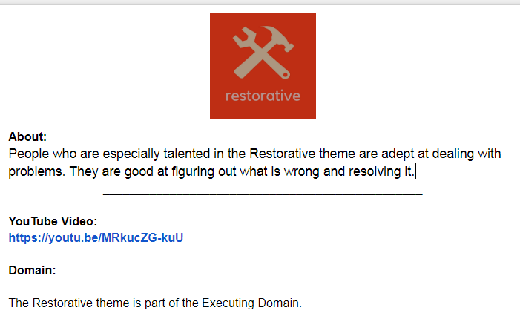
Phase I - Discovery What I’m good at
Complete Strengths Quest and submit top 5 themes in a Google form
Get an email with links to customized pages for each theme with videos, academic tips, career tips, etc. to learn more.

Slide 11
Phase I - Discovery What I’m good at
Then, meet with a coach to discuss how you have used your strengths and how they empower you in your career

Slide 12
Interactive – Community treasure hunt
From the list, choose 2 or 3 of your strengths, talents, or gifts that you have.
Discuss:
How does this strength or talent empower you or make you especially good at something?
How does that strength positively impact your life or the lives of others around you?

Slide 13
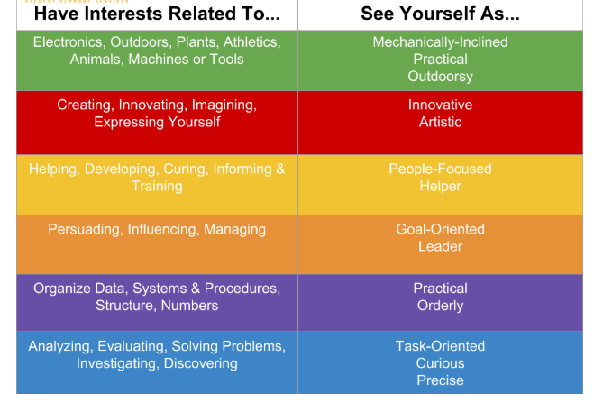
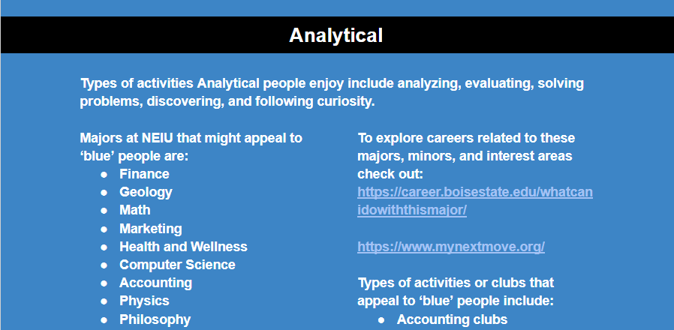
Phase I - Discovery What I love
Identify top career interest areas (RIASEC)
Get an email with recommended classes, majors, minors, and clubs and activities
Discuss career possibilities with a TRIO advisor or coach
THANKS !

Slide 14
What are your top two areas?

Slide 15
Phase ii – exploring possibilities
Create a Meaningful Work Statement
Meaningful Work Statement

Slide 16
Phase ii – exploring possibilities
Create a Meaningful Work Statement
Examples:
“I will use my gifts for analyzing data and learning to listen for opportunities to make change that help people be more secure, aware, and profitable.”
“In my pursuit to help others discover meaningful paths, I offer others my creative assistance in academic/personal problem-solving, an understanding of each individual’s uniqueness, and authenticity in my purpose to empower.”
“I will use my talents and gifts of adapting, encouraging others, and ‘future-thinking’ to assist individuals in finding their purpose in life.”
Meaningful Work Statement
Derived from Finding Your Why To A Meaningful Life Presentation/Training, William H. Johnson Jr., Student Success Navigator, Life Design Catalyst Coach/Instructor, The “Dream” Dean, University of North Carolina, Greensboro

Slide 17
Phase ii - exploring possibilities
Now, you create your own!... Brainstorm your talents, gifts, target audience, desired actions, and desired impact.
•I will use my talents or gifts in (talents and gifts) to (action) (audience) so that (benefit or impact).
•I will (action) (audience) with my talents of (talents and gifts), so that (benefit or impact)
•Or create your own template
Examples:
I will use my gifts for analyzing data and learning to listen for opportunities to make change that help people be more secure, aware, and profitable.
In my pursuit to help others discover meaningful paths, I offer others my creative assistance in academic/personal problem-solving, an understanding of each individual’s uniqueness, and authenticity in my purpose to empower.
I will use my talents and gifts of adapting, encouraging people and future thinking to assist individuals in finding their purpose in life.

Slide 18
Phase ii, III, IV - Continued…:
Explore & research career possibilities and job market
Set goals to develop the desired knowledge & skills
Develop or Strengthen resumé
Apply! Find opportunities and gain experience
Craft a Professional Identity or personal statement, LinkedIn profile, and other areas of career portfolio
Apply!

Slide 19
Strengths & Career model toolkit:
Desired self-assessment tools
Google Docs/Drive - A dedicated webpage for your own advising guides (https://tinyurl.com/triostrengthsfolio)
Google Forms – For your own trackable assessments
AutoCrat, FormMule (+a tech savvy team member) to utilize these add-ons
Advisors/coaches trained in integrating the process around other support services

Slide 20
Discussion
How can you help students on your own campus learn: what they are good at, what they love, what they value, and what they can do with this?

Slide 21
Next steps:
Explore TRIO Strengths & Career Guide: https://tinyurl.com/triostrengthsfolio
Like it and provide feedback
Questions? Concerns? More Information? …Contact me
Jesse Rutschman, Enrollment Coordinator
TRIO Student Support Services, Northeastern Illinois University
Phone: (773) 442-4974 Email: jrrutsch@neiu.edu

