Slide 1

Bridging the Gap:
Public Housing in Education

Slide 2
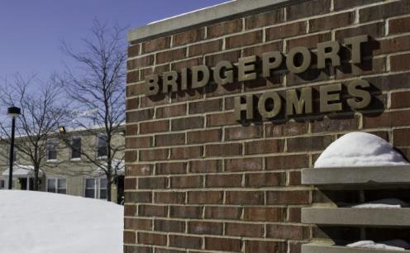
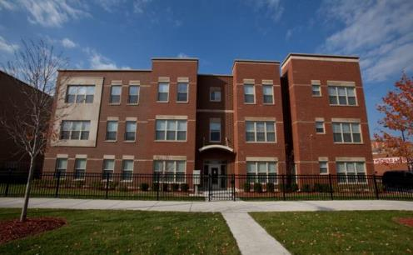
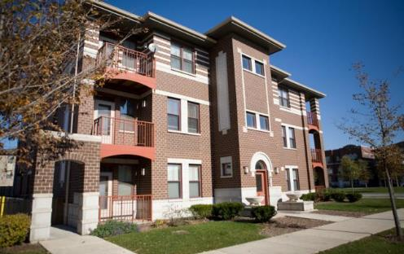
Types of Housing
Public Housing Properties:
  Mixed Income
  Scattered Site Properties
  Senior Properties
  Family Properties
Program Vouchers:
  - Housing Choice Voucher (formerly section 8)
  - Project-Based Housing

Slide 3
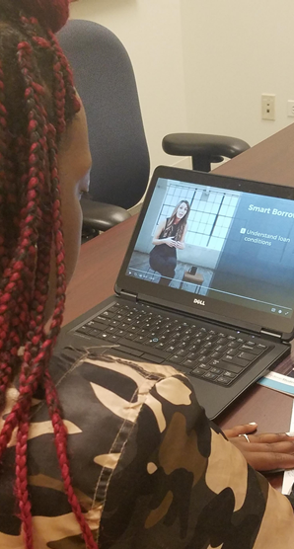
Housing &
Post-Secondary Education
Financial Barriers
Social Emotional
Knowledge about College Process
Navigating through College
  54% of CHA students have a gap in their enrollment at some point in college career
  75% of CHA college grad attended 2 or more schools to complete degree

Slide 4
Post-Secondary
Resources for CHA Residents
CHA Scholarship:
    $1,000 and $2,500 awards
    Application opens annually in January and closes in May
    Applicants notified in July, with awards for Fall
    220 scholarships are awarded:
      200 at the $1,000 level
      20 at the $2,500 level
Partners in Education:
    Inter-governmental partnership with City Colleges of Chicago
      Attend college for little to no cost
      Tuition, Book, Fee Vouchers & Uniforms
      Financial Aid applied first & unmet costs covered by CHA
      Certificates; Degrees; Summer School option for University students
      PLUS, one-on-one support of One Million Degrees

Slide 5
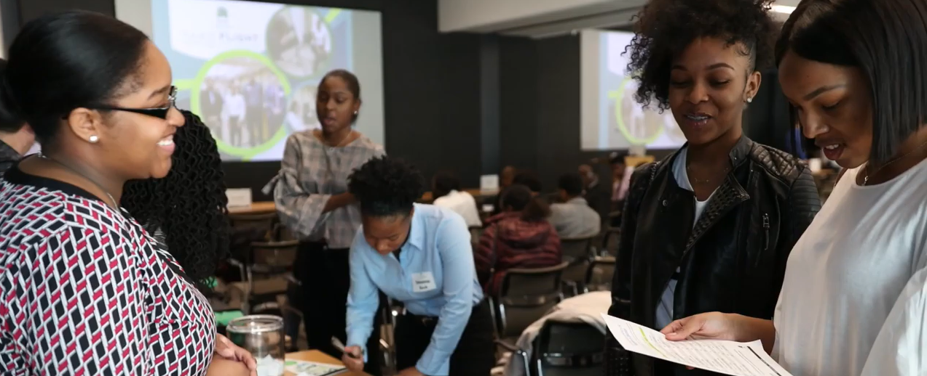
Post-Secondary Resources for CHA Residents
Take Flight: August “Trunk Party” for residents
Take Flight: January “Staying the Course”
Summer Internship Program for CHA College Students
Project S.O.A.R.: A Two-Year Demonstration Program by HUD

Slide 6
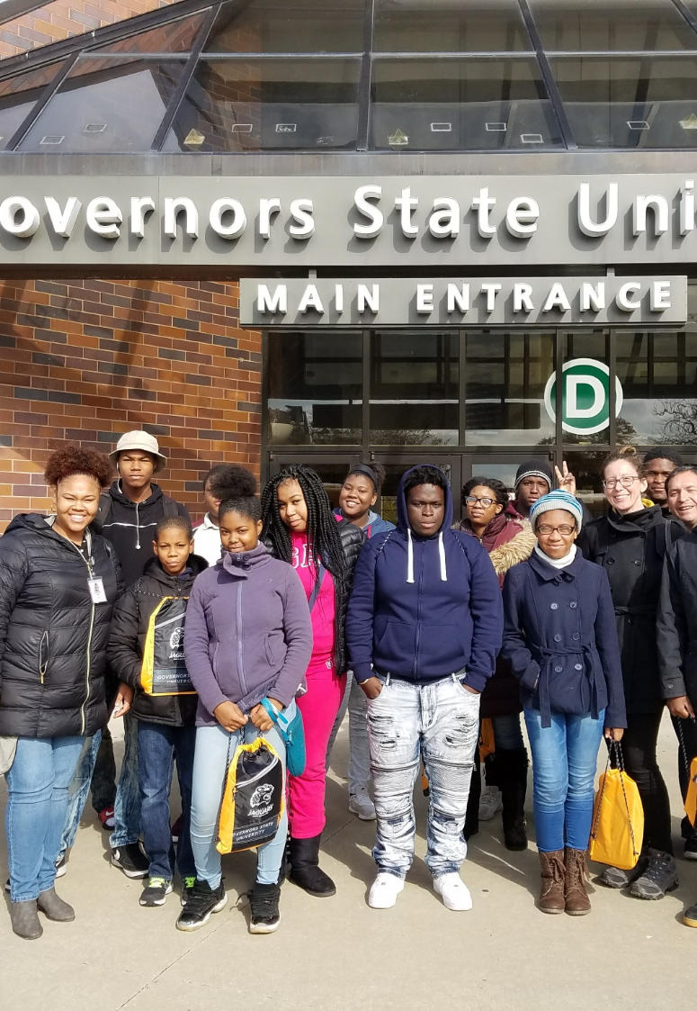
How can you partner with your local Public Housing Authority?
Community Colleges & PHA Partnerships:
  Consider Intergovernmental Agreements
  Create a scholarship program to track students over time, build a college network for PHA residents, & support reverse transfer students.
  Offer enrollment & testing session on properties
  College Tours, including current student residents when possible

Slide 7


How can you partner with your local Public Housing Authority?
High Schools & PHA partnerships:
  Invite PHA staff to post-secondary events: Career Days, Speed Networking, Financial Aid Nights or Personal Statement workshops
  Take your workshops to the community. Properties may have on-site or nearby resource centers. Collaborate with PHA staff or community agencies to offer FAFSA or College Application workshops on-site.

Slide 8
Contact Information
Ashley Ryan
Education Navigator
aryan@thecha.org
(312)786-6645
Ashley Thompson
Education Navigator
asthompson@thecha.org
(312)786-6909
Grant Vitale
Education Navigator
gvitale@thecha.org
(312)786-6908

Slide 9
Hunger and Homelessness on College Campuses (and New SNAP Rules)
Beth Malik
Law Project of the Chicago Coalition for the Homeless

Slide 10

Definitions (Wisconsin Hope Lab*)
Homelessness
HUD defines homelessness as sheltered (in a HUD funded emergency shelter, transitional housing, and supportive housing) and unsheltered (on the streets, in abandoned buildings, or other places not meant for human habitation).
The U. S. Department of Education (DOE) uses the education sub-title of the McKinney-Vento Act’s definitions of homelessness, which includes youth who lack a fixed, regular, and adequate nighttime residence; and unaccompanied, which includes youth not in the physical custody of a parent or guardian.

Slide 11
What is “Food Insecurity”
Food Insecurity is the limited or uncertain availability of nutritionally adequate and safe foods, or the ability to acquire such foods in a socially acceptable manner.
Very Low Food Security is multiple indications of disrupted eating patterns and reduced food intake.

Slide 12
Scope: How many students does this impact?
Wisconsin Hope Lab (2018)
Surveyed 66 institutions in 20 states (43,000 students, 7.3% response rate)
Includes 20,000 at 35 4-yr colleges and universities
35% were food insecure
37% were housing insecure
9% of those students were homeless

Slide 13
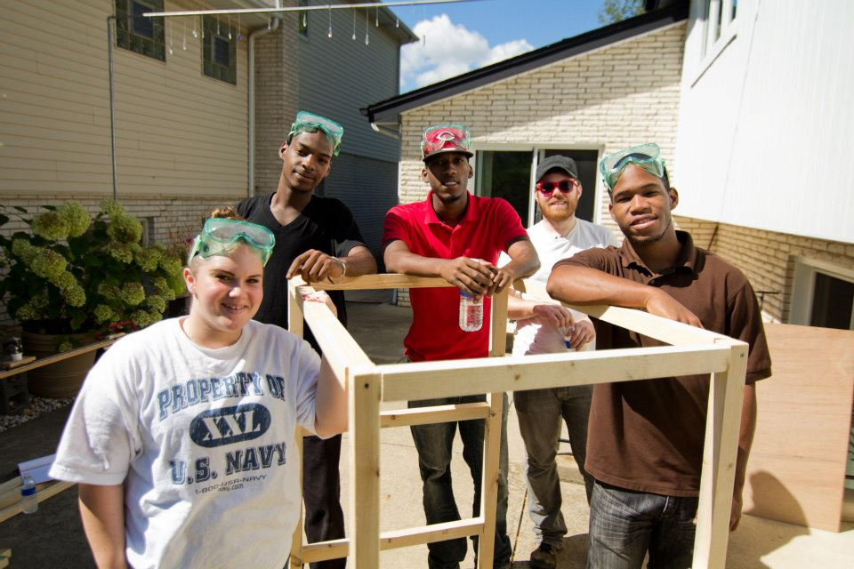
Homeless Youth in Illinois
There is an estimated 25,000 unaccompanied homeless youth ages 18 to 21 in Illinois (based on a 2005 study).
Approximately 580 shelter beds for 18 to 24 year-old homeless youth.
In July 2018, the Illinois State Board of Education reported that public schools identified 56,881 homeless students in the 2017-18 school year, a year’s increase of 4% or 2,212 students.

Slide 14

The Context: Why is this happening?
Prevalent causes of youth homelessness:
Physical, sexual, and emotional victimization at home
Rejection based on identity and/or circumstances (e.g., LGBTQ, pregnancy)
Caretaker addiction, incarceration, mental/physical illness, death
History in foster care and/or juvenile justice system
Overcrowding and/or public housing rules
Lack of work history and inability to earn living wage
Structural conditions (e.g., poverty, racism, unemployment, lack of affordable housing)

Slide 15

The Context: Why is this happening?
Students are told a college degree = financial security - and that financial aid will be there.
A greater percentage of college students qualify for financial aid than in the past so fewer dollars per student are available.
Students experiencing homelessness often don’t qualify because of inaccurate calculations of expected family contribution.
With or without aid, students’ existing financial insecurity presents a significant barrier to college completion.
Financial insecurity leads to difficult decisions about whether to reduce spending on food or housing in order to remain in school.
Students who need support often aren’t eligible for safety-net programs like SNAP and TANF because eligibility is more restricted for students than others.

Slide 16
What Can You Do About It?
Identify and assist homeless students
Single Points of Contact
Remove barriers to housing and financial aid
Understand and refer students to community resources
Utilize on campus resources
Food Pantry
Connect eligible students to SNAP

Slide 17

SNAP 101
The Supplemental Nutrition Assistance Program (SNAP, formerly Food Stamps) is the nation’s most important and effective anti-hunger program.
SNAP distributes monthly benefits to qualifying, low-income households through an EBT card that can only be used to purchase food.
In 2016, 1 in 7 Illinoisans participated in the SNAP program.
SNAP benefits are 100% federally funded.
In 2016, SNAP benefits contributed $3.0 billion into Illinois’ economy.

Slide 18
SNAP Eligibility
To qualify for SNAP, a household's total Gross Monthly Income must be below 165% to 200% of the Federal Poverty Limit, depending on household type.

Slide 19
Who is in a household?
Members are in the same “household” if they purchase and prepare meals together.
Certain people must be considered together:
  Parents and children (up until age 22)
  Children living with a caretaker (up until age 18)
  Spouses
Individuals who are in the same food stamp household will be on the same case, and the entire household’s income, assets, and expenses will be considered.
“Qualified Member” households include:
  Elderly—60 or over
  Disabled—receiving disability benefits

Slide 20
Application Process
General Application Process:
Submit application in person, over the phone, or online
Interview to be scheduled within 14 days
Decision to be issued within 30 days
Applicant must be notified in writing via letter
Upon approval, Link Card is mailed
Expedited Process:
Monthly income < $150 and assets <$100
OR
(Rent/mortgage + utilities) > (income + assets)
Upon approval, Link Card is mailed within 5 days of the application

Slide 21
Student Eligibility
Students enrolled at least half-time in postsecondary or vocational training may be eligible for SNAP if they are:
  Under 18 or over 50,
  Working an average of 20 hours per week,
  Participating in state or federal work study program,
  Receiving TANF cash assistance,
  Responsible for the care of a child under 6,
  Responsible for the care of a child between 6 and 12 and adequate child care is not available for school and work, OR
  Enrolled full-time and single parent of child under 12.
If they do not meet these requirements, the student and their income and assets will be excluded from the household.

Slide 22

New Rule For Illinois Community College Students
As of January 1, 2018, low-income Illinois community college students enrolled in a Perkins- approved course of study will be eligible to apply for SNAP benefits, whether enrolled full or part-time

Slide 23



Perkins – Approved Courses:
Perkins-approved areas of study include:
Agriculture, Food & Natural Resources
Architecture & Construction
Art, Audio/Video Technology, & Communications
Business Management & Administration
Education & Training
Finance
Government & Public Administration
Health Science
Hospitality & Tourism
Human Services
Information Technology
Law, Public Safety, Corrections & Security
Manufacturing
Marketing
Science, Technology, Engineering & Math
Transportation, Distribution & Logistics

Slide 24

NEW for 2019!
Under SB1641, students who are eligible for the Monetary Award Program (MAP) would be notified that they may be eligible for SNAP benefits. The student would still be required to fil out and submit an application to the Illinois Department of Human Services (IDHS) for a final determination.

