Slide 1
Know & Exercise Your Rights!
Notes:
Main Points:
Welcome
Introduce yourself
If there is time, have everyone introduce themselves

Slide 2
What Will We Cover Today?
Know Your Rights with Police
Know Your Rights with Immigration
Preparing an Emergency Plan
Overview of Immigration Relief

Slide 3
Chicago’s Legal Protection Fund
Chicago’s Legal Protection Fund is a city initiative that supports organizations to expand access to protect immigrants in Chicago. The Fund was created in December 2016 to protect more than 180,000 undocumented immigrants in Chicago following the Presidential election of Donald Trump.

Slide 4
Chicago’s Legal Protection Fund
In 2017:
439 Community Navigators were trained
750 “Know your Rights” Presentations were hosted
24,947 people attended “Know your Rights” Presentations
1992 intakes conducted by NIJC
1003 cases taken by NIJC
In 2018:
118 Community Navigators were trained
730 “Know your Rights” Presentations were hosted
29,538 people attended “Know your Rights” Presentations
1550 intakes conducted by NIJC
1755 cases taken by NIJC – 875 new cases in 2018
Notes:
Legal protection Fund numbers in 2017 & 2018 – showing the success of the program

Slide 5
You Have the Right to:
REMAIN SILENT
To exercise this right, say loudly: “I wish to remain silent”
SPEAK WITH AND BE REPRESENTED BY AN ATTORNEY
In Immigration, an attorney is at our own expense
NOT SIGN ANYTHING
NOT PERMIT AN ENTRY
It is NOT necessary to open the door unless ICE or the Police have a signed Judicial Warrant
REQUEST A LOCAL TELEPHONE CALL
Memorize phone numbers of family/friends with legal status
Notes:
Main Points:
Everyone has these rights- these rights are constitutional
You must say “I wish to remain silent”
Additional information:
Immigration agents can use tactics to intimidate and try to force someone to signing documents
It’s important to not sign anything even if it’s in your native language. The documents may have legal repercussions and it’s important to understand those repercussions before you sign anything.

Slide 6
Know Your Rights with the Police
Police should not ask you about your immigration status
You are not required to have a license or ID as a passenger in a vehicle
You do not have to answer questions about where you were born or how long you have been in the United States
Ask: “am I free to go?" and walk away calmly
Notes:
Main Points:
Many times a deportations can begin after having had interactions/ problems with the police. That is why its important to avoid confrontations and know your rights
It’s risky to drive without a license and even more risky and dangerous if you’re driving under the influence.
It’s always important to ask “Am I free to go?” and walk away calmly.

Slide 7
Court and Bond: Police
Court
If you have court or probation and you do not go, you will have a warrant for your ARREST
Bond
Pay 10% of bond
Bond will be reimbursed or credited
**ICE agents have been arresting individuals who appear at local courthouses. Do not speak to anyone who is not your attorney**
Notes:
Main Points:
SHOW UP TO COURT
Have someone who will be able to pay your bond/fine; a person with a legal status.
Additional Information:
The person who pays for bond will have to be physically present at the appropriate district police.
Make sure you receive copies of all the payments made

Slide 8
Know your Rights if ICE Comes to Your Home or Workplace
AT HOME:
Do NOT open the door – teach children not to open the door!
You are NOT required to open the door unless ICE has a warrant signed by a judge
AT WORK:
ICE must have a warrant signed by a judge or permission from your employer to enter your work place
You do not have to answer any questions
Do not carry false document with you
IN PUBLIC PLACE:
ICE does not need a warrant to search public places
If ICE stops you on the street, you are not required to show identification. Ask: “Am I free to go” and walk away calmly
Notes:
Main Points:
If ICE comes to your home, do not open the door. Unless they have a signed and valid judicial warrant
If ICE tries to force their entry or knocks down the door, take down as much information as possible
ICE must have a valid judicial warrant to enter into private places
Additional Information:
ICE will rarely show up with a judicial warrant
Once you open the door, it is then very difficult to avoid answering any questions
Reference Know Your Rights Doorhanger

Slide 9
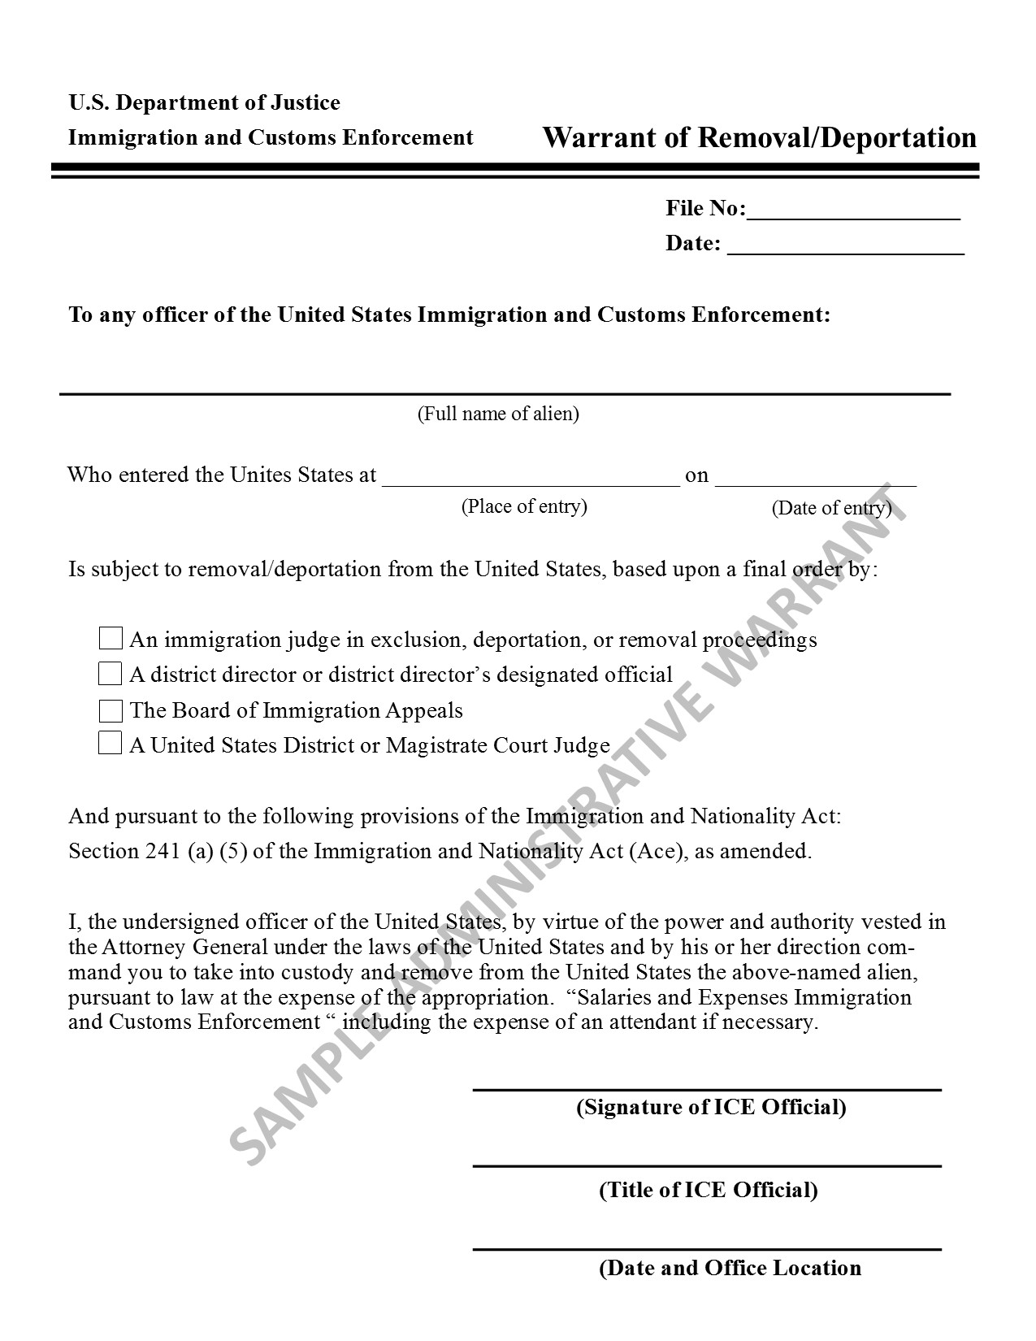
Sample
Administrative Warrant
ICE CANNOT COME INTO YOUR HOME
Notes:
Main Points:
This does not authorize anyone to go into a private property/space
Notice it is signed by an ICE official and NOT A JUDGE
These only work if they pick you up on the street, not in your house
Additional Information:
This warrant is much easier to obtain given that it only has to be signed by an ICE official
It’s important to contact an attorney if ICE shows up with an administrative warrant to your home

Slide 10
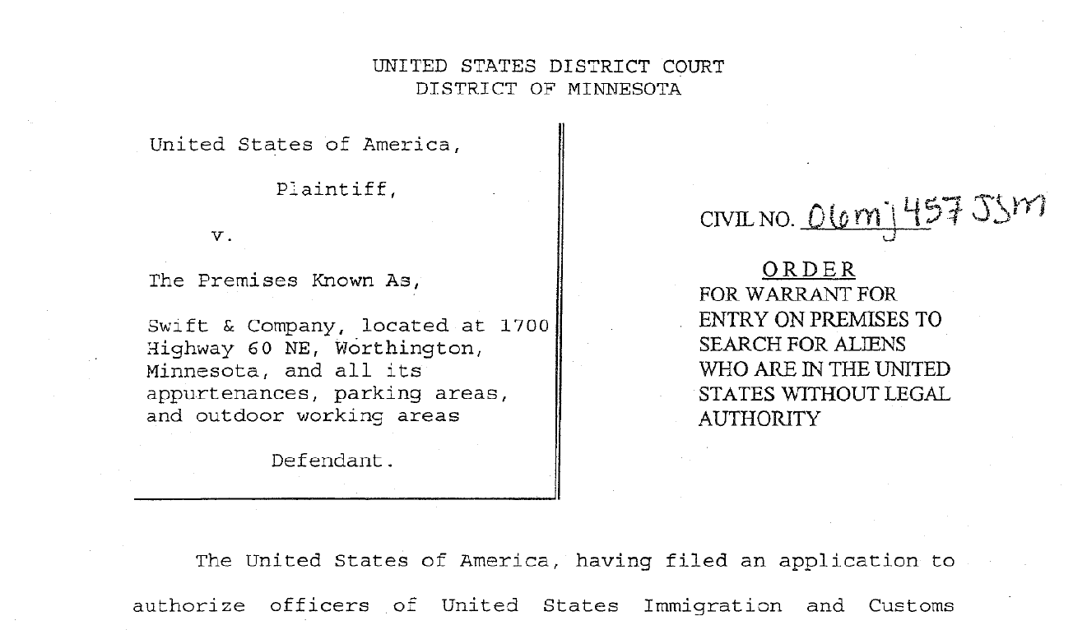
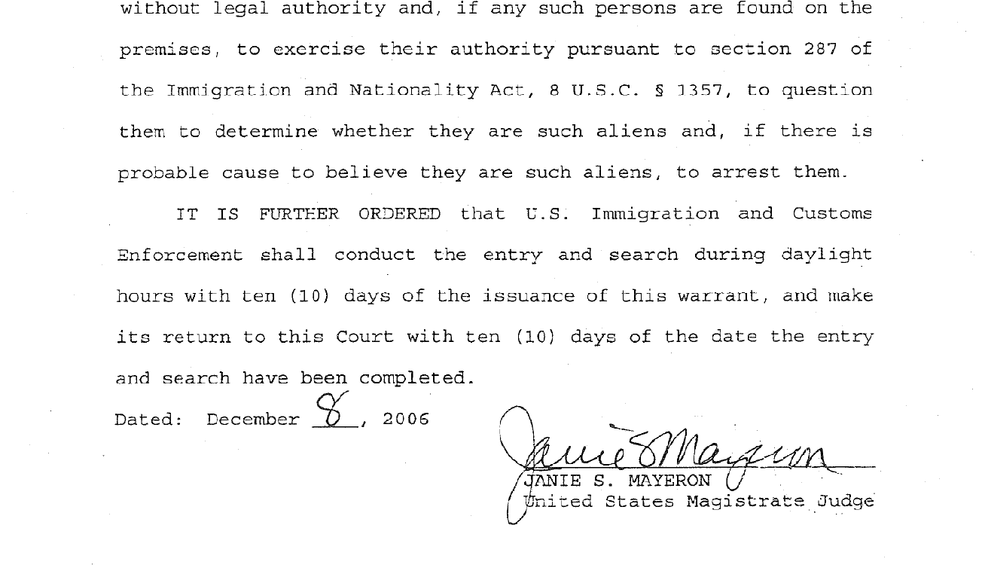
SAMPLE JUDICIAL WARRANT
Name & Address
DATE
JUDGE
Notes:
Main Points:
If the Judicial warrant is correct, this gives authority to go in to the address listed
The warrant must have, Name, address, date and signed by a judge
When I doubt- DO NOT OPEN THE DOOR but agents will most likely force their entry
ICE officials will most likely be waiting outside your home
Additional Information:
Name and Address must be correct and without errors for the warrant to be valid
Date must be recent
Some warrants will specify for how long the warrant is valid for
Verify that the warrant has a judges’ signature

Slide 11
If You Are Detained by ICE
ONLY PROVIDE YOUR NAME AND DATE OF BIRTH
You are NOT required to give this information but that may help your family members locate you
MEMORIZE YOUR 9 DIGIT A NUMBER
ASK TO TALK TO AN ATTORNEY
All detention centers should let you make a call – there will be a charge
ONLY inform your lawyer about your immigration status
ALWAYS ASK TO SEE A JUDGE & DON’T SIGN ANYTHING YOU DON’T UNDERSTAND
Notes:
Main Points:
You do NOT need to answer any more questions
You will have to provide your emergency contact, attorney and your consulate with your A number
Additional Information:
Your A number will be on a tag around your wrist or your neck
The A number refers to “Alien number”. An A number is provided to someone who has applied for immigration status, legal permanent residents, or someone with an open immigration case

Slide 12
Tactics by ICE
Individuals being detained outside of court
ICE acting like police officers
ICE officials not identifying themselves
ICE officials conducting traffic stops
What other tactics are you seeing/hearing in the community?
Notes:
Main Points:
Tell the audience the tactics ICE is using in the community to detain people
Open it up for people to add what other tactics ICE is using/ seeing in the community

Slide 13
ICE Conducting Traffic Stops
If you are driving and get pulled over:
An officer can require you to show your license, vehicle registration, and proof of insurance
You don’t have to answer questions about your immigration status
Do not provide your foreign documents - only provide your TVDL
For residents of Chicago, apply for City Key
If you are pulled over in a traffic stop:
Ask the officer to identify themselves – if they are local police or ICE
ICE officials often identify themselves as “police,” but it is important to know what agency they represent
If they are ICE officials – REMEMBER YOUR RIGHTS
Do not answer any questions or provide any documentation before you speak with your attorney
Notes:
Main Points:
People are asking a lot of questions around traffic stops
Have information regarding the Chicago City Key and TVDL

Slide 14
If You Are Detained by ICE
Detained Individuals
Processing at Broadview Facility
Transfer to Detention Facility
Immigration Court
Non-Detained Individuals
Processing at Broadview Facility
Released from Detention
Immigration Court
** IF YOU ARE AFRAID TO RETURN TO YOUR COUNTRY, SAY SO to the immigration officer during processing **
Notes:
Processing at Broadview Facility:
At Broadview:
Individual is printed, interviewed, and ICE runs various checks
This is one point where ICE may try and force you to sign a stipulated removal order
At this stage, ICE will determine whether to release you on your own recognizance (no bond paid), whether to give you a bond amount, or whether you are subject to mandatory detention and ineligible for bond
If ICE gives you a bond amount but you or your family cannot afford to pay the amount, you should ask to speak to a judge to request a bond redetermination to see if the immigration judge will lower the bond
The minimum bond amount for immigration is $1500, unlike with criminal proceedings where you only pay 10% of the bond amount, for deportation proceedings, you have to pay 100% of the bond amount to be released
Detention Facilities:
McHenry County Jail (Woodstock, IL)
Kenosha County Detention Center (Kenosha, WI)
Dodge County Detention Center (Juneau, WI)
Pulaski County Detention Center (Ullin, IL)
Boone County Jail (Burlington, KY)
Clay County Jail (Brazil, IN)
Jerome Combs Detention Center (Kankakee, IL)
Broadview Processing Center (Broadview, IL) – not an overnight facility
The remote locations of these facilities make it difficult for individuals to and Each facility has their own protocol for scheduling conference calls with detainees and sending/receiving faxes
If you remain detained and have a defense to your deportation…
Your case could take 3-6 months in detention
If you are detained and have no relief…
Your departure can occur within a couple of weeks to a few months depending on the country after having accepted either voluntary departure of a deportation order
It’s best to try and pay bond to be released
If you are not detained and have a defense…
Your case can take several years to complete
If you are not detained and have no relief…
Your case can still take several months to a year to obtain either voluntary departure or deport order

Slide 15
If a Family Member is Detained by ICE
Locate them: LOCATOR.ICE.GOV
Call your consulate’s emergency # México: (855)463-6395
The person who pays bond must have legal status
Call your attorney
Notes:
Main Points:
The attorney and the consulate will have easier and faster access to the person detained
If you do not have a lawyer, your consulate or ICIRR emergency hotline number will be able to help you
Additional Information:
Contact your consulate to find out if they have an emergency contact number
There are minimal risks if the person who pays your bond is a U.S. citizen
ICIRR hotline number provides you with resources available in your community

Slide 16
Information Regarding ICE
Do I have a deportation order?
Call 1-800-898-7180 (Executive Office of Immigration Review – the immigration court) and enter your 9-digit A-number
A deportation order may not show up on the 1-800# - you may have to request your file from the immigration agencies in order to verify if you have a removal order
We STRONGLY recommend that you contact an immigration attorney if you have a deportation order or if you live with someone who has a deportation order!
Notes:
Main Points:
The attorney and the consulate will have easier and faster access to the person detained
If you do not have a lawyer, your consulate or ICIRR emergency hotline number will be able to help you
The “Know Your Rights” cards we will pass out at the end of the presentation will have ICIRR hotline number
Additional Information:
Contact your consulate to find out if they have an emergency contact number
There are minimal risks if the person who pays your bond is a U.S. citizen
ICIRR hotline number provides you with resources available in your community

Slide 17
Court and Bond: Immigration
Court:
If you have court or supervision and you do not go, you will have an order of DEPORTATION.
Bond:
You must pay 100%
The person who pays must be a U.S. Citizen or Legal Permanent Resident.
Bond is reimbursed at the end of your case
Notes:
Main Points:
YOU MUST GO TO COURT. Not going to court does not mean you will not be deported.
Immigration bonds are generally never less than $1,500 and it depends on the person’s case. The average cost of a bond is $5,000
Bond is reimbursed at then end of the case to the person who paid it
Additional Information:
There has been recent cases where a person who shows up to their supervision appointment is deported. That is why it’s important to have a lawyer go with you to your supervision appointment

Slide 18
Basic Vocabulary to Exercise your Rights:
Do you have a warrant?
¿Tiene una orden de arresto?
Are you Chicago police or ICE?
¿Es parte de la policía de Chicago o de ICE?
Am I free to go?
¿Estoy libre de irme?
I wish to remain silent
Quiero permanecer en silencio
I want to make a phone call
Quiero hacer una llamada
I want to speak to my lawyer
Quiero hablar con mi abogado
I want to see a judge
Quiero ver un juez
I will not sign anything I don’t understand
No voy a firmar algo que no entiendo
Notes:
Main Points:
These are the main phrases you will need to know, in case you are arrested on the street or in your car, or if ICE comes to your home.
Take the time to practice the vocabulary with the audience
Additional Information:
Establish how you will practice the basic vocabulary with the audience.
The presenter will say each line one by one
The audience will then repeat the sentence one by one
Tell the audience they can record and practice at home

Slide 19
Begin Preparing Your Emergency Plan
Identify who will take care of your children and assets and have a meeting about it.
Update your emergency contact information at your children's school and doctor.
Apply for your children’s double nationality and their passport and verify your options with your consulate.
Gather important documents in a safe place and make sure your emergency contact is aware of it.
Save money. Make sure your bank account is connected to a debit card so you can access it in another country and make sure you have access to online banking.
Notes:
Main Points:
Make sure your family is aware and knows of your emergency plan
Prepare your documents in a safe place and make sure your emergency contact knows where to locate the documents
Use the Emergency Plan packet that will be given to you at the end of the presentation as a guidance when gathering your documents.
Additional Information:
Inform your emergency contact person of your plan and make sure your children are also aware of it.
Having a short term guardianship can be an option. The possibility of both parents being deported at the same time is unlikely
Update your children's school and medical information so your emergency contact or trusted person can receive limited information regarding your children.
Your children do not loose any rights or U.S. status by receiving a double citizenship. They actually have more benefits by being a citizen of their parents country of origin.
It’s important to obtain your children's U.S. passport asap because it becomes much more difficult if one parents is not present.
You must apply for the U.S. passport with time as it may take weeks to receive it. You must complete form DS-82 that can be filled out and submitted at a Post Office.
Examples of documents to gather in one place: Passports, Birth Certificates, Diplomas/ School records, medical records, ID’s, Marriage certificates, Custody documents, Bank Statements and any other documents you think are important or necessary for your family to be aware of.
Consider adding a trusted person to a joint account with you
There are several ways to protect your money. Keeping cash at home is not a safe place and will make it difficult to access if you are detained or deported.

Slide 20
What Can Allies Do?
Know and exercise the same rights
Don’t provide information on your legal status
Record, take video and pictures if you see any ICE/police enforcement
Volunteer and provide Know your Rights presentations at your local community organizations
Refer them to NIJC or a trusted attorney at an organization
Notes:
Main Points:

Slide 21
Legal Consultations are Very Important
Obtain a Legal Consultation!
If you obtained a legal consultation in the past, it’s important to get an updated consultation by an attorney or a DOJ accredited representative
Who can give immigration legal advice?
Licensed Attorney
DOJ Accredited Representative
Law students under supervision by an attorney
Beware of Notary Fraud
Notary publics are typically not also licensed attorneys and cannot give legal advice
Notes:
MAIN POINTS:
It’s important to consult with an attorney for possible options of an immigration relief
Additional Information:
A thorough legal consultation will cover a wide array of information to assess for all potential relief under our current immigration laws and policies.
We have found that over 14% of the individuals that we have screened for DACA eligibility are potentially eligible for more permanent immigration relief.
In fact, that number is even higher because depending on the benefit, the individual may be able to include spouse, children, parents, or siblings in their application
It is vital to know your options especially in this enforcement heavy environment
It is helpful to be prepared for your consultation by:
Taking copies of any immigration-related documents you may have (especially if you have filed applications with immigration in the past)
Taking certified dispositions for all criminal matters
A certified disposition is a document from the criminal court that outlines the specific charge(s) against an individual and the legal outcome of the charge(s)
Certified dispositions are public records – it may be best to have a U.S. citizen or LPR friend or family member go to the courthouse to request these documents on your behalf
This is especially important if you suspect that you may have an active arrest warrant against you for missing a court date or not paying fines, etc.
If you suspect you have an arrest warrant, you should speak to a criminal defense attorney asap to resolve the matter
Your criminal defense attorney can contact our NIJC Defenders Initiative at: to speak to one of our attorneys and figure out how the pending immigration charge might affect your immigration status
If you don’t remember when/where you have been stopped by the police or if you don’t have copies of prior immigration paperwork, let the attorney know and he/she will discuss the usefulness/risks of filing FBI prints or FOIA requests with DHS
IT’S IMPORTNANT TO CONSULT WITH AN ATTORNEY REGARDING YOUR OPTIONS

Slide 22
Common Immigration Benefits
Adjustment of Status and Naturalization
Family Petitions (including for refugees)
Protection for Survivors of Crimes and Domestic Violence
Immigration Relief in Deportation Proceedings
Asylum
Special Immigrant Juvenile Visas
Parole-in-Place
Notes:
A thorough legal consultation will cover a wide array of information to assess for all potential relief under our current immigration laws and policies.
We have found that over 14% of the individuals that we have screened for DACA eligibility are potentially eligible for more permanent immigration relief.
In fact, that number is even higher because depending on the benefit, the individual may be able to include spouse, children, parents, or siblings in their application
It is vital to know your options especially in this enforcement heavy environment
It is helpful to be prepared for your consultation by:
Taking copies of any immigration-related documents you may have (especially if you have filed applications with immigration in the past)
Taking certified dispositions for all criminal matters
A certified disposition is a document from the criminal court that outlines the specific charge(s) against an individual and the legal outcome of the charge(s)
Certified dispositions are public records – it may be best to have a U.S. citizen or LPR friend or family member go to the courthouse to request these documents on your behalf
This is especially important if you suspect that you may have an active arrest warrant against you for missing a court date or not paying fines, etc.
If you suspect you have an arrest warrant, you should speak to a criminal defense attorney asap to resolve the matter
Your criminal defense attorney can contact our NIJC Defenders Initiative at: to speak to one of our attorneys and figure out how the pending immigration charge might affect your immigration status
If you don’t remember when/where you have been stopped by the police or if you don’t have copies of prior immigration paperwork, let the attorney know and he/she will discuss the usefulness/risks of filing FBI prints or FOIA requests with DHS

Slide 23
Assistance
Immigration
National Immigrant Justice Center
(312) 660-1370
(We provide you with referral for a free legal consultation)
Short Term Guardianship
WWW.ILLINOISLEGALAID.ORG
Chicago Volunteer Legal Services (CVLS) (312) 332-1624
Fraud
Attorney General (800) 386-5438
Notes:
Main Points:
Go over the referral process with NIJC
CVLS can answer questions regarding short term guardianship
To report notary or attorney fraud
Additional Information:
Make sure you are aware of how the referral process works; each organization is different.

Slide 24
QUESTIONS? To have a presentation like this, contact Magaly Arteaga magaly@partnershipfornewamericans.org

