Slide 1
Supporting Our State’s Immigrant Population
Tanya Cabrera, Assistant Vice Provost for Student Inclusion, University of Illinois at Chicago
Laura Mendoza, Immigration Organizer, The Resurrection Project
Luis Narvaez, EL Postsecondary Manager, Chicago Public School

Slide 3
ILLINOIS LEGISLATIVE UPDATES

Slide 4
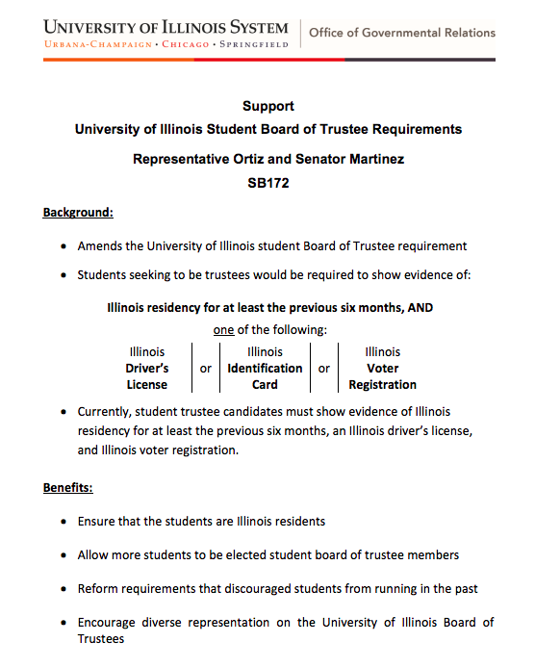
Representative Ortiz and Senator Martinez pass legislation to allow undocumented students to run for Student Trustee 2019

Slide 5
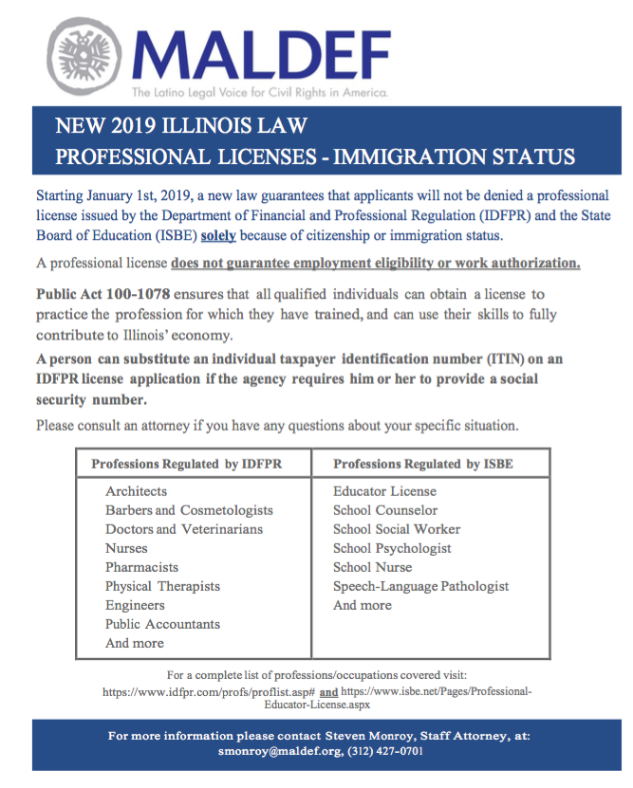
IL passes legislation to allow professional licenses to immigrants. Including nursing.

Slide 6
On Friday, June 21,at UIC Gov. Pritzker signed all three Campaign for a Welcoming Illinois bills in to law:
RISE Act (HB 2691): Provides access to financial aid for undocumented students, trans students, African American and other students who have had limited access to aid.
Private Detention Facility Moratorium Act (HB 2040): Bars the state and local communities from entering into contracts for private immigration detention centers.
Keep Illinois Families Together Act (HB 1637): Bars 287g agreements that deputize police to act as ICE agents.

Slide 9
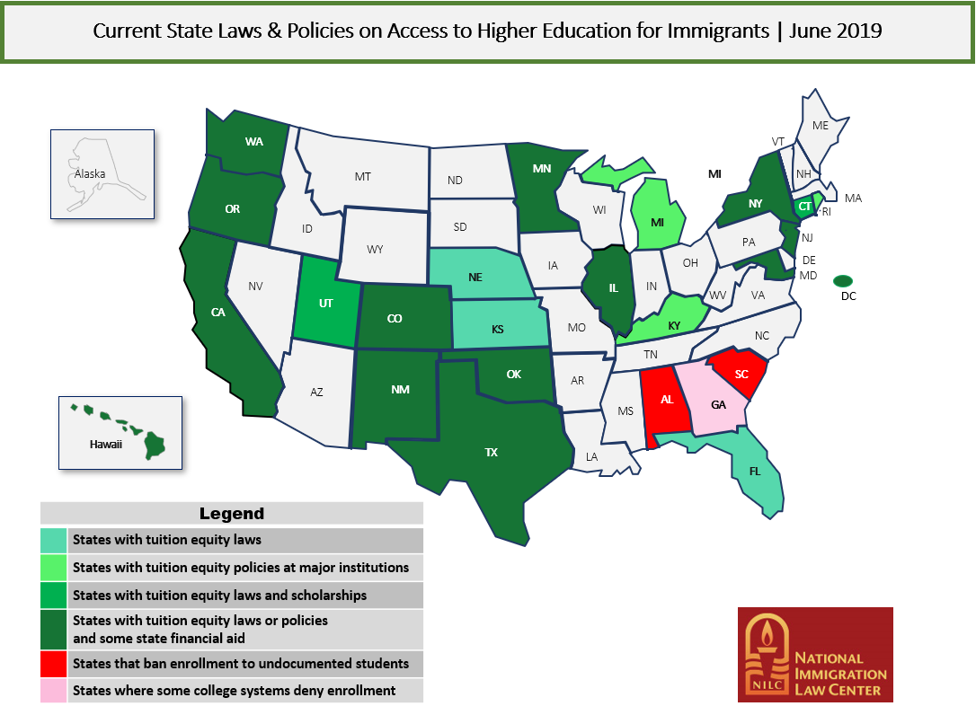

Slide 10
Tips for Educators (from Immigrants Rising)
Engage with an Open Mind (there is no one single mold to define undocumented immigrants)
Create a safe space at your cubicle, office, building, and campus in general
Learn your campus’ policies and state legislation
Find and advocate for scholarships and financial support (and if there’s none, create some!)
Build your own network of educators and allies supporting this cause

Slide 11
Tips for Educators (from Immigrants Rising)
Connect students to community leaders, government officials, and consular representations
Engage parents and community members
Use the resources in the following page; always make sure to take a look at a page’s publishing date to ensure you are looking at the latest information
Build agency and power; support a club on campus!
Create safe spaces for story telling and creative expression

Slide 12
LINKS AND RESOURCES
icirr.org/community-resources
DREAM.UIC.EDU
nilc.org
immigrantjustice.org
mydocumentedlife.org
thedream.us
illinoisstate.edu/admissions/undocumented
admissions.illinois.edu/Apply/undocumented
iacac.org/undocumented
uleadnet.org/map/illinois-policy

Slide 13
Contact Us
Tanya Cabrera - University of Illinois at Chicago
Assistant Vice Provost for Student Inclusion
TCabrera@uic.edu | 312-355-0011
Laura Mendoza - The Resurrection Project
Immigration Organizer
LMendoza@resurrectionproject.org | 312-919-3067
Luis Narváez - Chicago Public Schools
EL Postsecondary Manager, Office of Language & Cultural Education
LNarvaez2@cps.edu | 773-553-2077

