Slide 1
Career Outcomes Illinois High School Seniors
Ewa Gallagher, IL Dept of Employment Security
Erin Mitchell, IL Student Assistance Commission
Patrick Payne, IL State Board of Education
George Putnam, IL Dept of Employment Security

Slide 2
Career Outcome Projects
71,000 training completers
33,000 Youth and 38,000 Non-Youth training completers 2012-2014
Associated Builders and Contractors IL, CompTia, DeVry University, IL Community College Board, IL Dept of Commerce and Economic Opportunity, Jane Addams Resource Center and Manufacturing Skills Standards Council
Data linkages: completers to career outcomes
Primary deliverable: data tables with findings
360,000 post-secondary graduates
IBHE 65 institutions (private and public) 2013-2015; ICCB 48 institutions 2010-2015
Data linkages: graduates by program of study to career outcomes
Primary deliverables: student/parent mobile app (released Sep 2018) and institutional researcher portal (released Mar 2019)

Slide 4
High School Seniors
2007 - 2016

Slide 5
High School Seniors
2007 - 2016
Post-Secondary Records
Enrollment/Completion

Slide 6
Workers’ Employment and Earnings
High School Seniors
2007 - 2016
Post-Secondary Records
Enrollment/Completion

Slide 7
Workers’ Employment and Earnings
High School Seniors
2007 - 2016
Post-Secondary Records
Enrollment/Completion
Student FAFSA Data

Slide 8
Career Outcome Projects
More than 1.5 million IL high school seniors
2007-2016 Illinois High School student cohorts from ISBE
Data linkages: seniors to postsecondary enrollment/completion (life-long learning), FAFSA applications (intergenerational mobility), and career outcomes
Primary deliverables
ISBE researcher portal
Student/Parent mobile app
Information pipeline to local school administrators

Slide 9
Presenters
Erin Mitchell
Data Scientist, IL Student Assistance Commission
Topic: data infrastructure, ISBE researcher portal
Ewa Gallagher
Workforce Outcomes Manager, IL Dept of Employment Security
Topic: HighSchool2Career student/parent tool
Patrick Payne
Director of Data Strategies and Analytics, IL State Board of Education
Topic: information pipeline to local school administrators

Slide 11
Student Employment Data
High School Seniors
2007 - 2016
Post-Secondary Records
Student FAFSA Data

Slide 12
Student Level Data
Individualized Education Plan (IEP)
Graduation Status
Native Language
Career and Technical Advancement (CTE) Courses
Advanced Placement (AP) Courses
Foreign Language Courses
ACT Score
Homeless
Low-Income
Gender
Race
Student High School
Student Employment Data
High School Seniors
2007 - 2016
Post-Secondary Records
Student FAFSA Data

Slide 13
High School Level Data
School Size
4, 5, & 6-Year Graduation Rate
Dropout Rate
Mobility Rate
% Homeless
% English Learners
% Minorities
% Low-Income
% Individualized Education Plan
Student Employment Data
High School Seniors
2007 - 2016
Post-Secondary Records
Student FAFSA Data

Slide 14
High School Seniors
2007 - 2016
Post-Secondary Records
Enrollment/Completion

Slide 15
Post-Secondary Data
College Enrollment
School Type:
4-yr/2-yr/Less than 2-yr
School Type:
Public/Private
Major
Degree(s)
Student/Term level data
Length of time in school
All schools attended
Gaps in schooling
Transfers between schools
Learning pathways
Student Employment Data
High School Seniors
2007 - 2016
Post-Secondary Records
Enrollment/Completion
Student FAFSA Data

Slide 16
Workers’ Employment and Earnings
High School Seniors
2007 - 2016
Post-Secondary Records
Enrollment/Completion

Slide 17
Career Outcomes
Person/Quarter level data
Workforce Connectivity
Length of time in job
Gaps in employment
Multiple job holding
Career Job Earnings
Highest paying job
Secondary paying job
Career Job Profiles
Job changes across detailed industries
Workers’ Employment and Earnings
High School Seniors
2007 - 2016
Post-Secondary Records
Student FAFSA Data

Slide 18
Workers’ Employment and Earnings
High School Seniors
2007 - 2016
Post-Secondary Records
Enrollment/Completion
Student FAFSA Data

Slide 19
Student FAFSA Data
Parent Education Level
First Generation College Student
Student status:
Dependent/Independent
Student Income Information (if independent)
Parent Income Information (if dependent)
Marital Status
Military Service
Any questions asked on the FAFSA form
Student Employment Data
High School Seniors
2007 - 2016
Post-Secondary Records
Student FAFSA Data

Slide 20
Workers’ Employment and Earnings
High School Seniors
2007 - 2016
Post-Secondary Records
Enrollment/Completion
Student FAFSA Data

Slide 21
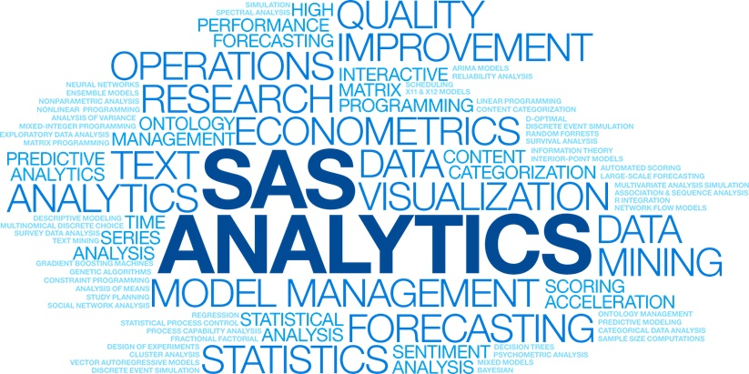

Slide 22
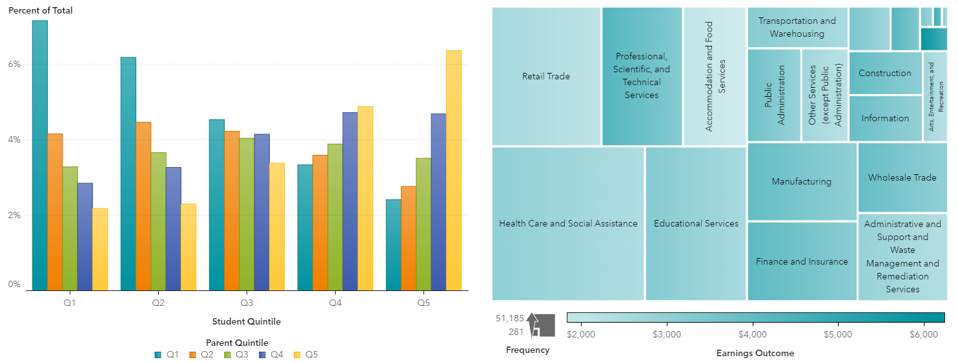

Slide 23
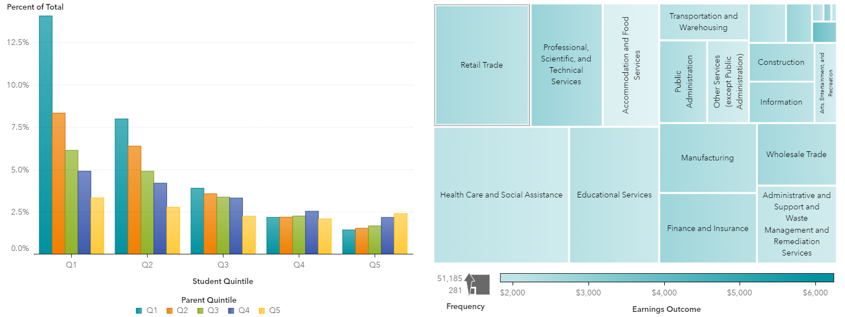

Slide 24
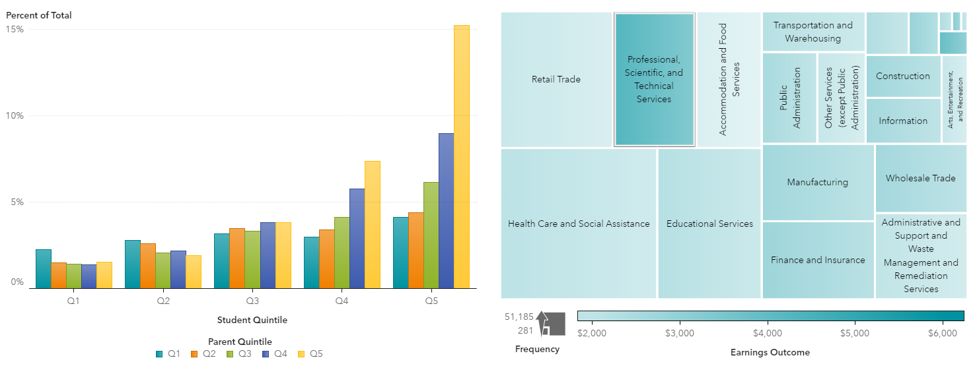

Slide 25
Presenters
Erin Mitchell
Data Scientist, IL Student Assistance Commission
Topic: data infrastructure, ISBE researcher portal
Ewa Gallagher
Workforce Outcomes Manager, IL Dept of Employment Security
Topic: HighSchool2Career student/parent tool
Patrick Payne
Director of Data Strategies and Analytics, IL State Board of Education
Topic: information pipeline to local school administrators

Slide 26
What is HighSchool2Career?
HighSchool2Career is a smartphone-enabled website for students and parents to make more informed decisions about their post high school career or education choices in Illinois.
For those who want to directly enter the labor force from high school, the tool provides career outcomes by industry
For those who want to pursue post-secondary education, the tool provides career outcomes by higher education institution and program of study
The tool connects high school data to higher education and employment allowing greater transparency in understanding workforce outcomes for IL High School graduates
Notes:
The tool connects higher education data to employment data and allows for greater transparency in understanding the workforce outcomes of graduates in Illinois.

Slide 27
What does the tool do?
Includes Illinois High School seniors 2007-2016 representing all public high schools
Focuses on 4 groups of students:
1) individuals that did not enroll in the post secondary education
2) individuals that enrolled in the post secondary education but did not complete
3) individuals that enrolled and completed degree in 2-year colleges
4) individuals that enrolled and completed degree in 4-year colleges
Has 30+ different metrics
Highlights real career pathways for graduates of Illinois high schools
Includes additional selection criteria:
Individualized Education Plan (IEP)
Career and Technical Advancement (CTE) Courses
Advanced Placement (AP) Courses
Foreign Language Courses
Low-Income or homelessness

Slide 28
Partnerships
Illinois State Board of Education (ISBE)
Illinois Department of Employment Security (IDES)
Illinois Student Assistance Commission (ISAC)
Illinois State University (ISU)
Notes:
The career outcomes measures were created by matching students’ data received from the Illinois Board of Higher Education (IBHE) and the Illinois Community College Board (ICCB) to wage records from IDES and augmented by additional characteristics harvested from White House Scorecard, College Navigator, and IPEDS Data Center.

Slide 29
Agreements, Governance, Disclosure Proofing
Agreements – MOU with ISBE, IDES, ISAC, ISU
Data governance – match of students’ data to employment and earnings is done at ISU and augmented by additional characteristics harvested from FASFA by ISAC, who designed the data environment and smart-phone enabled website
Disclosure proofing
data is de-identified
the disaggregation of outcomes down to the high school level
data is suppressed if there are less than 10 individual students behind the information
non-career outcome metrics are harvested from publicly-available sources

Slide 30
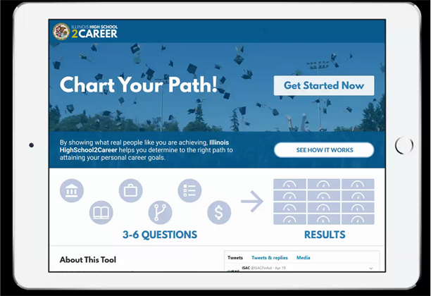
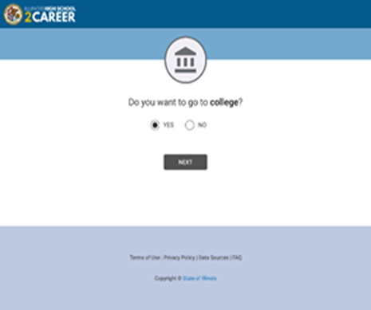
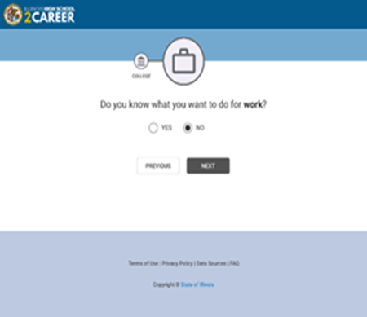
IL High School 2 Career Student / Parent Mobile App

Slide 31
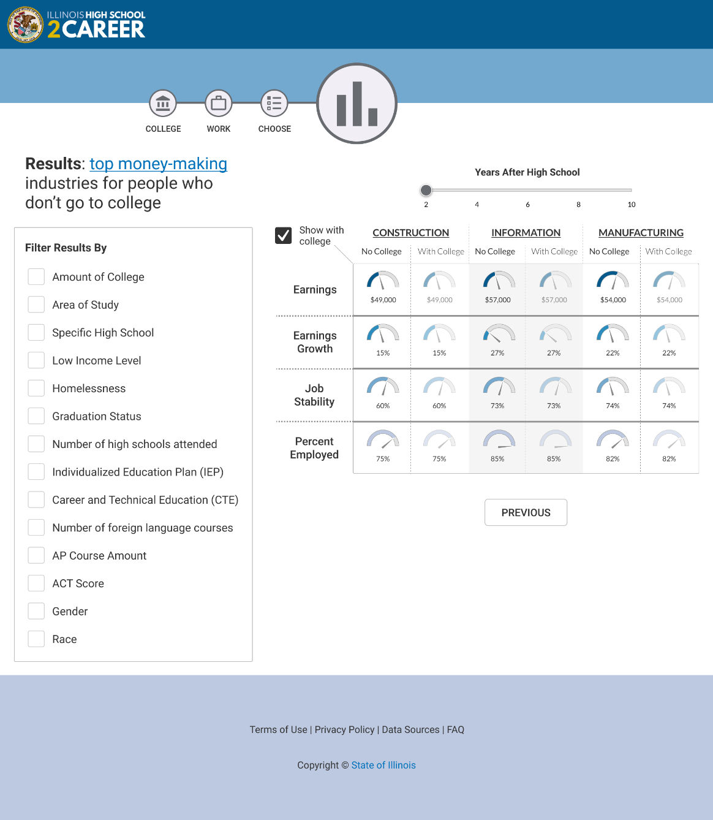
HS student decides not to go to college – top money –making industries

Slide 32
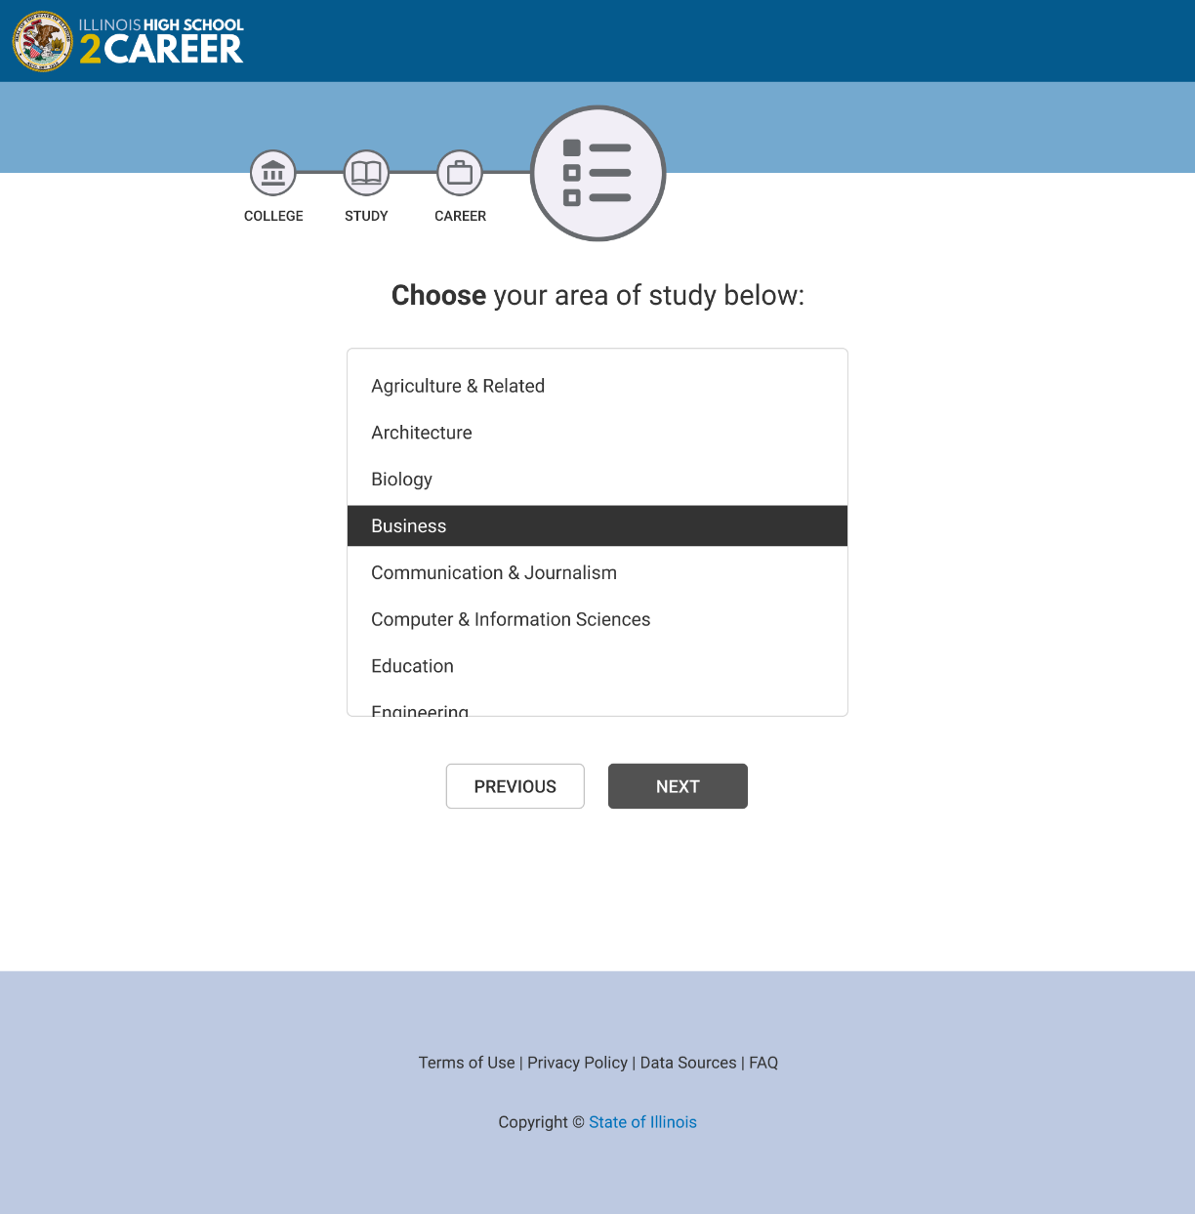
HS student wants to go to college - Business as area of study

Slide 33
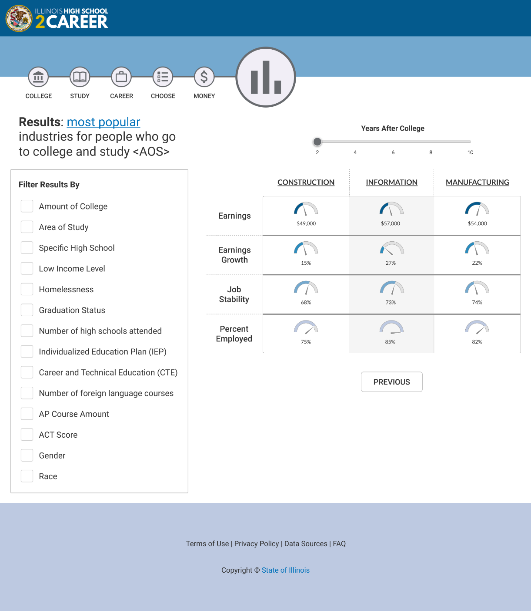
HS student wants to go to college - Business as area of study

Slide 34
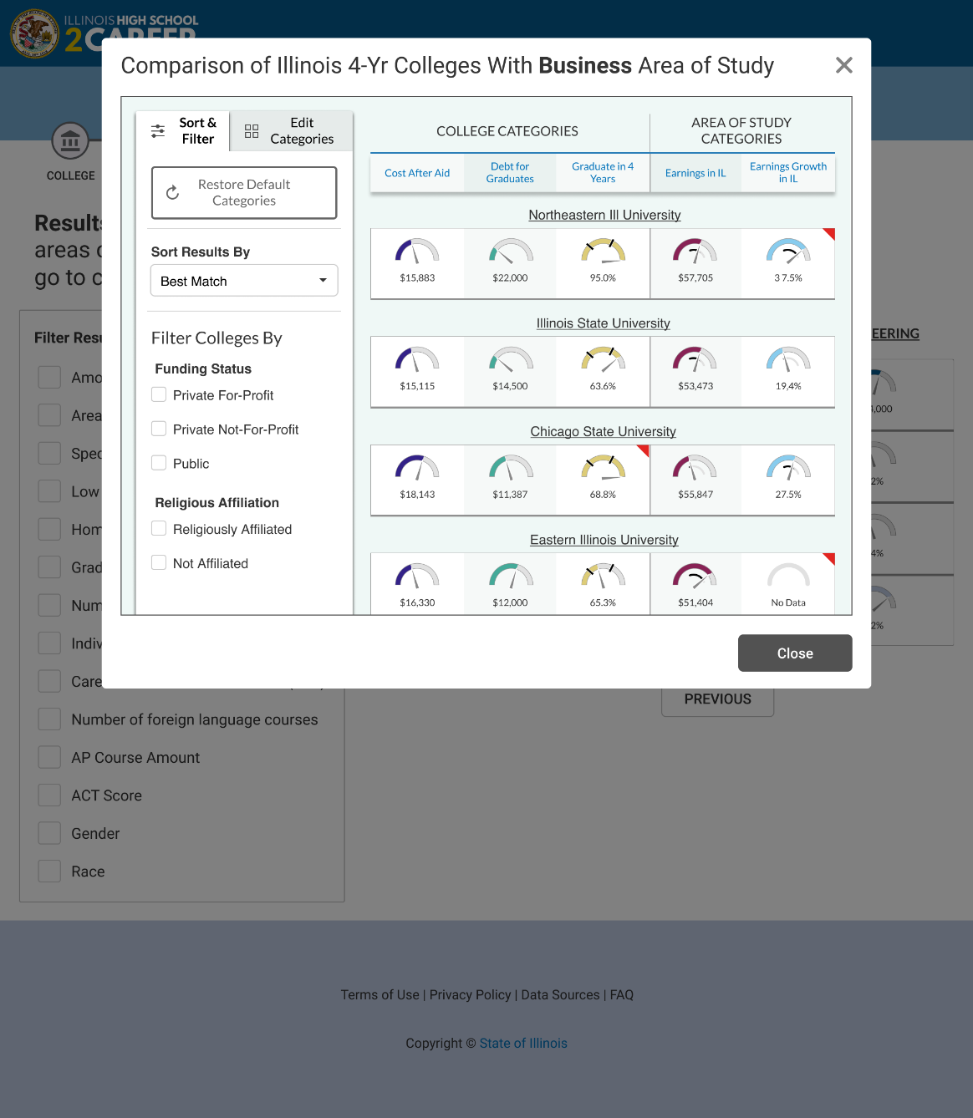
HS student wants to go to college - Business as area of study – linked to ILC2C

Slide 35
How we got here
ISAC tested HS2Career twice:
- Buffalo Grove High School on 4/3/2019
- Downers Grove High School on 4/30/2019
In addition, our designs and functionality took into account user testing we have done on a different website (ILC2C) on at least four different occasions
- West Leyden High School in Spring 2018
- Buffalo Grove High School on 11/8/2018 and on 4/2/2019
- Downers Grove High School on 4/30/2019
ILC2C also has a “Feedback” button that allows any user to provide feedback – these comments were taken into account by the project team and changes were discussed and implemented based on those comments
At each of these usability tests, ISAC met with between 10 and 20 students

Slide 36
How we got here (continued)
Students wanted to know: Why would they use it? What is this telling me?
Students mentioned wanting to be able to compare different careers
Students mentioned seeing the wages/earnings of different jobs was helpful
Students mentioned wanting to be able to compare different majors
Once students had a major in mind, they wanted to know what is a “good school for that major”
To determine a “good school” - Important characteristics included campus size and location and whether or not they “felt like it was a good school for them” which was often determined through campus visits
Different students had different situations: some knew what they wanted to study, some knew what they wanted to do for work, some knew they wanted to go to college but didn’t know what to study or what career they would have

Slide 37
Next steps
HighSchool2Career smartphone-enabled student/parent tool
Continue testing screen design and data flow
Include user feedback link
Test and finalize data linkages
Release to the public Fall 2019 (tentative)
Also visit www.ILCollege2Career.com for career outcomes of IL college graduates by higher education institution and program of study

Slide 38
Presenters
Erin Mitchell
Data Scientist, IL Student Assistance Commission
Topic: data infrastructure, ISBE researcher portal
Ewa Gallagher
Workforce Outcomes Manager, IL Dept of Employment Security
Topic: HighSchool2Career student/parent tool
Patrick Payne
Director of Data Strategies and Analytics, IL State Board of Education
Topic: information pipeline to local school administrators

Slide 39
About Ed360
Ed360 is a free, secure web application built to support student instruction using the ISBE data warehouse.​
Custom, in-house developed dashboard ​
Single sign on via G Suite for Education​ and Office 365
Whole Child • Whole School • Whole Community

Slide 40
About Ed360
Data includes
District and school level metrics
Class rosters, enrollment history, course history
Student and educator demographics
Educator retention and educator licensure information
PARCC/IAR, SAT, ISA, KIDS, ACCESS, DLM-AA​
Opt-in Services > Plickers, NWEA MAP and Ed Leaders Network​
Whole Child • Whole School • Whole Community

Slide 41
Important Facts
Requires District Administrator​ to opt in
Not a new data collection
Data is refreshed daily​
Role-based security following FERPA guidelines
Whole Child • Whole School • Whole Community

Slide 42
Ed360 vs Illinois Report Card
Instructional support
Operational
Secure district access
Detailed data
Inform communities
Accountability
Public access
Aggregate data
Whole Child • Whole School • Whole Community

Slide 43
District/School Admin Metrics
School Compare feature
State Assessment Performance charts
5 Essentials Survey Results
CTE Concentrators and Participants
Average Class Size
Student Mobility
Student Attendance
Whole Child • Whole School • Whole Community

Slide 44
Educator Metrics
District FTE by employment category
Educator Equity: Effective and Inexperienced Teachers
License and Endorsements, including expiration indicators
Percent of first year teachers by school
Average years of teaching experience by school
Post secondary degree(s)
Years of teaching experience
Professional development credits
Educator retention
Whole Child • Whole School • Whole Community

Slide 45
Student Metrics
Demographics (enrolled grade, gender, race/ethnicity, homeless, native language, EL, CTE participation, on track progress, passing Algebra I)
IEP (primary/secondary disability, related services, education environment, percent special education)
Attendance
Current year course list
Assessment history (state and local assessments, as applicable)
State: KIDS, PARCC/IAR {w/SGP}, ISA, SAT, ACCESS, DLM-AA​
Local: NWEA MAP
Local: Renaissance STAR ← under development
Enrollment history
Course history (subject, course, final letter grade, credit earned)
Remediation by subject area
Postsecondary enrollment
Whole Child • Whole School • Whole Community

Slide 46
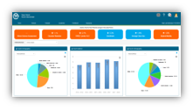
Obtaining Data for Ed360
District Data
Secure Metrics
State Support Systems
1
3
Employment Information System (EIS)
Educator Licensure Information System (ELIS)
Student Information System (SIS)
Entity Profile System (EPS)
Illinois Student Tracking and Reporting System (I-Star)
5Essentials Survey
Ed360
ISBE
Data Warehouse
Updated
nightly
2
Whole Child • Whole School • Whole Community

Slide 47
Ed360 Access
Access to Ed360 is based on employment data via Employment Information System (EIS).​
Positions |  | Ed360 Default Roles
District Superintendent | => | District Admin
Assistant Principal | => | School Admin
Special Education Teacher | => | Teacher
Parapro, Instructional Coach, Tech Specialist, Gen Admin/Sup, etc | => | General Access
Whole Child • Whole School • Whole Community

Slide 48
High School to Career Pipeline in Ed360
Initial Release for Ed360 | Second Phase Release | Potential Future Releases
Post Secondary Enrollment / Outcomes | School to School Comparison | Learning Pathway and Workforce Outcomes: Predictive Analytics
Industry Focus | District to District Comparison | Intergenerational Mobility
Geographic Migration | Geographic Comparison | Early High School Intervention
Workforce Outcomes |  | Middle School Intervention
 |  | Course Recommendations
 |  | Career Profile

Slide 49
Contact Ed360
Ed360 Outreach Team
ed360@isbe.net
Ed360 Login
ed360.isbe.net
Ed360 webpage
isbe.net/ed360
Whole Child • Whole School • Whole Community

