Slide 1
Cultivating Partnerships to Change lives: Creating Successful Academic Resource programs for diverse TRIO students
Mercedes Terrazas
Student Support Services Specialist
Project Achieve / TRIO Student Support Services
Joliet Junior College
Miguel Millett
Director
TRIO Educational Talent Search
Kennedy King College

Slide 2
Introduction
Ice Breaker: T- shirt Activity
Let's reflect:
Take this time to reflect on your motivations, passions, skills, and desires
Why did you get into this work in the first place?

Slide 3
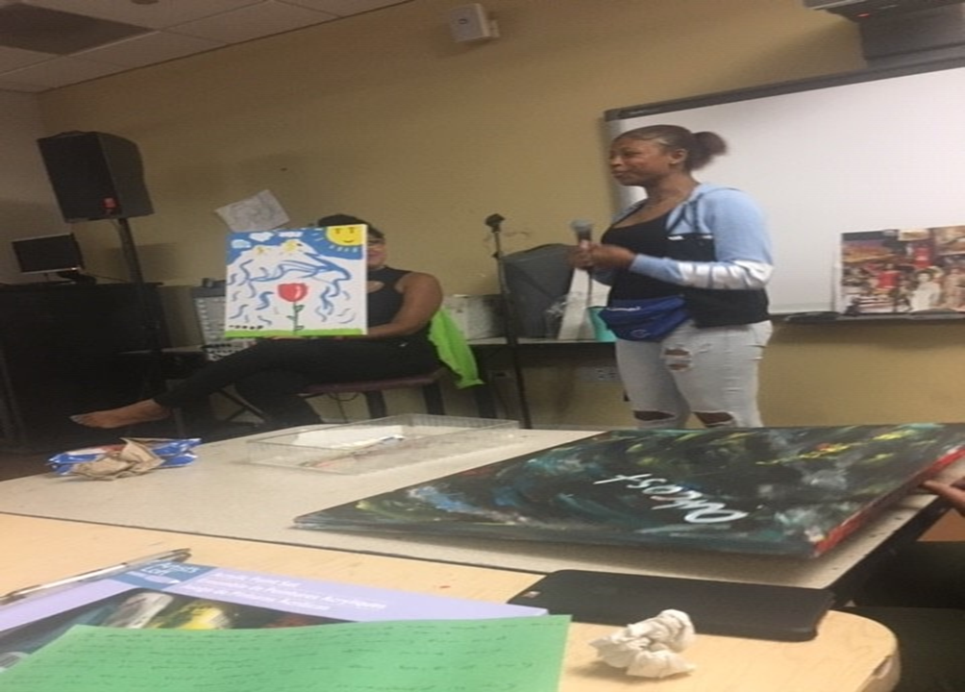

Slide 4
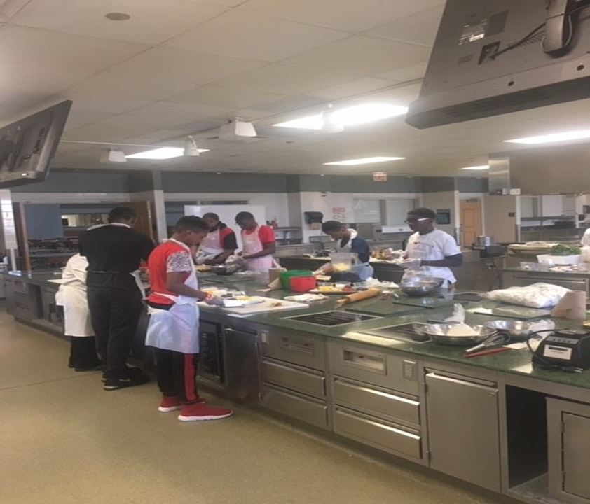

Slide 5
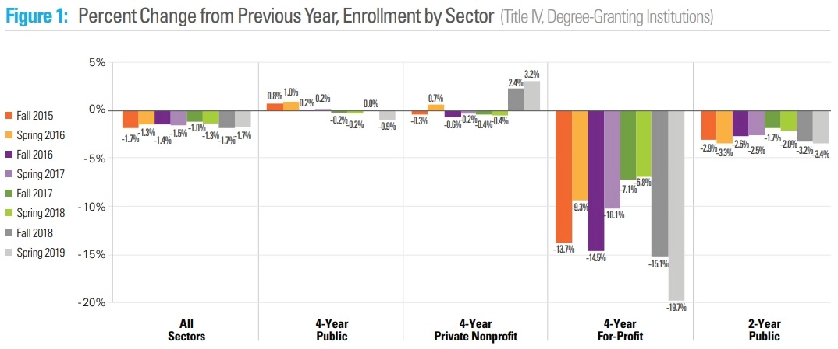

Slide 6
An Investment with Benefits Dual credit vs. AP
Dual Credit
Guaranteed college credit upon successful completion of course
AP Classes
No guarantee upon completion of course; must pass state exam score with a 3 or above
Examples:
Baylor - 4 Economics, 3 Government, 5 Psychology
OU - 3 English, 5 Economics, 3 Government
TCU - 3 English, 4 Economics, 3 Government
UT - 4 History, 4 Economics, 4 Psychology

Slide 7
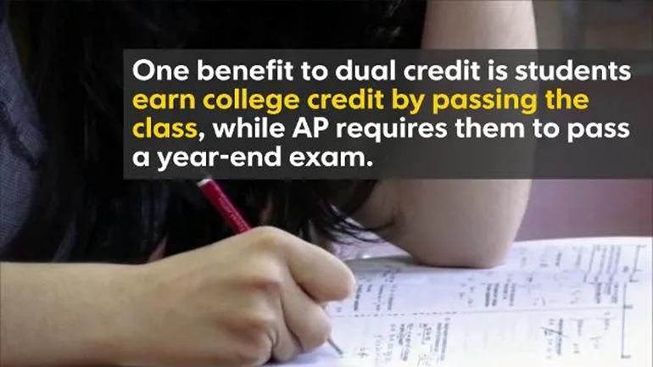

Slide 9
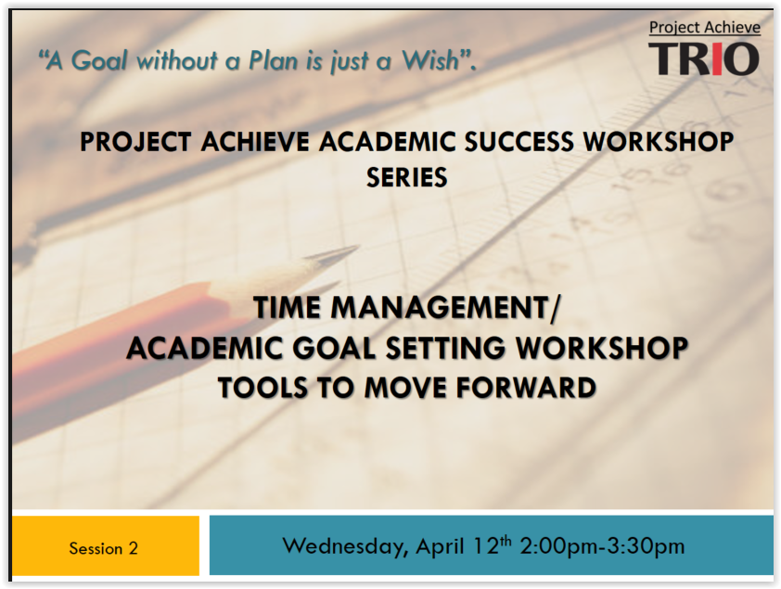
Project Achieve/ TRIO Student Support Services
The SSS team offers a myriad of services, resources, and opportunities for our diverse students.
Academic Advising
Academic and Character Building Workshops
Educational planning
Financial Literacy

Slide 10
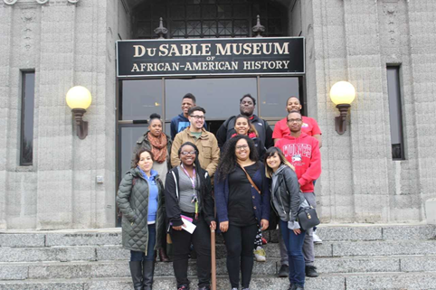
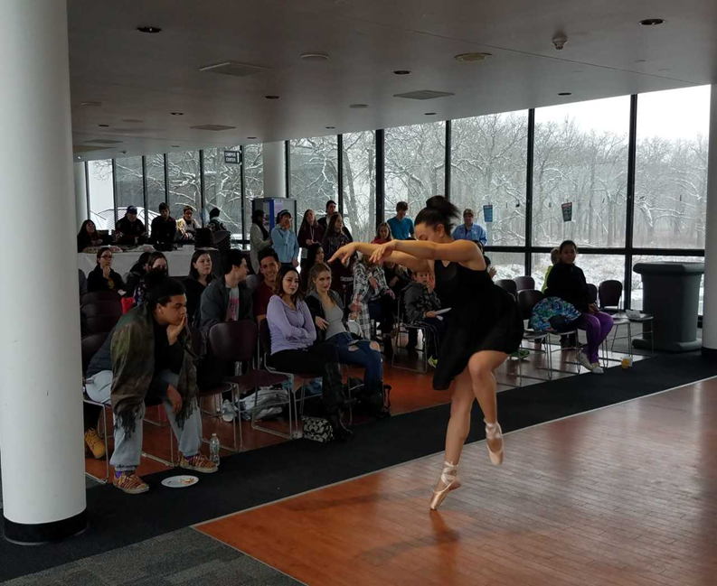
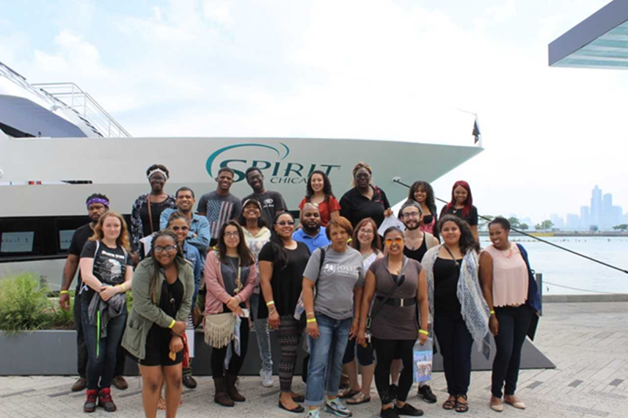
Project Achieve/ TRIO Student Support Services
The SSS team plans programming which ranges from workshops, presentations, cultural events/outings, and campus visits.
Cultural Outings
Transfer Support
Multicultural events / programming
Four year college/university Campus visits

Slide 11
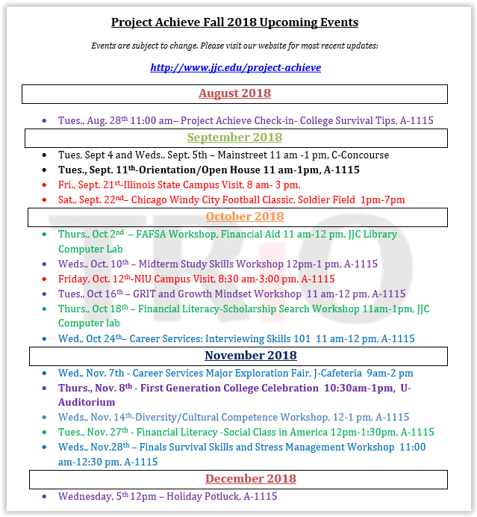
Project Achieve / TRIO Student Support Services
Project Achieve partners with programs/ departments/ organizations to offer academic resources, student support services, and a myriad of opportunities that assist our diverse students in achieving success.
Building Intentional Partnerships with campus departments to better serve the diverse college students
First Year Experience team
Financial Aid Office
Tutoring and Learning Center
Disability Services
Testing Services
Academic Intervention / Monitoring
Workforce Development

Slide 12
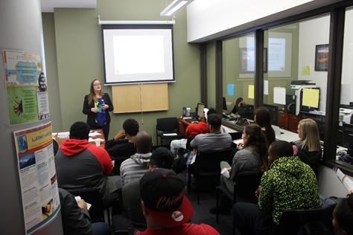
Project Achieve / TRIO Student Support Services
Developing strategic collaborations with student development and student support services in the college campus
Admissions Office
Student Advising Center
Office of Multicultural Student Affairs
Office of Student Activities

Slide 13
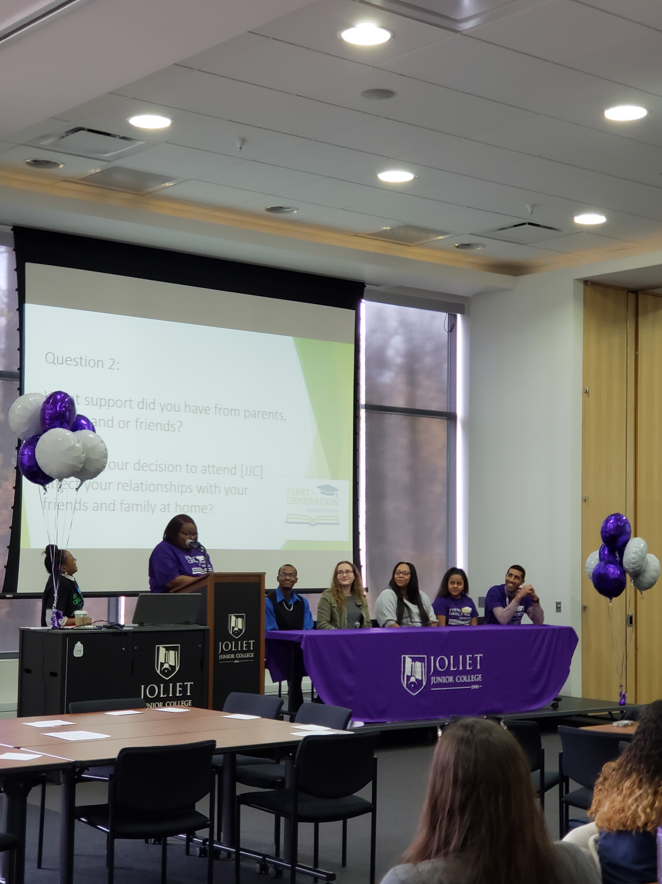
Project Achieve / TRIO Student Support Services
TRIO SSS creates working partnerships with faculty and administrators to better support the needs of the diverse students we serve
Student Success
Student Centered
Holistic approach
Outreach / Recruitment efforts
Retention, Persistence, & Completion efforts
Classroom visits/ presentations

Slide 14
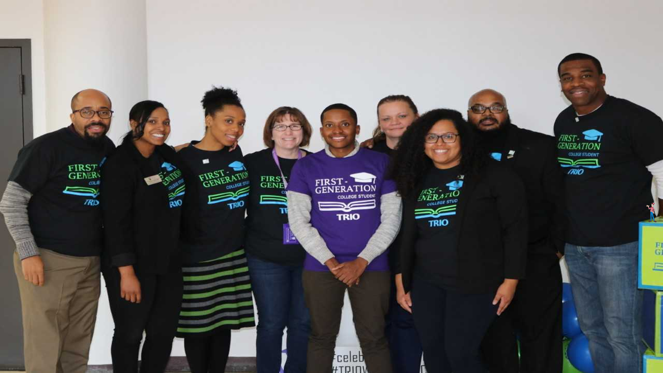
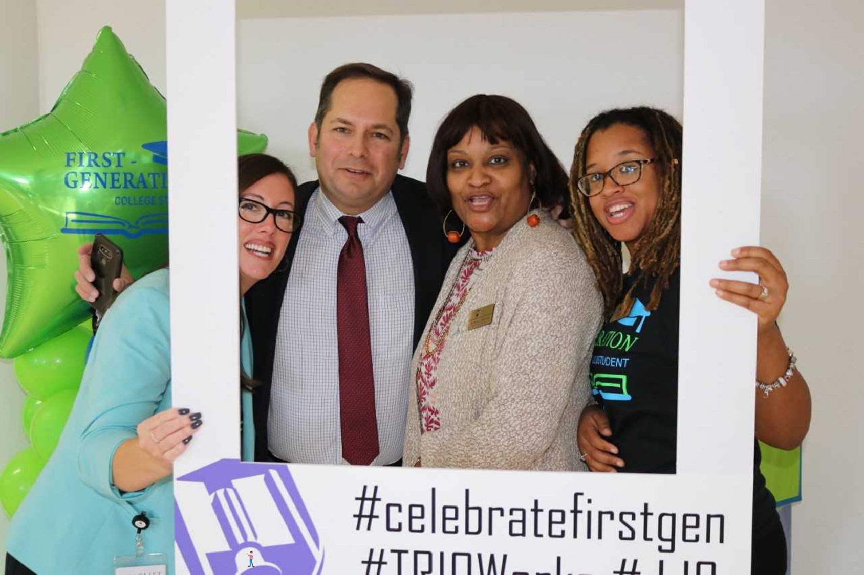
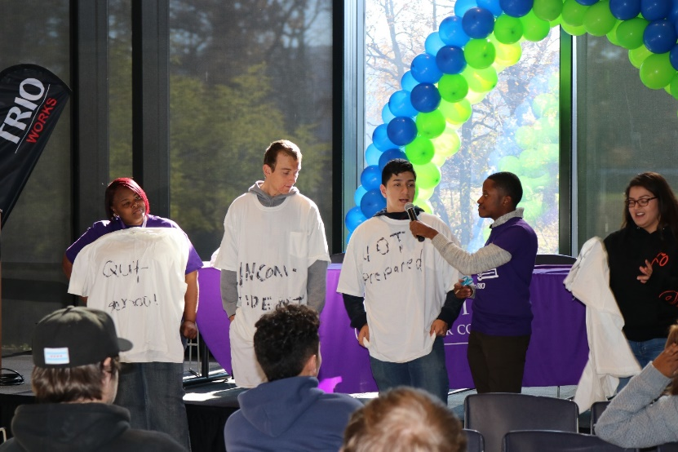
1st Annual
First - Generation College Student
Celebration
Awarded the Awards for Excellence Grant for $3,500 from the Joliet Junior College Foundation
Invited all SSS students, First Gen-college JJC students, faculty, and staff
Approximately 150 First Gen students, college administrators/staff attended

Slide 15
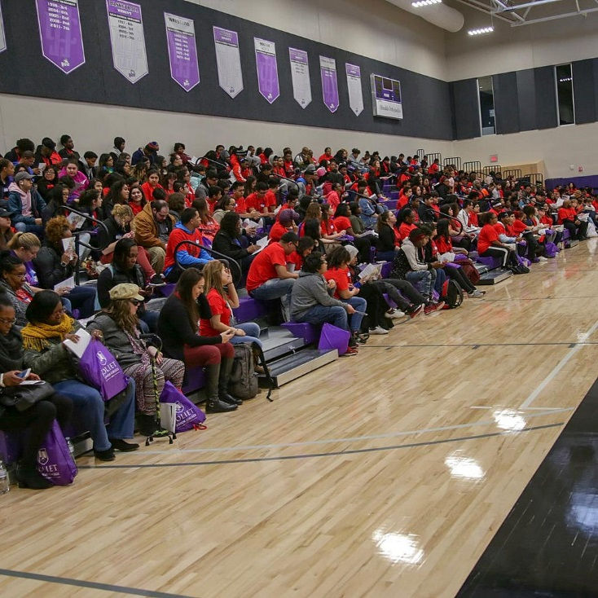
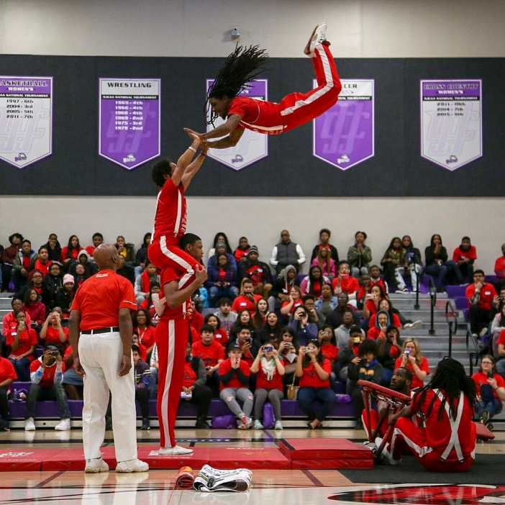
TRIO Day North
Project Achieve/ TRIO SSS hosted TRIO Day North on our Joliet Junior College campus
We had over 500 high school and college students attended
Academic and cultural presentations

Slide 16
Group Activity: Asset Mapping
Identify:
1. Resources, services, skills, & talents of your program/ school/ organization
(what assets are in your program/ school/ organization?)
2. Capabilities available (or possible) through local organizations & institutions
(what resources are in your community?)
3. Needs (what assets do you need?)

Slide 17
Recommendations: Successful Strategies
Ensure that you stop working in silos, and be deliberate in understanding the resources and opportunities that are on the college campus for diverse students
Determine what resources your school/administrators/ community partners need and how you can provide them
Figure out what resources your students need that they cannot get anywhere else and how your program can provide them
Know your regulations! Ask questions and strategize to figure out creative solutions.
Ensure that you write the discussed partnerships in your institutional grant and that they are supported by the administrators in your institution/ organization
Cultivate ongoing successful partnerships with programs, departments, and organizations that are mutually beneficial

Slide 18
Thank you for your time!
Contact information:
Mercedes Terrazas Miguel Millett
Student Support Services Specialist Director
Project Achieve / TRIO Student Support Services TRIO Educational Talent Search
Joliet Junior College Kennedy King College
mterraza@jjc.edu mmillett1@ccc.edu

