Slide 1




Developing a
Mentoring Program 101: from recruitment, training, and engaging your volunteers

Slide 2
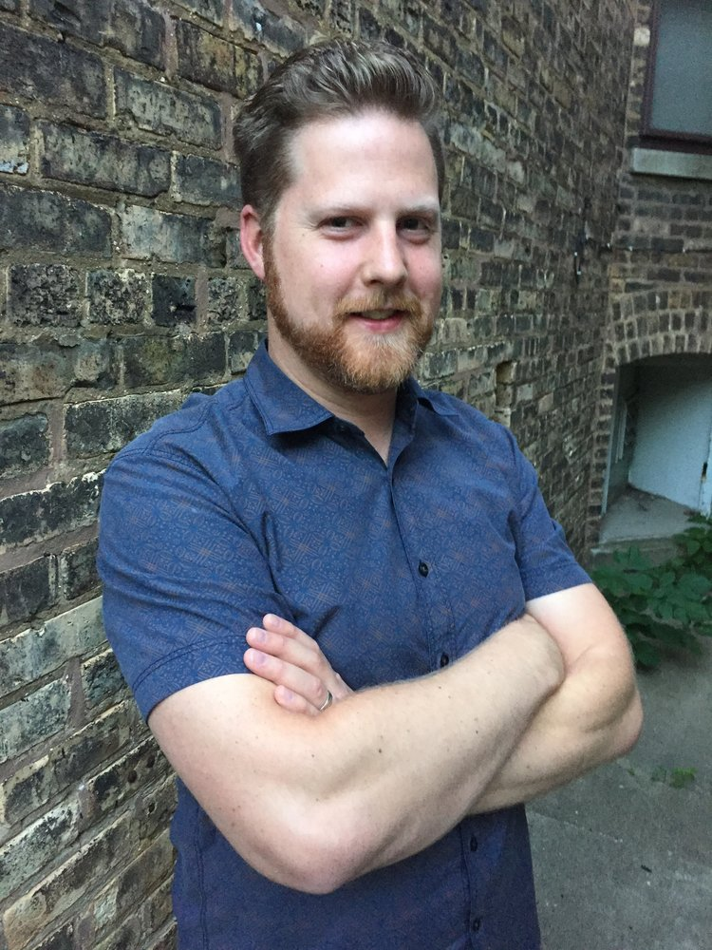
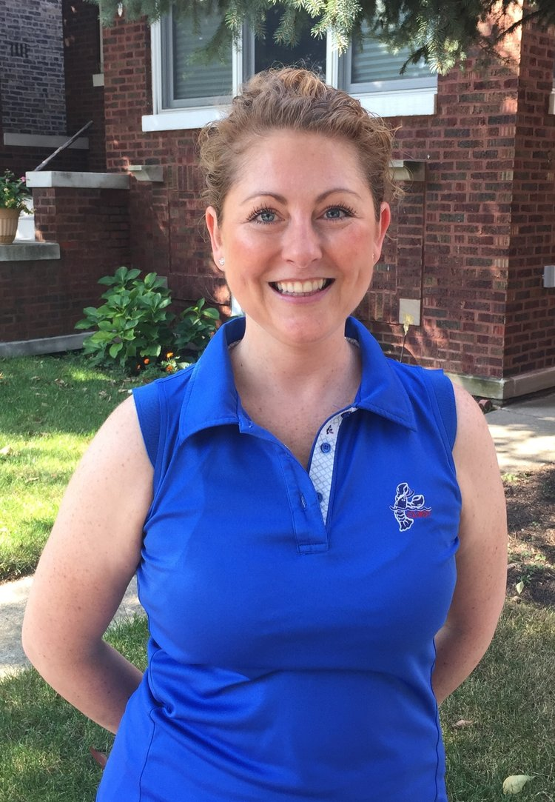
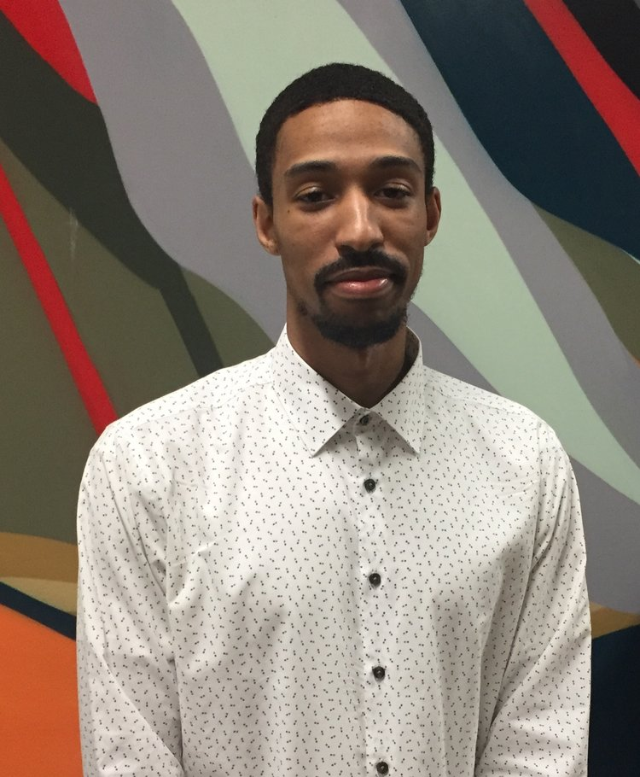
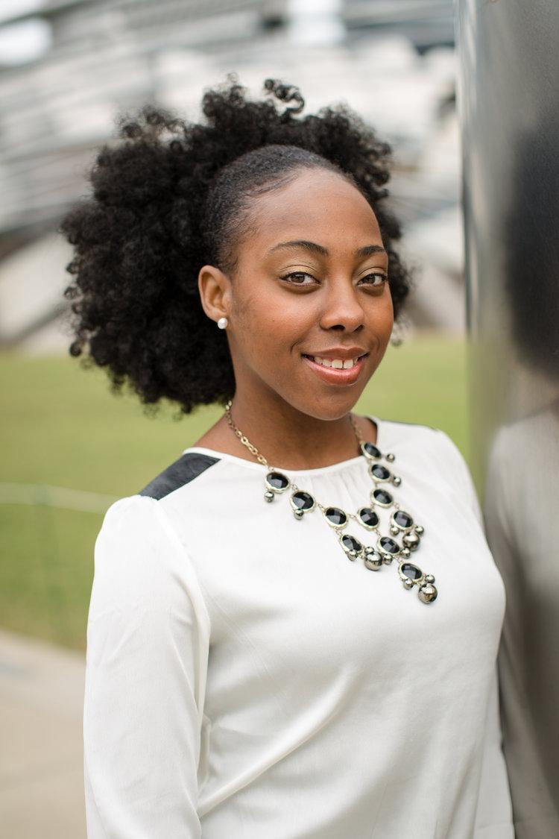
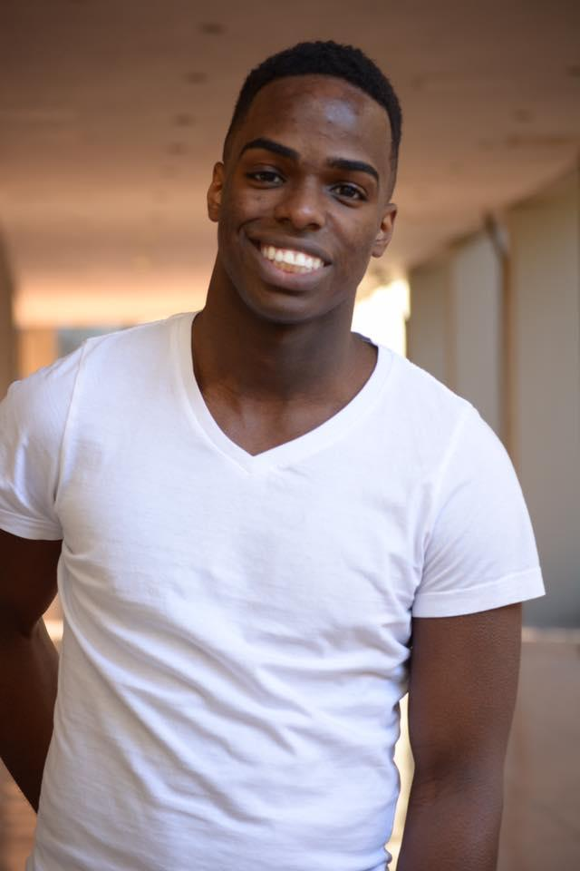
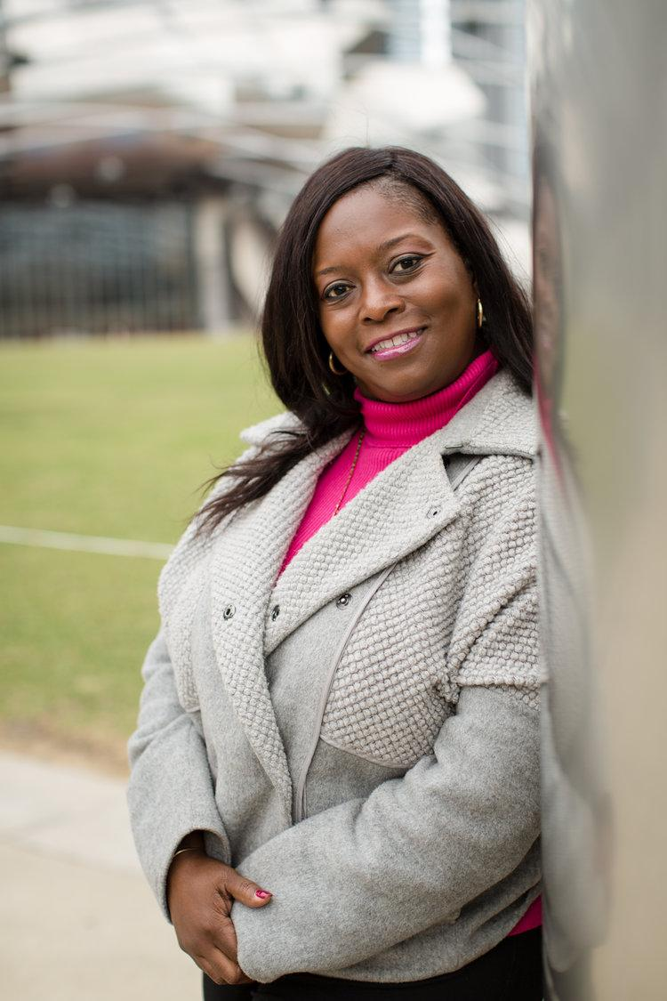
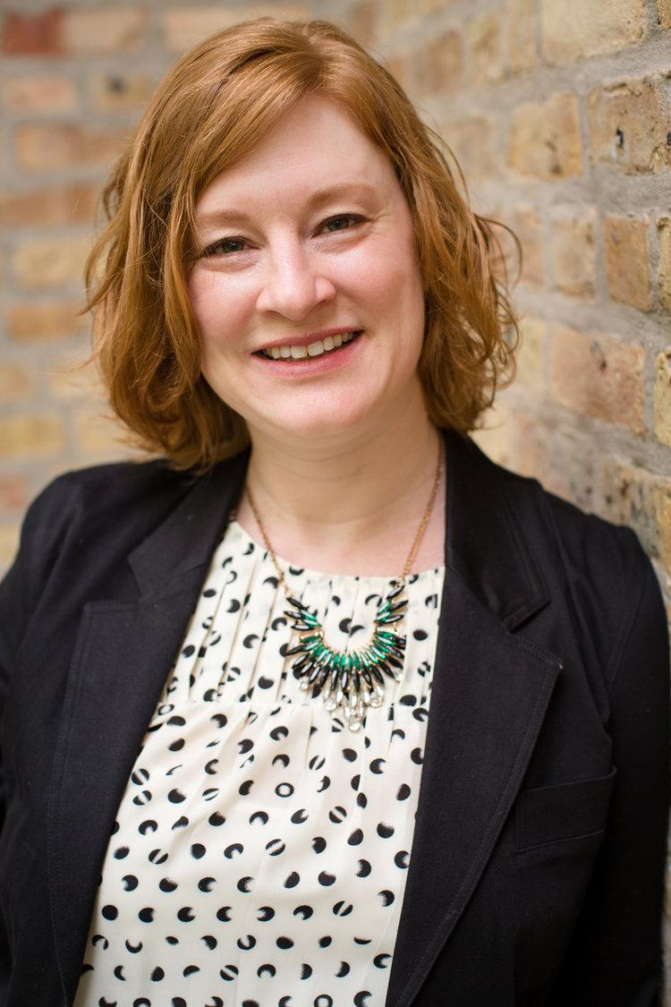

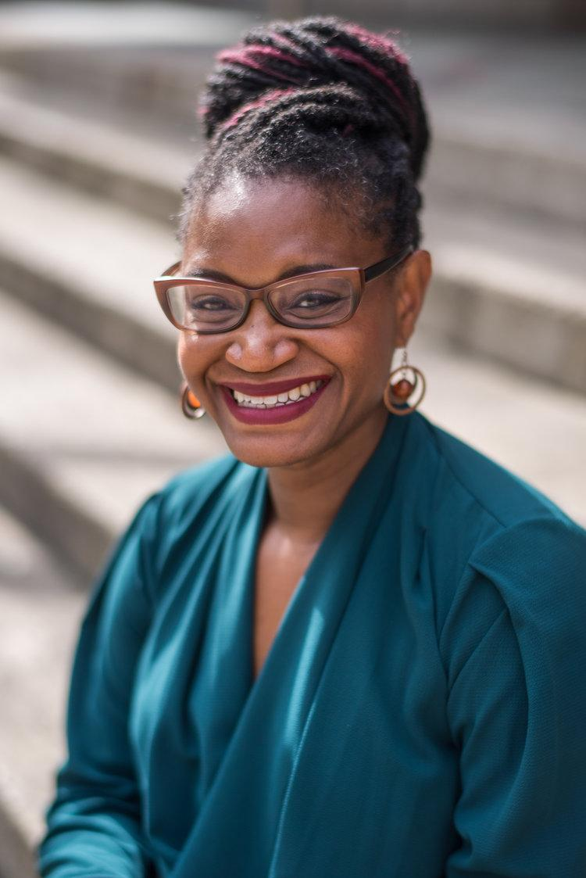
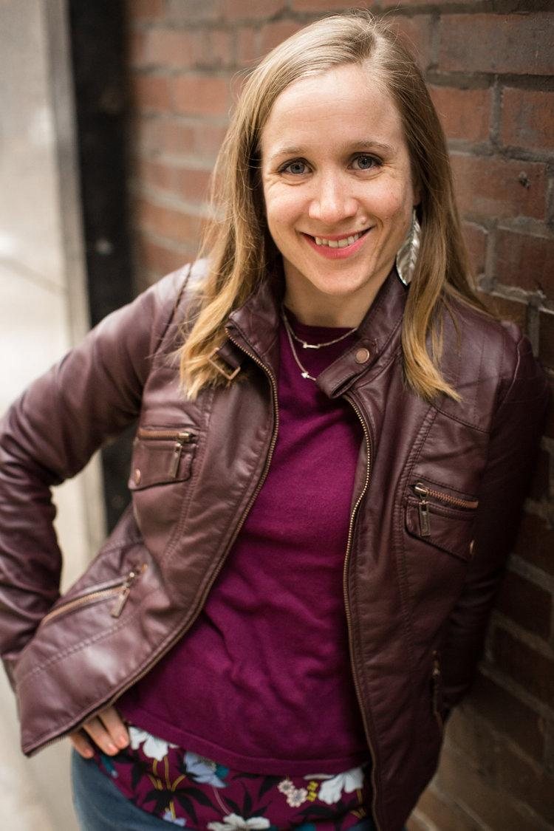
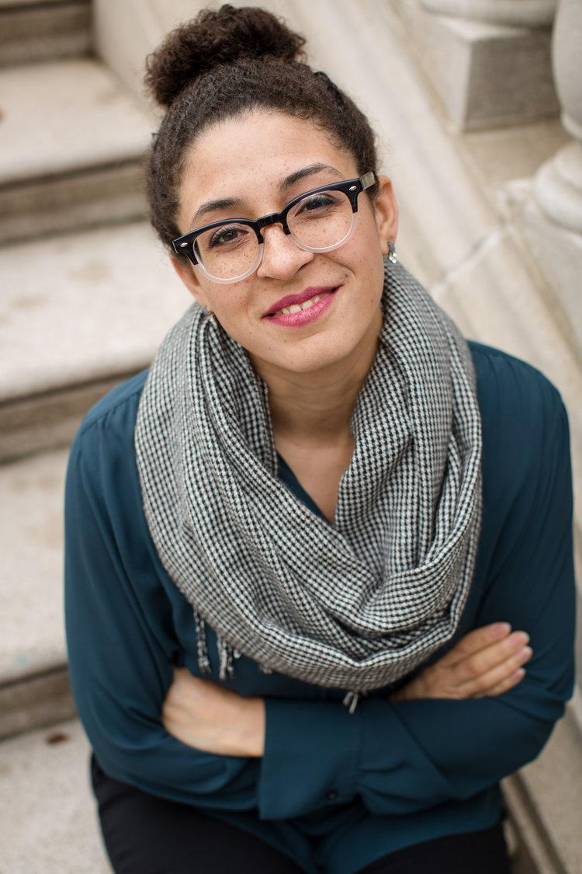

Slide 3

Our mission
Empowering youth from foster care to attain a college degree and transition into adulthood successfully by providing mentorship, advocacy, and educational opportunity.

Slide 4
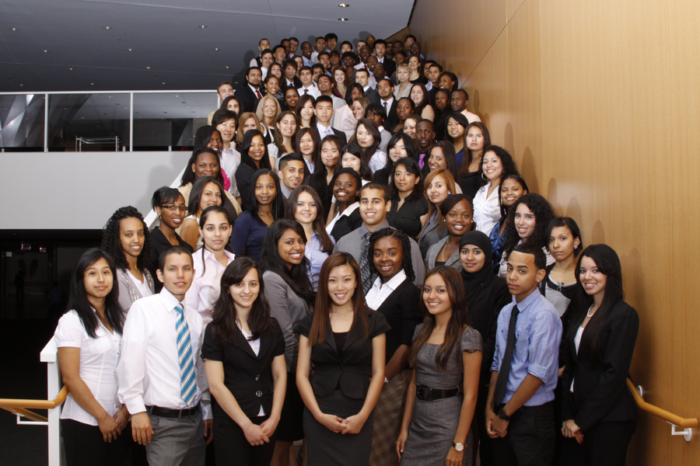

America Needs You

Slide 5
MISSION
To fight for economic mobility for ambitious, first-generation college students.
We do this by providing transformative mentorship and intensive career development.
Notes:
*
As you heard from Elijah, Janice and Marcus, ANY works to ensure that our students, who are ambitious, talented and extremely hard-working, have access to the same opportunities and resources as their non-first generation peers so that they not only persist in and graduate from college, but that they are ready when they graduate to pursue a career of their choice.
Easier said than done. As XX mentioned, of the +4.5 million first-generation college students enrolled, only 11% are graduating nationally. In Illinois, 37% of low-income students graduated compared to 75% of their higher income peers. A college degree is increasingly essential – “by 2020, at least 65% of jobs will require post-secondary education.” For most college students, there are a ton of questions to navigate – What do you want your major to be? What career paths do you want to pursue? How do I afford college? How do I build my professional network? How do I go about getting an internship? – that are not being directly addressed in college. For first-generation college students, there are often barriers – systemic, socioeconomic for example, that prevent access to the people, resources or opportunities that anybody needs to navigate these questions. And yet it’s imperative that they’re able to – “by 2020, at least 65% of jobs will require post-secondary education.”

Slide 6
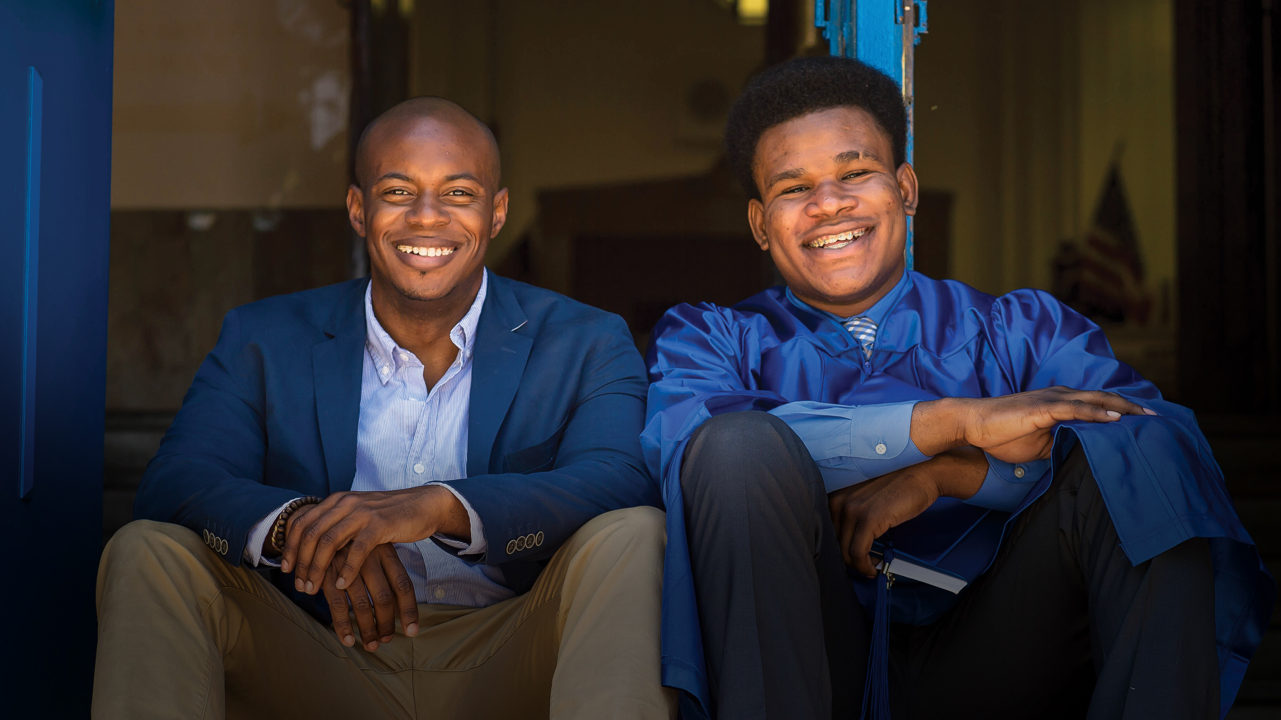

Engaging Mentors in the Post-Secondary Years

Slide 7
Our Mission
iMentor builds mentoring relationships that empower students from low-income communities to graduate high school, succeed in college or another post-secondary pathway and achieve their ambitions.
iMentor partners with high schools so that every student in a class or cohort receives individualized support in the college application process.

Slide 8
Introductions & Program Models
Recruiting great volunteers
Why mentoring? Pros and Cons
Training new mentors
Keeping mentors engaged
Q & A

Slide 9
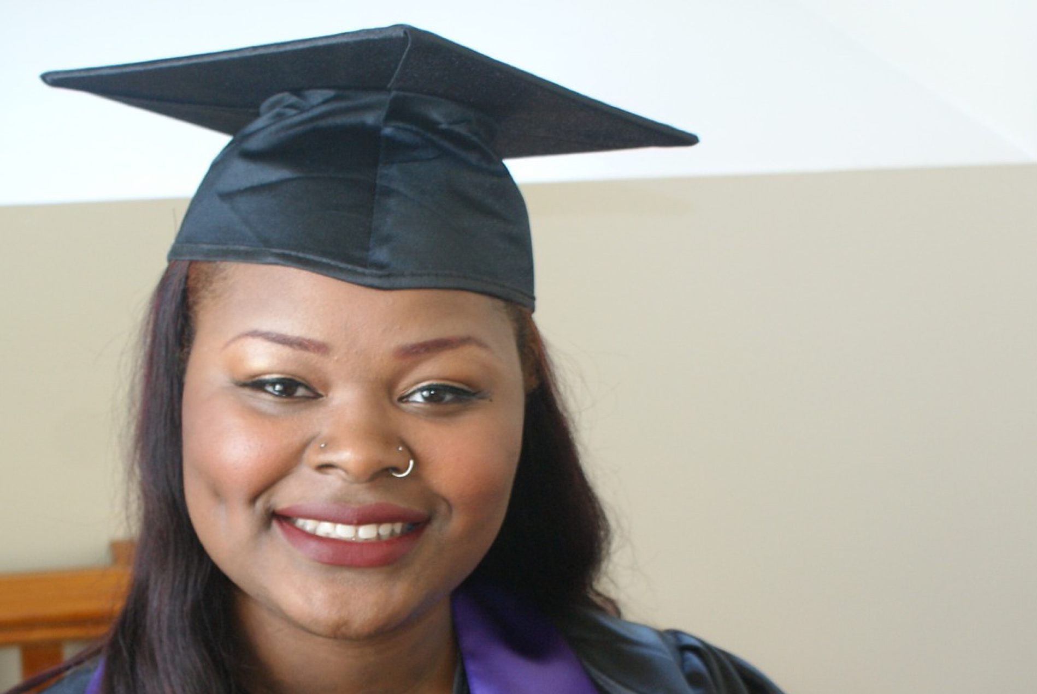
College Mentoring
& Scholarships

Slide 10
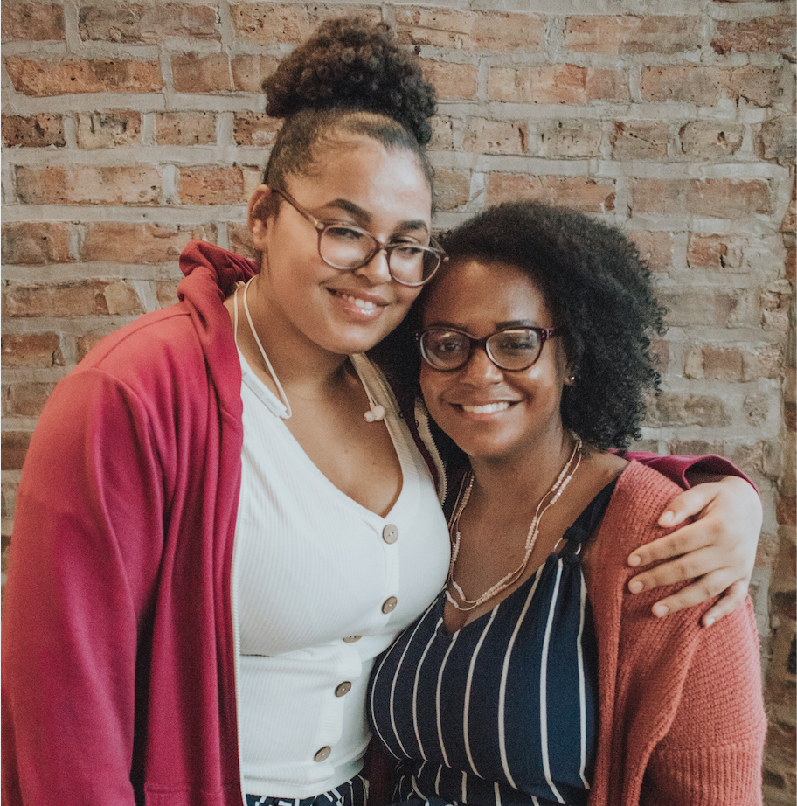
Why use the one-on-one mentoring model for college access programming?

Slide 11
PROS CONS
Individualized support
Strong communication with student
Transportation
Meet students where they are
(literally and metaphorically)
Relationship and support can extend beyond formal program
Extends student’s network
Time consuming to recruit, vet, and train mentors
Matches sometimes fail
Less control over the content students receive
Misguided advice from mentor

Slide 12
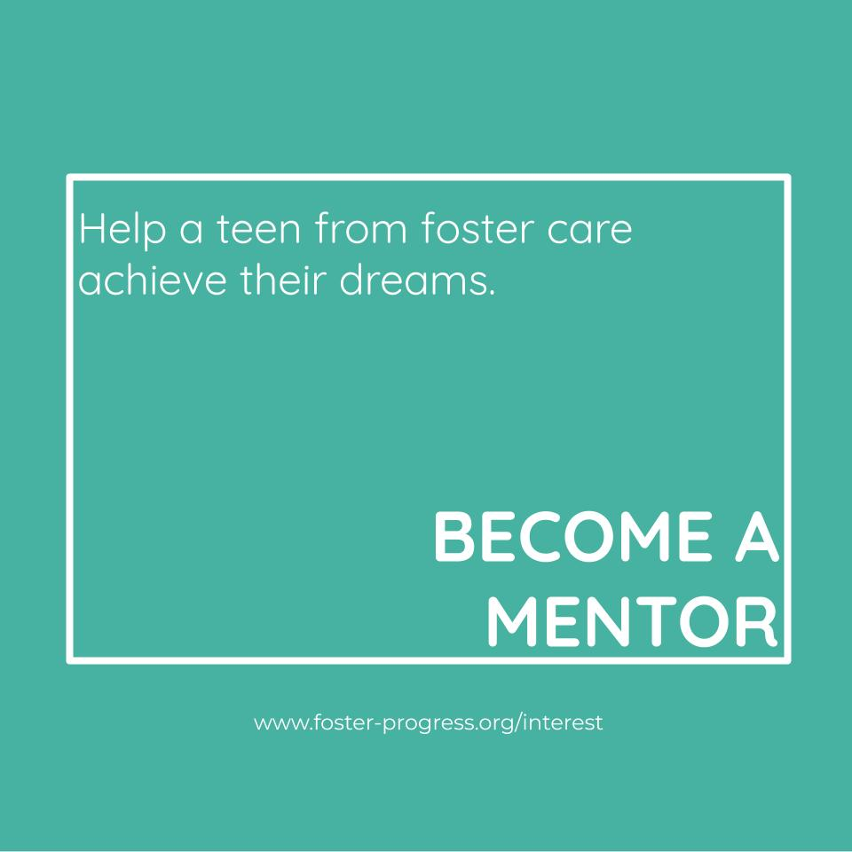
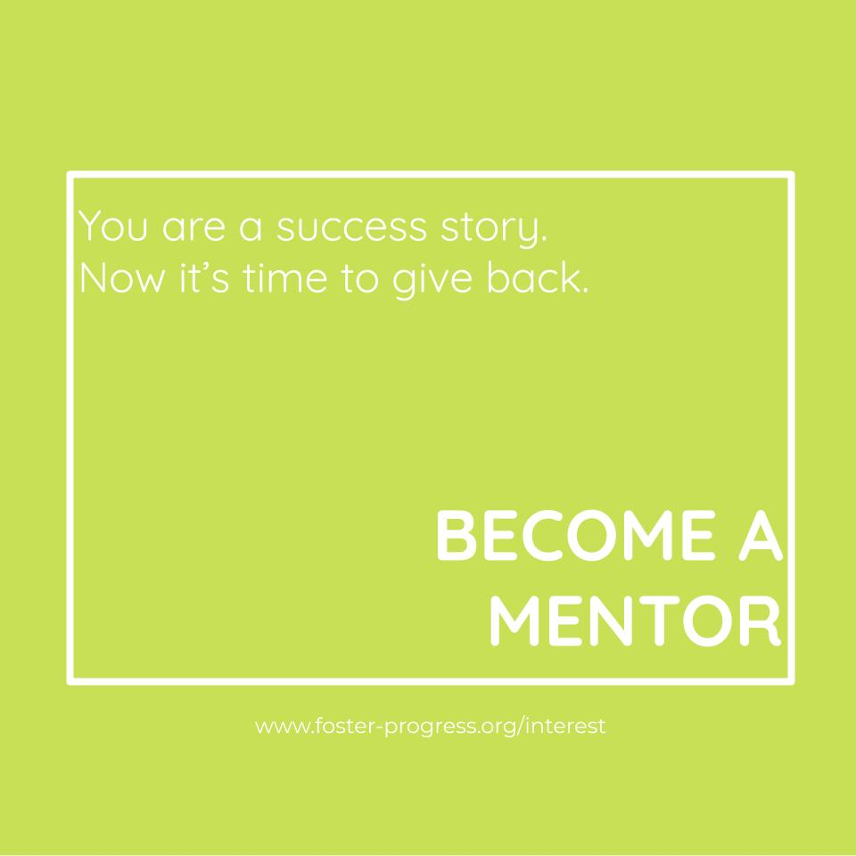
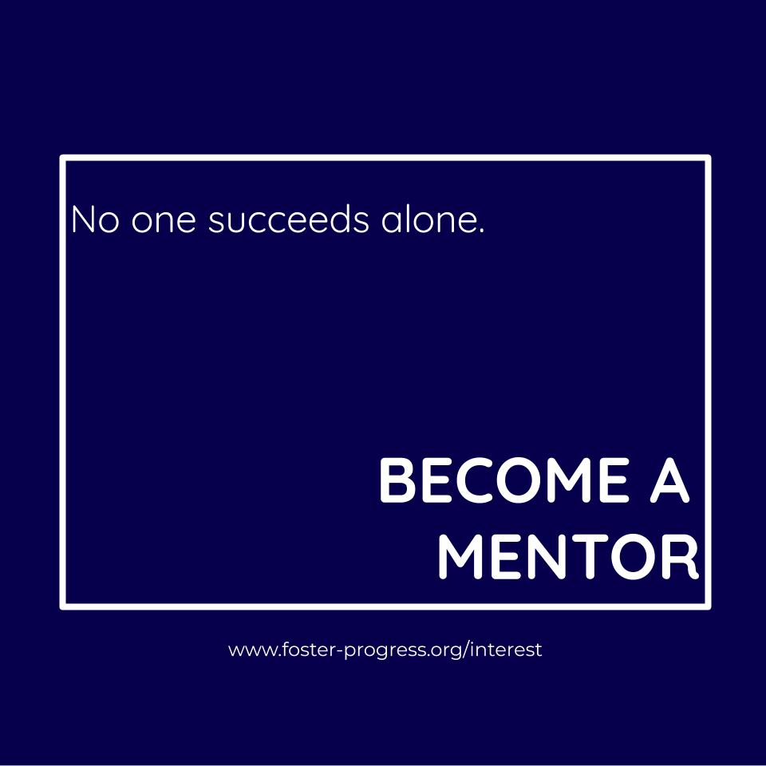
Recruiting
Social Media posts
E-newsletter
Word of mouth
Tabling at events, or doing presentations
Interest Sessions
Mentoring.org

Slide 13
Vetting Process
Expectations
Intro video
Application
Interview
Background check
References
Training
1
2
3
4
5
6
7
Notes:
Don’t make the job sound easier than it is. Better to set expectations high for the amount of work and commitment.
Protecting youth from predators as well as well-intentioned “saviors”

Slide 14
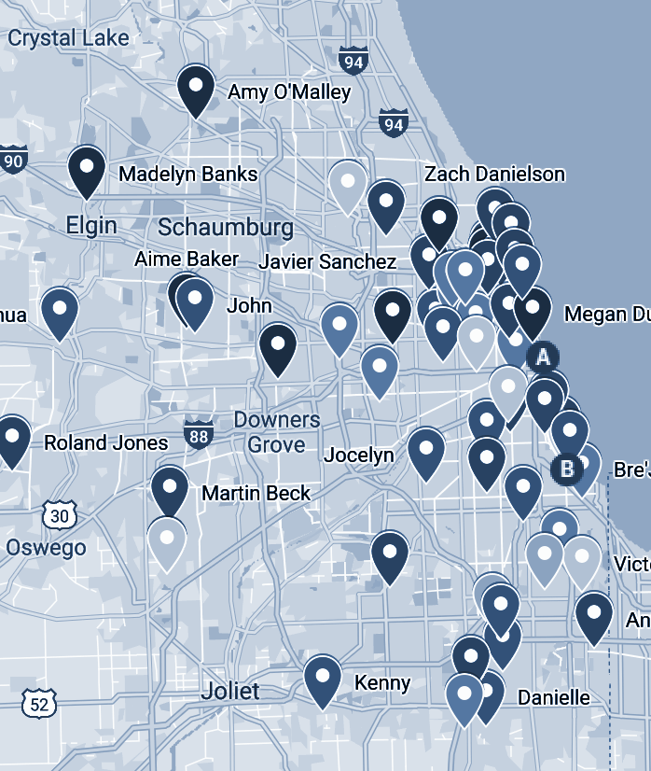
Special Considerations
Geography
Vulnerable population
Race & Ethnicity
Gender & Sexuality
Interests, Career, Major, Personality
Notes:
Must ask questions in such a way that the mentor and youth won’t feel judged for their interests.

Slide 15
America Needs You

Slide 16


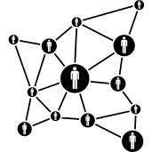

OUR PROGRAM
The ANY Program has FOUR components including:
Intensive Career Development
One-on-One Mentorship
Robust Networks
Holistic Support
Notes:
*

Slide 17
July
August
September
October
November
December
January
February
March
April
May
Orientation: Defining the role and the coaching model
Building Trust and Rapport
Goal setting and communication
Academic success
Strength of Relationship (SOR)
Career development
Internship support
Summer engagement / Closure

Slide 18

The term Mentor Coach captures
ANY's vision for mentoring first-generation college students.
Sometimes you are a coach, focused on skill development, professional exposure, strategizing, and feedback.
Sometimes you are a mentor, offering support, guidance, and a listening ear.
Students may encounter obstacles and disappointment as well as moments to celebrate.

Slide 19
Coaching Framework
Clarify the Topic
Identify Goal
Develop Solutions
Create Accountability
Wilson, J., & Gislason, M. (2009). Coaching skills for nonprofit managers and leaders: developing people to achieve your mission. John Wiley & Sons.
Notes:
Clarify Focus: get to the point of the coaching conversation. What do you and the Scholar really need to talk about? What do they really want? It’s not always obvious. You may need to take time listening to understand a person’s current reality help the Scholar thing about what he/she is trying to achieve.
ID Goal: know where the conversation is headed. Help the Scholar name the end goal. What does success look like? Identify this first before going to solutions.
Develop solutions: Identify what is needed to move from point A to point B. Help identify options for getting to the end goal. This isn’t the time to give advice –hold off until it is asked for. One you both understand the gap between A and B, you can think together about the desired outcome and create a path for getting there.
Create accountability: Call forth commitment and ownership. Review actual steps the person can and will take to progress. This way the Scholar develops accountability, self-responsibility, and ownership. The goal is to gain agreement about what will happen next and who will do what and by when.

Slide 20
Being the Coach
“Coaching is unlocking a person’s potential to maximize their own performance. It is helping them to learn rather than teaching them.”
– John Whitmore, 2002
“A primary assumption of coaching should be that the person being coached is naturally creative and resourceful. In other words, people are not ‘broken’ and in need of fixing”
– Wilson and Gleason, 2017

Slide 21
We care about the whole person…
America Needs You Fellow
Physical Well-being
Psychological Well-being
Financial Well-being
Social Well-being
Academic Success
Professional Development
Mentor Coaches engage in holistic mentoring
Notes:
We’ll talk more about holistic mentoring next workshop

Slide 22
Engaging Mentors in the Post-Secondary Years

Slide 23
iMentor Model
Our model harnesses the power of long-term, personal relationships to help students succeed.
How it works
We match
every student
in a school.
We provide
best-in-class
college curriculum
and staff support.
We harness the power of personal relationships.
Notes:
We match every student in a school.
iMentor partners with schools in low-income communities, where a majority of students will be first-generation college students. We match every student in our partner schools with a college-educated mentor, who commits a minimum of three years to a single student. Mentoring pairs have the option to continue their relationship through college completion.
We provide best-in-class college curriculum and staff support.
Our research-based college success curriculum structures each week of the mentoring relationship, providing a baseline of conversations and experiences for all mentoring pairs. iMentor assigns program staff, trained as college counselors, to ensure the success of each relationship by providing case management support to mentoring pairs. With our curriculum and staff to guide them, mentors and students build their relationship through weekly online communication and monthly in-person meetings.
We harness the power of personal relationships.
Our model provides the structure and support that every mentor and student needs to develop a close personal relationship. Because our mentors gain a holistic understanding of their mentee’s individual talents, aspirations, and challenges, they are able to provide a level of support that could not be achieved through traditional school counseling alone.

Slide 24
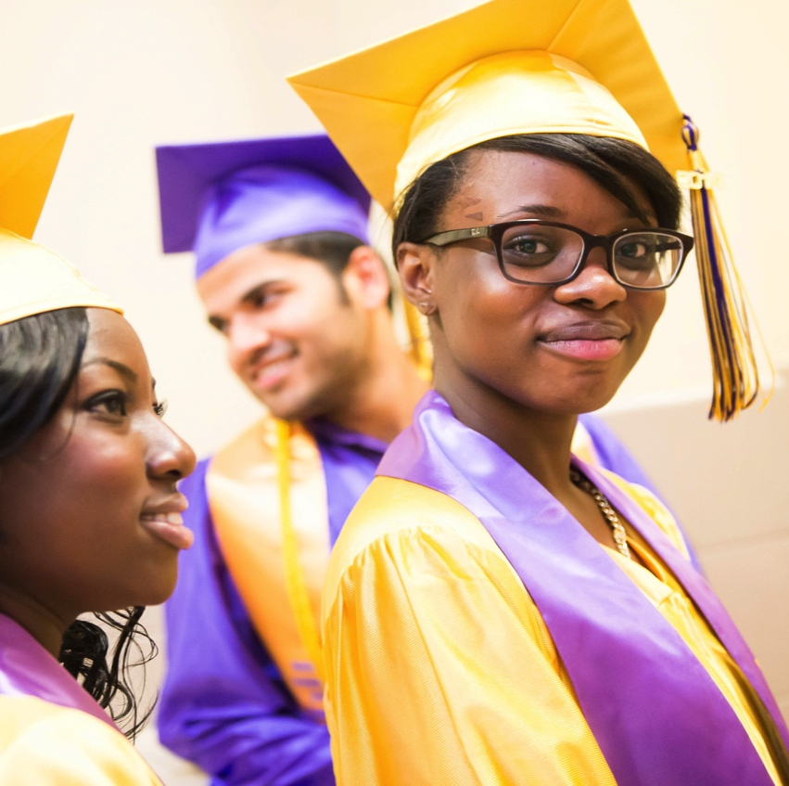
Post-Secondary Program Launch and Engagement Challenges
HISTORICAL CONTEXT
ENGAGEMENT CHALLENGES
Formal Program Launch in 2017
Summer Melt Text Campaign
Mentoring Discussion Guides
Monthly Surveys
Less Structure
Lack of Clarity: Mentor Role and Expectations
Pairs Not in Touch (with each other and with us)
Limited Opportunities to Intervene
Reactive Support

Slide 25
Post-Secondary Program Model Components
Targeted Pair Support from Program
Managers
Mentoring Curriculum
Text Messages
Monthly Newsletters
Summer Programming & Pair Events
Individual Advising Sessions
Financial Support via Student Incentives and Emergency Fund
Notes:
iMentor’s Post-Secondary Program (PSP) supports pairs to ensure that:
the mentor/mentee relationship continues even through the transition out of high school
students complete college or another post-secondary pathway on the road to personal and professional success

Slide 26
MENTOR EXPECTATIONS
Communicate Weekly with Mentee and Meet Monthly (In-Person or Virtually)
Engage in Curriculum Conversation During Monthly Meetings
Share Updates with iMentor via Online Quarterly Surveys
Attend Advising Sessions, Summer Workshops, and Pair Events

Slide 27
Role of the Mentor In the Post-Secondary Program
Building off of the foundation they have built in high school, we equip pairs with the knowledge, resources and targeted support to help ensure our mentees persist in their chosen pathway.
ENCOURAGE
Ensure students have the encouragement necessary to persist through challenges and feel that someone who knows and cares about them deeply has their back at all stages of the Post-Secondary journey
GENERATE OPPORTUNITIES
Leverage network and social capital to identify and advocate for opportunities that can drive their mentee’s post-secondary success and aspirations
IDENTIFY ISSUES
Ask probing questions early and often.
Identify issues and share back with Program Manager immediately.
ENSURE ENGAGEMENT
Ensure strong engagement from mentee in iMentor’s Post-Secondary Program and on their college campus or program community.
Notes:
We have revised mentor and mentee orientations to ensure mentors understand benefits and commitment of continued participation.
We have added 2 events during 11th and 12th grade to promote the Post-Secondary Program
We are providing more training on college persistence and alternate pathway

Slide 28
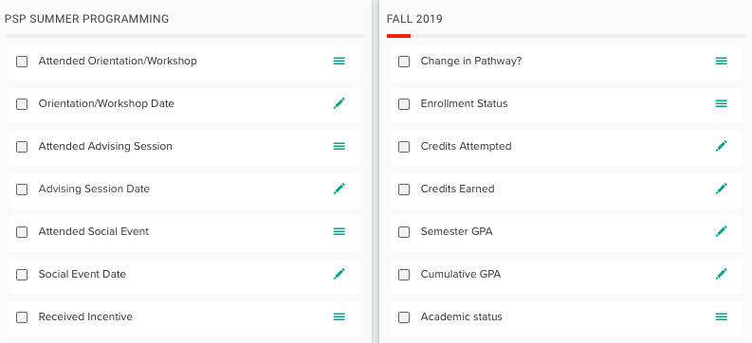
Tracking Engagement and Impact
Program Participation
  Pair Events
  Advising Sessions
  Summer Workshops
Matriculation, Persistence, and Completion
Program Persistence

Slide 29
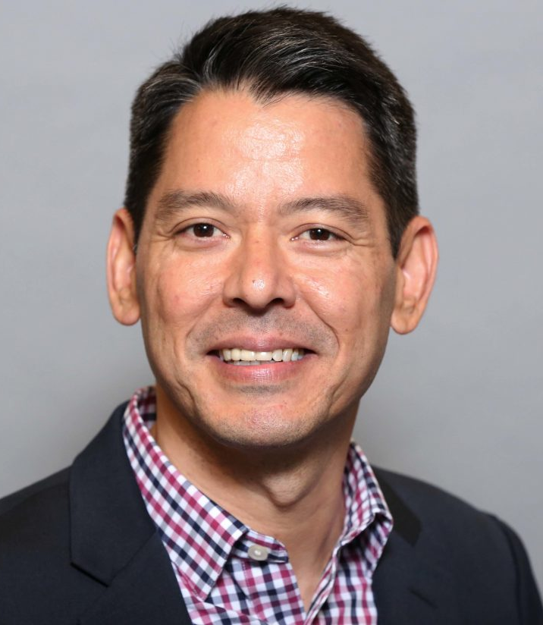
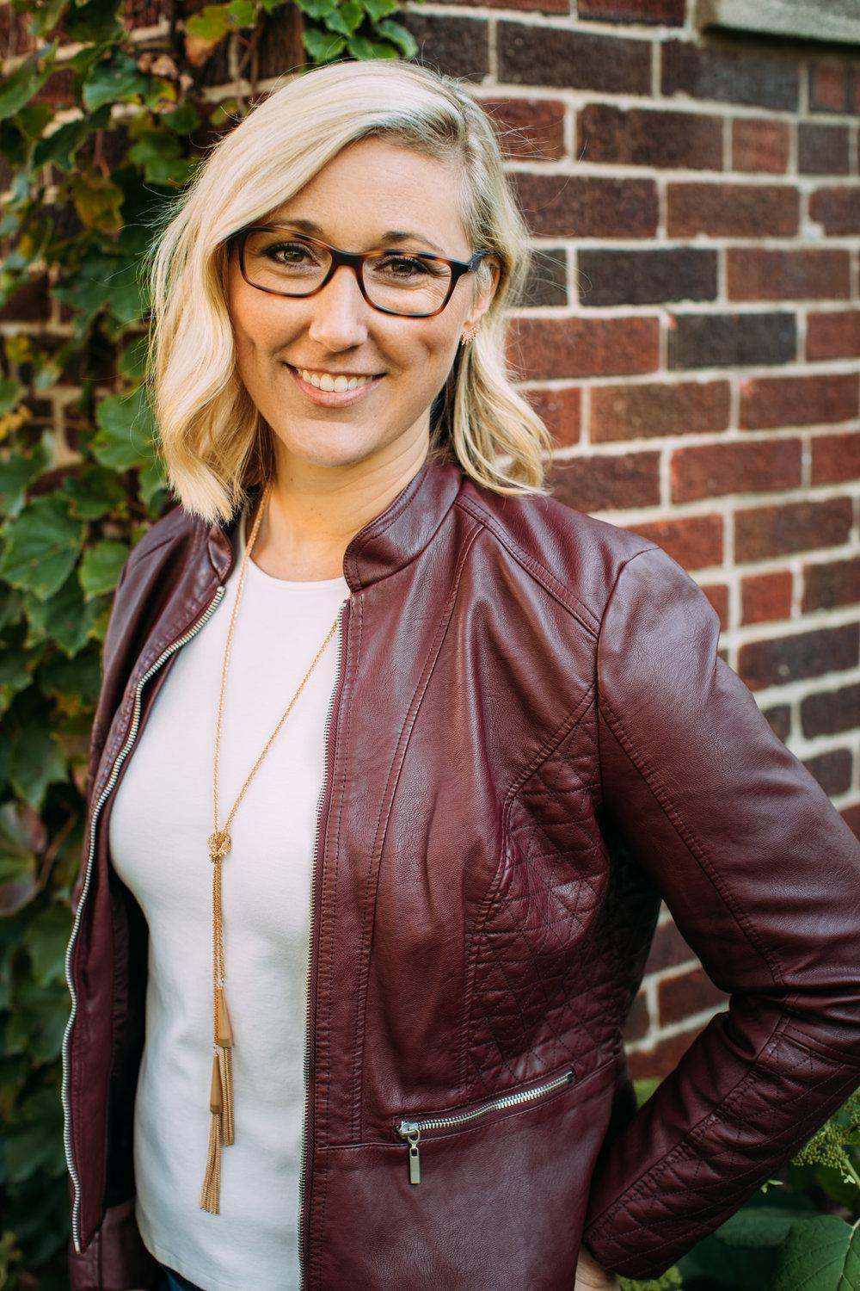
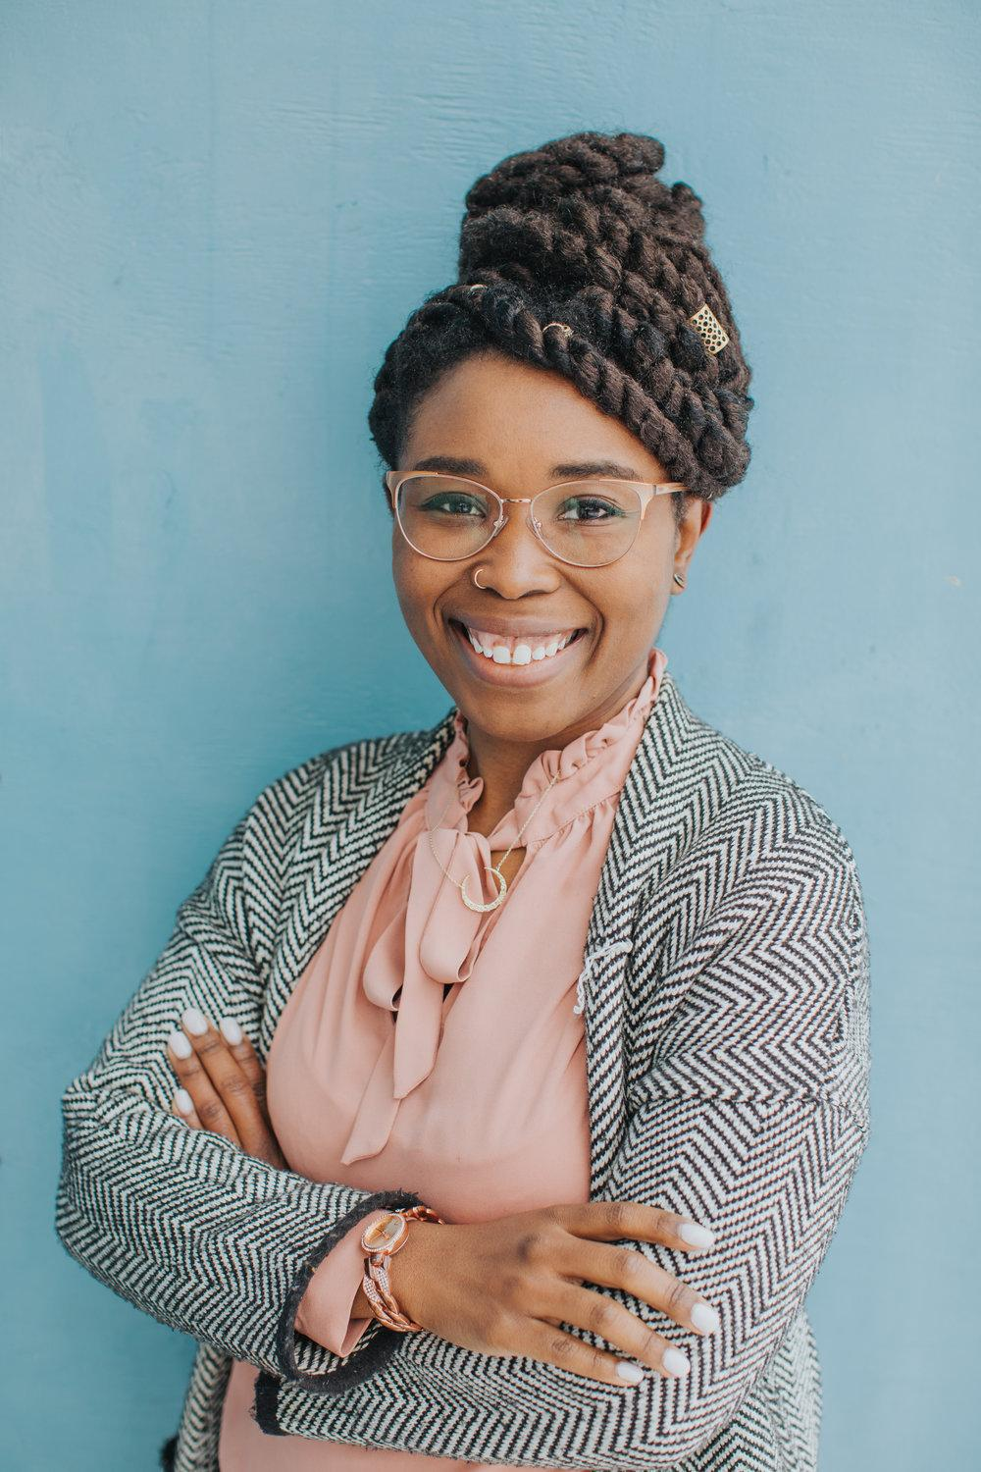
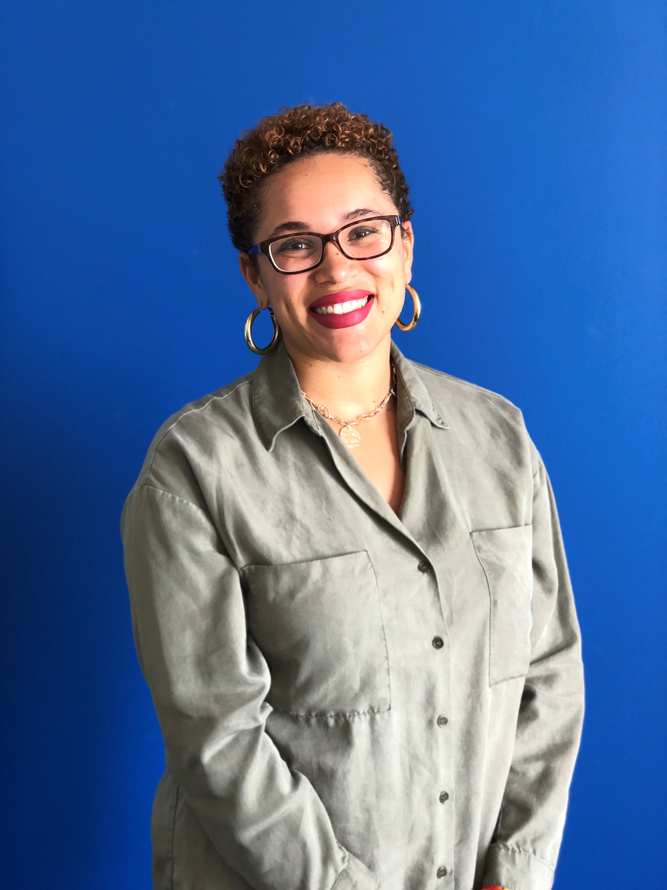
Stay in touch!
Kate Danielson
kate@foster-progress.org
773-793-0951
Richard Porter
rporter@imentor.org
312-219-8796
Jasamine Young-Paulhill
Jasamine@foster-progress.org
872-666-1498
Aleya Jones
aleya.jones@americaneedsyou.org
312-240-2727

Slide 30
Questions?

