Slide 1
Middle School Career Exploration Efforts
Illinois GEAR UP
Kimberly Korando

Slide 2
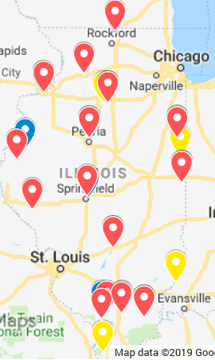
Illinois GEAR UP Grant Gaining Early Awareness and Readiness for Undergraduate Programs
ISAC was awarded the federal GEAR UP grant from the U.S. Department of Education in late 2016
GEAR UP provides grants to states and partnerships at middle and high schools in high need areas
Currently serving 19 pairs of middle and high schools across the state with the leading cohort entering 10th grade this coming school year

Slide 3
Illinois GEAR UP Grant Gaining Early Awareness and Readiness for Undergraduate Programs
We will follow the lead cohort through their first year of college and add a new class of 7th graders every year
We provide service delivery in several program areas including:
College and career exploration, successful transitions from middle school through college, admission and financial aid application assistance, parent engagement and school enrichment/capacity building

Slide 4
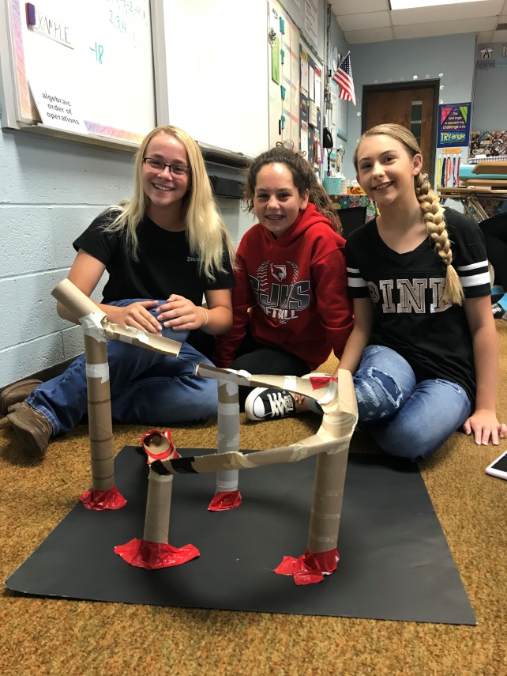
Middle School Career Exploration
The GEAR UP grant provides students with tools to explore careers through:
Classroom Curriculum
Field trips, career panels/speakers
Capacity Building funds
Each award year, GEAR UP schools are eligible for additional capacity building funds to create unique opportunities for their students
Hands-on career exploration activities are a popular use of the funds

Slide 5
Makerspace
Used in collaboration with STEM classes and often placed in the school library
A space for making, collaborating, learning, and sharing
A makerspace can be started simply with cardboard, Legos and art supplies and can be advanced to include items such as 3D printers and robotics
Use of a makerspace can assist with developing critical thinking skills, boost self confidence and encourage an entrepreneurial spirit
Overall purpose is to create something out of nothing and explore interests
There are a variety of books and online resources that can help you get started

Slide 6
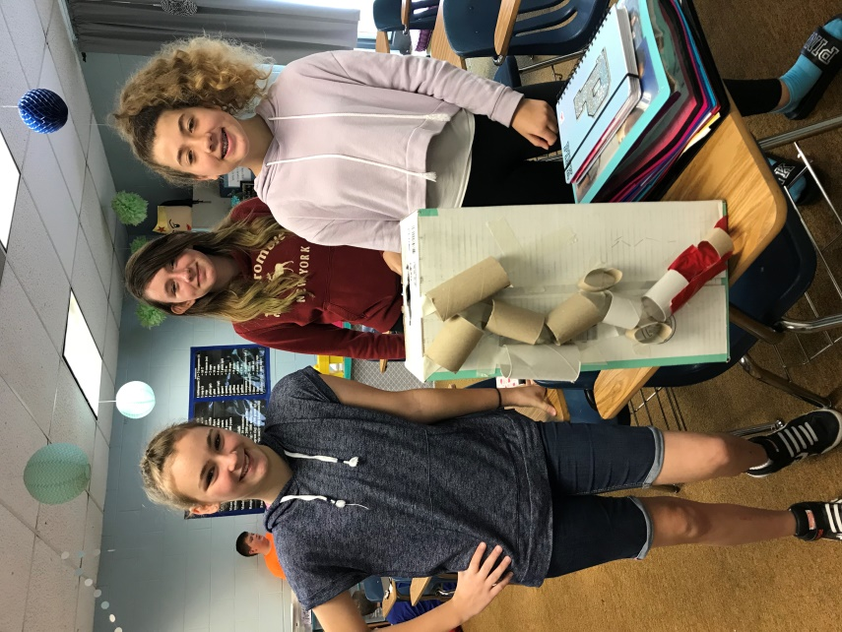
Makerspace
Students at Central Junior High School in West Frankfort used engineering principles to create a marble run course and a catapult. They also recorded a news program with audio visual equipment.
Students were excited to learn about careers they had never heard of before and to use skills they didn’t know they had
Many reported considering new careers in the future after participating in Makerspace activities

Slide 7
INCubator
At the start of the 2018-19 school year, Stephen Mack Middle School in Rockton started offering INCubator as an elective class.
The curriculum is composed of entrepreneurial lessons where students learn about the foundation, skills needed, and overall importance of starting a business.
Students think of a problem they face in their every day lives, brainstorm a solution, and create a product that solves the problem.
Each group member is responsible for a specific task such as manager, customer champion, timekeeper, and other more hands-on roles such as builder.
The final portion of the class allows students to create the product and sell it on an open web market. The students can earn a profit based on sales.

Slide 8
INCubator Products

Slide 9
INCubator Process

Slide 10
Middle School Career Exploration Field Trips
Local Employers
Students at Mt. Carmel Junior High School toured a local Toyota manufacturing plant where many citizens of their town are employed.
Southern Illinois Construction Careers Expo
Students met representatives from several construction and engineering companies in southern Illinois
There were many hands-on activities at the exhibits
Students learned how they could become qualified to work in a variety of construction careers when they finish high school
#IL60by25

Slide 11
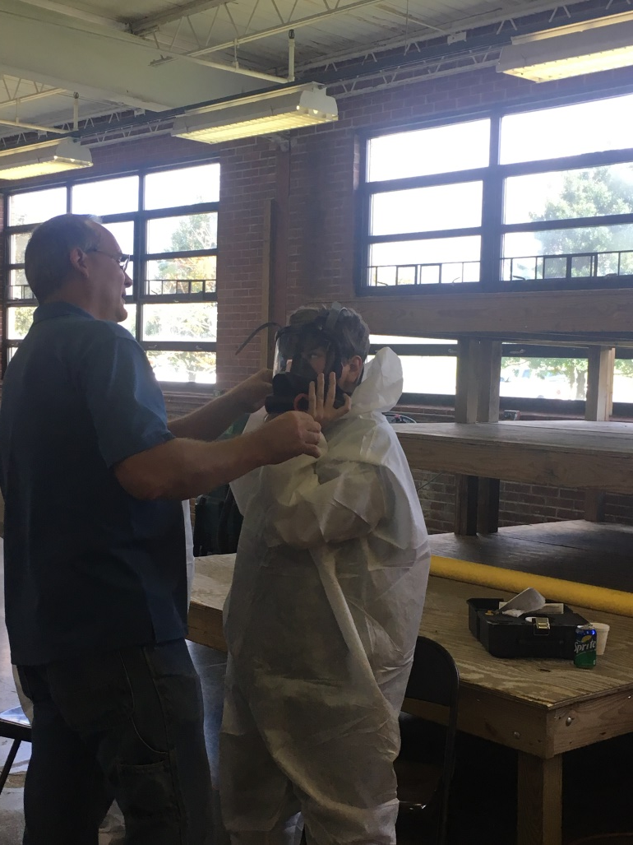
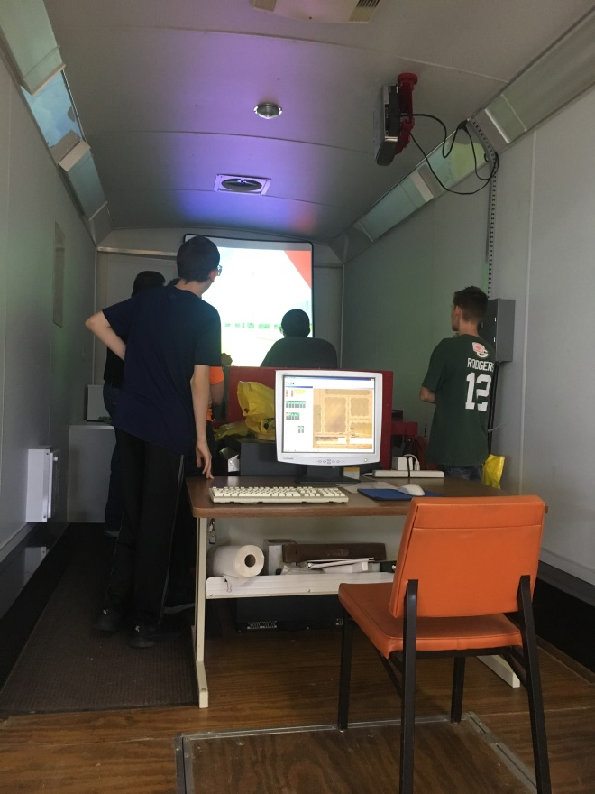
Southern Illinois Construction Careers Expo

Slide 12
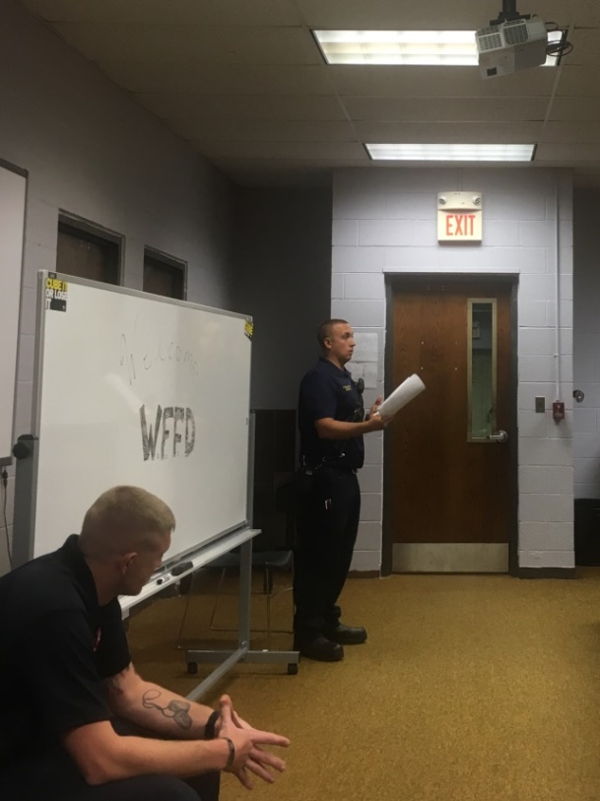
Middle School Career Exploration In-Classroom Career Panel/Speaker Series
The GEAR UP Corps member at Central Junior High School asked three fire fighters from the local fire department to speak to students
They shared stories about how and why they chose their career path and talked about what a typical day is like working at the firehouse
Students were given a chance to ask questions and were interested in how to become a firefighter, what the training is like, and some asked to hear rescue stories.
Firefighters from the West Frankfort Fire Department speaking to students

Slide 13
Middle School Career Exploration ILGU Classroom Curriculum
Knack Games
Designed to help users identify their natural abilities and personal strengths using a mobile device.
Knack’s behavior analysts look at many variables during game play such as: how long users hesitate, what part of the screen they touch, and the moves they choose to make.
Upon completing the games students receive a list of:
9 Knacks - natural skills and abilities
9 Superknacks - career options

Slide 14
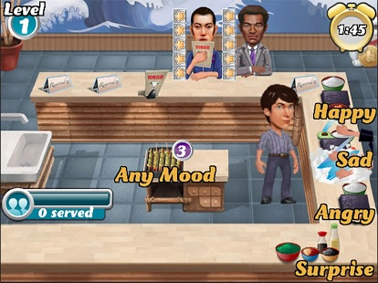
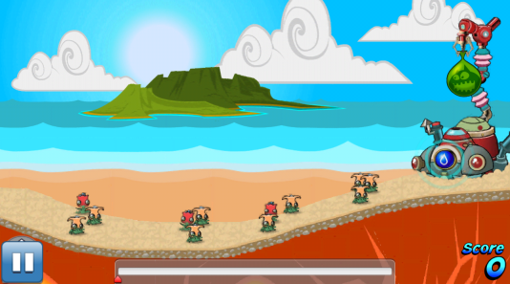
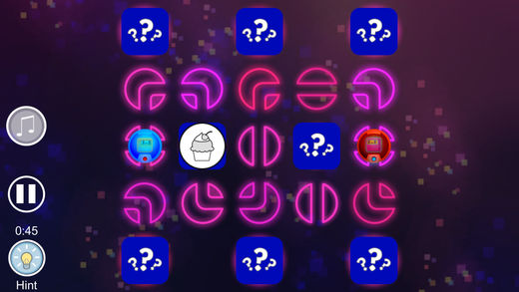
Knack Games
Dashi Dash
Serve the meal that matches the client’s nonverbal facial expression. Don’t forget to pick up the dirty dish!
Bomba Blitz
Use water balloons to extinguish the fire launching imps before they burn your flowery friends and get to the contraption.
Meta Maze
Create a path within a maze in order to connect two space robots.

Slide 15
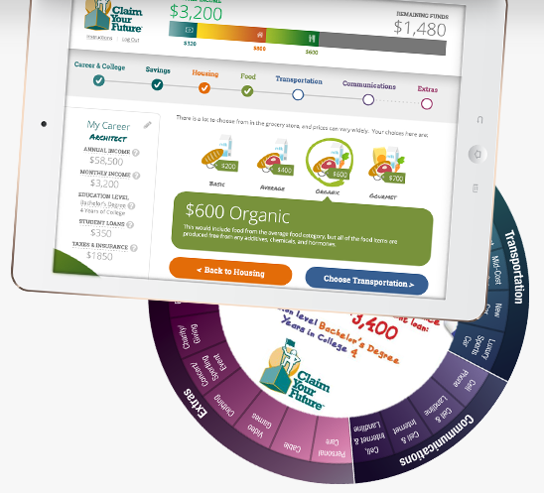
Claim Your Future
Students choose a career and navigate through different spending choices
Kit includes 50 career wheels, online version offers 125 career options
Unique career descriptions and key vocabulary
Printable budget worksheet
Additional financial education resources
isac.claimyourfuture.com/game

Slide 16
Claim Your Future - Watch Us Play
www.isac.claimyourfuture.com

Slide 17
THANK YOU
Kim Korando
Illinois GEAR UP
kim.korando@illinois.gov

