Slide 1
Illinois Board of Higher Education Private Business Vocational Schools Division
Helping Up:
IBHE Outreach Efforts Within the Illinois Department of Corrections
Adam E. Campbell & Michelle M. Shaver
Notes:
One of our goals is to increase attention on the educational opportunities within the prison system

Slide 2
Overview
IBHE Responsibilities
Private Business & Vocational Schools Division
Importance of Post-secondary Involvement
Recent Outreach Efforts
Logan Correctional Center
Decatur Correctional Center

Slide 3
Illinois Board of Higher Education
IBHE’s Statutory Responsibilities:
Master Planning
Analyze the needs and requirements of Illinois’ higher education system and modify policies that guide the state’s system of public and private colleges and universities
Budget
Recommend budgetary needs, operations, grants, and capital improvements for higher education institutions and agencies to the Governor and General Assembly
Grants Administration
Administer state and federal higher education grant programs
Information System
Maintain a comprehensive data information system concerning Illinois higher education
5. Program Approval
Approve/deny proposals for new units of instruction, research, or public service
6. Institutional Approval
Authorize institutions to operate and offer degree, diploma, or certificate programs in Illinois while ensuring institutions maintain the condition under which they were authorized to operate

Slide 4
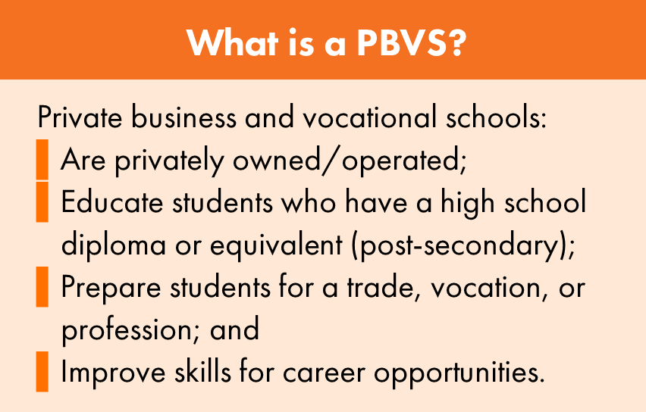

Slide 7
State of Corrections
United States:
6.5 million under correctional supervision
2.2 million incarcerated
95% will be released
68% recidivism within 3 years
77% recidivism within 5 years
Illinois:
204,000 under correctional supervision
41,000 incarcerated
43% recidivism within 3 years
$151,662 per recidivism event
$13 billion over the next 5 years

Slide 8
Educational Condition of Formerly Incarcerated Persons (data source: 2008 Bureau of Justice Statistics National Former Prisoner Survey (NFPS)
27% unemployment rate
50% hold ONLY HS diploma/GED; 25% hold NO credential
Compared to General Public
2x as likely to have no HS credential
More likely to have GED rather than traditional HS diploma
7-10% vs. 60%
75% of FIP earn GED while incarcerated
8x less likely to complete college
College
Persons 25 and older,
55.4% of general public had taken at least one college course
23% of FIP had taken at least one college course
29% of US population held college degree in 2008; only 4% of FIP
Public has 1 in 3 chance of obtaining college degree; FIP less than 1 in 20

Slide 9
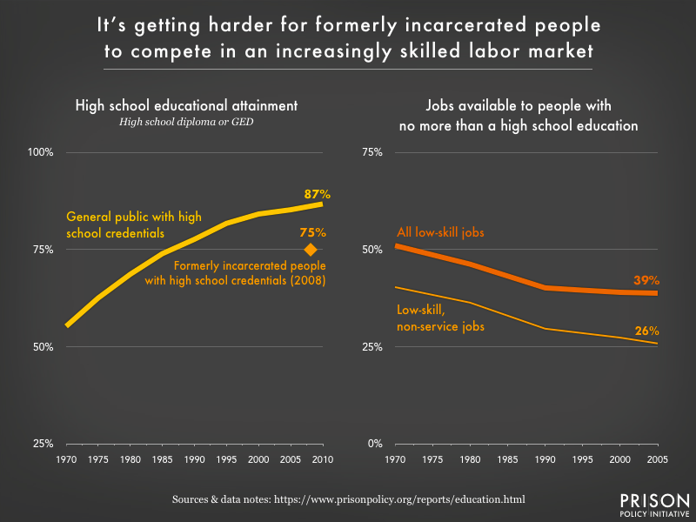
Educational Condition of Formerly Incarcerated Persons (data source: 2008 Bureau of Justice Statistics National Former Prisoner Survey (NFPS)
Barriers
Job Market
1986; last time 25% of US adults had no HS credential
Low-skill jobs disappearing
Criminal history question on applications
License restrictions
Limited programs while incarcerated

Slide 10
Advantages of Correctional Outreach
In 2014, 60% x 2025 Goal 3 of the Illinois Public Agenda for College and Career Success included post-secondary certificate programs, increasing the percentage of credentials by 6%.
Recidivism decreases when inmate skills increase.
When inmate skills increase, post-release opportunities increase.
Providing skills and resources for a vulnerable population decreases that vulnerability and breaks the cycle of generational offenders.

Slide 11
IBHE Correctional Outreach
2015- Present
Logan Correctional Center, Lincoln, Illinois
2017- Present
Decatur Correctional Center, Decatur, Illinois

Slide 12
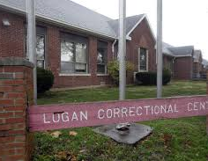
Logan Correctional Center
Multi-level Security Women’s Facility
Total Population 1,657
Academic:
ABE (Adult Basic Education)
Pre GED (General Education Development)
GED (General Education Development)
Nail Technology
Cosmetology
Hair Braiding
Vocational:
Construction Occupation
College Associate Degree
Career Technology
Food Services
Horticulture
Industries:
Recycling Shop
Helping Paws Program
Photo © Associated Press
Data source: www2.illinois.gov

Slide 13
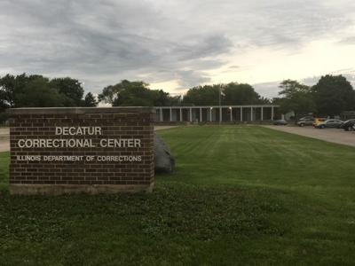
Decatur Correctional Center
Minimum Security Women’s Facility
Total Population 549
Academic:
ABE (Adult Basic Education)
GED (General Education Development)
College Remedial
Vocational:
Commercial Custodian
Computer Technology
Food Service Technology
College Baccalaureate ( AA)
Industries:
Upholstery
Furniture manufacturing
Offender apparel production
Basic dog grooming
Kennel keeping
Photo © Associated Press
Data source: www2.illinois.gov

Slide 14
Outreach Topic Areas
Bring awareness of educational opportunities to inmates preparing for release.
Provide resources
GED Attainment
Refer to local community college or ICCB
FAFSA
Provide handouts from FAFSA.gov regarding federal aid and incarceration
Disqualifying Convictions and Waiver Information
Provide information from IDPH
Avoiding Diploma Mills
Define and describe what a diploma mill is and how they prey on vulnerable populations
Consumer Empowerment
Provide information on what questions to ask and how to confidently seek higher education from privately owned, for-profit colleges and vocational institutions
Offer Support
Provide IBHE contact information and convey agency interest in their success.

Slide 15
Common Questions/Issues
“Can I go to college with a prior conviction?”
“Can I get financial help even though I’ve been incarcerated?”
“My cellmate/mother/boyfriend told me…”
“I don’t know what I want to do.”
“Should I call the college I saw advertised on TV?”
“I used to be a [licensed occupation]. Can I still do that?”

Slide 16
How to Get Involved
Contact Reentry Coordinators at nearest institution
IDOC Summit of Hope
Post-release (federal and state)
“One-stop” environment
Throughout Illinois
Contact the IBHE

Slide 17
Contact Info
Michelle Shaver
Assistant Director
Academic Affairs, PBVS Division
Illinois Board of Higher Education
1 N. Old State Capitol Plaza, Suite 333
Springfield, Illinois 62701
Phone: (217) 557-7339
Email: Shaver@ibhe.org
Adam E. Campbell
Assistant Director
Academic Affairs, PBVS Division
Illinois Board of Higher Education
1 N. Old State Capitol Plaza, Suite 333
Springfield, Illinois 62701
Phone: (217) 557-7342
Email: Campbell@ibhe.org

