Slide 1
A First Look at the Common Core
Notes:
ACT presented the national version of this report in Nov. of 2010 to the Chief State School Officers. At their request, 25 of the states rec’d an individual state-level report.
ACT is uniquely positioned to provide you with this report. As you probably know, we were a lead partner ccss development (in fact, our College Readiness Standards were instrumental in their creation and our definition of CCR was adopted by the CCSS initiative), and we’re the only organization with enough data and longitudinal research to provide base line information and move the discussion forward with recommendations and actual action plans.
In the absence of any Common Core performance indicators, we needed to establish a baseline for performance
We wanted to provide research and resources to assist states as they prepared to handle the transition to the CCSS

Slide 2
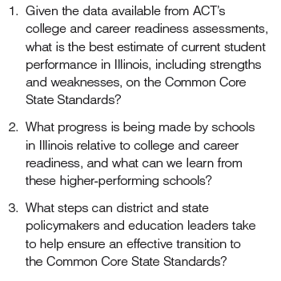
3 Basic Questions
Notes:
We don’t have performance indicators yet, but because of the role ACT played in the development of the Common Core State Standards Initiative we understand the standards and what went into their creation and could code corresponding items on the ACT to the common core. This report uses ACT’s CCRBs to estimate or project, CCR performance levels on each of the CC clusters. For each cluster for which ACT has data,, we reported the % of students who would meet or exceed a college and career level of readiness on the test items associated with that cluster.
From the 2010 grad class.
So what would IL look like today, if we had already implemented the CCSS and were testing them?

Slide 3
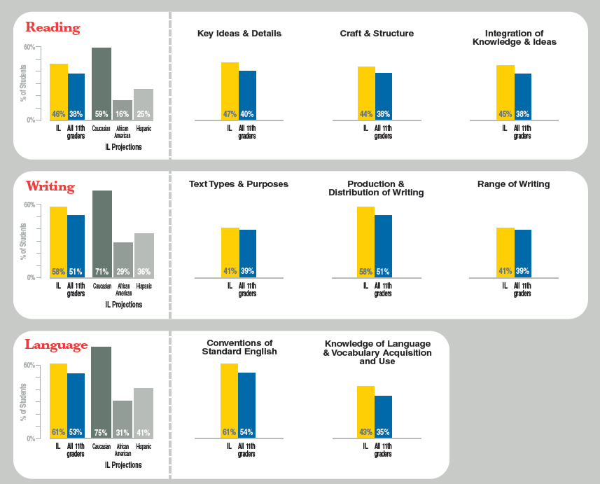
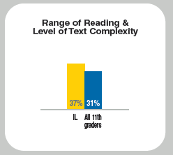
English Language Arts
3 Basic Questions
Notes:
Key Understandings:
All 11th graders =257,000 in sample of several states who administer the ACT to all their spring 11th graders.
Yellow is the projected performance for the entire student population.
Thought it was important to break it down by ethnicity.
Key Findings:
IL comes out more prepared than the national sample in all areas
But we still have a large achievement gap
And we’re still below the 50% in 7 out of the 9 clusters
And Level of Text Complexity is the most troubling: too few students are able to understand complex text—and that spills over into literacy
Teachers and schools need to implement and systematize interventions for students who are behind: Forgotten Middle.

Slide 4
Literacy
Notes:
1. Students need to read more informational text (and maybe less poetry and literature—and increase in complexity with each grade)
2. Complex reading needs to be incorporated into all content areas. We need reading across the curriculum like some colleges have writing across the curriculum.

Slide 5
Mathematics
Notes:
We need to focus on foundational math (Number and Quantity) because these skills are fundamental to success in all other clusters. Students need to understand numbers , operations, arithmetic expressions, solve problems about math, reason about math, and explain their thinking. Students need to problem solve in early grades.
Schools need to provide interventions

Slide 6
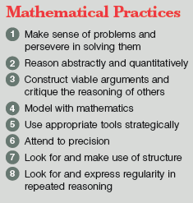
Mathematical Practices
Notes:
These complex tasks will be extremely difficult for students who still struggle with Number and Quantity—basic understandings of numbers.

Slide 7
Where Do We Go From Here ?
Shift Happens!
Manage Expectations
Use the data we already have
Educate all stakeholders
Collaborate
Notes:
We are shifting expectations, not lowering student performance. Remember IL in 2002?
So we have to manage our communication and the expectations so that people understand. A recent survey commissioned by Achieve, showed that 79% of the public knew nothing or very little about the CC . However, when read a brief statement about what the CCSS are, 77% said they strongly favored their implementation. School leadership has never been more important.
And we can use all the EXPLORE/PLAN/ACT data we already have for help with interventions
All constituents need to be informed: parents, school boards, legislators, higher ed partners.
We need to share best practices if high performing schools and successful strategies. Teachers need to be able to talk to each other and share ideas and understandings.

