Slide 1
WELCOME
Dr. Judith Marwick, Provost
Harper College

Slide 2
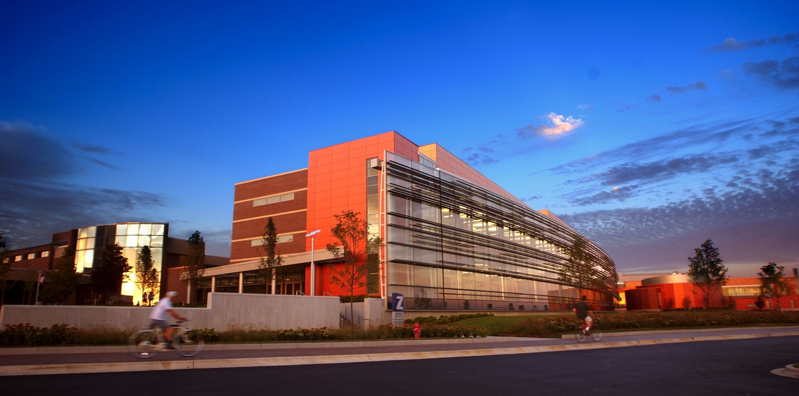
Harper College Fast Facts
Enrollment (Unduplicated Headcount):
• Credit: 26,441
• Noncredit: 7,554
Faculty:
• 200 full time
• Approximately 653 part time
Programs Offered:
• 8 Associate/Transfer Degree Programs
• 41 Associate of Applied Science Degrees
• 111 Certificate Programs
Campus Size:
• 200 acres, 24 buildings
Notes:
High School Graduates = 6,609 (2011)
% Graduates Enroll at Harper = 35% (2011)

Slide 3
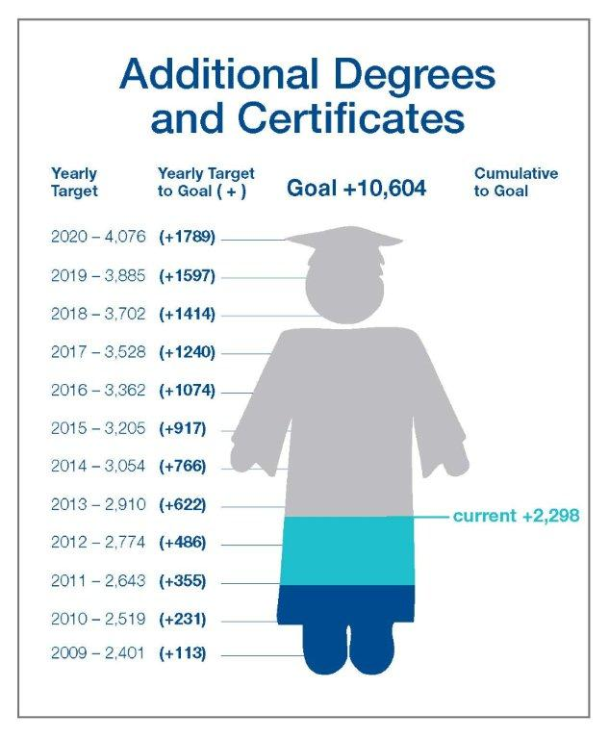
The Harper College Number
10, 604
  Harper College Completion Agenda
  2,298 ahead of schedule
Notes:
KEN
We began by identifying our numbers. Use this slide to discuss the direction of Harper College to increase completion rates. The partnership with the high schools is a major initiative to assist us in reaching our target.

Slide 4




The Northwest Educational Council For Student Success
A formal agreement with
Three high school districts (12 high schools)
and
Harper College
Notes:
High School Graduates = 6,609 (2011)
% Graduates Enroll at Harper = 35% (2011)

Slide 5
Partners for Success--Mathematics
Specific Results with District 211
8% increase in enrollment in senior math by Algebra II juniors
6% increase in number of Harper freshman taking a college-level math class
11% decrease in number of Harper freshman taking a lowest level math class

Slide 6
Project Success Pilot Fall ‘11
Partnership
  Students, faculty, counselors and Harper support services
  Grew from our AtD research on at-risk students
Target Population
  First-year students who are recent high school graduates
  Place and enroll in two or more developmental courses or levels of developmental courses
  Approximately 800 – 900 identified
  335 students chosen for the Pilot
Notes:
Sheryl
Strategic Direction: Increase completion and achievement of all students with a focus on underperforming student groups
Strategic Goal: Decrease student achievement gaps of developmental, young male and black non-Hispanic students, while increasing academic achievement for all
Strategy: Project Success – Early Alert
Mention REACH cohort

Slide 7
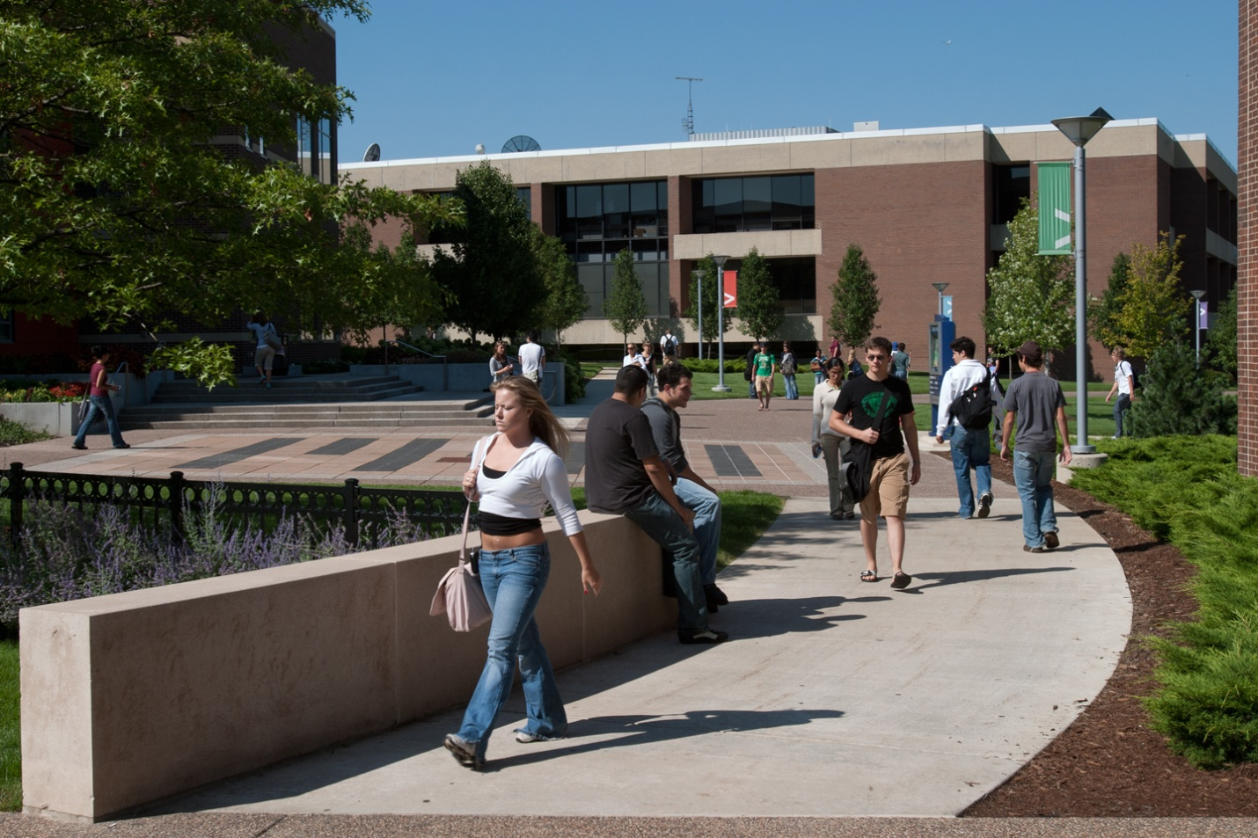
Project Success: Process
Target Students
  Project Success Welcome Letter – 2nd week
    Project Success Video has received 750+ hits
Notes:
Kathi
During the 2nd week of the semester a Welcome Letter went to the students in several forms
snail mail letters
Email
Posted letter on the Student’s Portal
We also created a video to inform students about Projects Success which was also posted on their Student Portal
Here is the message we conveyed: [PLAY VIDEO]

Slide 8
Project Success: Process
Faculty
  278 faculty in pilot
  Access to names of students - 3rd week
  Receive Surveys through Starfish at Weeks 4 & 6
  Respond to Survey based on student’s performance
    http://www.youtube.com/starfishretention#p/u/3/DXl02ey-edU
Notes:
Kathi
During week 3 emails went to 278 faculty which provided them access to select students from our Pilot to monitor
It also instructed them when their Starfish Survey would arrive and how to respond.
If we have access to internet show the You Tube instructional; if not explain the Survey example shown on the screen.

Slide 9
Project Success: Results
278 faculty had one or more of the 335 pilot students in their classes
191 (69%) of the faculty in the pilot completed the survey
189 (56%) of the pilot students were flagged for concerns
145 (77%) of flagged students met with their counselor
Notes:
Eric
Flags raised by faculty (in order)
Low Grades/Poor Academic Performance
Missing/Late Assignments
Poor Attendance/Participation
Other
Never Attended

Slide 10
Project Success: Results
More pronounced positive results when compare students who saw counselors vs. those who did not
Fall-to-Spring Persistence
Cohort | Counselor | No Counselor | Difference
PS – Flagged | 82.1% | 47.7% | 34.4
PS - Not Flagged | 94.8% | 83.0% | 11.8
Control Group | 88.3% | 67.1% | 21.2
Notes:
Eric

Slide 11
Project Success: Results
Completer Success Rate – All Courses
Cohort | Counselor | No Counselor | Difference
PS – Flagged | 58.6% | 28.6% | 30
PS - Not Flagged | 72.3% | 72.7% | -.4
Control Group | 70.1% | 46.8% | 23.3
Completer Success Rate – Developmental Courses
Cohort | Counselor | No Counselor | Difference
PS – Flagged | 58.6% | 31.9% | 26.7
PS - Not Flagged | 76.8% | 75.5% | 1.3
Control Group | 74.4% | 48.6% | 25.8
Notes:
Eric

Slide 12
Questions?

