Slide 1

College & Career Readiness in Illinois
Brian Durham
Senior Director for Academic Affairs & CTE
Illinois Community College Board
brian.durham@illinois.gov

Slide 2
The Numbers
46% of recent Illinois public high school graduates transitioning as full-time community college freshmen in 2006-08 enrolled in at least one remedial course (Office of the Lieutenant Governor, 2012).
36% of recent Illinois public high school graduates transitioning as full-time community college freshmen in 2006-08 enrolled in at least one remedial math course (2012).
21% of recent Illinois public high school graduates transitioning as full-time community college freshmen in 2006-08 enrolled in at least one remedial English course (2012).

Slide 3
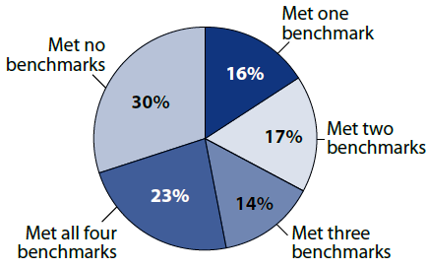
The Numbers
ACT College Readiness Benchmarks
ACT (2011) as cited in Office of the Lieutenant Governor (2012)

Slide 4
The Reasons
Most jobs require some skills associated with higher education (Carnevale, et al., 2011).
An individual with a Bachelor’s degree earns 2.1 million dollars over the course of his or her life, twice as much as an individual with only a high school diploma (U.S. Department of Education, 2006, p. 7).

Slide 5
The Policy Environment
Illinois’ Completion Agenda– 60 x 2025
P-20 Council
College and Career Readiness Efforts
Notes:
Focus on the Finish
60 X 2025

Slide 6
Illinois Completion Agenda
60 x 2025
Focus on the Finish calls for:
  The creation of a statewide college and career readiness framework.
  “Community colleges should collaborate with K-12 education in a systematic way to set expectations and measure the impact of this secondary and postsecondary collaboration.”
      Improved data collection
      Universal assessment
      Dissemination of best practices
      Promoting collaboration

Slide 7
P-20 Working Group
Mission: “to increase students' opportunities for success in college and careers by developing indicators and recommending policies to support and align transitions across the P-20 spectrum and with other stakeholders.”
Goals:
  “Define” College and Career Readiness
    Informed by the Conley Model
    Informed by the ACTE Model
  Benchmark College and Career Readiness
  Recommend Policy to the Education Agencies and the P-20 Council

Slide 8
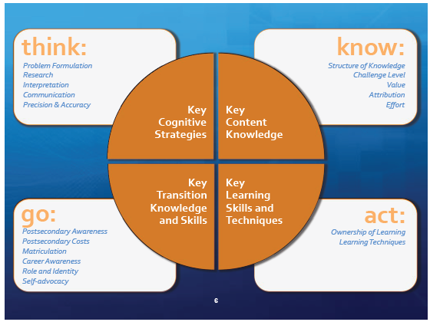
The Conley Model

Slide 9
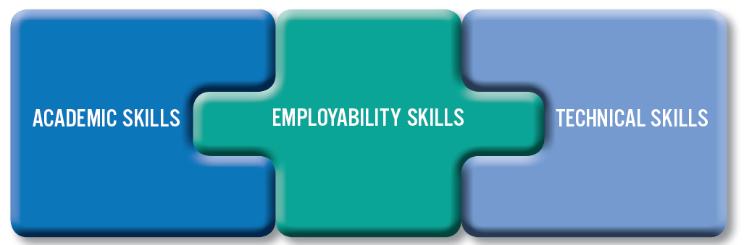
The ACTE Model

Slide 10
The Complexity of College and Career Readiness
  Conley: The Complexity of College & Career Readiness

Slide 11
The College and Career Readiness Pilot Project Act: The Elements
Develop a system to diagnose college readiness
Reduce the need for remediation
Align high school and college curriculum
Enrich the senior year
Establish an evaluation process to measure effectiveness of the intervention strategies
Notes:
1. Develop a system to diagnose college readiness by developing a system to align ACT scores to specific community college courses
2. Reduce the need for remedial/developmental coursework in math, reading, and writing at the college level
4. Enrich the senior year by providing resources and academic support to students

Slide 12
The College and Career Readiness Pilot Project Act 2009
Contacted 3,500 students and Enrolled 400 in interventions
71 Meetings with High Schools and Interacted with 566 College and High School Staff. These meetings led to better alignment of high school to college curriculum.
Approximately 200 CCR Students Transitioned to Credit Bearing Courses or Higher Levels of Developmental Coursework.

Slide 13
The College and Career Readiness Pilot Project Act 2010
Seven Sites contacted 12,575 students and enrolled 884 students in interventions.
251 separate meetings with high schools and interacted with hundreds of college and high school staff.
CCR sites partnered with 75 high schools.
Approximately 384 CCR students transitioned to credit bearing courses or higher levels of developmental coursework.

Slide 14
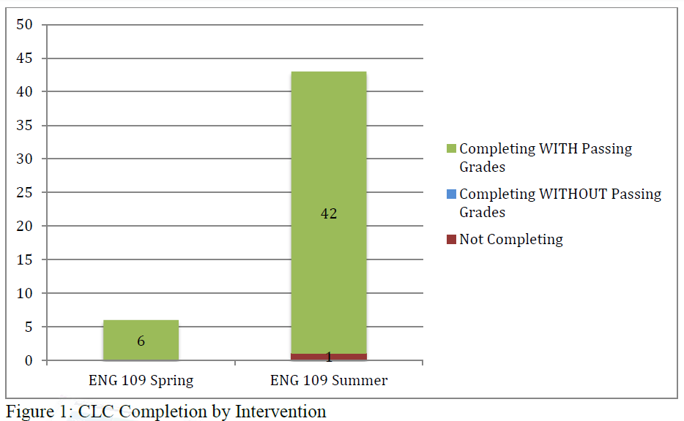
CCR Data 2011

Slide 15
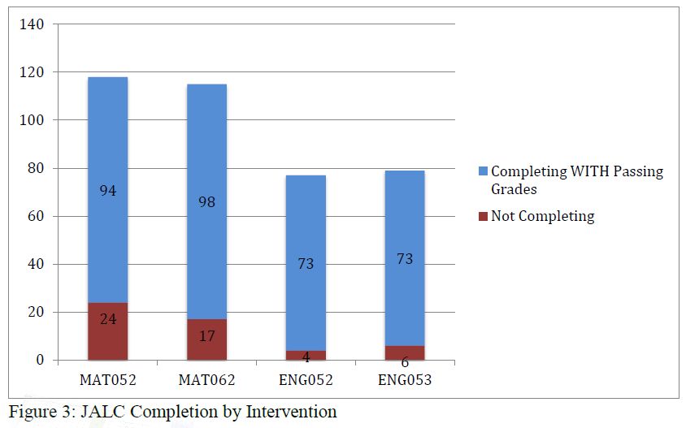
CCR Data 2011

Slide 16
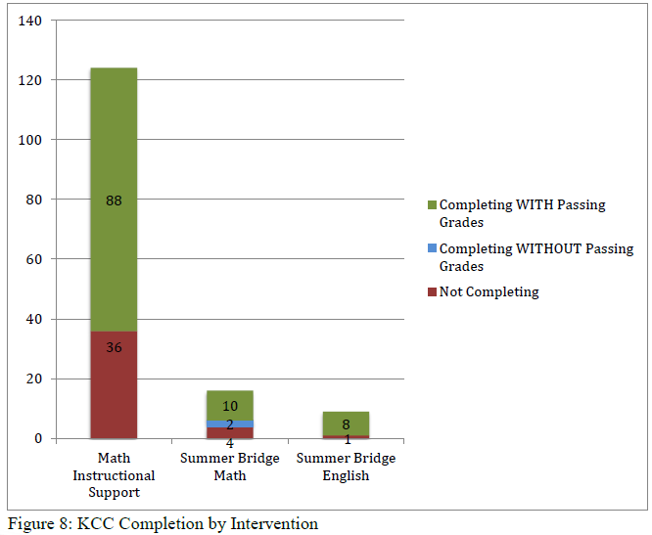
CCR Data 2011

Slide 17
NEXT STEPS: STEM College and Career Readiness
Part of the Race to the Top
Seven Community Colleges are in the process of being selected
Highly Prescriptive Model Planned
Math Focused
Tied to the Race to the Top Districts
  Must be able to serve a RTTT District
Fall, Spring Interventions; Summer Bridge

Slide 18
What are we responding to?
An Emphasis on College and Career Readiness
Reconfiguration of Standards
Diminishing Resources and Accountability
Completion Agenda

Slide 19
The Core Elements of Success
Curriculum Alignment
Partnerships
Faculty Participation
Intensive Engagement

Slide 20
How must we be diligent?
Initiative Fatigue
Access v. Completion (Equity)
Implications of Higher Standards
Costs

Slide 21

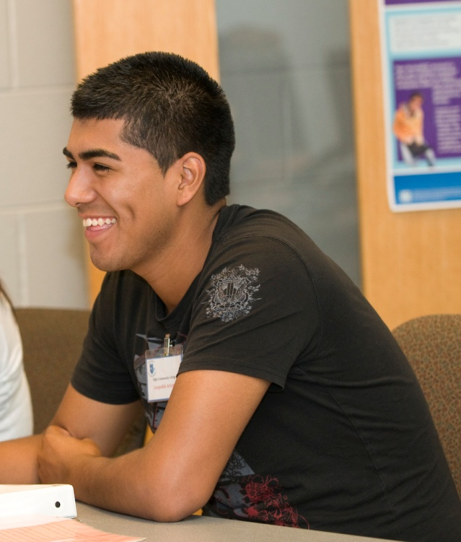
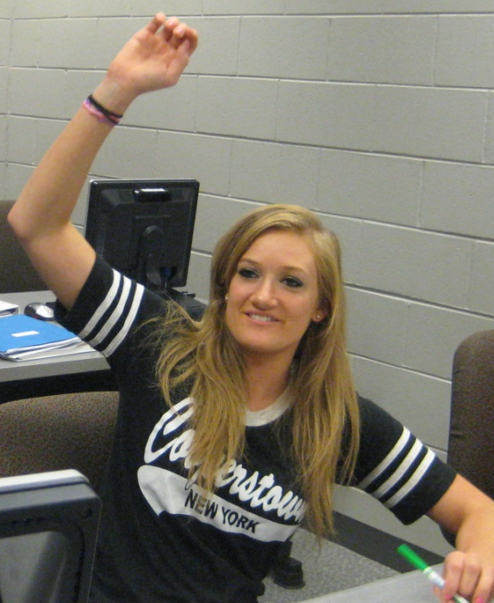
The Alliance for College Readiness
One Local Partnership Effort to Improve College & Career Readiness in a Climate of Layered, Rapid-fire Reform
Julie Schaid, Ph.D.,
Assoc. Dean, College Readiness & School Partnerships
Elgin Community College

Slide 22

Our Alliance Structure:
Advisory
Council
Math
Team
STEM
Team
Writing
Team
Reading
Team
Supporting Transitioning, Engaging Parents & Students (STEPS Team)
ELL Team
Data
Team
Notes:
22

Slide 23
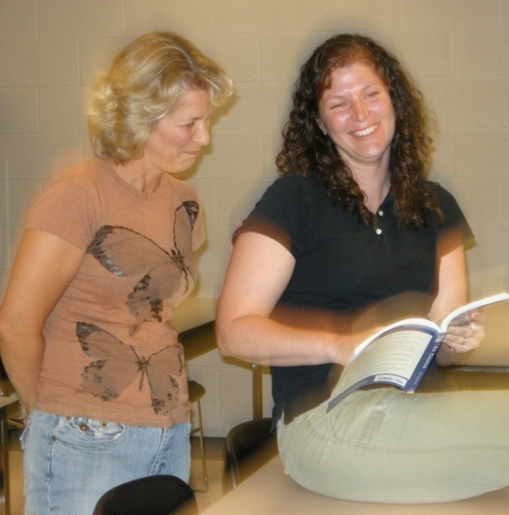


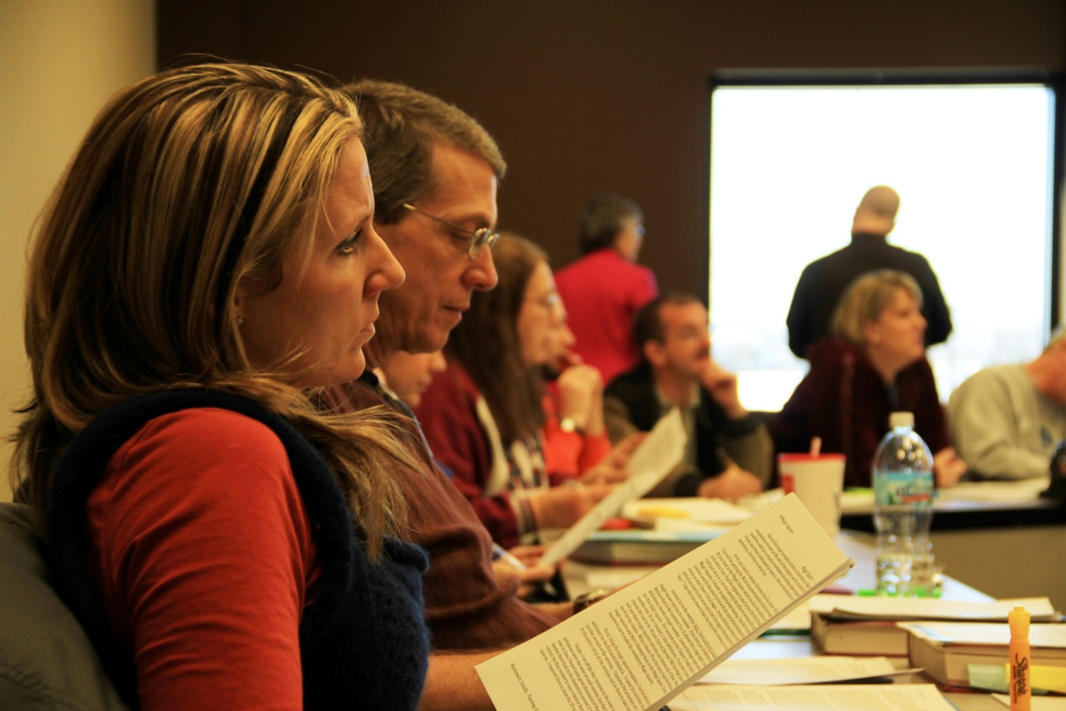

Points of Connection in the Schools
Central Office Leadership
(Credibility & Gaining Permission)
Faculty to Faculty
(creating ideas)
Building Administrators
(Implementation & Support)
Curriculum Directors

Slide 24

The Work of the Alliance:
Content Knowledge & Cognitive Strategies:
  College Ready Writing PP
  Summer Bridge Program
  New 4th Year HS Math Course
  Literacy Survey
  Middle School Participation
College Knowledge & Self-Mgt. Skills
  Middle School Visits
  Parent Communications
  HS Senior Transition Day
College & Career Ready Student
Key Content Knowledge*
Key Cognitive Strategies*
Key Self- Management Skills*
“College Knowledge”*

Slide 25

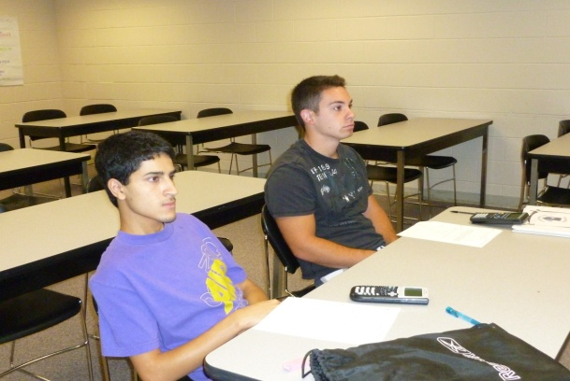
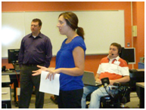
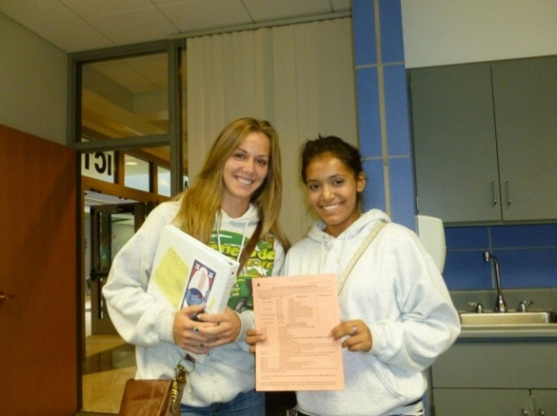
Summer Bridge Results:
Four Years = 111 Students and 73% Success!
2011 Bridge: 36 Students
25 moved up at least one level
  12 moved up 2+ levels
2009 Fall Semester Grades: 82% success*
2010 Fall Semester Grades: 92% success*
2011 Fall Semester Grades: 75% success*

Slide 26
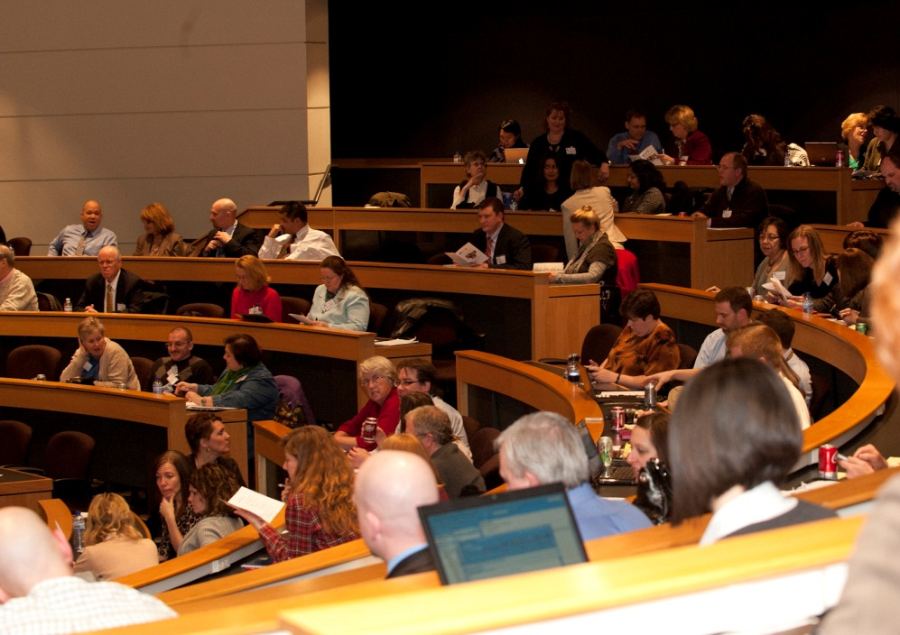
The Work of the Alliance:
Data Sharing
  Math Course-taking study
  National Clearinghouse
    76% of the 2009 high school grads
    in CC District 509 enrolled in college
    within 2 years of HS graduation.
Professional Development
  Kane Co. Professional Dev. Day
  Summer Bridge
  Literacy Workshops

Slide 27
Data Sharing –
High School Course-taking Patterns & College Readines
Fall 2008 – 663 Developmental Math Students
54% did not enroll in (41%), or failed (13%) senior math

Slide 28
Data Sharing
High School Course-taking Patterns & College Readiness
Fall 2008 – 345 College Ready Math Students
71% successfully completed senior math – 82% above Algebra 2 level

Slide 29
What does our data tell us when broken out by high school?
High School “X” – 93% of Dev. students took senior math but 26% failed senior math
High School “Y” 75% of Dev. students did not take senior math

Slide 30
Increasing College Readiness…
 | % College Ready |  |  | Total Developmental Need
 | Math | English | Reading | 100% CR | Need 3 | N
2006FA | 29% | 57% | 73% | 24% | 21% | 957
2011FA | 37% | 60% | 74% | 30% | 19% | 1,296

Slide 31

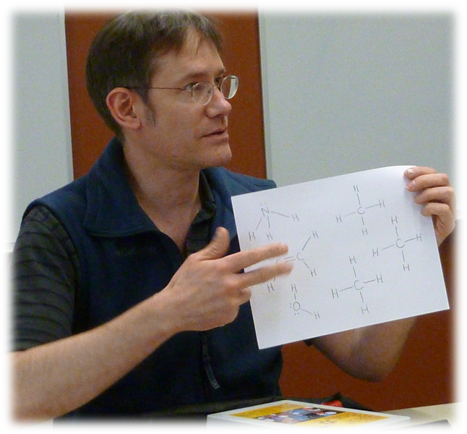
What’s Next?
Expand Bridge
Focus on Achievement Gaps
ELL
Other?

Slide 32
Readiness
College
Common Core Curriculum
College Completion

Slide 33
Brian Durham Senior Director for Academic Affairs & CTE Illinois Community College Board brian.durham@illinois.gov | Julie Schaid, Ph.D., Assoc. Dean, College Readiness & School Partnerships Elgin Community College jschaid@elgin.edu

Slide 34
References:
Office of the Lieutenant Governor (2012). Focus on the Finish:
http://www2.illinois.gov/ltgov/Documents/CC%20Report%20for%20web.pdf
Illinois Community College Board:
www.iccb.org
Elgin Community College
www.elgin.edu
Educational Policy Improvement Center:
https://www.epiconline.org/
Association for Career & Technical Education: https://www.acteonline.org/readiness.aspx
ACT (2011). “Illinois; The Condition of College and Career Readiness, 2011.” http://www.act.org/newsroom/data/2011/states/pdf/Illinois.pdf

