Slide 1
Illinois STEM Workforce Demand
Dr. Jim Applegate
Executive Director
Illinois Board of Higher Education

Slide 2
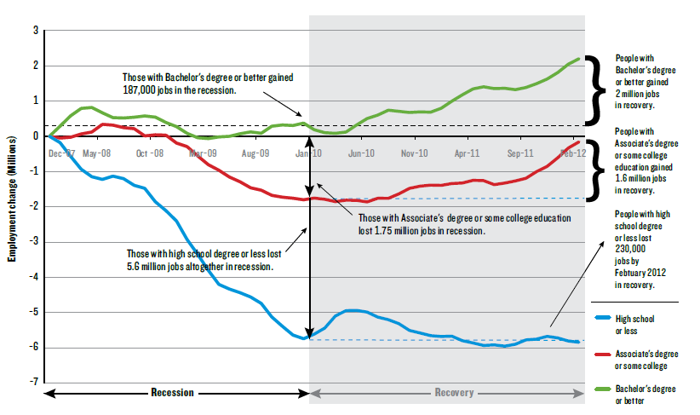
The Finish Line Has Changed: College is Necessary in the New Economy

Slide 3
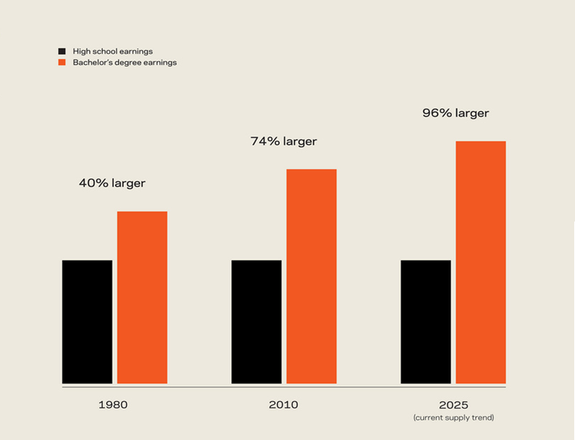
College Matters More Than Ever!
Notes:
UPDATE 2013—DEPT OF LABOR 98%!!!

Slide 4
We Are Wasting Talent
Notes:
NOTE: US data not Illinois. But affordability data to come can’t imagine too different.

Slide 5

In Illinois-- STEM Talent Matters!

Slide 6

STEM Categories
IT
Healthcare
Engineering and Advanced Manufacturing
Analysts
Sciences
Notes:
Burning Glass report of STEM careers in Illinois
Real time labor demand
Scanned and analyze thousands of job postings from a 12 month period
Similar to IDES data, (Help Wanted On Line and Job Link) but BG digs more deeply into job requirements

Slide 7
Missed Opportunities
200,670 STEM job postings in Illinois in 2013
Largest category by far is IT
  82,000 total postings (41% of all postings)
80% require BA+
IT | Entry-Level Illinois Job Openings | Illinois Degrees Produced | Gap (Need) | Ratio (Postings: Grads )
Bachelor’s Level | 32, 990 | 2,877 | (30,113) | 11.5:1
Sub- BA Level | 7,616 | 2,960 | (4,656) | 2.5:1

Slide 8
STEM Attrition
48% of STEM majors in 4 yr schools change majors or drop out
69% of community college STEM majors change majors or drop out
      Institute of Educational Sciences
      U.S. Department of Education
      STEM Attrition: College Students Paths Into and Out of STEM Fields
      November 2013
Notes:
We’re revving students up for STEM Careers, they the hit college and have cold water thrown on them

Slide 9

It’s Time to Remodel

Slide 10
Remodel the P-12 to College Connection
Implement the new IL Learning Standards and Assessments widely and well
Create simple and transparent STEM pathways to college
Implement need based “early promise” financial aid programs that reward progress to college readiness and STEM pathways
Remodel the senior year for either “speed up” or “catch up”
Notes:
STATE SUBSIDIZED DATING SERVICE

Slide 11
Remodel to Re-train the Current Adult Workforce
Notes:
SOME COLLEGE WAGES LITTLE BETTER THAN Hs --- Major remodel required , employers engaged

Slide 12

Remodel Academic Delivery: Guided Pathways Systems
Whole programs of study
Informed choices and meta-majors
Default pathways
Guaranteed milestone courses
Intrusive “just in time” advising (based on comprehensive student data systems)
Multiple math pathways
Incorporate prior learning assessment
Notes:
UIC, SIU-C, City Colleges

Slide 13

Remodel College to Career Connection:
Completion for What?
Connect higher education and
employment data
Issue regular reports on outcomes for college graduates (1,5,and 10 years out)by institution and program
Engage employers in remodeling academic programs and supporting student success
Align academic learning outcomes and degree production with 21st century economic and civic demands

Slide 14


Remodeling Isn’t “Rocket Surgery”
Notes:
SUNY Nancy reference----

Slide 15
It Is NOT About Heroes and Miracles: It Is About Us
Rediscovering the Spirit of American Progressive Movements
Notes:
Steven Johnson FUTURE PERFECT

