Slide 1
C-STEMBE BADGING Community STEM Badges Ecosystem
Natasha Smith-Walker
Executive Director
Project Exploration

Slide 2
What’s badging all about?

Slide 3
Pilot Stage
C-STEMM as an example of a Community of Learning
Grounded in……
• shared language (Badges)
• best practices (Criteria and Guidelines)
(based on the presentation of the Mentor Framework at January 2014 Hive Meeting)

Slide 4
Who’s in the picture? Chicago STEM Museum Digital Badge Working Group (C-STEMM)

Slide 5
C-CTEMM Pilot Stage
Connecting Communities of Learning
• Align community badges (C-STEMM badges with Common Core + NGSS + Project Exploration’s Framework)
• Align program badges with Community Badges (Astrojournalism Badges with C-STEMM + Astronomy + Journalism)

Slide 6
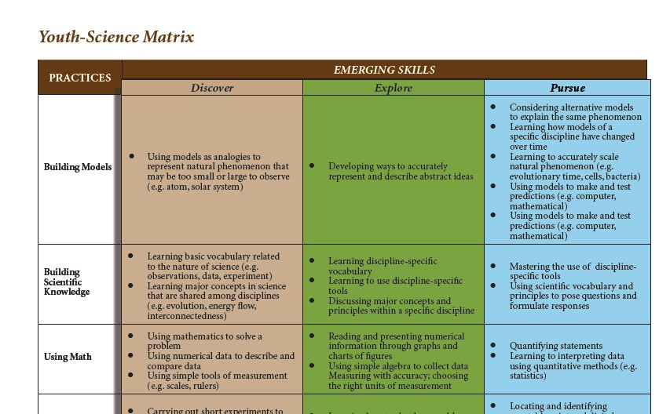
Framework
Project Exploration's Youth Science Matrix

Slide 7
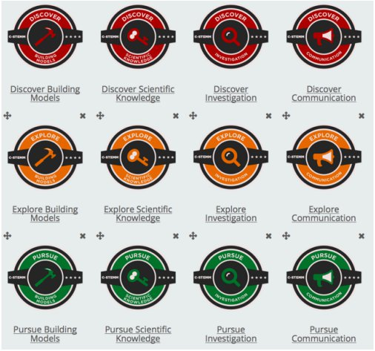
C-STEMM BADGES

Slide 8
C-STEMM BADGES
Facilitate Communication Across Domains
Consider an Astrojournalism Badge aligned with C-STEMM + Astronomy + Journalism that includes as evidence, an article the learner wrote.
The learner could share their badge as part of an application to a C-STEMM program:
• with their science teacher at school
• with the editor of their school newspaper
All leading to a community of learning for the student

Slide 9
C-STEMM BADGES
What we did…
Meet monthly
Identify (agree on) relevant skills and criteria
Build out badge system (specify learning outcomes and assessment for issuing badges)
Choose technologies and create badges
Pilot test
Evaluate
What we learned…
How do we implement badges with limited technology?
How can badges be integrated effectively into the learning context?
How can we give value to badges for youth, and the public?

Slide 10
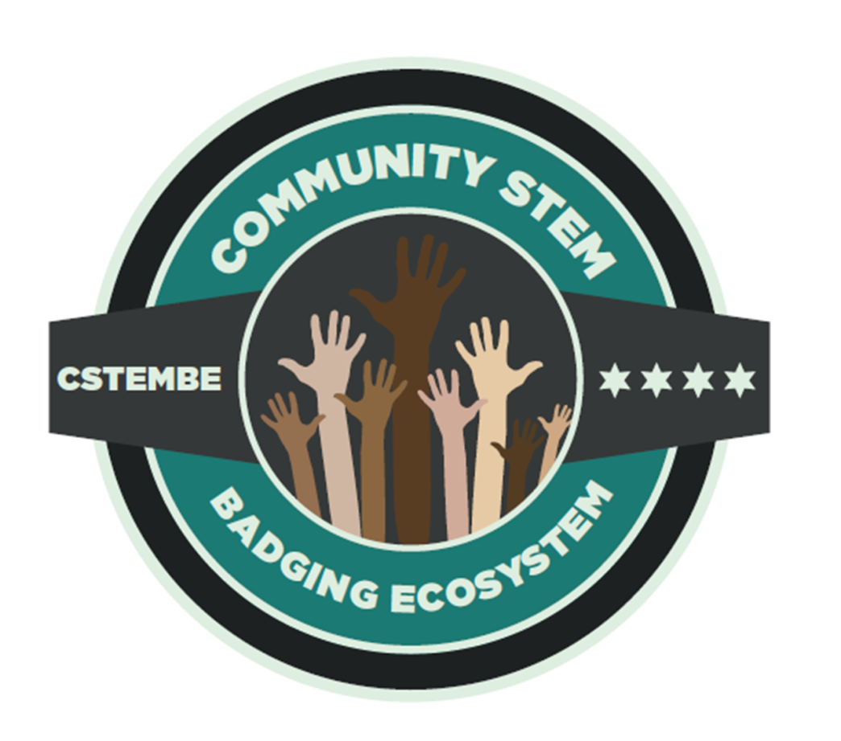

Slide 11
C-STEMBE Goals
Students
Engage students in reflection on learning
Recognize students for achievement
Allow students to share work with others, including in formal education contexts
Incentivize learning
Program
Document student work (PR/publicity)
Longitudinal record of student progress
Program evaluation

Slide 12
C-STEMBE Working Groups
Equity, Access, and Pathways
Make technology-based badges accessible to all learners
Increase student access to opportunities
The Value of Badges
Support intrinsic value for students
Create extrinsic value for education and career communities
Integration, connecting content and skills
Relationship between institutional level (content) badges and skills badges like C-STEM
Ensure consistent criteria and issuance across institutions
Technology
Create interoperability between badging platforms
Provide a seamless experience for organizations and learners

