Slide 1
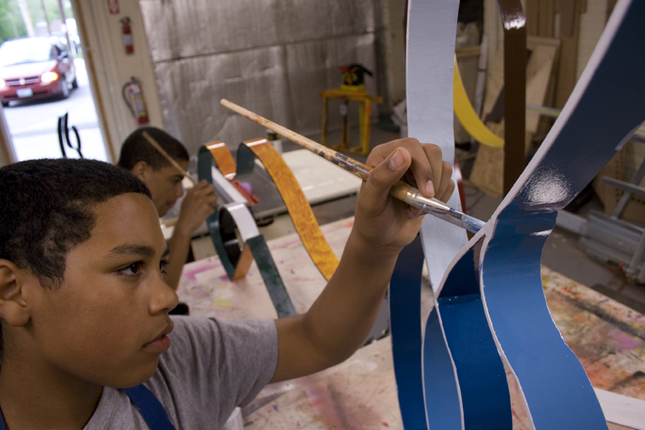
Rethinking High School Credit
ELOs for Credit: A Solution to Engage and Prepare Rhode Island Youth for the Future
Notes:
Quick overview of RIASPA
Quick overview of ELOs for Credit–
Opportunities for students to pursue learning outside of the traditional school day that expand upon or connect to learning in the classroom
Student-driven, rigorous, and competency-based
Learning can occur anywhere at anytime
In school, offsite, afterschool, during the summer
Can involve groups of students or an individual
Seven participating districts, two charters schools

Slide 2
State Context

Slide 3
State Context
2009- Rhode Island Basic Education Plan
Transition from “seat time” to proficiency-based system
Multiple Pathways→ meet needs of diverse leaners in the state
Proficiency-based graduation requirements→ required students to demonstrate proficiency
Expanded Learning Opportunities
Notes:
At Risk of Not Graduating:
Low-income students
English Language Learners
Students with special needs or disabilities
Minority students

Slide 4
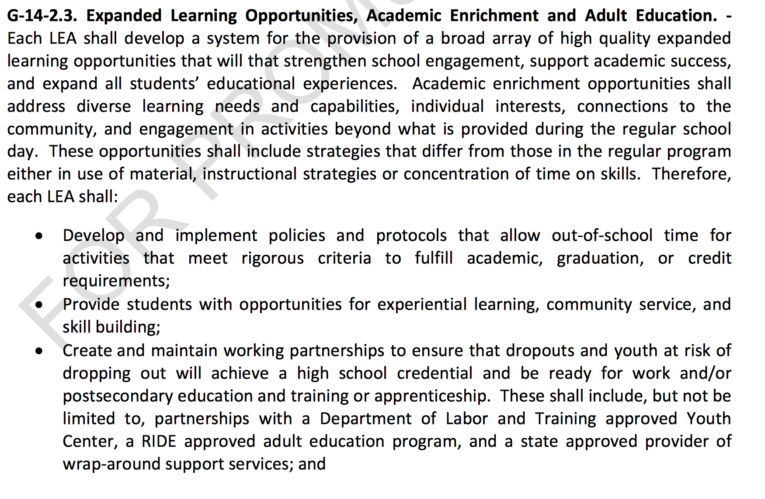

Slide 5
ELOs are…
Individualized
Competency-Based
Expanded Learning Opportunities
Student-Driven
Academically Rigorous
Builds Essential Skills
Hands-on and Experiential
Notes:
Project-Based learning elements– Research, Reflection, Product, and Presentation

Slide 6
ELOs for Credit Model
Student– At the center of learning
Teacher– Facilitator of learning and rigor
Industry Mentor– Guides hands-on, real world learning

Slide 7
Building the Initiative
Planning
Pilot Implementation
Expansion
Providence
Woonsocket
Central Falls
Establishing policy and processes to support districts
Defining roles of teachers and partners
Developing assessment to fit school and partner needs
Expand to serve more students—funding capacity

Slide 8
ELO Opportunities
Over 50 organization and individual community/industry mentors engaged statewide
Opportunity to engage industry and higher education partners in an effort to build college and career success
Notes:
Group and individual mentors
Opportunity to engage industry and higher ed partners to build career pathways

Slide 9
Outcomes of First Cohort
Over 400 students in Central Falls, Woonsocket, and Providence have received credit through ELOs since 2009.
ELOs were sited as integral to increasing the graduation rate by 18% from 2010 to 2012 at Central Falls High School.
Students at Central Falls who participated in ELOs cited increased interest in the subject matter, more incentives to attend school, improved learning habits, higher academic motivation, better self-confidence, and greater achievement.
Digital badges issued to participants in PASA’s the HUB

Slide 10
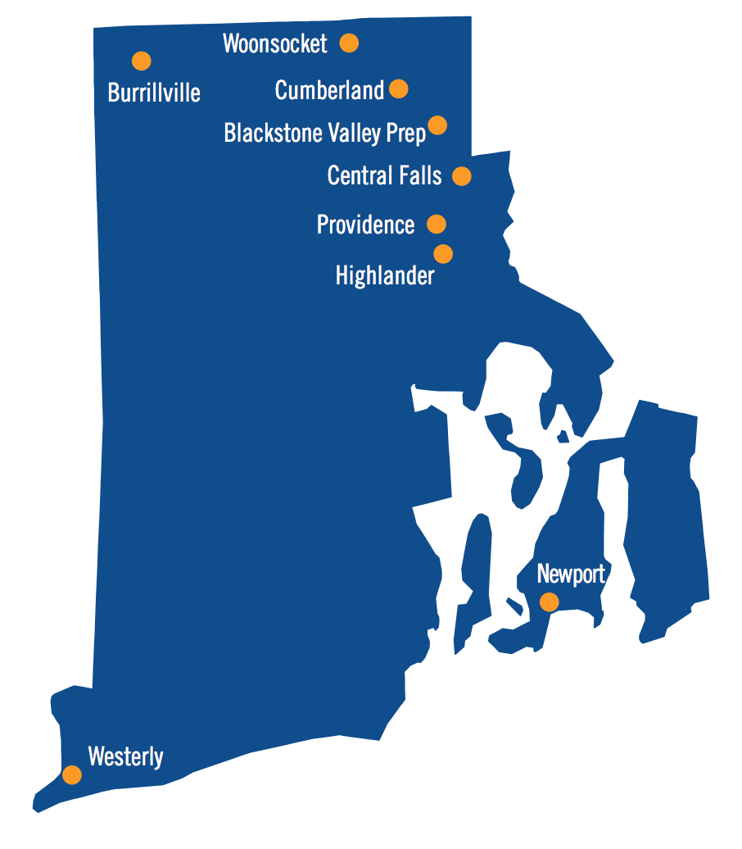
Going to Scale
4 new districts and 2 charter schools
Successes:
Working with RIDE to promote proficiency-based learning
ELOs as graduation requirement in charters

Slide 11
Various Models To Fit District Needs
Central Falls
Create multiple pathways to graduation as part of school-wide transformation– credit recovery
Burrillville
Personalized learning for unique student needs
Fulfill digital portfolio requirement
Westerly
Support transition from middle school to high school
Improve student engagement and school culture and climate
Cumberland
Create interdisciplinary learning experiences
Tie multiple expanded learning efforts together
Enhance afterschool offerings, increase partnerships
Incorporated experiential learning into the school day
Expand STEM offerings
Expand course offerings
Notes:
Common Challenges:
Connecting learning to real world experiences– engagement of students with different learning needs
Supporting students in meeting PBGRs
Expand course offerings
Highlander and BVP– incorporated into graduation requirement for students
East Providence– thinking about how to reach repeat 9th, 10th grade students who have failed Algebra 1 and English 9 through an alternative learning program that incorporates experiential learning into core curriculum

Slide 12
Next Steps for RIASPA
Supporting rigorous statewide community partners to map to graduation expectations
Maintaining buy-in from districts to support sustained funding
Expanding to new districts
Formalize connection with higher education partners
Digital badges!

Slide 13
Check Us Out
RIASPA: http://afterschoolri.org/
Woonsocket: http://elowoonsocket.weebly.com/
Central Falls: http://cfhs.cfschools.net/expanded-learning-opportunities.html
Providence (PASA’s the Hub): http://hubprov.com/

Slide 14
For More Information
Contact Info:
Michelle Un
Michelle.Un@afterschoolri.org

