Slide 1
Personalizing Student Learning Using Adaptive Learning
Adaptive Learning—How is Learning and Teaching Different?
Rob Manzer & Judy Komar

Slide 2
The Adaptive Learning Story
What is the problem?
The Variance Factor
We Don’t Know….
Swiss Cheese
Let’s get personal
Manzer, Komar
Notes:
Story

Slide 3
The Problem:

Slide 4
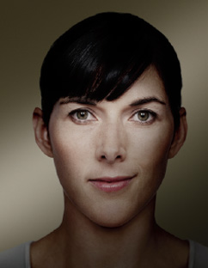
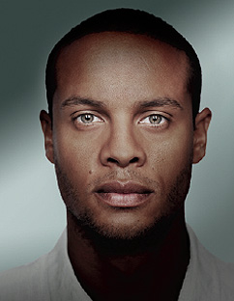
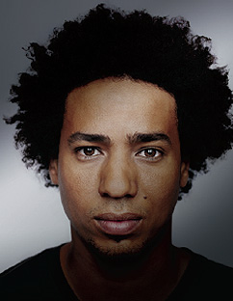
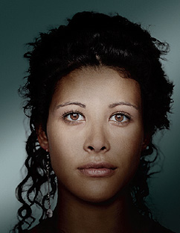
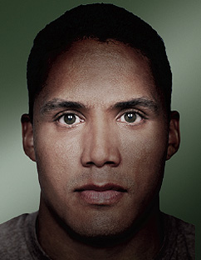
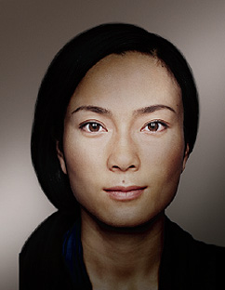
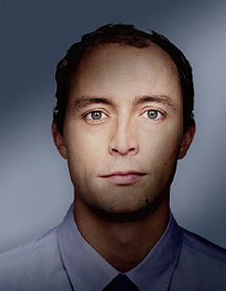
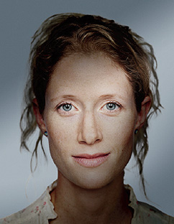
The Challenge: How do we know what they need?
What they bring….
• Educational experience
• Work experience
• Life experience
• Diversity
• Adult life responsibilities
What they need….
• Efficiency in learning
• An R.O.I.
• An impact on their lives, careers, goals
What they bring….
• Educational experience
• Work experience
• Life experience
• Diversity
• Adult life responsibilities
What they need….
• Efficiency in learning
• To be met where they are
• An impact on their lives, careers, goals

Slide 5
The Answer: Demystify Learning through Technology
I did the assignment but still don’t get it
I haven’t read the material
I mastered the thesis statement
I need a challenge
Know what they know, what they don’t know, and where they need help
I need a refresher on statistics
I
Know the 4 Ps of Marketing
I mastered the steps in the writing process
I need remediation

Slide 6
Three Key Areas
Personalized Learning
Internalizing Learning
Tailored Content & Assessments
Optimized Pacing
Directed improvement
Organic Continuum of learning
Active Learning
Student is a driver, internal motivation
Real-time feedback
Comprehensive coverage of content
Knowledge State, Knowledge Covered, Knowledge Growth
A New Way of Teaching
Instructor begins from a new place
Informed through real-time data
Adaptive Instructional Strategies
Guide students through learning paths, traversing the map, and knowledge growth

Slide 7
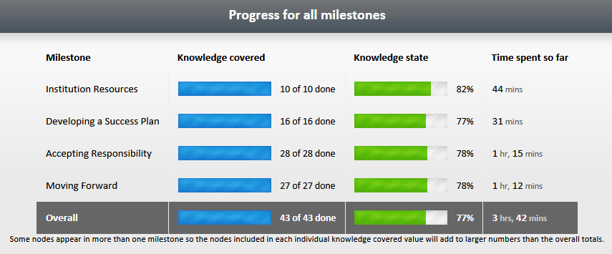
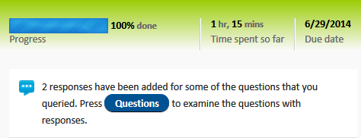
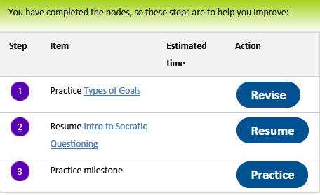
Personalized Learning
a. The learning process is tailored to the individual learner
b. Learning Analytic Engine and Mapping facilitate learning
c. Informed Learners from real-time interaction, data, feedback, and analysis

Slide 8
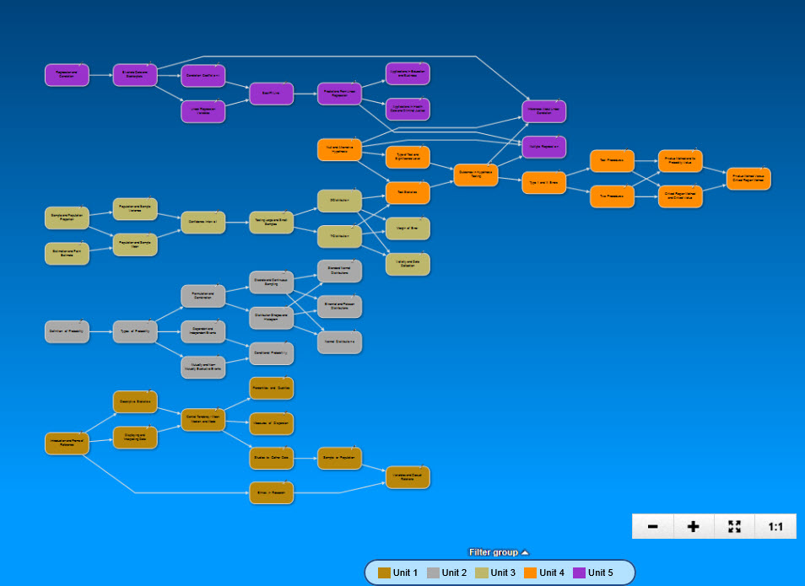
Key: Internalizing Learning
a. More comprehensive coverage of content at a more granular level
b. Learners have increased control of learning experience and that changes everything—light bulb is now on

Slide 9
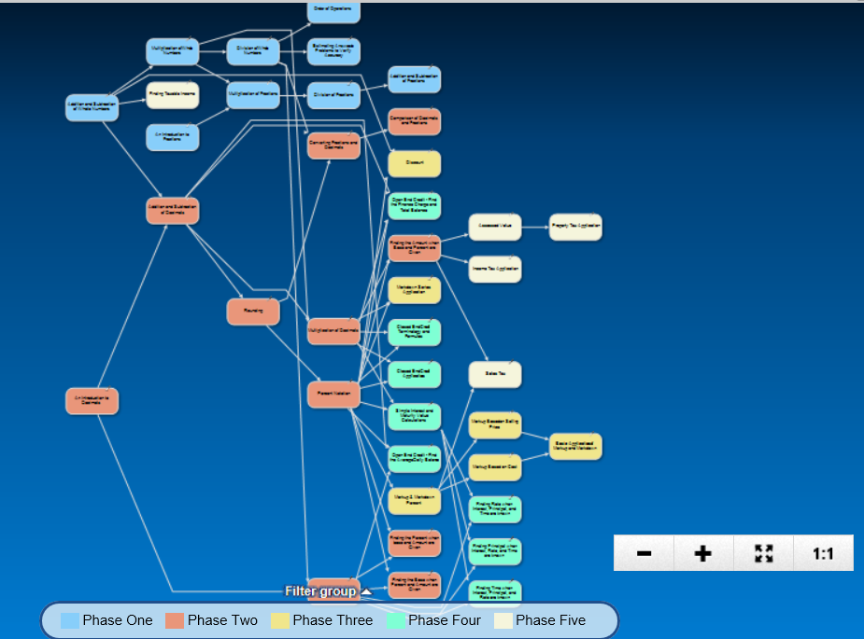

Slide 10
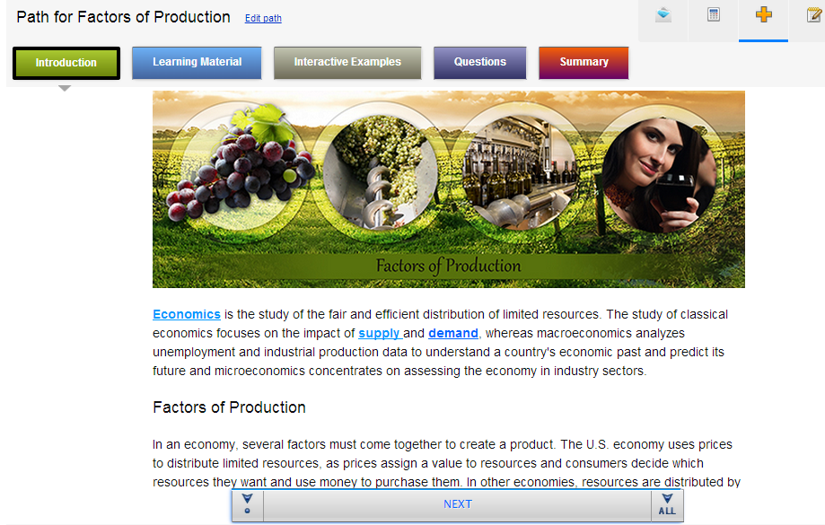
Personalized Learning: Tailored Content & Assessments
a. Goal of engine = right content, for the right learner, at the right time
b. Content alignment with learner’s gaps, filling knowledge gaps, allowing learner to master content
c. Assessment is continual (checked every 3-5 minutes)evidenced

Slide 11
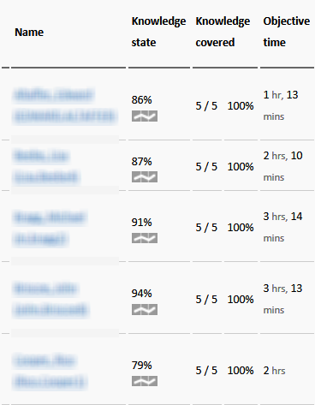
Personalized Learning: Pacing and Student Growth
Optimized Pacing
a. Convenient for learners
b. Time to master if you choose
Directed improvement
a. Learner, engine, and faculty can direct improvement
b. Learners are choosing to return to completed lessons and improve

Slide 12
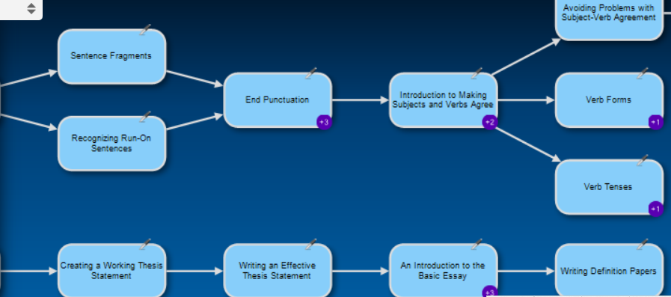
Personalized Learning: Organic Continuum of learning
a. Breakdown of lock step
b. Meeting learners where they are
c. Systems let’s them go where they choose to go within the pathing, traversing the learning map back and forth
d. Continuum between concepts, units, courses
Orientation
English Composition I
English Composition II

Slide 13
Active Learning
Learner is an empowered driver who has internal motivation
a. Learning experience is not chosen for learner, learner has input, choice, options, takes responsibility for learning
b. Replaces passivity in learning—tailored content challenges and stimulates active stance
c. Replaces standard pacing and moving on before the learner may have mastered concept
d. Engaging and interactive experience with Learning Analytic Engine giving personalized information for learner

Slide 14
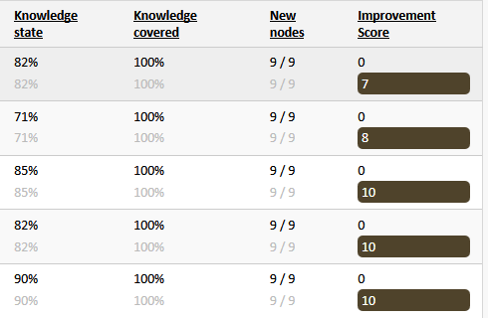
Active Learning: Learning in Real Time
Real-time feedback
a. Feedback is personalized and immediate
b. Allows learner to move forward and continue to learn asynchronously
Comprehensive coverage of content
a. Content is granular and individual gaps (Swiss cheese) are filled
b. Understanding and application of knowledge to authentic assessments of course
Knowledge State, Knowledge Covered, Knowledge Growth
a. Knowledge vs. Grading and Assignments

Slide 15
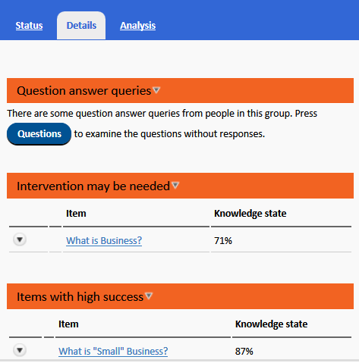
Teaching from Knowing
Start from Knowing
Informed through real-time data
Focus: when and how to intervene, who to help, and who to challenge
Focus: difficult content and concepts

Slide 16
Faculty Focus
Motivation: effective teaching
Focus: adaptive, responsive teaching strategies
Most informed faculty ever
From canned material to tailored, responsive intervention
Guiding students through gap-filling learning process and authentic assessments of student learning
Sage on the side

Slide 17
Adaptive Learning at AIU
60 different maps in Gen Ed., Business, Information Technology, & Criminal Justice
Orientation, Associate, Bachelor, Masters
Implementation key points:
SME and Curriculum Leaders design learning map structure
Rethinking Design – best use and sequence of all course elements
Assessment Question Design—variety, variables, and dynamic questions
Faculty Training
Reporting & Analytics

Slide 18
AIU Goal: Improve Student Outcomes
11 Business Courses
From 73% to 80% pass rate improvement
From 10% to 5% in-term drops
90.4% Average Knowledge Covered for all courses
40% Average Rate of return to practice or revise lessons that are complete

Slide 19
Adaptive Learning in Practice: A few facts
50,000+
Students
62 million
6.4 million
Assessment Questions
Lessons Completed
1.4 million
1.1 million
Practice & Revision Lessons
Faculty and Student Interactions and Interventions

Slide 20
Your questions for us?

