Slide 1
Minding the (Soft-Skills) Gap: The Importance of Soft-Skills Development for Community College Students
Presenters: Jessica Besser-Rosenberg, Director, Research & Communications, One Million Degrees
Jiffy Lansing, PhD Candidate, Human Development and Social Policy, Northwestern University

Slide 2
What We Know College Changes & How “College” Is Changing
Positive association between a college degree, including associate’s degrees, and labor market earnings
Community colleges constitute an increasing sector within higher education
Field-specific associate’s degrees and certificates

Slide 3
Lingering Issues
Persistence at community college is challenging
Marketability and mobility on the labor market requires more than just a degree
Human Capital has two components:
Hard skills
Soft skills

Slide 4
One Million Degrees’ Mission
One Million Degrees empowers low-income, highly motivated community college students to succeed in school, in work, and in life.

Slide 5
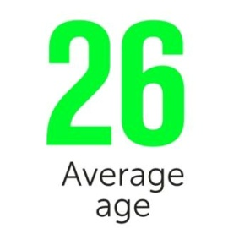
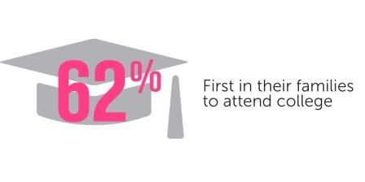
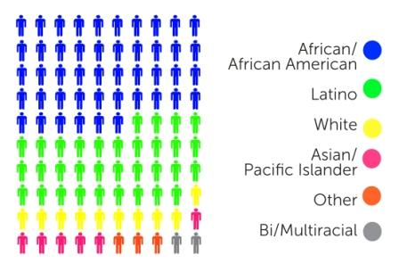
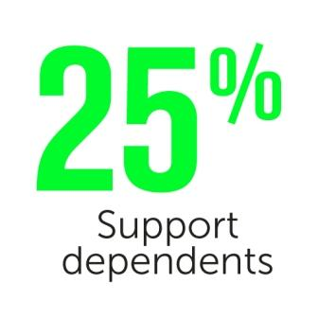
The OMD Scholar
40%
60%

Slide 6
Scholar Strengths
Highly motivated
Rigorous application process
Examples of resilience
Vision for future
Commitment

Slide 7
Scholar Challenges
Financial
Competing responsibilities
Majority working
15% parenting
25% care-giving
Housing
Social

Slide 8
Scholar Challenges Continued…
Varying levels of resources at community colleges and in surrounding community
Even when resources are available, few community college students take advantage of support services on their own

Slide 9
OMD’s Conceptualization of ‘Soft Skills’
Professionalism
Executive Functioning
Soft Skills

Slide 10
Our Scholar Development Model
Long-term, personalized one-on-one coaching with volunteer professionals who receive ongoing support and training from OMD.
Academic Advising
Proactive support to map out and plan for degree completion, transfers to universities, and career paths.
Coaching
Immediate, individualized, sustained interventions and support to succeed academically.
Personal Supports
Ongoing intensive support from a dedicated staff, and referrals to additional supports as needed.
Tutoring
“Last dollar” scholarships to supplement federal and state financial aid and stipends to defray educational costs.
A three-year curriculum of professionalism and communication skills, financial literacy training, and civic engagement and leadership development.
Financial Assistance
Life Skills
Career Readiness
Regular opportunities to visit Chicago-area workplaces and learn first-hand about different industries and functions.

Slide 11
OMD Program & Soft Skills
Professionalism
Executive Functioning
Soft Skills
OMD Programming

Slide 12
Is There Something Else Going On?
Professional-ism
Executive Functioning
?
Soft Skills
OMD Programming

Slide 13
Adulthood and Occupational Identity
Work as:
Pathway to self-sufficiency
Mechanism of social inclusion
Means to developing and expressing one's adult identity
Current policy focus:
Economic self-sufficiency outcomes
Development of human capital
Argue that policy should also focus on:
Broader well-being outcomes
Development of satisfying and productive adult identity

Slide 14
Identity Framework
Actor
Performance
Behaviors and Styles
Agent
Motivation
Planning and Commitment
Author
Integration
Past and Future
* Inspired by and adapted from McAdam’s & Zapata-Geitl’s “Three Strands of Identity Development Across the Human Life Course: Reading Erikson in Full.” 2013 in K.C. McLean & M. Syed (Eds), The Oxford Handbook of Identity Development

Slide 15
OMD, Identity, & Soft Skills
Professional-ism
Executive Functioning
Authorship
Soft Skills
Actor
Agent
OMD Programming

Slide 16
Year 1 Research Goals
Describe the experience of OMD from multiple stakeholder perspectives (including OMD staff, coaches, and scholars)
Highlight key program components’ strengths, challenges, and opportunities for improvement.
Develop conceptual framework linking identity development, capital development, and OMD programming

Slide 17
Application of Identity Framework
How, if at all, can identity work be done by OMD to support a path from college to career and upward mobility?
Which aspects of OMD programming relate to which of the three identity streams?
The important role of “audiences” in the identity framework

Slide 18
Methods
Qualitative Data Collection and Analysis:
Scholar focus groups (3)
Coach focus groups (2)
Staff focus group (1)
Staff interviews (3)
Observation of workshops and events (10)
Program material review

Slide 19
Identity Audiences
Actor
Immediate social interactions
Agent
Pathways – opportunities and obstacles
Author
Trusted others

Slide 20
Operationalizing Identity Work
ACTOR
Habits of self presentation
Developing professionalism and communication skills
Traits in action
Identifying and practicing socio-emotional skills

Slide 21
Operationalizing Identity Work
AGENT
Future orientation
Career & self exploration
Goals, planning and decision-making
Developing pathways and preparing for obstacles
ACTOR
Habits of self presentation
Developing professionalism and communication skills
Traits in action
Identifying and practicing socio-emotional skills

Slide 22
Operationalizing Identity Work
AUTHOR
Integrating past & potential future
Navigating “belonging” and “becoming”
Understanding and explaining
Storytelling to supportive audiences
AGENT
Future orientation
Career & self exploration
Goals, planning and decision-making
Developing pathways and preparing for obstacles
ACTOR
Habits of self presentation
Developing professionalism and communication skills
Traits in action
Identifying and practicing socio-emotional skills

Slide 23
OMD, Identity & Soft Skills
 | ACTOR | AGENT | AUTHOR
Related Soft Skills | Professionalism | Executive Functioning | Authenticity, Belonging & Sustainability
OMD Programming | Professionalism & communication curriculum Experiential events | SMART goals Career exploration activities | Focused reflective writing exercises Bi-weekly reporting of successes & struggles
OMD Practices | Clear expectations and consequences Modeling by staff and coaches | Regular check-ins by phone/email Office hours on campus Bi-weekly self report | Coaches & scholars encouraged to share their own stories
OMD Roles | Program Coordinator Coaches Volunteers | Program Coordinator Coaches College Advisors | Coaches Program Coordinators

Slide 24
Mechanisms
Accountability
Scholarship
Clear Expectations
Encouragement & Guidance
When I came to OMD, I didn’t know what I was capable of but now I realize I am capable of anything I put my mind to. (second year scholar)

Slide 25
Final Thoughts
How do we best measure development in each layer of identity?
How are the three layers related to each other?
What outcomes should we be measuring?
Self-efficacy
Healthy relationships
Community engagement

Slide 26
Thanks!
Jessica Besser-Rosenberg, One Million Degrees
jbr@onemilliondegrees.org
Jiffy Lansing, Northwestern University jiffy@uchicago.edu

