Slide 1
Strategies and structure for local educational needs
Katya Nuques

Slide 2
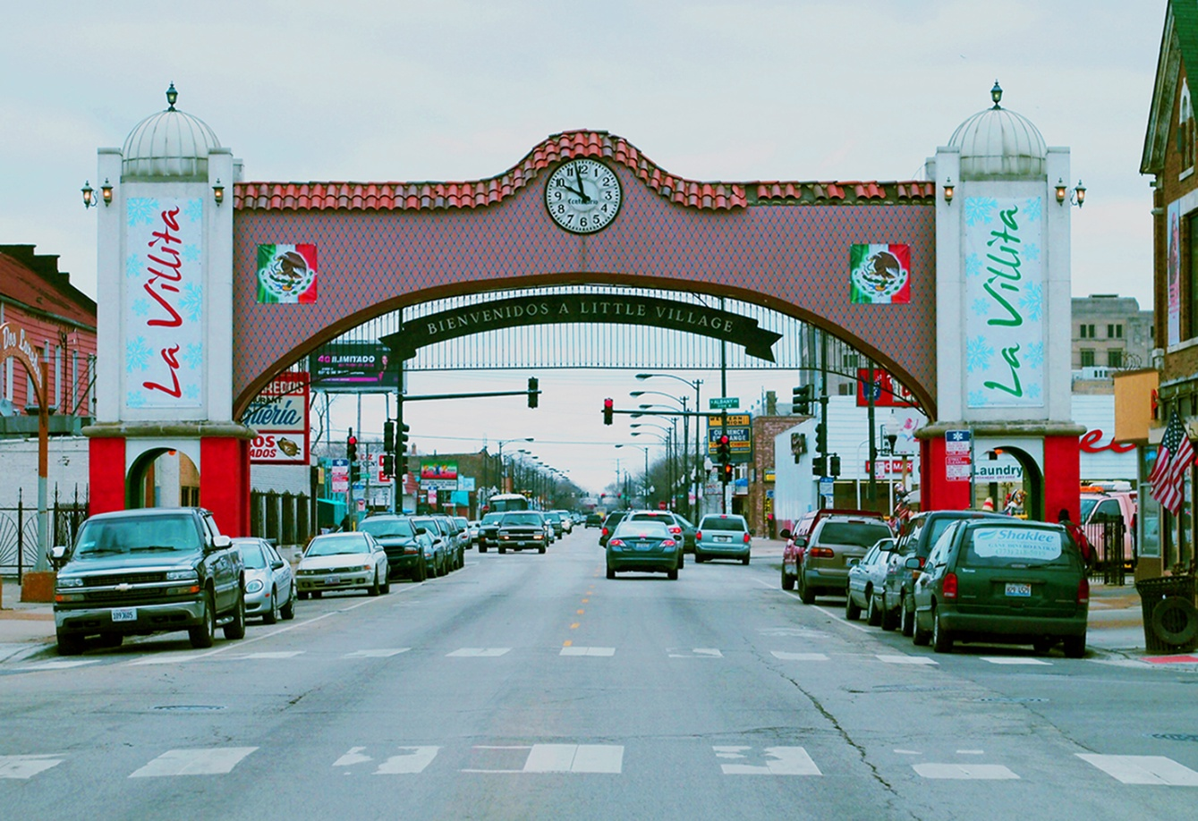
Little Village (South Lawndale) South West of Chicago
Population: 79,288
82% Latino
47% foreign born
53% native born
31% non-citizens.

Slide 3
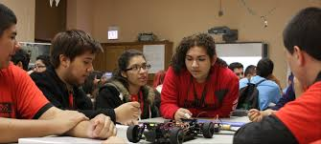
A very young community!
30% of the population under 18 years of age. 10% under the age of 5 (8,000 0-5 children)

Slide 4
Education Facts
Only 24% of residents hold a high school diploma.
Only 10% have any college experience.
There are 16 elementary schools (public) and 5 high schools (1 neighborhood high school and 4 small schools housed in a high school campus).

Slide 5
Graduation and College Enrollment Rates of Local High Schools

Slide 6
The role of community-based organizations
COLLEGE-GOING CULTURE
STRATEGIES AND STRUCTURE RESPOND TO LOCAL NEEDS
CRADLE TO COLLEGE
CAREER READINESS
STRONG O&A ELEMENT, COALITION WORK

Slide 7
Supporting Undocumented Students
Quintiliano Rios Perez,
Postsecondary Coordinator-LVLHS Community High School

Slide 8
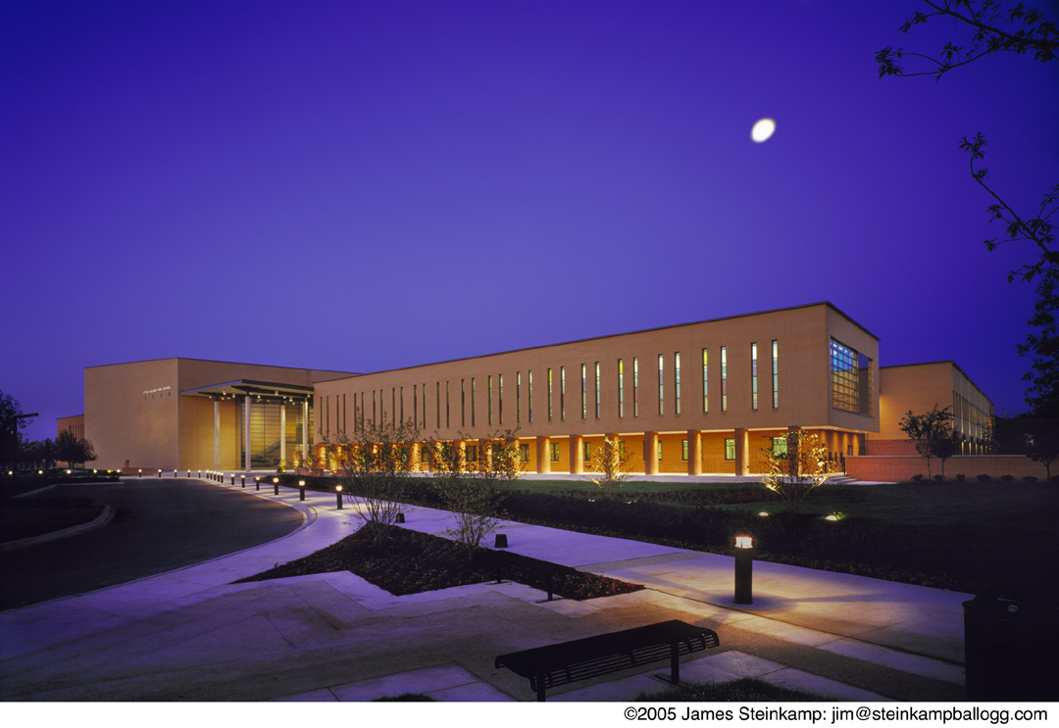
Support
2 Locations
Farragut Career Academy
Little Village Lawndale Campus
One-on-one.
Cohort model.
Workshops/training.

Slide 9
Resources
Needs:
Post-secondary Finances; College Passport
Scholarships
Deferred Action for Childhood Arrivals

Slide 10
Resources (continued)
Scholarships are scarce
More chances for local, community-based scholarships.
Getting into college vs Staying in college.

