Slide 1

College and Career Readiness Begins at Birth: Connecting the Dots for Student Success
July 17, 2014
College Changes Everything Conference
Tinley Park, Illinois
Reyna Hernandez, Assistant Superintendent
Center for Language and Early Child Development
Illinois State Board of Education
Theresa Hawley, Executive Director
Governor’s Office of Early Childhood Development

Slide 2
College and Career Ready Students
Establish independence
Acquire a strong content knowledge base
Adapt communication to audience, task, purpose or discipline
Comprehend, critique and question
Value evidence through citing and evaluating
Use technology and digital media thoughtfully
Understand other perspectives and cultures
National Governors Association/Chief State School Officers (2010)
Notes:
The definition of career and college ready students is listed in the Common Core document. Students who are college and career ready in reading, writing, speaking, listening and language establish independence, have a strong content knowledge base, and adapt communication to specific audience, task, purpose and discipline. These students comprehend, critique and question what they consume. They value evidence through citing evidence while communicating and evaluating others use of evidence. College and career ready students use technology and digital media thoughtfully and understand and appreciate other perspectives and cultures.

Slide 3
Continuity in the Early Years
Through alignment efforts across birth to grade 3, we can improve transitions for children and families and improve educational outcomes.
A seamless system of education from birth, through kindergarten, and into elementary school is key to maximizing impact of early childhood investments.
Early Childhood
K
Early Elementary
Alignment Efforts Will Improve Transitions
Early Childhood K Early Elementary

Slide 4
Organization
Core Components | Early Childhood |  | Early Elementary
 | Birth to Age 3 Years | Preschool Age 3 to 5 Years | Kindergarten | 1st Grade | 2nd Grade | 3rd Grade
Organization | Home Visiting Center-based No Universal Access Non-compulsory | School District Child Care Head Start No Universal Access Non-compulsory | School District Private Universal Access Non-Compulsory | School District Private Universal access Compulsory (ages 6-17)
Non-Compulsory
Compulsory
No Universal Access
Universal Access

Slide 5
Student/Child Learning Standards
Core Components | Early Childhood |  | Early Elementary
 | Birth to Age 3 Years | Preschool Age 3 to 5 Years | Kindergarten | 1st Grade | 2nd Grade | 3rd Grade
Student/Child Learning Standards | Illinois Early Learning Guidelines for Children Birth to Age Three | Illinois Early Learning and Development Standards (3 years to Kindergarten Enrollment) | Illinois Early Learning Standards for Kindergarten incorporating Common Core State Standard | Illinois Learning Standards, incorporating the Common Core State Standards Illinois Social-Emotional Learning Standards
Child Development
College and Career Readiness

Slide 6

Illinois Early Learning Guidelines 0-3
The Newborn Period
Self Regulation: A Foundation of Development
Domains of Development
  Social and Emotional Development
  Language Development, Communication, and Literacy
  Physical and Motor Development
  Cognitive Development
Approaches to Learning
http://www.isbe.net/earlychi/pdf/el-guidelines-0-3.pdf

Slide 7

Illinois Early Learning and Development Standards 3-5
Foundational understanding of what children from 3 to 5 years of age are expected to know and do across multiple domains
Developmentally appropriate expectations for children ages three to five
A forward progression of learning aligned with the Kindergarten Common Core Standards
Benchmarks that address all areas of development and learning
http://www.isbe.net/earlychi/pdf/early_learning_standards.pdf

Slide 8
College and Career Readiness
Illinois Learning Standards
(includes Common Core)
Early Elementary through High School
Illinois Early Learning Standards for
Kindergarten
(includes Common Core)
Ages 5-6 Years
Illinois Early
Learning and Development Standards
Aligned with the Head Start
Child Development & Early Learning Framework
Ages 3-5 Years
Illinois Early Learning Guidelines
Birth to Age 3 Years

Slide 9
Standards Alignment
Early Learning & Development Standards | Kindergarten-12 Learning Standards
Language Arts | English Language Arts and Literacy (CCSS)
Mathematics | Mathematics (CCSS)
Science | Science (Next Generation Science beginning 2016-17)
Social Studies | Social Science
Physical Development & Health | Physical Development and Health
The Arts | Fine Arts
English Language Learner Home Language Development | Foreign Language
Social/Emotional Development | Social Emotional Learning
Early English Language Development | English Language Development
Spanish Language Arts
Notes:
There is a lot of overlap between standards. However, certain things are distinct. ELDS were developed based on developmental literature regarding how children are expected to develop. Common Core was developed looking at what students need to know and be able to do to be successful in college, career, and life. The balance, coverage, depth, and difficulty may be different across the continuum. There is a lot of room for aligning practices based on standards.
“The Common Core was developed by building on the best state standards in the United States; examining the expectations of other high-performing countries around the world; and carefully studying the research and literature available on what students need to know and be able to do to be successful in college, career, and life.”

Slide 10
Relationship Between Standards and Assessment
  Standards are “goal-like” statements about the learning and development that most children typically exhibit by specific ages, when adequately supported
  Assessment provides a way to measure children’s progress along developmental continua that correspond to key competencies identified in the standards

Slide 11
Student/Child Assessments
Core Components | Early Childhood |  | Early Elementary
 | Birth to Age 3 Years | Preschool Age 3 to 5 Years | Kindergarten | 1st Grade | 2nd Grade | 3rd Grade
Student/Child Assessments and Screening | Broad-based developmental screening and formative assessments (e.g. Ages & Stages Questionnaire) | Formative assessments (e.g., Teaching Strategies Gold, High Scope Core, and Work Sampling) | Statewide - Formative Assessment Kindergarten Individual Development Survey (KIDS) District assessments (e.g., Dibels) | District assessments – formative, interim, and/or summative | District assessments – formative, interim, and/or summative | Statewide - Summative Assessment (e.g. ISAT) District assessments – formative, interim and/or summative

Slide 12


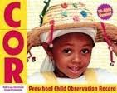
Appropriate Assessment in the Early Years
Observational assessments are best practice
Teachers collect observations on children’s demonstration of competence in everyday activities in the classroom
Rigorous systems for assessing children’s development on all dimensions (cognitive, language, social-emotional, etc.)

Slide 13

To learn more about KIDS:
illinoiskids.org

Slide 14
Interpreting Children’s Kindergarten Readiness
Readiness at beginning of Kindergarten
Meeting Early Learning and Development Standards (IELDS)
Readiness at end of Kindergarten
Meeting Early Learning Standards - Kindergarten (IELS-K)
Kindergarten
Range 1
Range 2
Range 3

Slide 15
Educator Qualifications
Core Components | Early Childhood |  | Early Elementary
 | Birth to Age 3 Years | Preschool Age 3 to 5 Years | Kindergarten | 1st Grade | 2nd Grade | 3rd Grade
Educator Qualifications | Teacher Licensure with Early Childhood Endorsement (Birth to 2nd Grade) |  |  | Early Childhood or Elementary Endorsement |  | Teacher Licensure with Elementary Education Endorsement
 | Gateways to Opportunity Credentials
Teacher License - Early Childhood
Teacher License – Elem. Ed.

Slide 16


Gateways Credentials for ECE
Progression of credentials for ECE professionals
Competency-based
Cover entry level through graduate degree level
Specific credentials for directors, infant-toddler, etc.

Slide 17
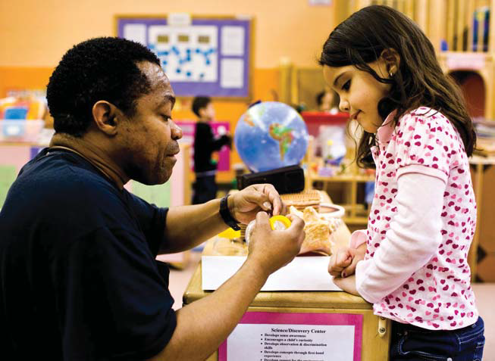
Teacher Licensure
New Grade Spans
Early Childhood – Birth through 2nd grade
Elementary – 1st through 6th grade
Middle – 5th through 8th grade
High School – 9th through 12th grade
Notes:
Birth through age three will remain in the early childhood teaching license
Early childhood trained staff will exclusively teach kindergarten with current teachers being grandfathered
The licensing overlap between early childhood and elementary teachers has been cut in half from 4 years to 2 years

Slide 18
Program Quality & Continuous Improvement
Core Components | Early Childhood |  | Early Elementary
 | Birth to Age 3 Years | Preschool Age 3 to 5 Years | Kindergarten | 1st Grade | 2nd Grade | 3rd Grade
School, Classroom or Program Quality Assessments & Continuous Quality Improvement | Home Visit Rating Scale (HOVRS) Infant/Toddler Environmental Rating Scale | Early Childhood Environmental Rating Scale (ECERS) Classroom Assessment Scoring System (CLASS) | Student Outcomes Data (KIDS) |  |  | Student Outcomes Data (ISAT, PSAE, ACCESS)
 |  |  | 5 Essentials Survey (survey of learning conditions and organization for improvement)
 | ExceleRate Illinois, Quality Rating and Improvement System (QRIS) Statewide Training, Technical Assistance and Coaching |  | Rising Star Framework (8 Essentials and district and school level indicators) IL Center for School Improvement (CSI) (foundational, focused, priority supports)

Slide 19


  Quality Rating and Improvement System (QRIS) http://www.excelerateillinois.com/
Licensed Child Care Centers
Preschool for All
Head Start/Early Head Start

Slide 20
Structure of ExceleRate Illinois
Licensing
Bronze Circle of Quality C
  Complete training over a wide range of topics
Silver Circle of Quality
  Rigorous self-assessment, with ERS completed by trained person such as a CCR&R Quality Specialist
Gold Circle of Quality
  Demonstrated quality, validated by outside assessor
Awards of Excellence
  Recognizing best practice for fostering developmental gains for at-risk children
  Can be earned by programs that are at Gold Circle
Notes:
This is the structure of the levels. Expectation is that all Preschool for All and Head Start programs be at level 4, and that many achieve the quality endorsements in areas like preschool instructional excellence, family engagement excellence, inclusion of children with special needs, etc.

Slide 21
Single set of standards, multiple forms of evidence
ExceleRate is designed recognizing that programs already have many kinds of monitoring
Programs may use different forms of evidence to show that they meet the quality standards
  Preschool for All monitoring (includes ECERS)
  Head Start federal reviews and other monitoring systems
  On-site monitoring by National Louis University (McCormick Center) using Program Administration Scale and ECERS/ITERS/SACERS
  Accreditation review of accreditations systems alignment with QRIS criteria)
Notes:
Designed so there is no one “easiest way”—fair to all providers

Slide 22

Illinois CSI Services
Focused coaching
Facilitation of effective processes
Foster collaborative partnerships
Provide transparent and comprehensive information
Connect the dots
Offer a strong support system from a large network of partners
Our Vision
High-Performing Districts
High-Achieving Students
Our Goal
To coordinate the delivery of high-quality, research-based resources and services designed to increase district capacity, improve student performance, and close achievement gaps.

Slide 23
Family & Community Engagement
Core Components | Early Childhood |  | Early Elementary
 | Birth to Age 3 Years | Preschool Age 3 to 5 Years | Kindergarten | 1st Grade | 2nd Grade | 3rd Grade
 | Parent Education | Parent Involvement | Parent/Teacher Conferences, Parent night, etc.
Family and Community Engagement | ExceleRate Illinois requirements for family engagement |  | ISBE Family Engagement Framework

Slide 24

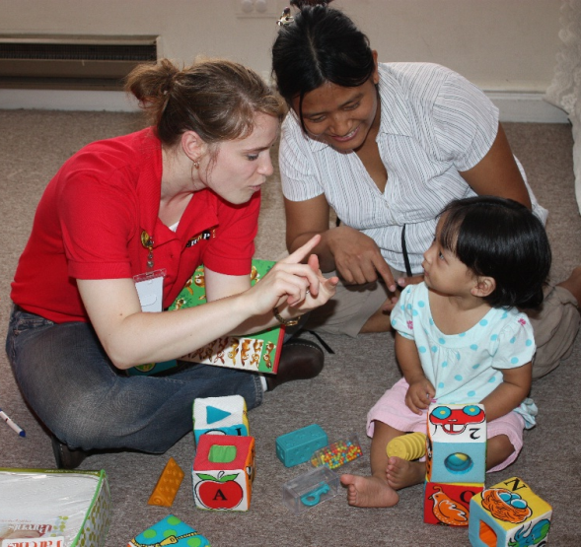


Family Engagement in Birth to Five
Home visiting as a key strategy
  Supporting parents to provide children early learning experiences and nurturance at home
Parenting education is a component of Preschool for All
Robust parent engagement is central to Head Start/Early Head Start

Slide 25
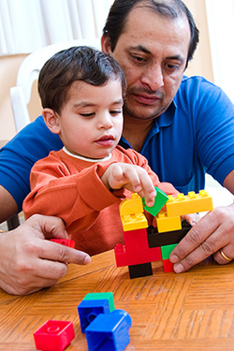

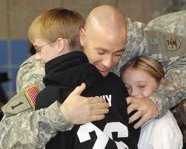
Family Engagement Framework
Guiding Document
Overall Purpose
  Bring together research, best practices, and program requirements
  Provide a resource for district/school leaders, and families to use in planning, implementing, and evaluating family engagement practices that directly improve student outcomes
Components
  Family Engagement Framework Overview
  Research Review
  Family Engagement Standards
  Integrating Family Engagement Matrix
  Legislative Requirements/References

Slide 26

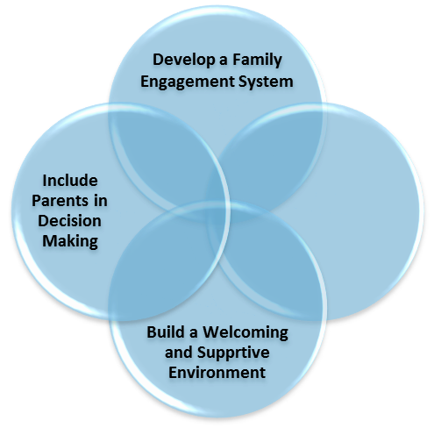
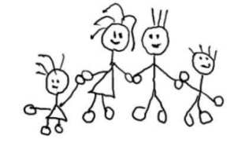
ISBE Family Engagement Framework
COMPREHENSIVE PLANNING
COMMUNITY & FAMILY
CURRICULUM
PROFESSIONAL DEVELOPMENT
Enhance
Communication
INSTRUCTION
CONDITIONS FOR LEARNING
ASSESSMENT
LEADERSHIP

Slide 27
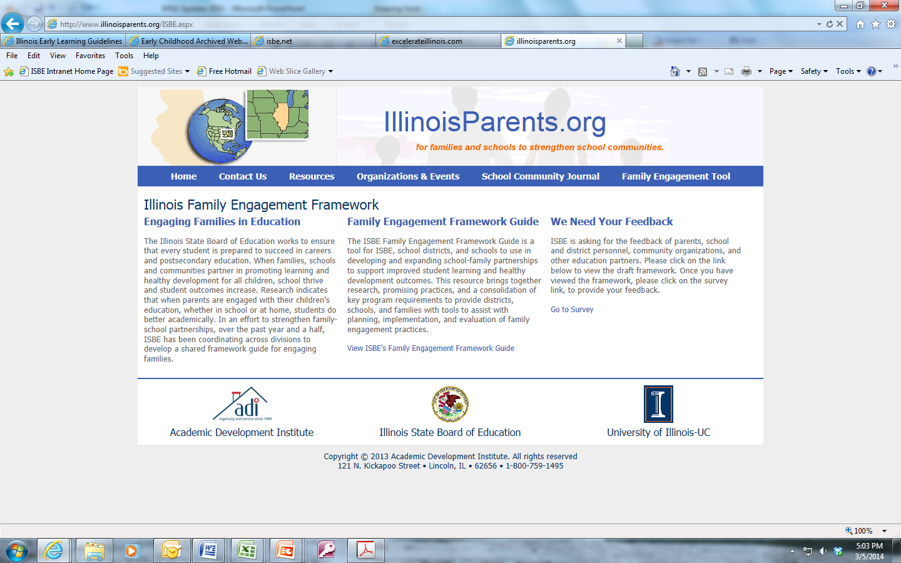
ISBE Family Engagement Website www.illinoisparents.org
Notes:
Take the survey and give us your feedback:
Go to the www.illinoisparents.org website
Click on the “ISBE Family Engagement Framework” blue button

Slide 28

Q & A

