Slide 1
Citizen Schools Illinois
Helping Children Discover and Achieve Their Dreams

Slide 2
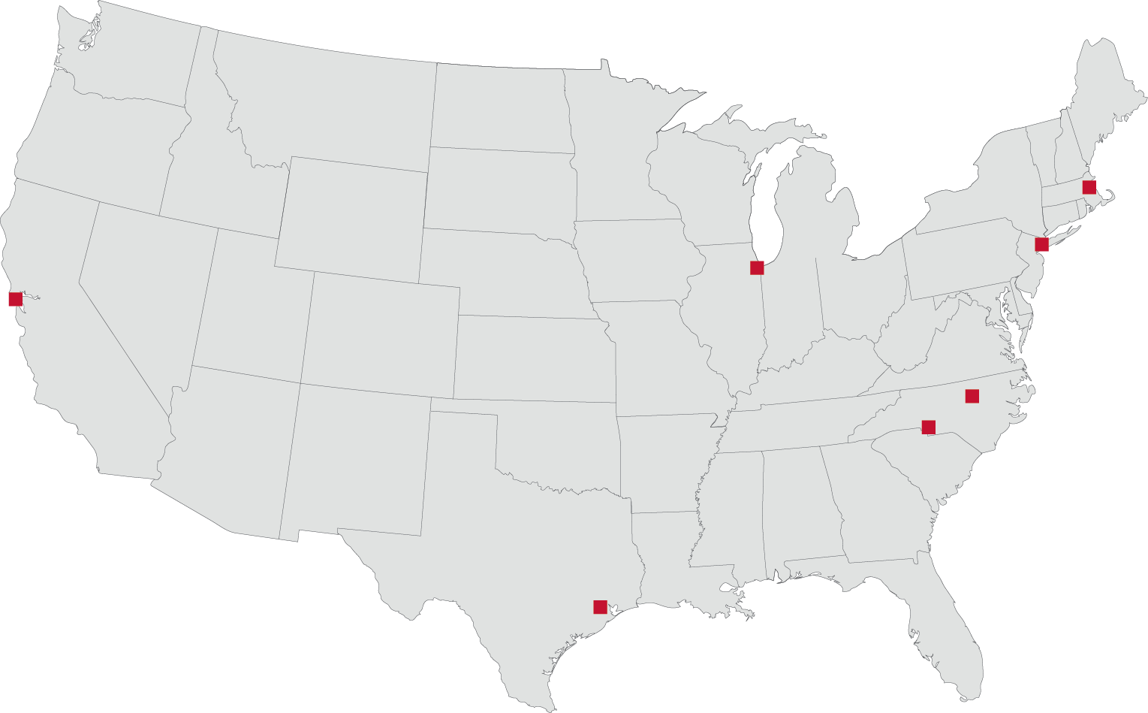
Our National Footprint
Founded in 1995 in Boston. 2013-14 : 7 states ■ 32 schools ■ 14 communities ■ 5,300 students ■ 4,700 volunteers
ILLINOIS - Chicago
Schmid Elementary (Pullman)
Woodson South Elementary School (Bronzeville)
NEW in SY14-15! Carter School of Excellence (Washington Park)
NEW in SY14-15! Chase Elementary (Logan Square)
MASSACHUSETTS
Boston
Dever-McCormack K-8 School
Edwards Middle School
Irving Middle School
Joseph Lee School
Orchard Gardens School
Chelsea
Joseph Browne School
NEW YORK
Bronx
Bronx Writing Academy
Harlem
Global Technology Preparatory
Isaac Newton Middle School
New Design School
Renaissance School of the Arts
Brooklyn
Urban Assembly Unison School
CALIFORNIA
East Palo Alto
Cesar Chavez Academy
Ronald McNair Middle School
Oakland
Elmhurst Community Prep
Lionel Wilson College Prep Academy
Redwood City
McKinley Institute of Technology*
Kennedy Middle School*
San Jose
Joseph George Middle School
NEW JERSEY
Newark
Eagle Academy for Young Men of Newark
Louise A. Spencer Elementary School
TEXAS
Houston
Edison Middle School*
Fondren Middle School*
Jackson Middle School*
Patrick Henry Middle School
NORTH CAROLINA
Charlotte
Martin Luther King Jr. Middle School*
Durham
Lowe’s Grove Middle School*
Neal Middle School*
2
2
Notes:
Citizen Schools started in 1995 under the premise that our citizens provide a tremendous untapped resource that can be better leveraged to close gaps in achievement and opportunity for low income students. Citizen Schools began their collaborative approach initially by leveraging volunteers. By partnering with members of the business and local community, Citizen Schools saw that we could drastically increase students engagement in school as well as their sense of possibility for their own futures.
Our program started in Boston and expanded across the country – most recently to Chicago in 2012.
Over the years- our model has evolved from an afterschool program where we collaborate deeply with volunteers from the business and local community teach students hands-on college and career aligned skills into a more in-depth model where we additionally collaborate deeply with \our partner school’s to help accelerate their school improvement efforts directly targeting the achievement gaps they want to close. We now focus not only on bringing in amazing volunteers from the corporate and local community but also on driving academic achievement through targeted academic support in ELA and or Math as well as socio-emotional and college and career skills and mindset development.

Slide 3
We Have an Innovative Approach to Closing the Achievement Gap
Notes:
So here is our model:
Our key premise at Citizen Schools is to build out the school day by three additional hours. In Illinois we partner with CPS middle schools to accelrate their school improvement efforts for students in grades 5-8 or 6-8 depending on the school and how they structure their middle grades.
We bring in committed adults, provide hands on learning in ELA or Math remediation as well as exposure to STEM fields, and spiral college and career as well as socio-emotional skills and messaging across our program.

Slide 4
We bring in an extensive team to support our schools
Campus Director
Full-time, college graduate with teaching experience. Serves as a member of the school leadership team
AMERICORPS MEMBERS
Either college graduates serving in the AmeriCorps National Teaching Fellowship, or Teaching Associates working part-time in pursuit of an education career.
Teaching Fellow
Teaching Fellow
Teaching Fellow
Teaching Fellow
Teaching Associate
Each Team Leader stewards 18-20 students, and partners with volunteer Citizen Teachers to support two apprenticeships each semester.
18-20 students
18-20 students
18-20 students
18-20 students
18-20 students
Volunteer Citizen Teachers volunteer in teams of 2-3 to teach a semester-long apprenticeship. One team teaches on Tuesdays, the other on Thursdays.
4-6 Citizen Teachers
4-6 Citizen Teachers
4-6 Citizen Teachers
4-6 Citizen Teachers
4-6 Citizen Teachers
Notes:
Here’s the manpower we bring to each school –
A campus director

Slide 5
We partner with schools to re-imagine the school day
MON
TUES
WED
THURS
FRI
Begins around 8:00 am
TRADITIONAL SCHOOL DAY
Overlap/PUSH-IN
Overlap/PUSH-IN
Overlap/PUSH-IN
Overlap/PUSH-IN
1:00-3:00pm
Transition around 3:00pm
HEALTHY Snack
HEALTHY Snack
HEALTHY Snack
HEALTHY Snack
TEACHING FELLOW
PROFESSIONAL
Development
Academic Support (more skills)
Academic Support (MORE SKILLS)
Academic Support (more skills)
Academic Support (more skills)
Apprenticeships (access to opportunities)
Apprenticeships (access to opportunities)
College to Career Connections & 8th Grade ACADEMY (beliefs)
College to Career Connections (beliefS)
Dismissal around 5:30pm
5
Notes:
Here is an example of our program day- during the school day our staff

Slide 6
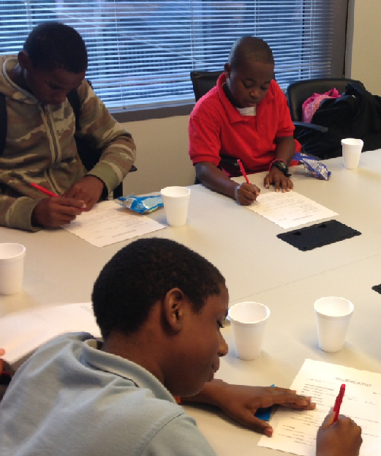
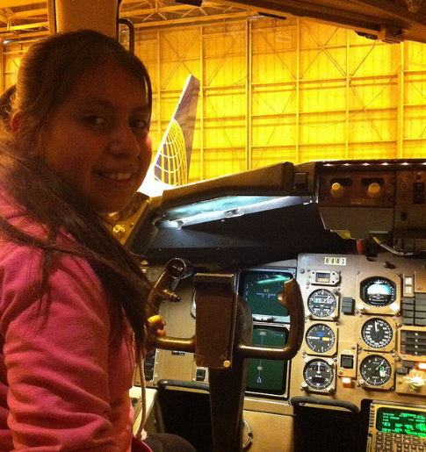
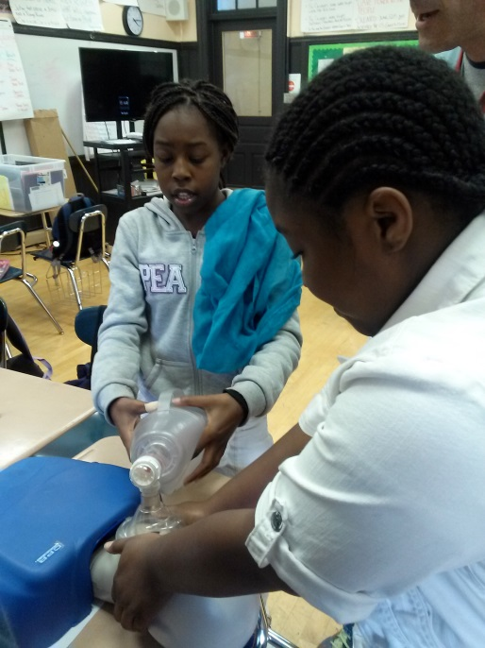
In a way that is exciting and empowers students
Academic Support
Additional standards-based Math and Literacy skills and concepts aligned to Common Core
Targeted homework support
Time management and self-organization skills
College to Career Connections
Explicit instruction in study skills and school success habits
Exposure to college and career opportunities and pathways
Individualized report card analysis to set goals for school success
Apprenticeships
Aligned to 21st Century Skills
Semester-long projects that culminate in student presentations
Co-taught by Citizen Schools staff and volunteer Citizen Schools Teachers who are experts in their fields
6
6

Slide 7
Our program is aligned to CPS SQRP
Report Card Measure | Weight | CSI Impact
National Growth Percentile on NWEA Reading | 12.5% | Academic Support, Gr. 6-8
National Growth Percentile on NWEA Math | 12.5% | Academic Support, Gr. 6-8
Priority Group National Growth Pctl. on NWEA Reading | 5%* | Academic Support, Gr. 6-8
Priority Group National Growth Pctl. on NWEA Math | 5%* | Academic Support, Gr. 6-8
% Making Nat. Avg. Growth on NWEA Reading & Math | 10% | Academic Support, Gr. 6-8
National Attainment Pctl. on NWEA Reading (Gr. 3-8) | 5% | Academic Support, Gr. 6-8
National Attainment Pctl. on NWEA Math (Gr. 3-8) | 5% | Academic Support, Gr. 6-8
National Attainment Pctl. on NWEA Reading (Gr. 2) | 2.5% | No influence
National Attainment Percentile on NWEA Math (Gr. 2) | 2.5% | No influence
Attendance Rate | 20% | Student & Parent Engagement, Gr. 6-8
ELL Progress on ACCESS | 5% | Limited Influence
5 Essentials Survey | 10% | Support an Organized School Environment through Student, Parent, Teacher Engagement
Data Quality Index | 5% | Some influence (can assist with Gr. 6-8 students turning in required paperwork)

Slide 8
We’re Driving Results
Accelerate Student Achievement
Increase Student & Family Engagement
CSI students made 2 years of academic gains in SY13-14!
CSI students met their NWEA growth targets (73% in subject area of focus) at a rate significantly higher than the average
95.4% attendance rate in Middle School
0.94% higher than all CPS middle school students
78.5% of 3rd-8th graders on-track to graduate (vs. 70.7% district-wide)
77% of students believe in importance of college vs. 49% of matched peers
80%+ of students who participated in a STEM-focused apprenticeship expressed interest in pursuing a STEM career, more than double the national rate
Greater parental attendance at report card pick-up days and other school events
Citizen Schools
Spr ‘14
National Avg
Citizen Schools
Spr ‘14
National Avg

Slide 9
Chicago Partners

