Slide 1
Strategies for Moving the Retention Needle
Renee Martinez, North Park University
Sylinda Menafee, Kishwaukee College
Pamela Bozeman-Evans, North Park University

Slide 2
The Evolution of Retention
1975 Vincent Tinto’s Retention Theory
Pre-college/pre-entry factors
Significant relationships & interactions
Support & sense of belonging

Slide 3
How well do Illinois colleges retain students?
4 year Private:
52.5% (4 year graduation rate)
65.7% (6 year graduation rate)
4 year Public:
40% (4 year graduation rate)
62.5% (6 year graduation rate)
2 year Public:
19.4% (150% time)
Source:
http://collegecompletion.chronicle.com/college-stats/

Slide 4
How are “WE” faring?
National Center for Educational Statistics (NCES) 1st-2nd year Retention:
Kishwaukee College:
60% FT Students
43% PT students
North Park University:
72% overall

Slide 5
So, what are the retention factors?
Academic
High School GPA & ACT/SAT scores
Non-Academic
Wellness: confidence, esteem, belonging
Personal: involvement, motivation, commitment
Academic : study skills, habits, time management
Context: size, selectivity, financial aid

Slide 6
What are the BIGGEST factors?
Strongest relationship:
Academic Skills
Academic Self-confidence
Commitment to the goal
Weakest relationship:
Academic motivation
General self-concept
Source: http://www.act.org/research/policymakers/pdf/college_retention.pdf

Slide 7
Kishwaukee College (Malta, IL)
Student Success Coach Program
The Student Success Coach program is designed to help connect students who are referred through our early alert program to college employees who can offer mentorship, direction, and encouragement.

Slide 8
Kishwaukee College
Success Coach Interventions (Week 4, Week 7, Week 12)
Instructors send early alert referrals (week 3) and encourage implementation of student goals (weeks 5-16)
Student-Coach matching and coordination (Retention Coordinator)
Ongoing communication with instructors (Retention Coordinator)
http://youtu.be/YNdI-uqnXE0

Slide 9
Kishwaukee College
Fall 2013 Pilot Results
 |  | Fall 2013 Coursework Performance |  |  |  |  |  | FA13GPA | SP14 Persistence
 |  | Pass |  | Fail |  | Withdraw |  | Mean | Yes |  | No
 |  | Count | % | Count | % | Count | % |  | Count | % | Count | %
Coached | Yes | 108 | 55.1% | 56 | 28.6% | 32 | 16.3% | 1.88 | 158 | 80.2% | 39 | 19.8%
 | No: Cohort | 89 | 48.4% | 51 | 27.7% | 44 | 23.9% | 1.79 | 144 | 77.8% | 41 | 22.2%
 | No: Other | 9506 | 67.8% | 2258 | 16.1% | 2266 | 16.2% | 2.49 | 10140 | 72.1% | 3919 | 27.9%
 | Total | 9703 | 67.3% | 2365 | 16.4% | 2342 | 16.3% | 2.48 | 10442 | 72.3% | 3999 | 27.7%

Slide 10
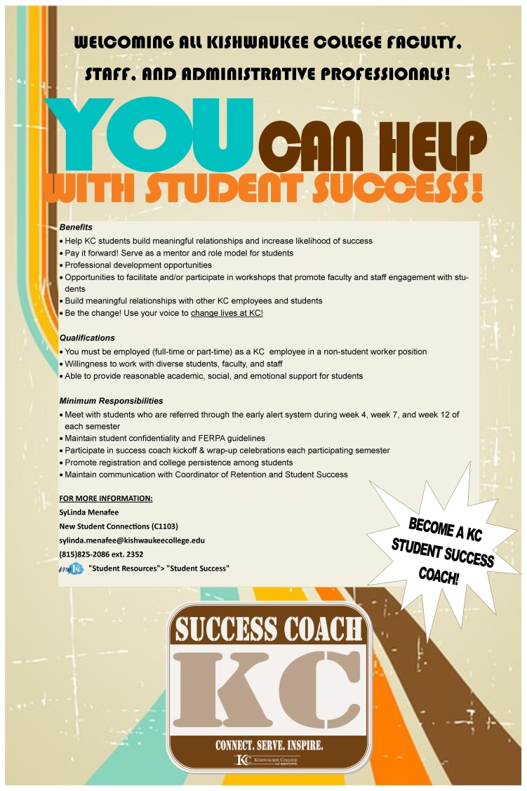
Kishwaukee College
Updates for 2014-2015
Partnership with Access, Equity, and Diversity Center to target specialized population
Expansion for the number of students we serve
Early Alert software purchase for tracking
Suggestions for implementation on other campuses

Slide 11
NPU Career Development and Internships Office
“How can career service departments implement/compliment intervention strategies that affect college persistence?”

Slide 12
North Park University
Address the Language and Culture of Retention
Terms like retention, outcomes, and interventions are academic terms that don’t translate well into community and family structures.
Must speak to cultural traditions, inter-generational finances, nontraditional support systems

Slide 13
North Park University
Address the Language and Culture of Retention
Retention is a critical factor in measuring college success, but it is not the end goal for most families/students. For many “end users” employment is the end goal.
In business we refer to ROI, in families we refer to family commitments and on-going contributions

Slide 14
North Park University
Address the Language and Culture of Retention
Retention is impacted by the diverse and changing demographic within our institutions. Understanding our audience shapes the way we communicate to and support student/families.
1st generation, Millennials, on-line options

Slide 15
North Park
Retention as a part of the institutional
mission and mandate
Once retention is embedded into the operational strategy of the university every department should track progress against work objectives.
NPU’s career services is committed to retention and demonstrates that by…

Slide 16
North Park University
Retention as a part of the institutional
mission and mandate
Smart collaborations are organic with an institutional mandate.
Student engagement, academics, athletics, and security must form a seamless relationship that naturally promotes retention i.e. orientation programs must all speak to retention

Slide 17
North Park University
Retention as a part of the institutional
mission and mandate
Retention begins at recruitment and beckons alumni to engage in the retention process
Career services must assist with recruitment, align freshmen with alumni in mentor programs, and create internships and job pathways through alumni networks

Slide 18
North Park University
Retention Strategies on a “Shoestring Budget”
Early Warning Systems (reactive)
Career services supporting financial hardships
Marketing materials from “first to finish”
Career services as a tool to promote retention

Slide 19
North Park University
Retention Strategies on a “Shoestring Budget”
Rapid Response Teams (proactive)
Career services can engage external partners to coach/mentor/sponsor disengaged students
Faculty Engagement (pizza budgets)
Career services connecting curriculum to vocation

Slide 20
North Park University
Retention Strategies on a “Shoestring Budget”
Intentional career service programs that engage (inspire) students according to their passion and career interests
Volunteerism, internships, experiential learning opportunities motivate students and help them find their “fit”

Slide 21
Why focus on the 2nd year?
Median 2nd year term-to-term retention at 2 year institutions = 85.7%
16-17% lost between 2nd & 3rd year at 4-year institutions
Only 59% reported having the financial resources to finish
Source: http://blog.noellevitz.com/2011/03/16/raising-completion-graduation-rates-2-clues-action-year/

Slide 22
Potential Actions Steps
“Completion Mindset”
Over ½ of the students surveyed said they wanted help with a written academic plan
“The desire to prepare for a career and the need to earn the money to do it come together.”
46% more sophomores want work or internships related to their majors vs. 1st year students
Source: http://blog.noellevitz.com/2011/03/16/raising-completion-graduation-rates-2-clues-action-year/

Slide 23
Thank you for your time!
Sylinda Menafee, Kishwaukee College
Sylinda.Menafee@kishwaukeecollege.edu
Pamela Bozeman-Evans, North Park University
pbozeman@northpark.edu
Renee Martinez, North Park University
rmtuckermartinez@northpark.edu

