Slide 1
Building Career Pathway Systems in Education with the STEM Learning Exchanges
Presenting:
Jim Nelson, IMA, Manufacturing Learning Exchange
Jess Smithers, FCAE, Agriculture, Food, and Natural Resources Learning Exchange
Bruce Neimeyer, UIC, Health Science Learning Exchange
Joan Matz, CompTIA, IT Learning Exchange
Jeff Mays, Illinois Business Roundtable
Moderating:
Andrea Messing-Mathie, Education Systems Center @ NIU

Slide 2
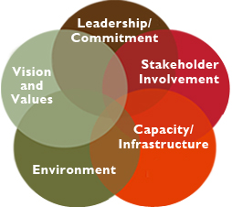
Collective Impact and Systems Reform
Shifting the conversation on systems reform
Collective Impact asks us to reverse the way we think about social change
Begins with an eye to building the eco-system of partners around a goal

Slide 3
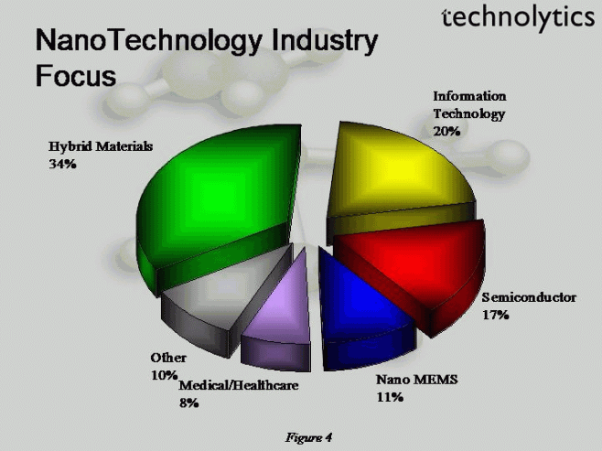
What do we know?
The employment landscape is shifting
Education needs to be more relevant to the real world
Resources and investments need to be coordinated in a way that makes sense to industry
We need complimentary community and state-level approaches to this work.

Slide 4
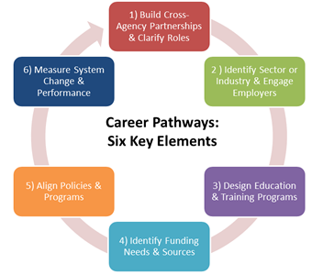
Emerging Roadmap

Slide 5
Illinois Pathways and 60 x 2025
Illinois Pathways is one of the key strategies of the state’s 60% by 2025 goal
Growing awareness that education and job opportunities are not aligned
The STEM Learning Exchanges are a key strategy of the Illinois Pathway approach
Redefining the relationship between education and employers
Organizes itself around a sector based approach
Engages with and encourages local communities as they develop local career pathway systems.

Slide 6
STEM Learning Exchanges
Delivering resources and supports for local career pathway systems
Expanding Quality Work-Based Learning Curriculum
E-Learning Curriculum
Access to resources
Supporting student organizations
Developing PD opportunities
Career exploration and outreach
Tools and resources to create personalized education
Internships, connecting with adult mentors, apprenticeships, meaningful connections
Student challenges
Coordinating across the state with pathways partners

