Slide 1
Collective Impact in Illinois: Getting to 60% by 2025

Slide 2
Presenters
Teresa Ramos, Outreach Director, Advance Illinois – tramos@advanceillinois.org
Dani Craft, Director of Operations & Community Engagement, Education Coalition of Macon County Foundation of Macon County – dcraft@edco4kids.org
Sarah Bjelland, Data & Research Manager, Education Coalition of Macon County – sbjelland@edco4kids.org
Sam Nelson, Director of Outreach Development, Illinois Student Assistance Commission – sam.nelson@isac.illinois.gov

Slide 3
Collective Impact: The Beginning
Since the 2011 Stanford Social Innovation Review article introduced the concept, collective impact has been widely adopted as an effective way to address complex social and environmental challenges.
Collective impact has proven to be a powerful approach in tackling a wide range of issues in communities all over the world.
Collective Impact vs. Isolated Impact

Slide 4
Stanford Social Innovation Review
“Collective Impact” – by John Kania & Mark Kramer, Winter 2011
http://www.ssireview.org/articles/entry/collective_impact
“Channeling Change: Making Collective Impact Work” – by Fay Hanleybrown, John Kania, & Mark Kramer, 2012
http://www.ssireview.org/blog/entry/channeling_change_making_collective_impact_work

Slide 5
Stanford Social Innovation Review
“Embracing Emergence: How Collective Impact Address Complexity” – John Kania & Mark Kramer – Jan. 21, 2013 SSIR Blog
http://www.ssireview.org/blog/entry/embracing_emergence_how_collective_impact_addresses_complexity

Slide 6
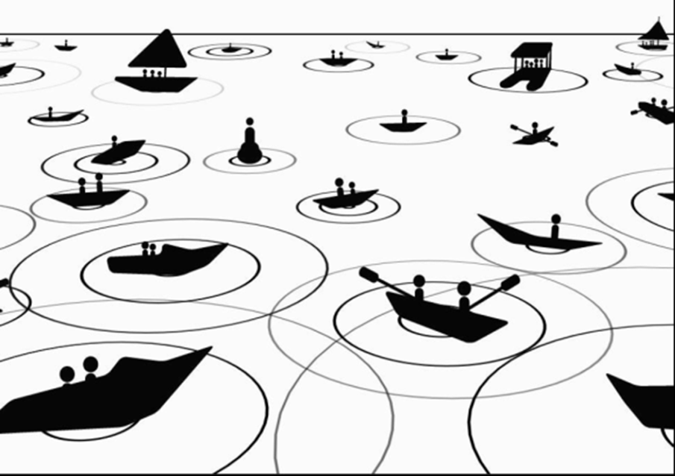
Isolated Impact

Slide 7
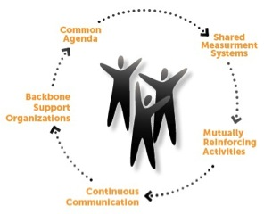
Collective Impact

Slide 8
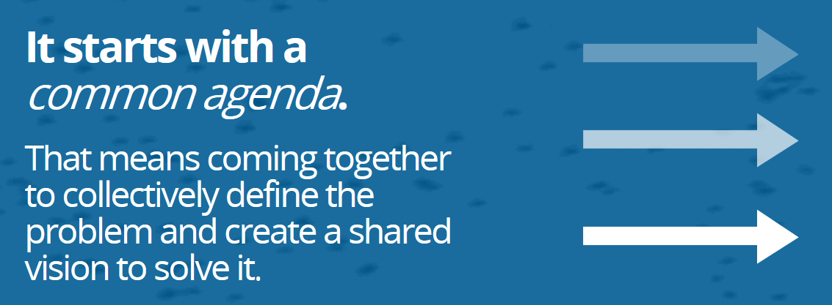
Collective Impact Condition #1

Slide 9
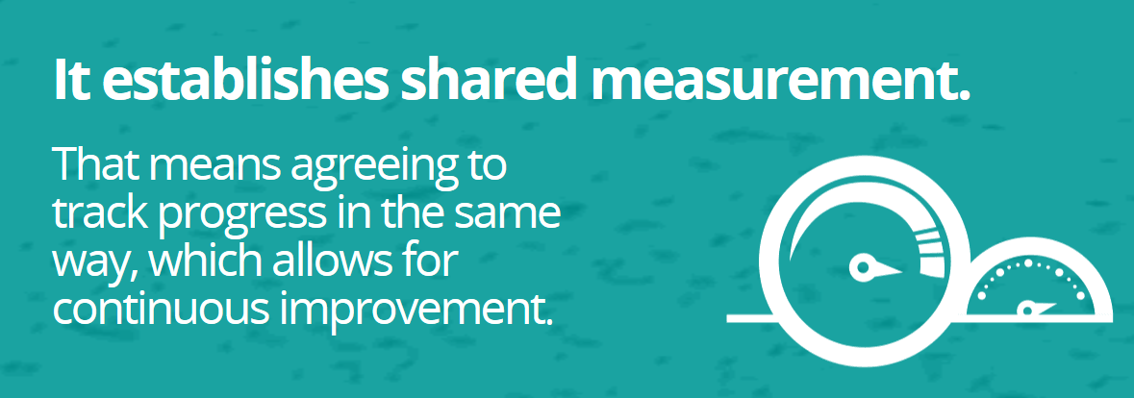
Collective Impact Condition #2

Slide 10
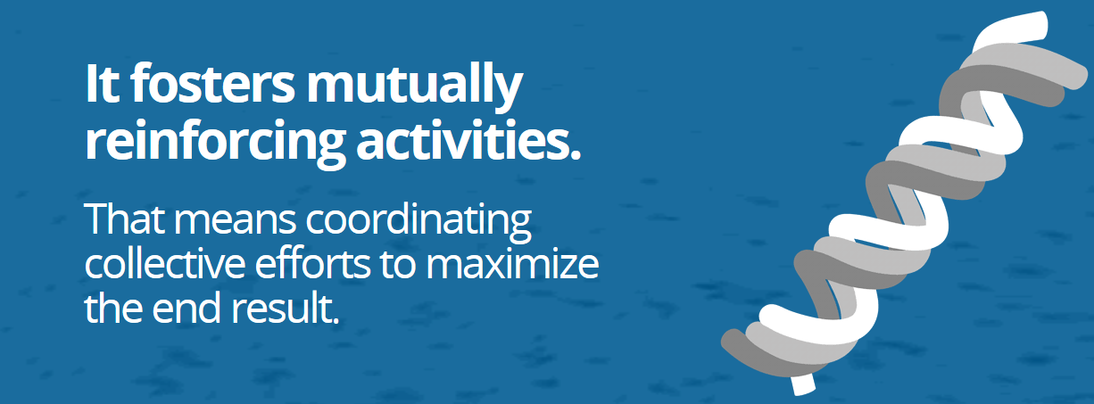
Collective Impact Condition #3

Slide 11
Collective Impact Condition #4

Slide 12
Collective Impact Condition #5

Slide 13
Collective Impact Forum
Online community where practitioners, policymakers, funders, and business can share success stories and challenges, solve problems, and learn from each other.
FSG, Aspen Institute Forum for Community Solutions, Forum for Youth Investment (Ready by 21), United Way Worldwide, and more…
http://collectiveimpactforum.org/

Slide 14
StriveTogether
A cradle to career vision for education –StriveTogether’s Student Roadmap to Success plots the course of a student’s journey from cradle to career.
Map is not just a guide for the student, but for all members of the community with an interest in seeing that students have successful journeys.
If they are not at these critical points, we know the potential for long-term success is greatly inhibited.

Slide 15
StriveTogether continued
It highlights specific research-based competencies and experiences, as well as key transition points where we must ensure students are on target developmentally.
StriveTogether Cradle to Career Network is comprised of 49 partnerships.
http://www.strivetogether.org/

Slide 16
National College Access Network (NCAN)
Based on research and best practices of its 350-plus members, NCAN developed a recommended set of Common Measures to help college access and success programs guide and assess their work.
https://dl.dropboxusercontent.com/u/58245140/Common%20Measures/Common%20Measures%202-page%20handout%2010-2-12.pdf

Slide 17
Gates Foundation Community Partnerships
The OMG Center for Collaborative Learning published a series of Issue Briefs highlighting lessons from the Bill & Melinda Gates Foundation's Community Partnerships portfolio evaluation.
The Issue Briefs share results of investments and tangible examples of how communities approached the goal of improving postsecondary completion.

Slide 18
Gates Continued
Issue Brief 1: Building Commitment to a Postsecondary Systems Change Agenda – focuses on how the partnerships built public awareness, deepened relationships with partner organizations, and engaged community leaders to implement their initiatives.
Issue Brief 2: Using Data to Advance a Postsecondary Systems Change Agenda – focuses on how the partnerships used data to build public commitment, set priorities for policy and practice changes, and monitor the partnership’s internal structures and processes.

Slide 19
Gates continued
Issue Brief 3: Aligning Policies and Practices to Advance a Postsecondary Systems Change Agenda – focuses on how communities can adopt and implement policies and practices to increase postsecondary success.
Issue Brief 4: Building and Sustaining Partnerships to Advance a Postsecondary Systems Change Agenda – on how communities can successfully strengthen partnerships to increase postsecondary success.

Slide 20
Gates continued
Issue Brief 5: Amplifying Learning in Systems Change Investments: An Experience in Developmental Evaluation – focuses on how communities, funders, and evaluators can conduct effective developmental evaluations to help advance postsecondary systems change.
All Issue Briefs available at: http://www.omgcenter.org/knowledge_center/issuebriefs/the_community_partnerships_issue_briefs_series

Slide 21
Illinois Examples
Education Coalition of Macon County – Community Improvement through Education http://www.edco4kids.org/
Alignment Rockford – Supporting our Public Schools http://www.edco4kids.org/
Achieve Quad Cities – creating a thriving community by engaging all Quad Citians in lifelong learning http://www.achieveqc.org/

