Slide 1
Success Knows No Gender: Projects for Nontraditional Occupations Learners and Others
Presented by
Ne'Keisha N. Stepney, MBA,
Waubonsee Community College
and
Aime′e Julian, PHD
Illinois Center for Specialized Professional Support, ICSPS

Slide 2
Welcome
Overview of ICSPS and Special Populations
Description of Nontraditional Occupations
Waubonsee Community College’s New Look Project Impact

Slide 3
ICSPS
The Illinois Center for Specialized Professional Support (ICSPS) provides professional development, technical assistance, and program improvement strategies and resources for career and technical education professionals.
ICSPS provides services to secondary
and postsecondary educational
organizations through the Educational Administration and Foundations
Department of the
College of Education
at Illinois State University.

Slide 4
Special Populations
The following are special populations as defined by the Carl D. Perkins Career and Technical Education Improvement Act of 2006.
  Displaced homemakers
  Individuals with limited English proficiency
  Individuals with disabilities
  Individuals from economically disadvantaged families
  Individuals preparing for nontraditional fields
  Single parents

Slide 5

Quick Facts on Nontraditional Occupations
A non-traditional occupation is one in which one gender comprises 25 percent or less of total employment

Slide 6
25% of what?
What data determines whether or not an occupation is non-traditional?

Slide 7
25% of what?
What data determines whether or not an occupation is non-traditional?
US Department of Education: enrollment by Classification of Instructional Programs (CIP)
US Department of Labor: Bureau of Labor Statistics Occupational Code by Gender
Women’s Bureau of the US Department of Labor

Slide 8
CTE at Waubonsee
Dedicated academic divisions
  Business and Career Technologies
  Health Professions and Public Service
Office of Career and Technical Education
  Vice President, CTE
  Perkins Analyst
  High School Partnerships
Addressing the skills gap: Untapped talent

Slide 9
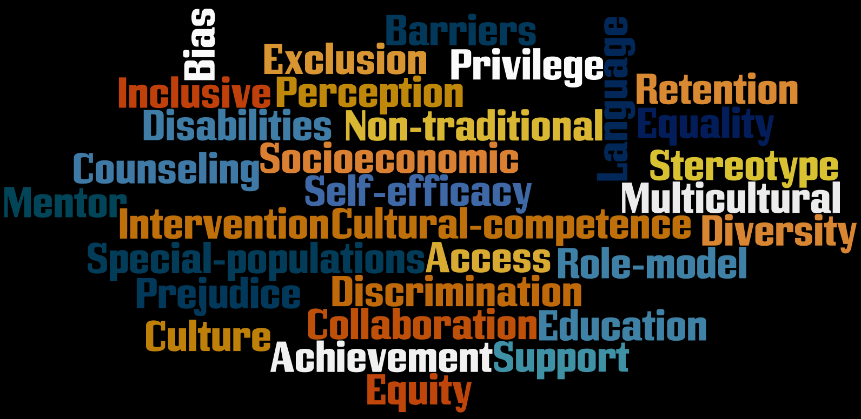

Slide 10


Slide 11
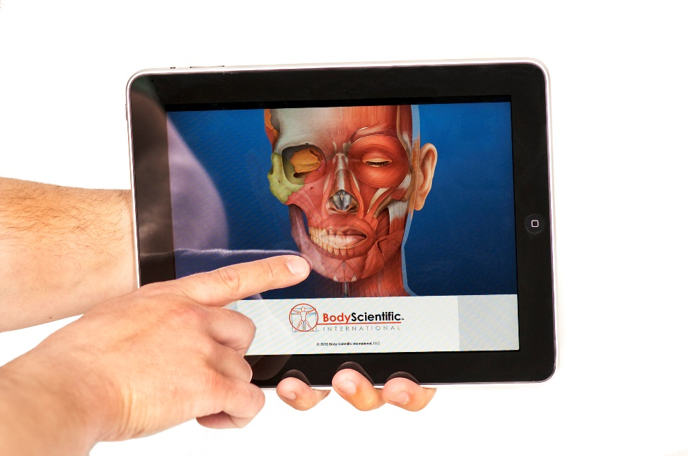
Limitless Possibilities: Men in Health Information Technology
Health Information Careers
  Lack of knowledge about the profession
Career Guidance
  Educate counselors
Barriers and Misconceptions
  Role models
  Realistic viewpoint

Slide 12
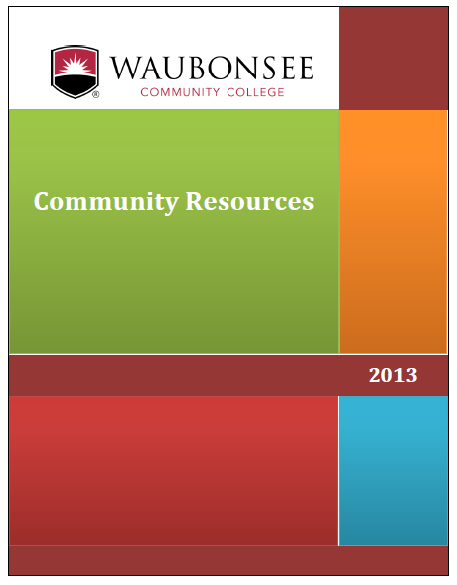
Administrative Office SUCCESS
Building Self-Confidence, Understanding, Courage, Charity, Esteem, Self-Acceptance, and a Sense of Direction
Issues
  Preconceived notions
Actions
  Data collection, analysis and identification of barriers
Future plans

Slide 13
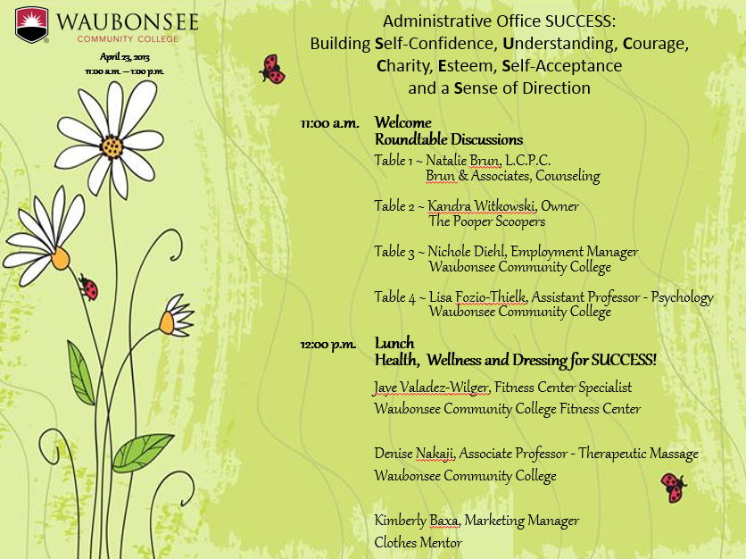

Slide 14
Women in Manufacturing:
21st Century View
Issues
  Awareness
Action: Inform, Create, and Collaborate
  Panel discussion
  Positive messages
  Secondary partners
Q&A session
Field trips
Women make up almost half of the country’s workforce but only a quarter of the manufacturing industry’s workforce!

Slide 15

Women in Manufacturing: Talking Points
What is your educational background?
Why you decided to go into your current field?
What does the day-to-day looks like?
How do you feel working in a male dominated industry?
What do you feel the future looks like for women in the industry?
Which classes students should focus on?
What are essential skills for the industry?
What was the influence of your mentor/role model?
How did you take risks?

Slide 16
So what does it all mean…?
How are we marketing programs?
Are we providing exploratory opportunities?
Are we unconsciously sending biased messages?
What early interventions are in place?
Are we challenging students to… STRETCH?

Slide 17
Looking Forward
Retention
Special populations programming
  Panel discussions, speaker series, 1cr. hour seminar course, field trips, guest speakers, tinkering
Improving programs through a special populations lens
  Recognition that other populations will be impacted
Gender specific marketing
Foster collaboration with secondary partners
  Parental involvement
Project alignment with other strategic initiatives
Positive role models
Dual credit opportunities
Cultural Competence
Engage, encourage…retain!

Slide 18

Questions?

Slide 19
Thank you.
For more information visit…
https://www.waubonsee.edu/
http://icsps.illinoisstate.edu/
Thank you!

