Slide 1
Connecting Low-Income College Students with Public Benefits

Slide 2
Panelists
Kim Drew- Heartland Alliance
Ellen Greenan- Illinois Student Assistance Commission
Dan Lesser- Sargent Shriver National Center on Poverty Law
Beth Malik- Chicago Coalition for the Homeless

Slide 3
What is “Food Insecurity”
Food Insecurity is the limited or uncertain availability of nutritionally adequate and safe foods, or the ability to acquire such foods in a socially acceptable manner.
Very Low Food Security is multiple indications of disrupted eating patterns and reduced food intake.

Slide 4
College Hunger
According to a national study, the broadest of college hunger to date:
  48% of college students surveyed reported experiencing food insecurity
  22% experienced very low levels of food security that qualify them as hungry
Food insecurity occurs at both two-year and four-year institutions
  25% of community college students experience very low food security
  20% of students at four-year schools experience very low food security

Slide 5

Homeless Youth in Illinois
There is an estimated 25,000 unaccompanied homeless youth ages 18 to 21 in Illinois (based on a 2005 study).
Approximately 580 shelter beds for 18 to 24 year-old homeless youth.

Slide 6
Homeless in College
New study of community college students conducted by Wisconsin HOPE Lab (March 2017) finds that 14% reported experiencing homelessness.

Slide 7
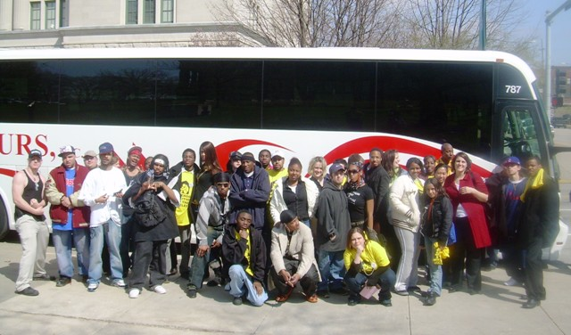
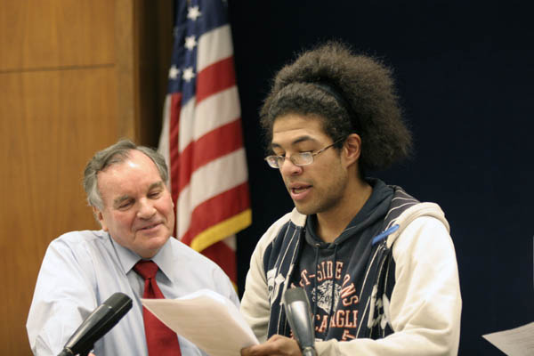
History of HB3211
In 2010, a group of homeless youth organized by the Chicago Coalition for the Homeless requested a meeting with Chicago Mayor Richard M. Daley to discuss ways the City could better serve homeless youth. At the meeting, they presented him with a plan to address barriers in 5 key areas including education.

Slide 8
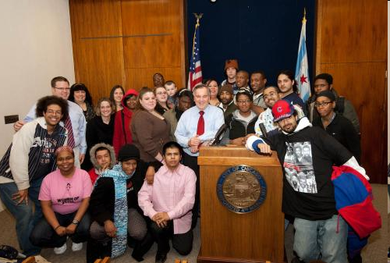

Slide 9
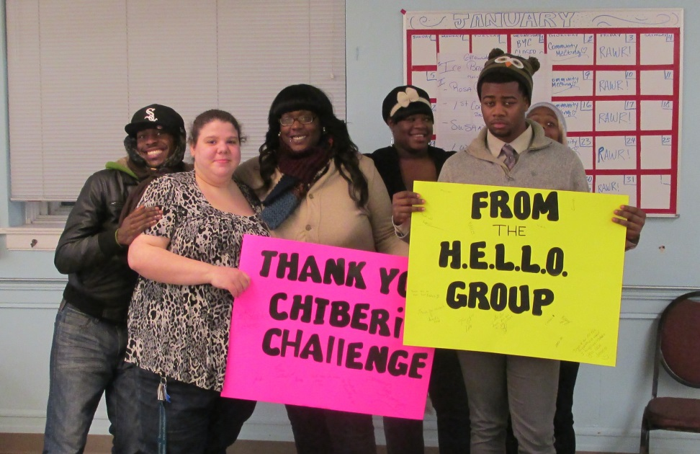
History of HB3211
The homeless youth leaders identified loss of SNAP benefits as a barrier to higher education.
Mayor founded the City’s first Task Force on Homeless Youth.
Task Force (including CCH, youth leaders, HY providers and Chicago’s DFSS) began researching solutions
  Massachusetts model

Slide 10

SNAP 101
The Supplemental Nutrition Assistance Program (SNAP, formerly Food Stamps) is the nation’s most important and effective anti-hunger program.
SNAP distributes monthly benefits to qualifying, low-income households through an EBT card that can only be used to purchase food.
In 2016, 1 in 7 Illinoisans participated in the SNAP program.
SNAP benefits are 100% federally funded.
In 2016, SNAP benefits contributed $3.0 billion into Illinois’ economy.

Slide 11
Snapshot of Illinois SNAP Participants
Almost 65% of SNAP participants are in families with children.
Almost 28% are in families with members who are elderly or have disabilities
Almost 41% are in working families.
Source: CBPP analysis of FY 2015 USDA SNAP Household Characteristics data

Slide 12
Application Process
General Application Process:
Submit application in person, over the phone, or online
Interview to be scheduled within 14 days
Decision to be issued within 30 days
Applicant must be notified in writing via letter
Upon approval, Link Card is mailed
Expedited Process:
Monthly income < $150 and assets <$100
OR
(Rent/mortgage + utilities) > (income + assets)
Upon approval, Link Card is mailed within 5 days of the application

Slide 13
Who is in a household?
Members are in the same “household” if they purchase and prepare meals together.
Certain people must be considered together:
  Parents and children (up until age 22)
  Children living with a caretaker (up until age 18)
  Spouses
Individuals who are in the same food stamp household will be on the same case, and the entire household’s income, assets, and expenses will be considered.
“Qualified Member” households include:
  Elderly—60 or over
  Disabled—receiving disability benefits

Slide 14
Income Eligibility
Number of People in Your Household | Maximum Gross Monthly Income | Maximum Gross Monthly Income (Age 60 and Over or Disabled)
1 | $ 1,634 | $ 1,980
2 | $ 2,203 | $ 2,670
3 | $ 2,772 | $ 3,360
4 | $ 3,342 | $ 4,050
5 | $ 3,911 | $ 4,740
6 | $ 4,480 | $ 5,430
7 | $ 5,051 | $ 6,122
8 | $ 5,623 | $ 6,815
9 | $ 6,195 | $ 7,508
10 | $ 6,767 | $ 8,201
Each additional person add | $ 572 | $ 693
There are 2 types of SNAP Monthly Income Standards: Gross Monthly Income and Net Monthly Income. SNAP units must meet the Gross Monthly Income Standard with a few exceptions.
Illinois has no asset test in order to receive SNAP benefits
As of 2016, Illinois has new income standards (130% FPL to 165% FPL) due to the advocacy work of the Shriver Center and Heartland Alliance.

Slide 15
Benefit levels
SNAP expects families receiving benefits to spend 30 percent of their net income on food.
Net income is determined after a set of deductions are applied including:
  Earnings (20%)
  Standard
  Excess shelter costs*
  Dependent care
  Medical expenses (QM only)
Therefore, the monthly SNAP benefit equals the maximum benefit for that household size minus the household’s expected 30% contribution.
Example: If family of 3 had $600 in net monthly income, it would receive the maximum benefit ($511) minus 30 percent of its net income (30 percent of $600 is $180), or $331.
Number of People in Your Household | Maximum Gross Monthly Benefits
1 | $ 194
2 | $ 357
3 | $ 511
4 | $ 649
5 | $ 771
6 | $ 925
7 | $ 1,022
8 | $ 1,169
9 | $ 1,315
10 | $ 1,461
For each additional person, add $146

Slide 16


How to use your SNAP benefits
SNAP benefits are distributed monthly onto an Electronic Benefits Transfer (EBT) card, which functions as a debit card that is accepted at most grocery stores.
In Illinois, the EBT card is referred to as the “Illinois Link Card”.
SNAP benefits cannot be used to purchase:
  Hot foods ready to eat,
  Food intended to be heated in the store,
  Lunch counter items or foods to be eaten in the store,
  Vitamins or medicines,
  Pet foods,
  Any nonfood items (except seeds and plants),
  Alcoholic beverages,
  Tobacco

Slide 17
Student Eligibility
Students enrolled at least half-time in postsecondary or vocational training may be eligible for SNAP if they are:
  Under 18 or over 50,
  Working an average of 20 hours per week,
  Participating in state or federal work study program,
  Receiving TANF cash assistance,
  Responsible for the care of a child under 6,
  Responsible for the care of a child between 6 and 12 and adequate child care is not available for school and work, OR
  Enrolled full-time and single parent of child under 12.
If they do not meet these requirements, the student and their income and assets will be excluded from the household.

Slide 18
Students Benefitting from HB3211
Over 40,000 economically-disadvantaged students at our 49 community colleges could become eligible for SNAP under HB 3211.

Slide 19
Students Benefitting from HB3211
A first-generation college student living at home, with low-income parents and younger siblings on SNAP. Currently, when a family member starts postsecondary education, the family’s benefit amount is reduced to reflect the new status of the student as ineligible, even if the student is approved for work study, but not provided a slot/job, or is working, but for less than 20 hours per week on average.

Slide 20
Students Benefitting from HB3211
A parent pursuing post-secondary education with a child or children in middle and high school (ages 12-18) Currently, the parent of a child aged 12-18 must work half-time or more while attending school, studying, and raising children, to qualify for SNAP. Students who drop out of community college frequently cite having to balance work with parenting, studying and class.

Slide 21
Students Benefitting from HB3211
An independent student, without any familial support. This includes unaccompanied and homeless youth pursing degrees at community colleges. These youth could be living in shelters, transitional housing or with roommates, and they do not qualify for benefits unless they are working 20 hours per week on top of classes or raising a child or children.

Slide 22

ISAC’s Role
College Student Hunger Bill
Identify “potentially SNAP-eligible” students
consult with Department of Human Services
income to be used at minimum
Develop electronic notice for schools
SNAP eligibility criteria,
Application Web address, and
Illinois Hunger Coalition’s Hunger Hotline

Slide 23
ISAC’s Role
College Student Hunger Bill
Notice would likely be posted on ISAC’s Web site, with additional information and links to relevant sources, to help students understand eligibility requirements and apply for SNAP benefits.
If bill becomes law, rules are to be adopted by October 1, 2017.

Slide 24
ISAC’s Role
College Student Hunger Bill
For those who work at a college or university . . .
Is hunger an issue on your campus?
If so, is the issue being addressed? How?
Thoughts on implementation?

