Slide 1
Statewide Implementation of the State Seal of Biliteracy
Luis Narvaez
Project Director
Chicago Public Schools

Slide 2

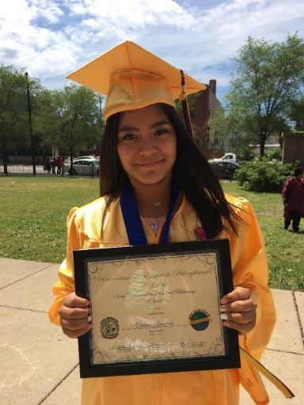

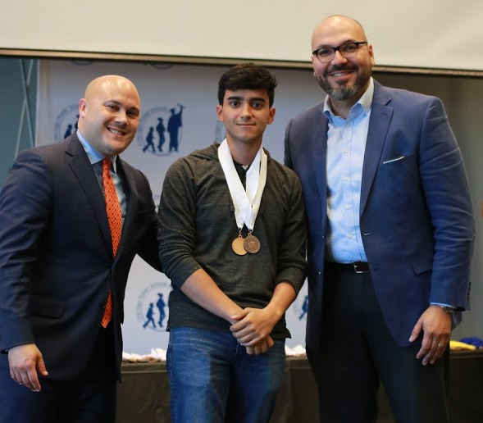
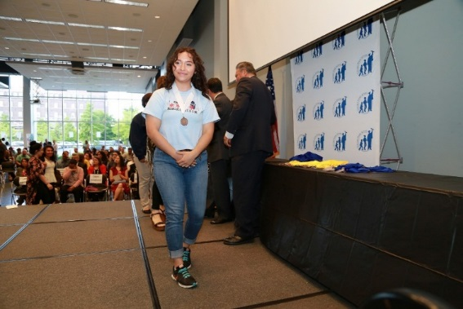
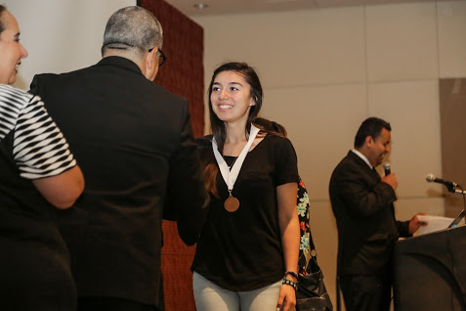

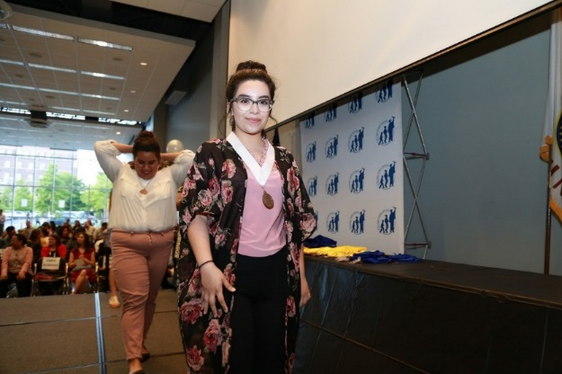
Celebrating our Multilingual Students
Pictures from the 2017 Chicago Public Schools Seal of Biliteracy Awards Ceremony

Slide 3
What is Biliteracy and why implement it?
Biliteracy is the ability to speak, read, and, write in two or more languages at a proficient level
The State Seal of Biliteracy aims to encourage students to study world languages for a longer period of time and supports current and former ELs' native language instruction
As a district, CPS provides the professional development and resources to aid in the proper teaching environments that support more students being exposed to languages earlier in their PK-12 education
We do this by supporting bilingual, dual, and world language education citywide
Notes:
© Copyright Showeet.com – Free PowerPoint Templates

Slide 4
What is the Seal of Biliteracy
12 min video by “Californians Together”
Provides perspective on the State Seal of Biliteracy
Californians Together: State Seal of Biliteracy
At the end of the video, please be prepared to share out your initial impressions on this program.
Notes:
20 minutes, including answering the questions

Slide 5
Pathways Towards Biliteracy Program
Notes:
© Copyright Showeet.com – Free PowerPoint Templates

Slide 6
What is the Pathways Program?
The CPS Pathways Towards Biliteracy program is a recognition given to students at the elementary and middle school levels awarding them for either:
  Maintaining their home language, in the case of current or former ELs; and/or
  Their studies of a world language at the early graders, ensuring they are on the pathway to receiving the State Seal of Biliteracy by the time they reach their senior year of high school.
It is a celebration of our students’ ability to communicate in two languages (including English) as they learn about the advantages of being biliterate throughout their life
While schools are able to recognize students at any grade level, OLCE has budgeted to support the testing of 5th & 8th graders

Slide 7
Questions?
Notes:
© Copyright Showeet.com – Free PowerPoint Templates

Slide 8


State Seal of Biliteracy
Notes:
© Copyright Showeet.com – Free PowerPoint Templates

Slide 9
What is the State Seal of Biliteracy?
The program recognizes graduating high school seniors for their bilingual and biliterate skills in English and a second language, including American Sign Language (ASL)
Seniors must adhere to the guidelines set forward by the Illinois State Board of Education and found at: www.isbe.net/Documents/assessment-list.pdf
Eligible seniors interested in participating complete a CPS online application in the fall semester
Let’s take a look at the eligibility criteria on the next page, as dictated by the State of Illinois!

Slide 10
State Seal of Biliteracy Eligibility
English
Must have scored a 540 or higher on the EBRW portion of the SAT
or
Meeting State proficiency through the ACCESS (for active or former High School ELs who took the exam in 2016, 2017 or 2018)
World Language
By having an AP World Language Score of 4 or above (Chinese, French, German, Italian, Japanese, Latin, and Spanish); 3 for commendation or
Intermediate High (or higher) score on a district-approved assessment tool; Intermediate Low for Commendation

Slide 11
What is Commendation?
For students who come close to meriting the Seal, they will receive the State Commendation toward Biliteracy, demonstrating progress toward full biliteracy in English and another language.
Recipients of the Commendation must still meet English proficiency requirements (or, for current or former HS ELs, they must receive at least a 3.5 in Literacy through ACCESS to qualify) and adhere to this criteria:
  Score a 3 on an AP World Language exam taken by their junior year of high school; or
  Score I1 (Intermediate Low) through I4 (Intermediate Mid) on all 4 domains of the AAPPL world language assessment to be taken during their senior year of high school

Slide 12
Necessary Proficiency for AAPPL
Proficiency Level (in form B) for 12th graders
Proficiency Level (in Form B) for Commendation
Notes:
© Copyright Showeet.com – Free PowerPoint Templates

Slide 13
What do the Recipients of the SSB get?
At CPS, recipients of the State Seal of Biliteracy will receive:
  a commemorative medal
  an invitation to an end-of-year celebration with their parents and teachers
  the actual Seal from the State of Illinois placed on their diploma
  the recognition worded on their final high school transcript
  new as of last year, they also become eligible for college credit if they enroll at a state public university

Slide 14
Awarding College Credit—State Law
HB 4330:
For admissions purposes, requires each public university in this State to accept the State Seal of Biliteracy as equivalent to 2 years of foreign language coursework taken during high school if a student's high school transcript indicates that he or she will be receiving or has received the State Seal of Biliteracy.

Slide 15
Awarding College Credit—State Law
HB 4330:
Provides that each public community college and public university in this State shall establish criteria to translate a State Seal of Biliteracy into course credit based on foreign language course equivalencies identified by the community college's or university's faculty and staff and, upon request from an enrolled student, the community college or university shall award foreign language course credit to a student who has received a State Seal of Biliteracy.

Slide 16
Awarding College Credit—State Law
HB 4330:
Requires the State Board of Education's rules to ensure that the criteria that pupils must achieve to earn a State Seal of Biliteracy meet the course credit criteria. Requires students enrolled in a public community college or public university who have received a State Seal of Biliteracy to request course credit for their seal within 3 academic years after graduating from high school.

Slide 17
Samples of What Colleges are Doing to Award Credit
University of Illinois at Urbana-Champaign:
https://citl.illinois.edu/citl-101/measurement-evaluation/placement-proficiency/faqs/ssob-faq
Northern Illinois University:
http://www.niu.edu/u_council/committees/minutes/bc/2016-2017/bc-02-09-17-a.pdf
Illinois State University:
http://registrar.illinoisstate.edu/transfer/biliteracy.shtml

Slide 18
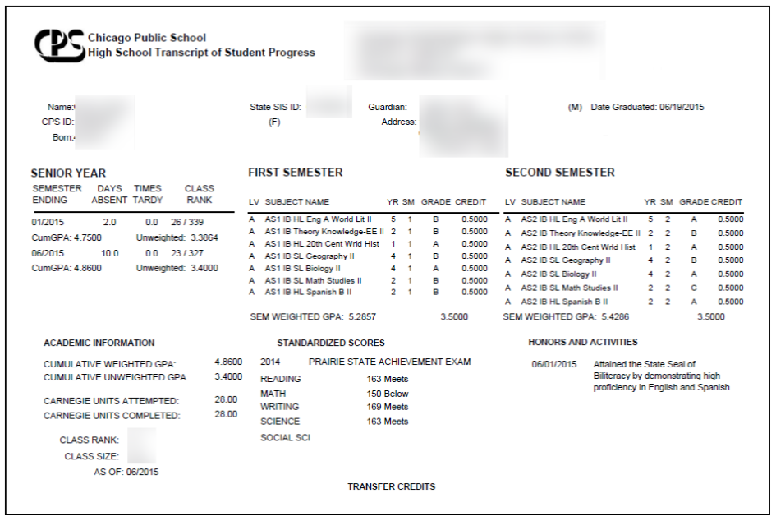

Slide 19
Why are students applying for the Seal?
“I think that it’s important to speak two languages so you can communicate with others” --Alejandro, Curie Metro HS.
“I would like to receive this seal in memory of my grandma because she was always there when I needed her and I know that it would make her proud.” --Gisselle, John F. Kennedy HS
“It's important to me to have recognition that I can speak and write Spanish fluently because it is my family’s primary language as well as a part of who I am. I've also felt like I have earned it through my efforts in my Spanish AP classes and it would be an honor to have the Seal.” --Jonathan, Catalyst Maria HS
Notes:
1 mins

Slide 20
Questions?
Please email seal@cps.edu
Notes:
© Copyright Showeet.com – Free PowerPoint Templates

