Slide 1
Connecting Illinois’ Youth to Services Before, During, and After College: The Service Provider Identification & Exploration Resource (SPIDER)
Noelle Cothern, MSW
In Conjunction with Northwestern University & IL Dept of Children & Family Services

Slide 2
What is SPIDER
SPIDER, short for Service Provider IDentification & Exploration Resource, is the newly redesigned resource formerly known as the Statewide Provider Database (SPD).
Like SPD, SPIDER is a 100% free, comprehensive database used to locate and gather information on social service agencies, programs, and services throughout the state of Illinois
SPIDER offers a more modern, streamlined user experience with much of the same functionality of the former SPD.

Slide 3
Training Agenda
Background of SPIDER
Key Features of SPIDER
How to Access the Database
Different Search Options
Reports that can be run using SPIDER
Live walkthrough and practice searches

Slide 4
SPIDER Background Information
Formerly known as the Statewide Provider Database, it began as a pilot projects in 2002 as a way to deter juvenile offenders away from incarceration and into helpful programs and services.
DCFS then contracted for services in 2004.
The database was then launched for all social service workers in 2008.
Now in 2018 the database has been renamed, updated, and made available for public use.

Slide 5
SPIDER Goals
Individual Level: to facilitate access to and utilization of individualized services by program participants
Agency Level: to assess gaps in resources and develop new resources in areas of local need
System Level: to reduce inefficiencies and encourage collaboration of provision of services to the client population
Sustainability: to become the #1 referral source amongst service providers throughout Illinois.

Slide 6
Who Uses This Resource?
Unlike SPD, which was only available to individuals making referrals, SPIDER is a public-facing resource available to anyone.
DCFS Staff, doctors, attorneys, school staff, and community members are just a few examples of SPIDERS range of users.
We encourage everyone to utilize this resource regardless of professional position or area of expertise.

Slide 7
Key Features of SPIDER
Over 1,700 agencies, 4,200 programs, and 23,000 services are currently housed in SPIDER
Programs can be searched for within a particular area and can be tailored to fit an individual’s family’s or community’s specific needs.
Listing contain all the information one would need to know about a program to make a referral including a contact person, eligibility requirements, documents needed for intake, and much more.
All agencies and programs are geo-coded allowing users to utilize SPIDER’s interactive map to evaluate services in an area of interest.

Slide 8
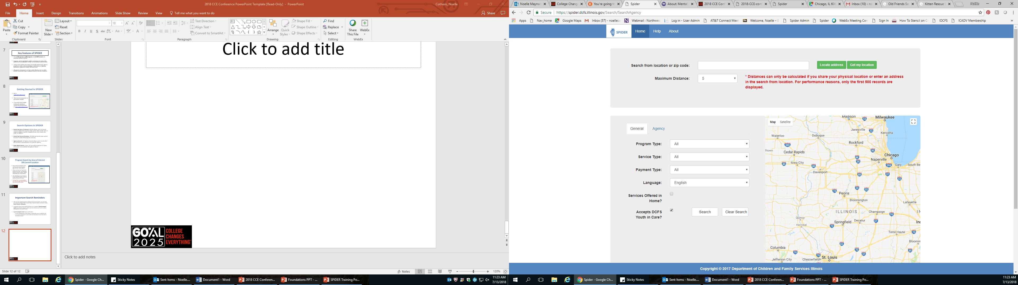
Getting Started in SPIDER
Go to spider.dcfs.Illinois.gov
There are no usernames or passwords needed
If you ever have trouble loading the database, contact the SPIDER team at: dcfs.spider@Illinois.gov

Slide 9
Search Options in SPIDER
Search by Area of Interest: SPIDER allows users to locate services within the locations that meets their needs such as services within a specific neighborhood, city, county, zip code, or address.
Search by Current Location: SPIDER can locate your current location to help find programs near by
State-Wide Search: Users can see what programs or types of services are available throughout Illinois.
Agency Search: An Agency Search allows users to see all of the locations and programs at a specific Agency.

Slide 10
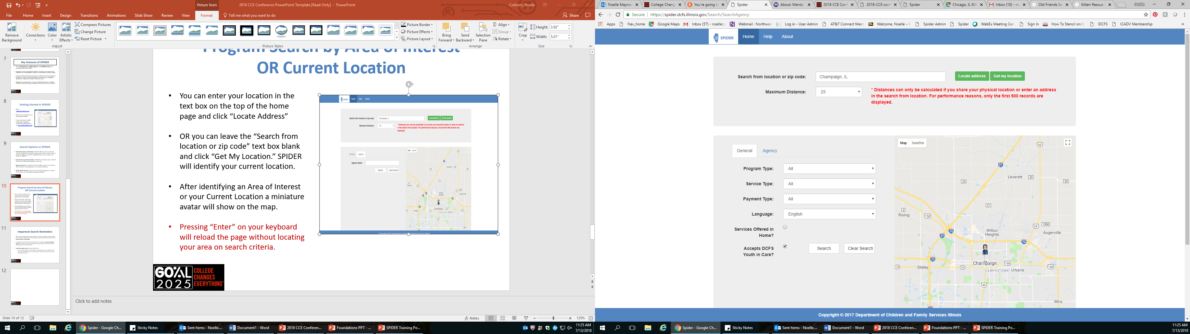
Program Search by Area of Interest
OR Current Location
Area of Interest: Enter your location in the text box on the top of the home page, select your Maximum Distance, and click “Locate Address”
Current Location: Leave the “Search from location or zip code” text box blank and click “Get My Location.”
After identifying an Area of Interest or your Current Location a miniature avatar will show on the map.
Pressing “Enter” on your keyboard will reload the page without locating your area on search criteria.

Slide 11
Important Search Reminders
After you have located your Areas of Interest or Current Location, you may tailor your search by Program Types, Service Types, Payment Options, and more, but no Search Criteria is mandatory.
Leaving the Search Criteria blank will allow you to complete a general program search, and all of the programs within your Area of Interest or Current Location will populate in the search results.
A general program search may be useful when:
  Working with a client living in a community you are unfamiliar with
  Closing out services with client and want to leave them with a list of local services

Slide 12
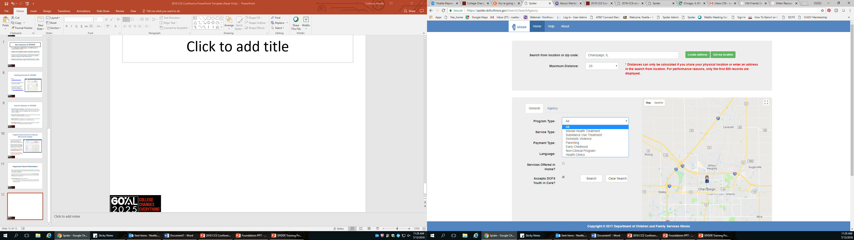
Search Criteria: Program Types
Click the “General” to utilize the different search criteria to find the appropriate programs and services.
The first drop-down box lists Program Types:
  Mental Health Treatment
  Substance Use Treatment
  Domestic Violence
  Parenting
  Early Childhood
  Non-Clinical Program
  Health Clinics

Slide 13
Program Types Defined
Mental Health: Programs that offer clinical services such as counseling or therapy.
Substance Use: Programs that focus on substance use treatment. If you cannot find an appropriate service in SPIDER, please visit SAMSHA’s Treatment Locator website listed in the SPIDER Help Tab.
Early Childhood: Programs that focus on early childhood development for children ages 0-5.
Domestic Violence: Programs that offer a range of services for victims and perpetrators
Parenting: Programs that support parents and help develop parenting skills
Non-Clinical: Programs without a clinical focus such as mentoring, utility assistance, job training, etc.
Health Clinics: Programs that offer physical health are such as medical treatment and dental services.

Slide 14
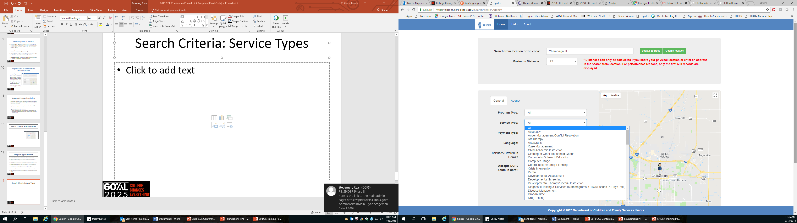
Search Criteria: Service Types
In the Service Type drop-down box, users will find a wide array of services.
Service Types can include anything from different types of Counseling to Tutoring and Recreational Activities.

Slide 15
Service Type Examples
Tutoring
Mentoring
Peer Support Group
GED/Academic Preparation
Vocational and Job Training
Recreational Activities
Life and Independent Living Skills
Parenting Skills
Food and meals
Housing Search Assistance
Legal/Court Advocacy
Individual Counseling
Emergency Shelter
Financial Assistance
Crisis Intervention
Case Management
Substance Use Treatment

Slide 16
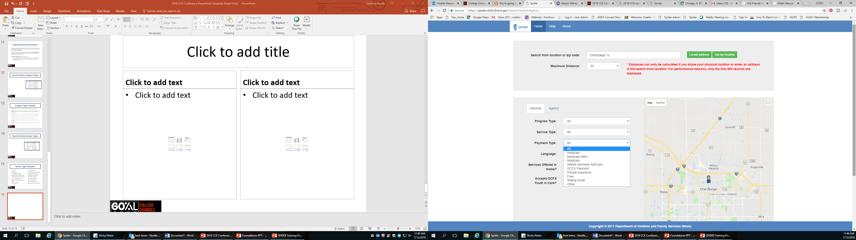
Search Criteria: Payment Options
SPIDER allows users to pick from different payment options.
Currently users can choose from:
  Medicaid
  Medicaid HMO
  Medicare
  AllKids
  DCFS Payment
  Private Insurance
  Sliding Scale
  Free
  Other

Slide 17
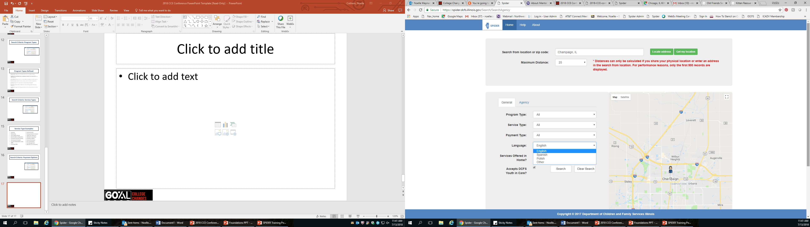
Search Criteria: Languages
If services are needed in a different language, select the preferred language in the drop-down box.
Currently in SPIDER there is:
  English
  Spanish
  Polish
  Other

Slide 18
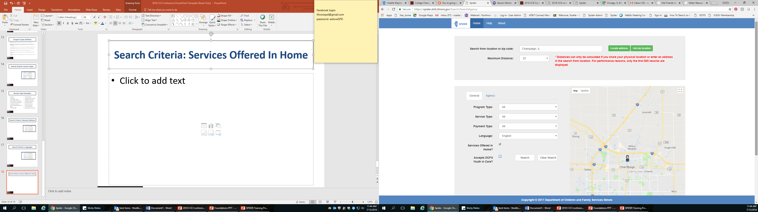
Search Criteria: Services Offered In Home
If you are in need of services that can be provided in the home, click the “Services Offered in Home” check box.
A word of caution: This check-box is a new feature. The SPIDER team is filling in services that are offered in the home continuously.

Slide 19
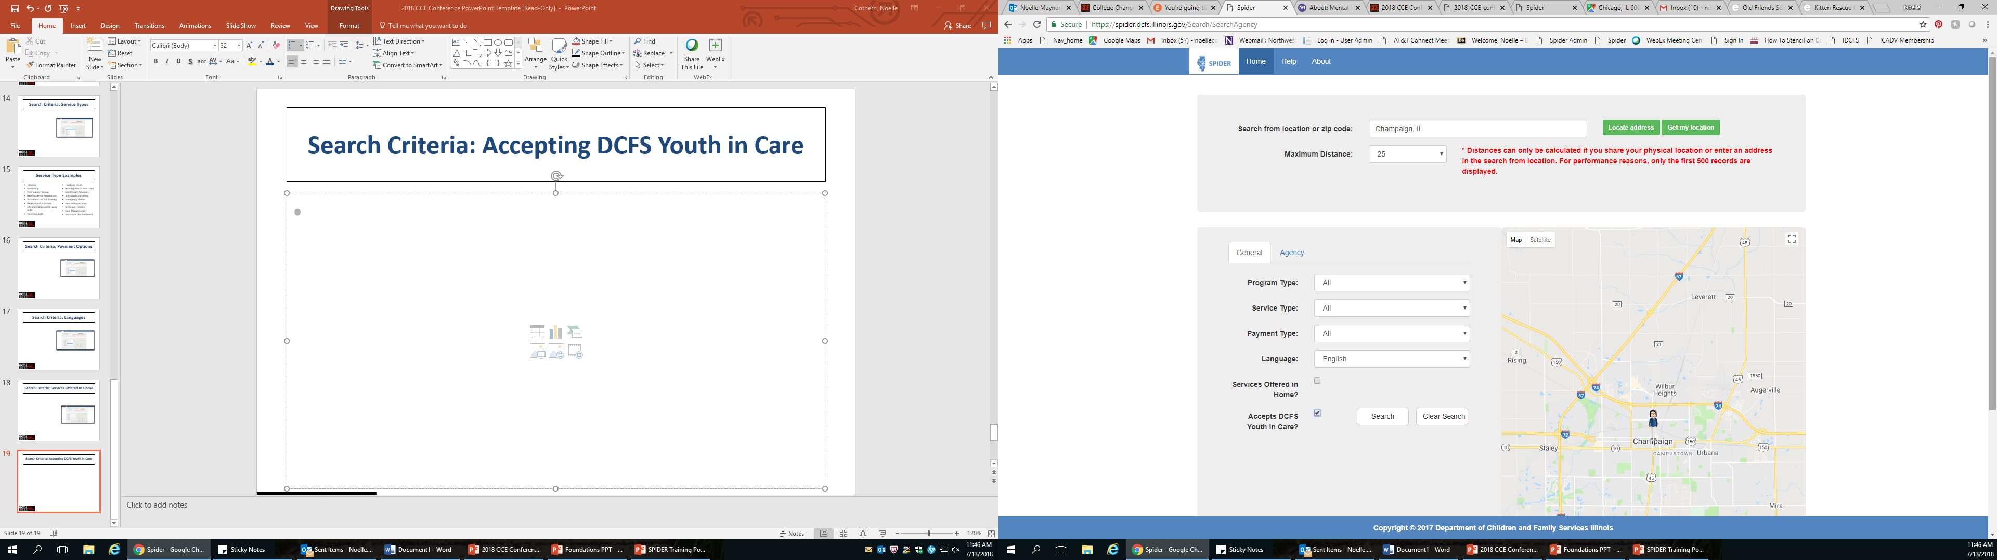
Search Criteria: Accepting DCFS Youth in Care
If “Accepts DCFS Youth In Care” is selected, search results will include programs that report being able to accept Youth in Care.
This does not identify programs that ONLY work with Youth in Care rather programs that can accept this population of youth into the program.

Slide 20
Selecting Search Criteria
When you are done selecting your Search Criteria hit the “Search” button to see the Search Results.
CAUTION: Do NOT press the “Enter” key!
Hitting the “Enter” key on your keyboard instead of clicking Search will clear out your Search Criteria, and you will have to set up your search again.

Slide 21
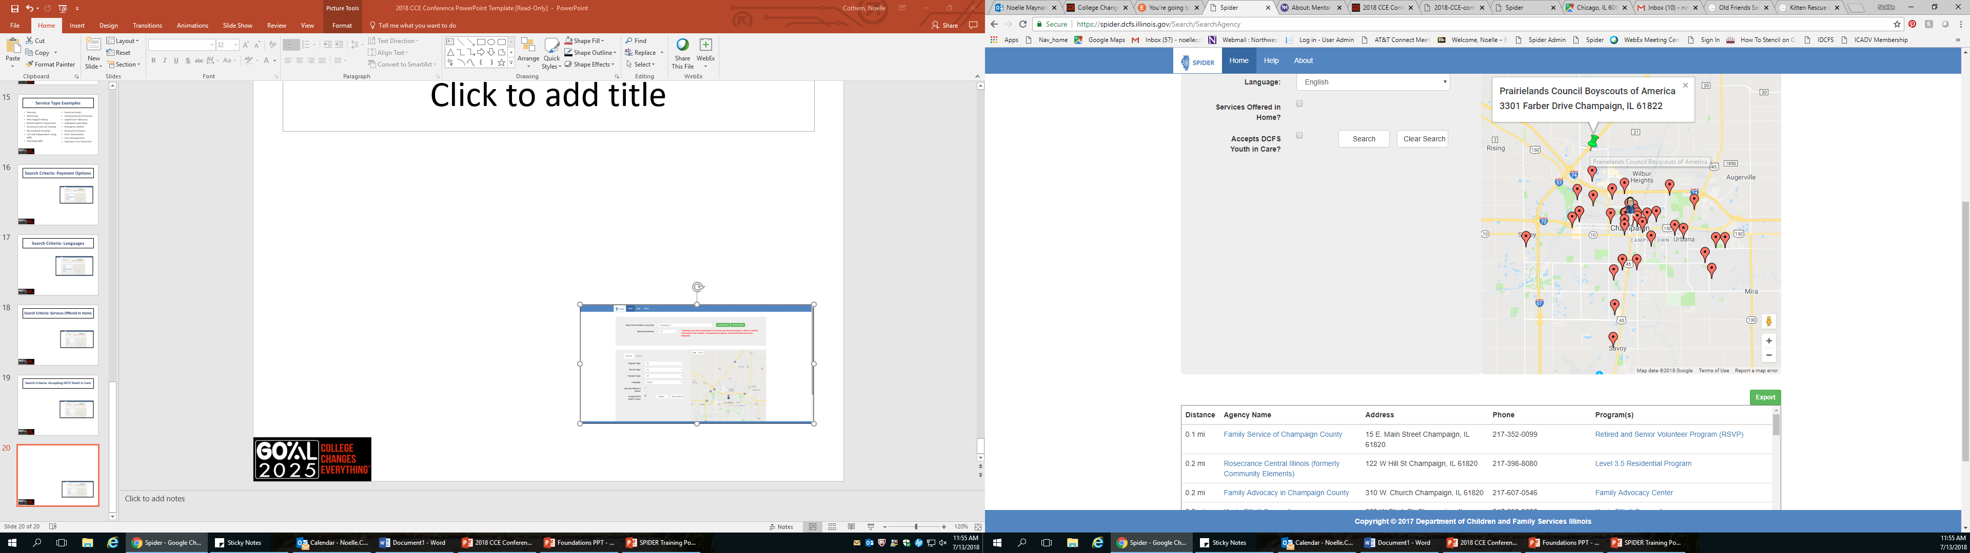
SPIDER Search Results
Search results will be generated on the map and listed out toward the bottom of your search screen.
Clicking on the hyperlinked Agency Name will show all of the general information on a certain agency, its locations, and programs offered at each location.
Clicking on a hyperlinked Program Name will show you all the information needed to gain a critical understand of the services offered.

Slide 22
SPIDER New Feature:
Exporting Search Results
SPIDER’s new feature allows users to export their search result into an Excel spreadsheet that can be edited and personalized for clients and other colleagues.
Simply click the green “Export” button above the search results.

Slide 23
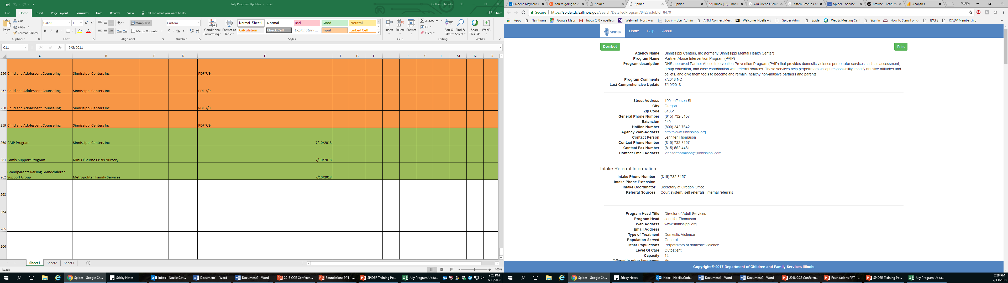
Detailed Program Report
After clicking on a hyperlinked Program Name users will be taken to the Detailed Program Report.
The Detailed Program Report lists detailed information including a contact person, payment options, intake information, eligibility requirements, flex funding, and more.
The green tables in the top corner allow users to download or print the program report straight from spider.

Slide 24
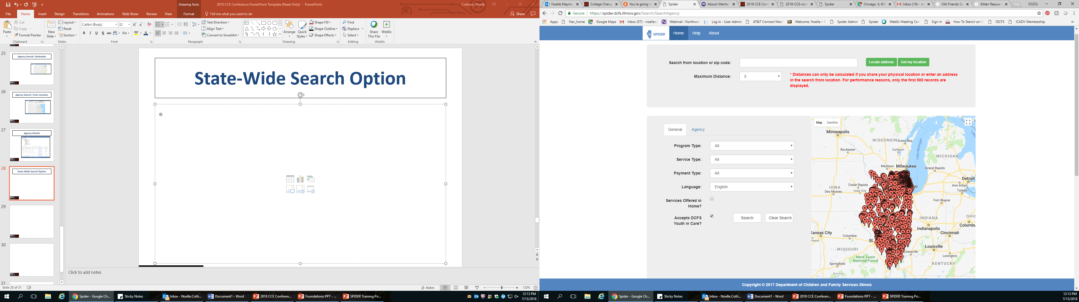
State-Wide Search Option
SPIDER allows users to perform a Statewide Search.
Leave the “Search from location or zip code” text bar empty and fill in the Search Criteria or leave it blank to find specific programs, services types, etc. available throughout Illinois.
All programs listed in the search result are alphabetized by city name.

Slide 25
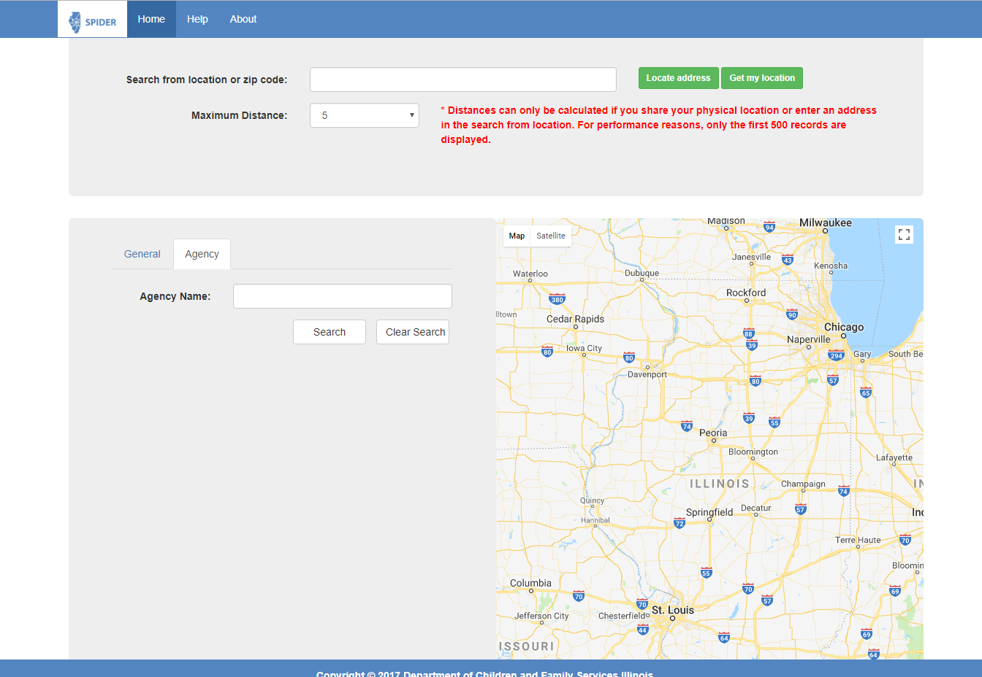
Agency Search Option
Users can search for a specific Agency within SPIDER.
The Agency Search Option allows users to search for an Agency from an area of Interest or search without a specific location identified.
Click on the Agency Tab to begin your search.

Slide 26
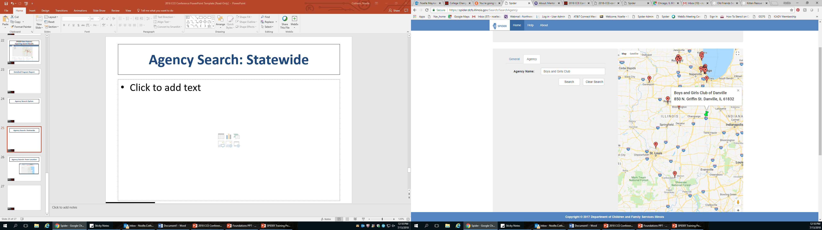
Agency Search: Statewide
An Agency Search without a location specified will show all of the Agency locations throughout the state.
The locations will be alphabetized by city name in the search results.
Click on the hyperlinked Agency Name to be taken to the Agency Details Report.

Slide 27
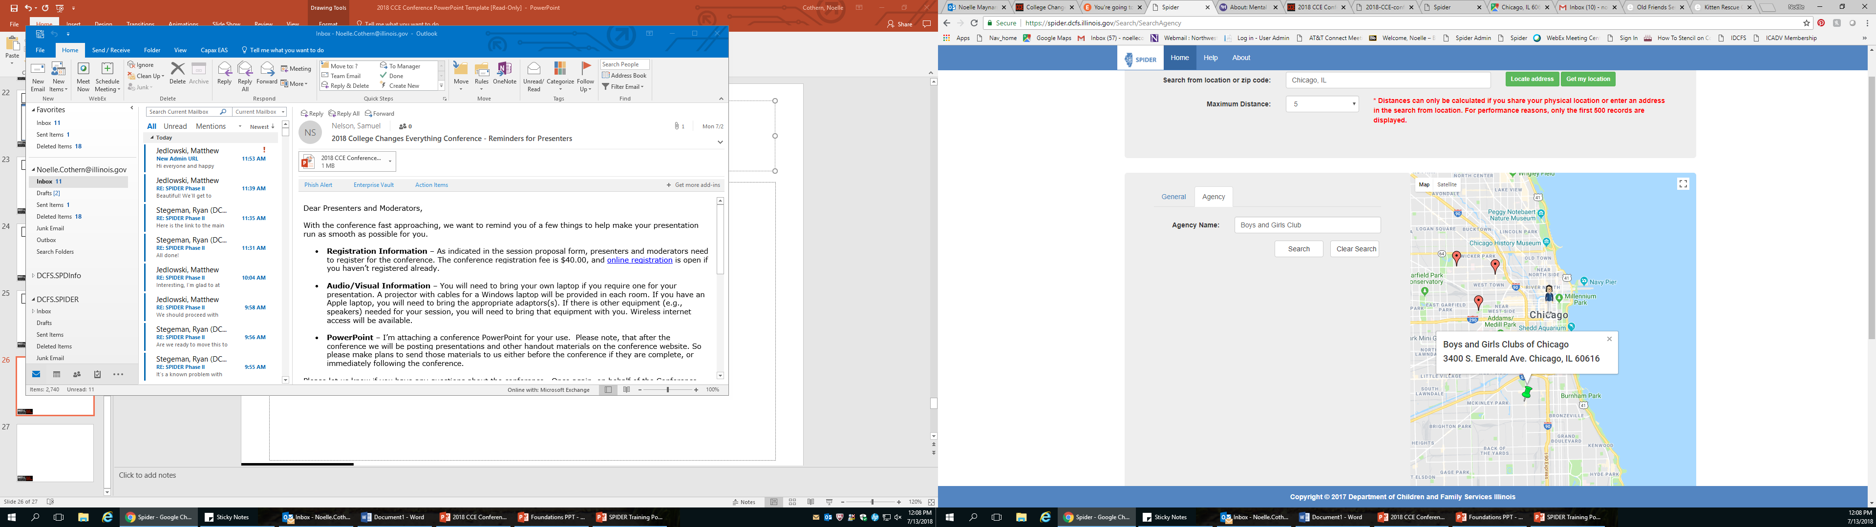
Agency Search: From Location
SPIDER will allow you to search for an Agency from a specific location.
The map will populate the locations that are near your location.
All of the Agency locations will be listed in the search result alphabetized by city name.

Slide 28
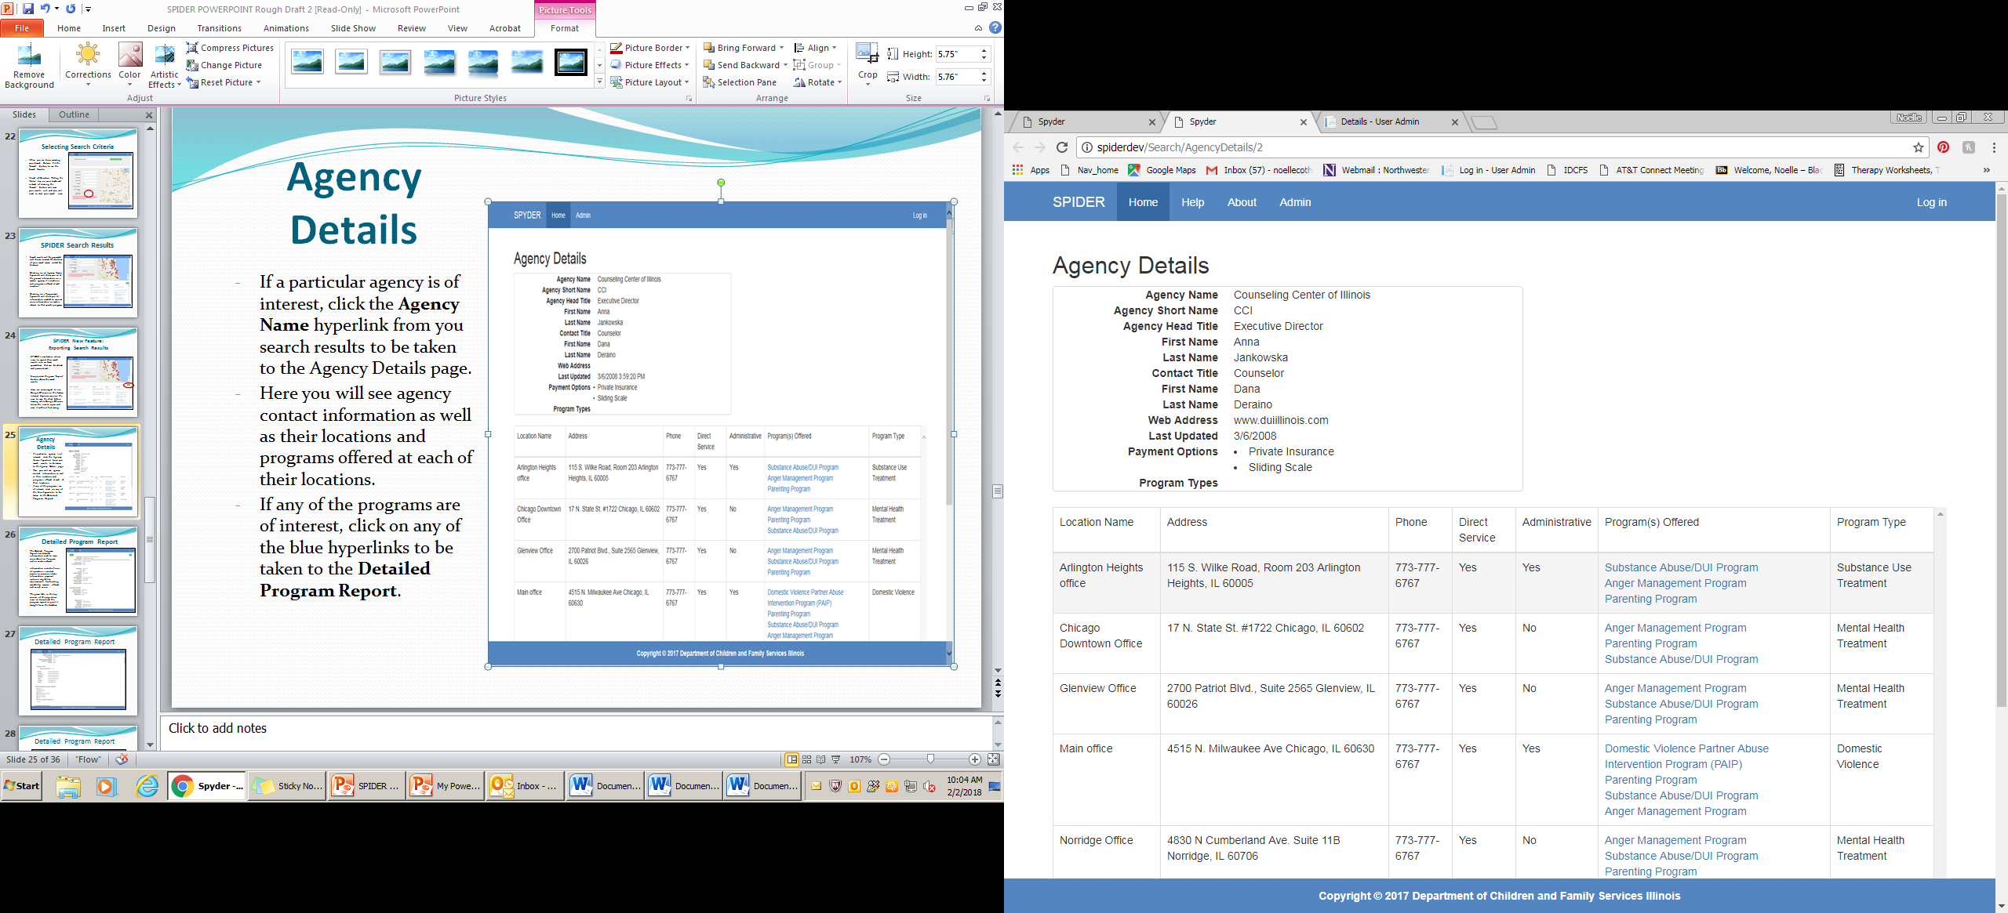
Agency Details
If a particular agency is of interest, click the hyperlinked Agency Name in the search results to be take to the Agency Details page.
This contains the agency contact information as well as locations and programs offered.
Click on the blue hyperlinks under Program(s) offered to navigate to the Detailed Program Report.

Slide 29
Benefits of SPIDER
SPIDER helps users quickly become Resource Experts
Saves time and effort in locating appropriate services
Improves users ability to find individualized services near a target location
Allows for more choice and options to community members as they seek supportive services
Offers the ability to analyze resource gaps with the use of SPIDERS’s interactive map

Slide 30
Contact SPIDER
Want to add or modify an agency, program or location?
Do you see inaccurate or outdated information?
Have any questions on SPIDER?
Need any assistance or support?
Want to schedule an in person or web-based training on SPIDER for your agency?
Please contact the SPIDER Team at: dcfs.spider@Illinois.gov

