Slide 1
Leveraging Community Based Partners to support Career Readiness
Notes:
Materials
My notes
Reports
Map One pager
Chicago Profile
Pens
Presentation on a USB drive
Adapter cable
ACT Now 1 pager

Slide 2
Welcome!
Notes:
Susan
Introductions for Everyone

Slide 3
Agenda
Background on the Map
Map Data
How We Use the Map
What Stakeholders Can Do
Notes:
Susan

Slide 4
What is ACT Now?
A statewide coalition that advocates for quality and affordable afterschool programs for Illinois’ youth
Our partners are:
Providers
Educators
State agency members
Community advocates
Youth organizations
Policymakers
Notes:
Susan
ACT Now is a statewide coalition that works to ensure that young people in Illinois have access to quality, affordable afterschool and youth development programs. ACT Now is a diverse coalition supported by Illinois families, educators, business leaders, afterschool providers, community advocates, youth organizations, and policymakers across the state.

Slide 5
Our Work
Policy
Professional Development
Quality
Community Schools
Afterschool Advocates
Notes:
Susan

Slide 6
Importance of Career Readiness in Afterschool
Afterschool is a natural vehicle for career exploration, work-based learning, interaction with industry, and exposing students to the opportunities that exist for them right here in Illinois
Afterschool programs help many students develop the skills they need to land the jobs of the future
These programs teach skills such as leadership, problem-solving, critical thinking, teamwork, responsibility, and time management
Notes:
Susan

Slide 7
Background on the Map
Notes:
Susan

Slide 8
Diving into the Map—Activity
Navigate to map.actnowillinois.org
Answering the following questions on your post-its and place your post-its on the corresponding poster on the wall
What do you see?
What does this map seem to do?
What data can this map give you?
How might we use this map?
Notes:
Susan

Slide 9
Why Do We Need a Map/Benefits to Providers
Fragmented field
Network with other programs/pool resources
Advertise to community members’ and parents
Educate policymakers and the public
Notes:
Susan

Slide 10
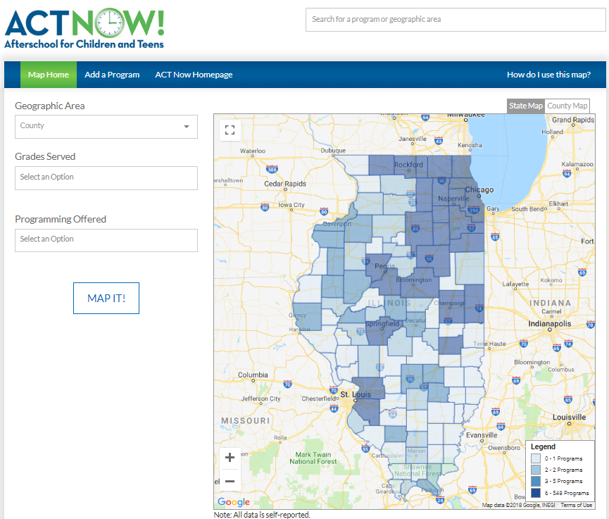
How We Use the Map
map.actnowillinois.org
Notes:
Susan
Walk through navigating from our webpage
Searching for program
country
other filters
by name
zoom into a county
Adding a program
Editing a program

Slide 11
How We Use the Map: Geographic Filter
Notes:
Susan

Slide 12
How We Use the Map: Content Filters
Notes:
Susan

Slide 13
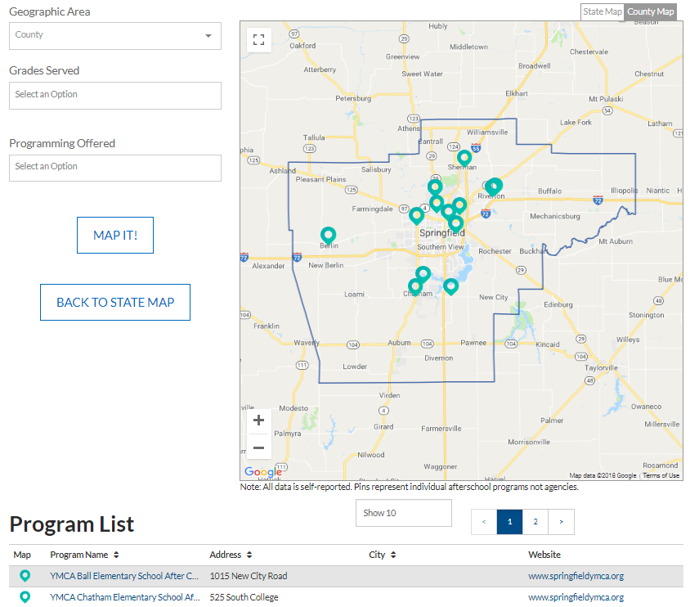
How We Use the Map: County View
Notes:
Susan

Slide 14
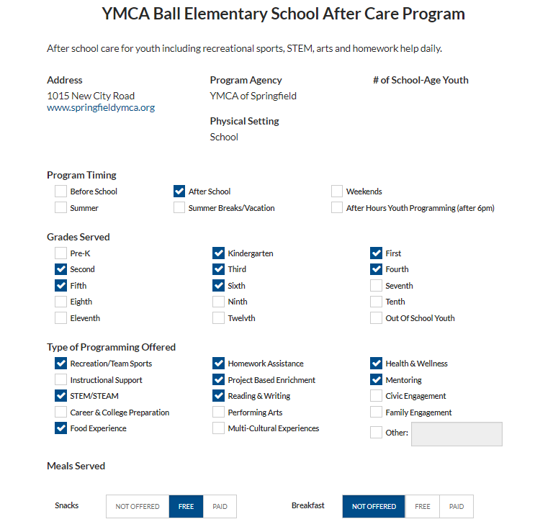
How We Use the Map: Program Profile
Notes:
Susan

Slide 15
Map Data
Notes:
Susan

Slide 16
The State Context For Afterschool
2,141 programs are in the map
Over 400,000 youth, or 18% of youth participate in afterschool
Programs on average had 6 staff people
The following is the breakdown of program timing:
Notes:
Faith
Mention that people can double answer

Slide 17
The State Context For Afterschool: Grades
Notes:
Faith

Slide 18
The State Context For Afterschool
Settings
Geographic Location
Notes:
Faith
Cook County has
the greatest number of programs with 547
programs reported. Northeastern Illinois has the
greatest concentrations of programs. Statewide,
counties with large cities also report greater
numbers of programs. In many rural counties,
4-H might be the main source of out-of-school
time programming. The southeastern portion of
the state has far fewer programs than any
other region as a whole.
The following counties reported no afterschool
programs at all: Alexander, Douglas, Ford,
Hardin, Putnam, and Stark. This is particularly
troubling given that some of these counties have
an extreme need for these services. Alexander
County has a child poverty rate of 47 percent,
and Hardin County has a child poverty rate of
36 percent.6 Douglas and Putnam Counties also
have child poverty rates of 14 percent, and Ford
County’s rate is 17 percent.7

Slide 19
Exploring Afterschool: Funding
Notes:
Faith

Slide 20
Exploring Afterschool: Quality Matters
468 programs report using the quality standards
260 report having qualified staff
Notes:
Emma
Generally explain what the standards and ILQPSA are
Go over map standards data
Explain how the ILQPSA relates to the map data

Slide 21
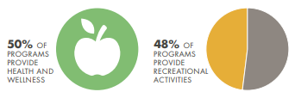
Exploring Afterschool: Healthy Lives
One in six children in Illinois struggles with hunger
19.3% of youth ages 10 to 17 are obese
44% of programs offer some sort of food
Notes:
Sara

Slide 22
Exploring Afterschool: Mentoring
Mentored students better attitudes toward school and better attendance
Mentoring can also support staff capacity
Notes:
Sara

Slide 23
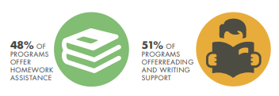
Exploring Afterschool: Academic Support
Afterschool programs help youth behave in class, improve their grades, and complete their homework assignments
The Afterschool Map and Database shows that afterschool programs are making a substantial effort to support academic achievement in Illinois, including:
48% offering homework assistance
77% offering instructional support
51% offering reading and writing support
77% offering project based enrichment
Notes:
Sara

Slide 24
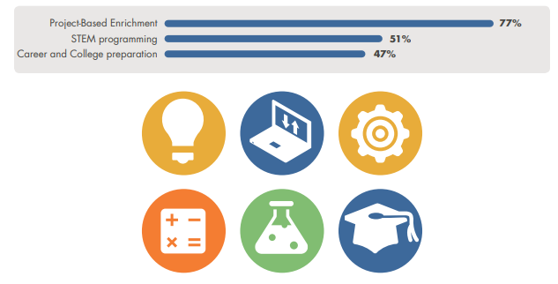
Exploring Afterschool: Career Readiness
Only 31 percent of students in Illinois graduate high school college and career ready
Many schools are not able to provide opportunities during the school day for all students to learn about college and career options or to develop vital 21st century workforce skills
Afterschool programs teach workforce skills and expose youth to new careers
Notes:
Sara

Slide 25
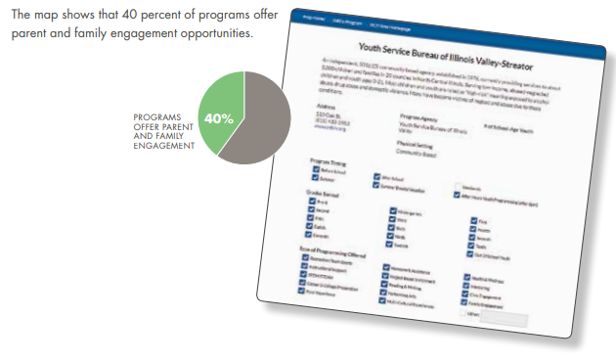
Exploring Afterschool: Family Engagement
Notes:
Sara
Child care
Engaging families in comfortable settings
Family engagement improves grades

Slide 26
The Unmet Need for Afterschool and Return on Investment
Need outpaces supply. For every 1 child in afterschool 2 are waiting to get in.
Less than one percent of the state’s investments in children and youth ($6.2 billion) are dedicated to keeping youth safe, connected, and engaged in their communities through service, recreational, or leadership opportunities.
Afterschool saves up to $9 for every $1 invested.
Notes:
Faith (Bringing it all together)
By increasing kids’ earning potential, improving academic achievement, and reducing juvenile crime and delinquency, afterschool saves up to $9 for every $1 invested.

Slide 27
How We Use the Map
Notes:
Susan

Slide 28
District/Regional Profiles
Notes:
Ashal
Why you created it
How you created it
What did it show

Slide 29
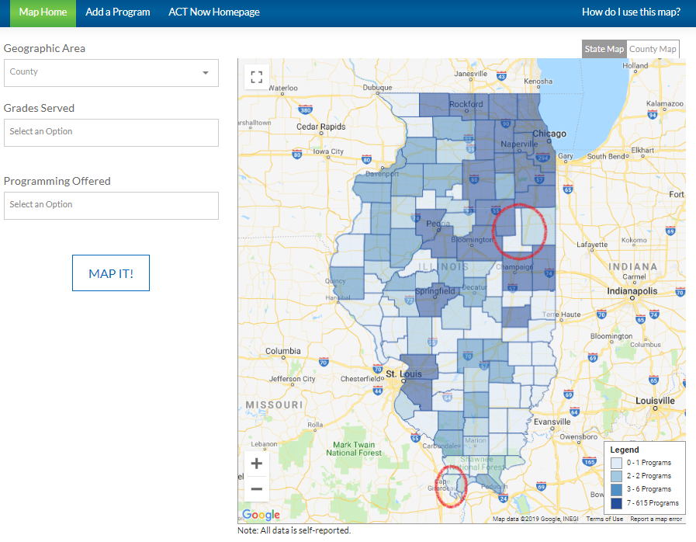
Afterschool Deserts
Places with high child
poverty and low numbers
of programs
Notes:
Emma
Explain how we identify desserts
Briefly what outreach we have done
Talk about the Alexander County trip

Slide 30
What Stakeholders Can Do
Notes:
Susan

Slide 31
How do you think different stakeholders can use map data? Schools Afterschool Programs Policymakers etc…
Notes:
Susan

Slide 32
What Can Stakeholders Do
State Agencies
Educators
Business Leaders
Policymakers
Support districts in afterschool
Promote afterschool as a way to improve schools
Helps CBOs and school collaborate
Share data and collaborate
Use afterschool quality tools
Advocate
Provide expertise
Support
Support funding and partnerships
Highlight the effectiveness of afterschool
Notes:
Susan
Ask for final questions

Slide 33
Contacts
Network Lead Susan Stanton Office: 312.877.0725 Email: StantonS@actnowillinois.org
Youth Development Associate Faith Knocke Office: 312.877.0726 Email: KnockeF@actnowillinois.org
Quality & Professional Development Specialist Emma Vibber Office: 312.520.5268 Email: VibberE@actnowillinois.org
Follow us on Facebook: @AfterschoolforChildrenandTeensNow Follow us on Twitter: @ACTNowCoalition

