Slide 1
College Changes Everything Conference
Thursday July 30, 2020
12:00 pm – 1:00 pm
Touching the Third Rail: Creating Campus Equity Plans to Eliminate Gaps in Degree Completion by Race and Pell-status at National Louis University and Moraine Valley Community College through the Illinois Equity in Attainment Initiative
Dr. Julian Williams, Partnership for College Completion
Tracy Templin, National Louis University
Dr. Scott Friedman, Moraine Valley Community College

Slide 2
Introduction
Julian Williams, Ph.D. Equity Program Manager Partnership for College Completion | Chicago, Illinois
Tracy Templin Executive Director, Strategy and Operations National Louis University | Chicago, Illinois Scott N. Friedman, Ph.D. Dean of Student Engagement Moraine Valley Community College | Palos Hills, Illinois

Slide 3
Agenda
Partnership for College Completion
Illinois Equity in Attainment (ILEA)
ILEA Equity Plan & Development Process
ILEA Equity Plan Experience - National Louis University
ILEA Equity Plan Experience – Moraine Valley Community College
Question & Answer

Slide 4
Partnership for College Completion
Partnerships
Public Policy
Public Awareness

Slide 5
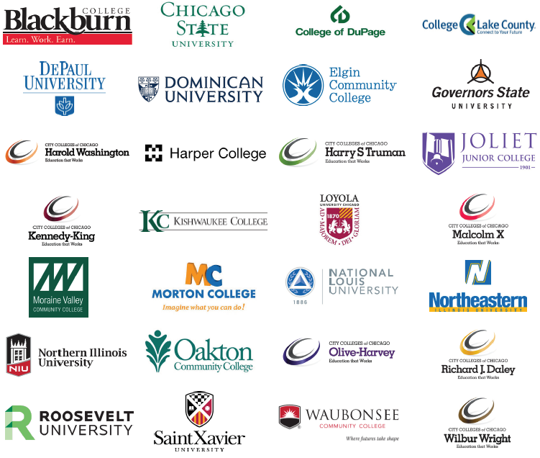
Illinois Equity in Attainment (ILEA)

Slide 6
ILEA Supports
Summits
Webinars
Academies
Equity Program Managers

Slide 7
ILEA Equity Plan
Table of Contents
1 | Signature/Endorsement
2 | Introduction
3 | Current State
4 | Future Vision
5 | Institutional Strategies
6 | Evaluation Plan
7 | Budget

Slide 8
ILEA Equity Plan Supports
Instruction Guide
Template Guide
Webinar Series
Review Process

Slide 9
National Louis University
Tracy Templin
Executive Director, Strategy and Operations

Slide 10
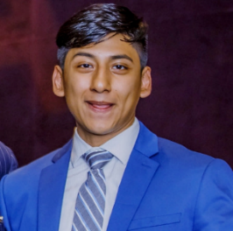
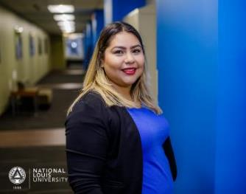
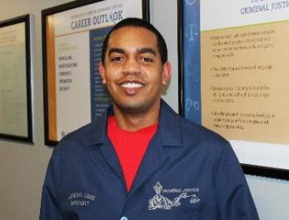
National Louis University Undergraduate College (UGC) Vision
Our Solution: Being Student-Ready
The Undergraduate College at National Louis University will
be a national leader in driving equity in bachelor's degree attainment and employment. Our graduates will possess the knowledge and skills to succeed as professionals and engaged citizens, leading to positive outcomes for themselves, their families, and communities.

Slide 11
The NLU Pathways Approach (for first-time full-time freshmen) Directly Addressing Barriers To and Through College
Why Students Don’t Access/Succeed in College
NLU Pathways (Daytime) Program Design
Financial barriers
Limited quality college options if not a top academic performer
Need to work or take care of family
Lack of readiness in terms of academic or non-cognitive skills
Limited course-taking and career guidance
Limited academic and personal support, often first-generation
Affordable at $10K/year
2.0+ GPA requirement
Flexible and convenient
Personalized, flipped, adaptive model, leveraging technology and data-driven support
Clear pathway to a degree
Career readiness focus
High-touch, supportive environment with Success Coach
Access
Success

Slide 12
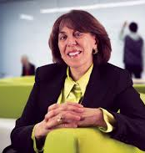
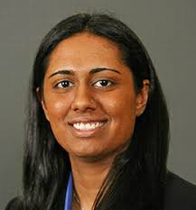
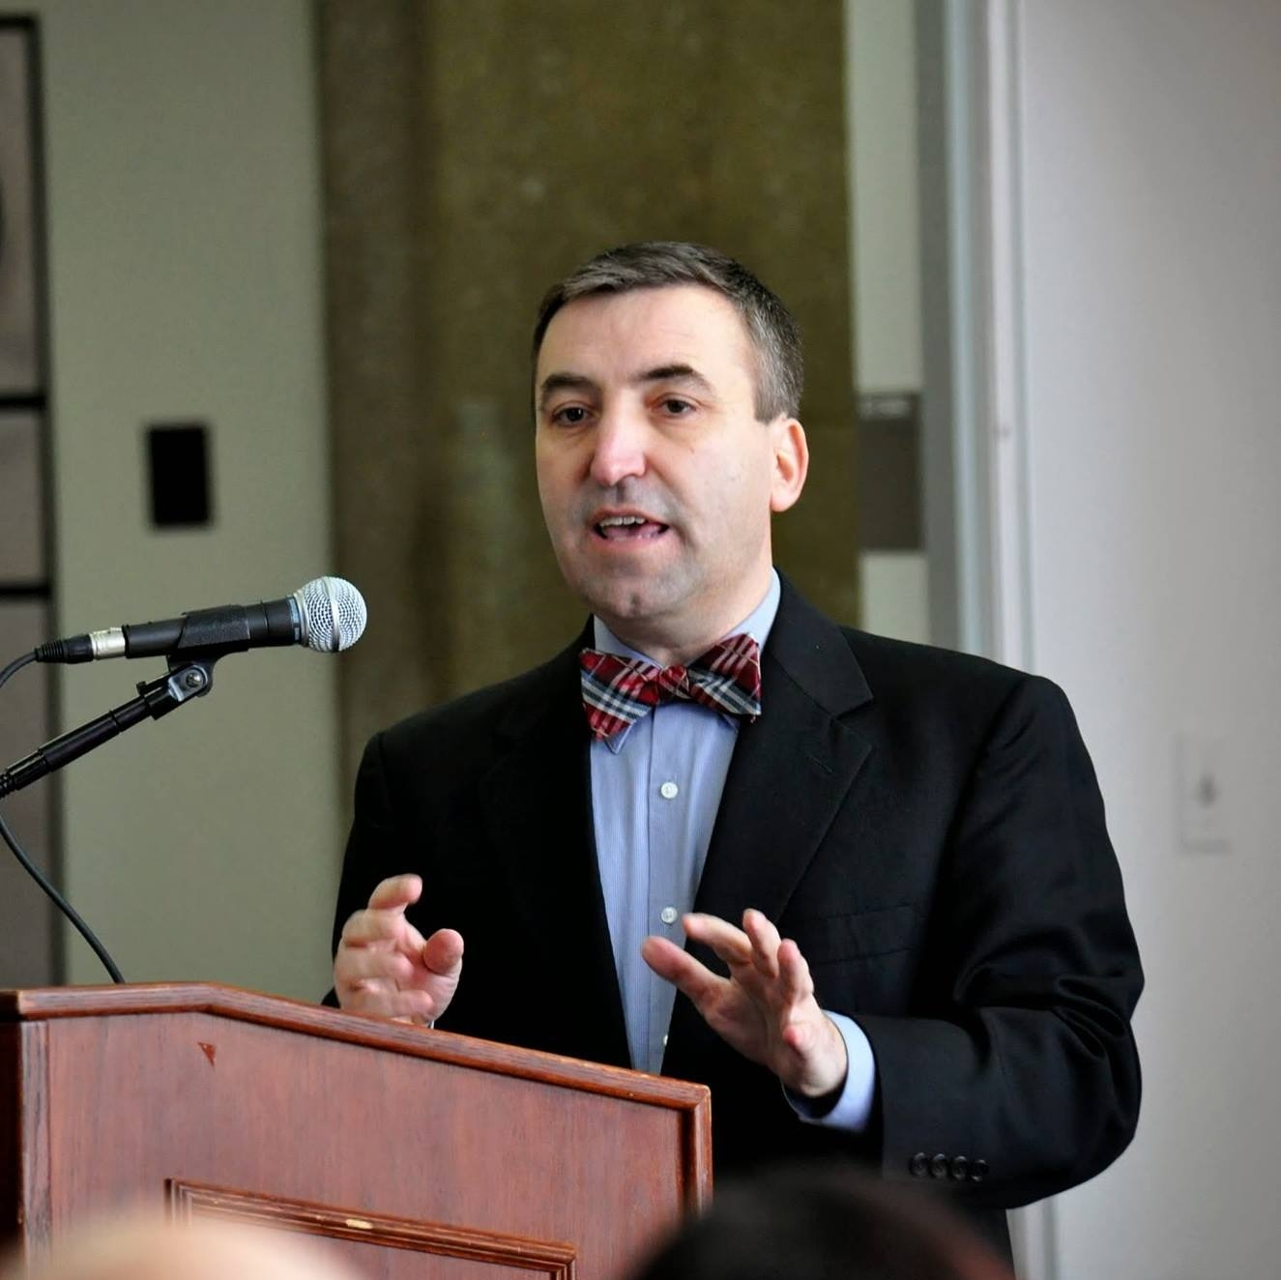
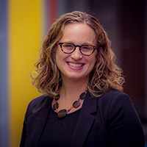
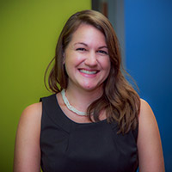
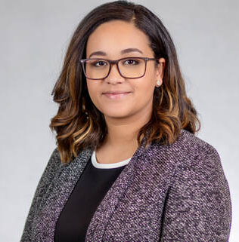
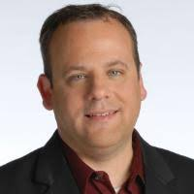
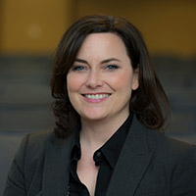
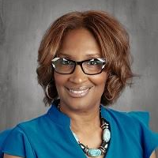
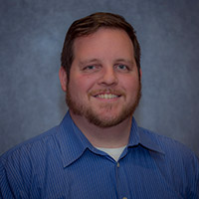
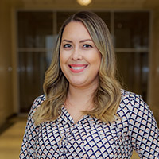
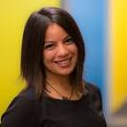
NLU ILEA Team
Nivine Megahed President
Aarti Dhupelia,
Vice President,
Dean, Undergraduate College
Aurélio Valente,
Vice President, Student Affairs
Dean of Students
Jennifer Robin,
Director, Student Success
Tracy Templin,
Executive Director, Strategy and Operations
Melanie Flores,
Director, HSI Programs
Stephen Neer,
Vice Provost, Advising and Registrar
Stephanie Poczos
Associate Dean, General Education
Wytress Richardson,
Associate Professor
Jon Oelke,
Assistant Professor
Aurora Flores Garcia,
Associate Director, Student Success
Serah Fatani,
Director, Enrollment and Strategic Growth

Slide 13
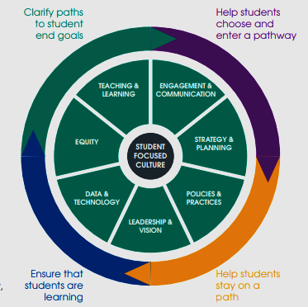
A Campus-Wide Effort with Multiple Engagement Opportunities
NLU Equity Plan
INSTITUTIONAL CAPACITY FRAMEWORK
Student Focus Groups
Faculty & Staff Debriefs

Slide 14
Strategies to Close Completion Gaps – African-American Students
Empowerment and Community Building for Young Men and Women of Color; Building a Culture of Inclusion
Faculty Professional Development on Culturally Responsive Classrooms – Restorative Practices
Expansion of the peer mentoring program launched in 2018 for men of color and creation of Exuberance, an intentional sisterhood, to promote retention and academic success through community building.
Training for faculty on creating culturally responsive classrooms and implementing restorative justice strategies in order to improve relationships between faculty and students of color and creating safe classroom spaces.
Eagle Brotherhood will aim to serve over 50% of African-American male 1st time freshmen at scale and contribute to reducing the gap in 1st year credit attainment and retention.
In addition to contributing to positive relationships, the strategy also aims to improve attendance, which we know to be highly correlated to academic performance.

Slide 15
Strategies to Close Completion Gaps – Latinx Students
Curriculum and Instructional Strategies for Serving English Language Learners
Building a Culture of Inclusion in the Student Experience
Improving support to English Language Learners through dedicated support specialists and curricular improvements to address the unique needs of non-native speakers.
Goals for this strategy include increased success in English Gateway courses and retention in the first year.
Increasing representation of students’ cultural heritage on campus, meaningful experiences that promote inclusion, and intentional events to promote equity focused dialogue between faculty, staff and students through the Centro de Excelencia.
Goals for this initiative include increasing students’ sense of belonging and engagement on campus.

Slide 16
Strategies to Close Completion Gaps – Pell Eligible Students
Holistic Student Wellness and Basic Needs Insecurities Support:
Satisfactory Academic Progress (SAP) Process Revision
Centralize and expand health and wraparound supports, including increasing access to mental health counseling, connections to community-based partners offering legal and social services, and supports to address housing/food insecurities.
Revise our current practices for students who are at-risk of having their financial aid suspended to reduce the barriers for low-income, first-generation students to successfully access and appeal for aid.
Goals for this initiative include increases to retention for students who are accessing services as basic needs are addressed.
Goals for the strategy include increasing the proportion of students who are able to pay for college and continue enrollment.

Slide 17
Strategies to Close Completion Gaps – Pell Eligible & Institutional
NLU Tuition Completion Program
Recruitment and Retention of Diverse Faculty and Staff
Institutional strategy that will impact all students. NLU will increase efforts to source, attract, hire, and retain diverse candidates to better reflect the community it serves.
This strategy will contribute to increased persistence and graduate rates across both first-time and transfer students.
Expansion of NLU’s successful scholarship program piloted with transfer students, the Eagle Completion Scholarship will target low-income students in their Junior or Senior year (over 90 credit hours) who are on-track to graduate but may experience unexpected financial hardship that prevents degree completion.
Strategy includes developing a leadership academy for mid-level managers to create a culture of growth and learning, and improve mangers’ skills in leading and developing their teams.

Slide 18
Future State: Degree Attainment
Baseline data shows significant gaps between African-American and White students and Latinx and White students. Goals were set across all populations to eliminate gaps while increasing the 4-year graduation rate to 75% for transfer students and the 6-year graduation rate to 60% for first-time freshmen.

Slide 19
Success, Challenges, and Learnings
Success & Learnings
Learnings from ICAT, Promise54, and community engagement to inform institutional priorities (e.g., focus on diverse hiring and retention)
Implementation of initiatives across each population (beginning to learn more and see outcomes, e.g., SAP Appeals, Tuition Completion Program)
Continuing to build awareness and integration into larger NLU initiatives (2030 Strategic Planning, President’s Diversity, Equity, and Inclusion (DEI) Council)
Addressing the shifting demographics of the undergraduate population (growing online, new culinary and hospitality students)
Challenges

Slide 20
Moraine Valley Community College
Scott Friedman, Ph.D.
Dean of Student Engagement and ILEA Core Team Lead

Slide 21
Institutional Overview
One of the largest comprehensive community colleges in Illinois
Serves the southwest suburbs
More traditional student age
Higher proportion of lower income students
High student and faculty/staff diversity
Many awards for diversity and equity work

Slide 22
Equity Plan Overview
Introduction
Data summary
Trend-indicated and stretch goals
Strategies
Evaluation plan, resources, and timeline
List of major stakeholders involved
DEI definitions for the campus

Slide 23
Process
Multiple campus-wide communications, presentations, and working sessions
Students were invited to participate in most faculty/staff working sessions
Verbal feedback plus over 2,000 written comments helped inform our Equity Plan
Core Team narrowed to strategies
Lead drafted the Equity Plan

Slide 24
Stakeholder in the Plan Development
Core Team (President, VPAA, VPSD, me, Director of IR, Coordinator of Multicultural Student Affairs, faculty representative)
IR support
Completion Commitment Committee
Student Trustees
Students
Stakeholders leading strategies

Slide 25
Challenges
Never enough time
No dedicated position or institutional structure for DEI work
No new budget provided, so strategies needed to already have funding
Recognizing some equity gaps were wider than expected and that our past efforts may not have had large enough scale and impact

Slide 26
Successes
Very high campus-wide engagement
Student voice included frequently
Strong, regular communications
Many volunteers
Developed internal DEI definition set
Equity Plan discussions helped us with strategic planning, Perkins grant, Aspen Institute, and other documents

Slide 27
Lessons Learned
Acknowledge we do not have all the answers or solutions to these HUGE issues
Celebrate the wins for our students
The Equity Plan is just the beginning
Keep chasing the light at the end of the tunnel

Slide 28
Question & Answer

