Slide 1
Working with, for, and about Adult Education Students
A COACHING EXPERIENCE
Sandy González, M.Ed. (She/Ella)
Academic Support Coach & Navigator
Waubonsee Community College

Slide 2
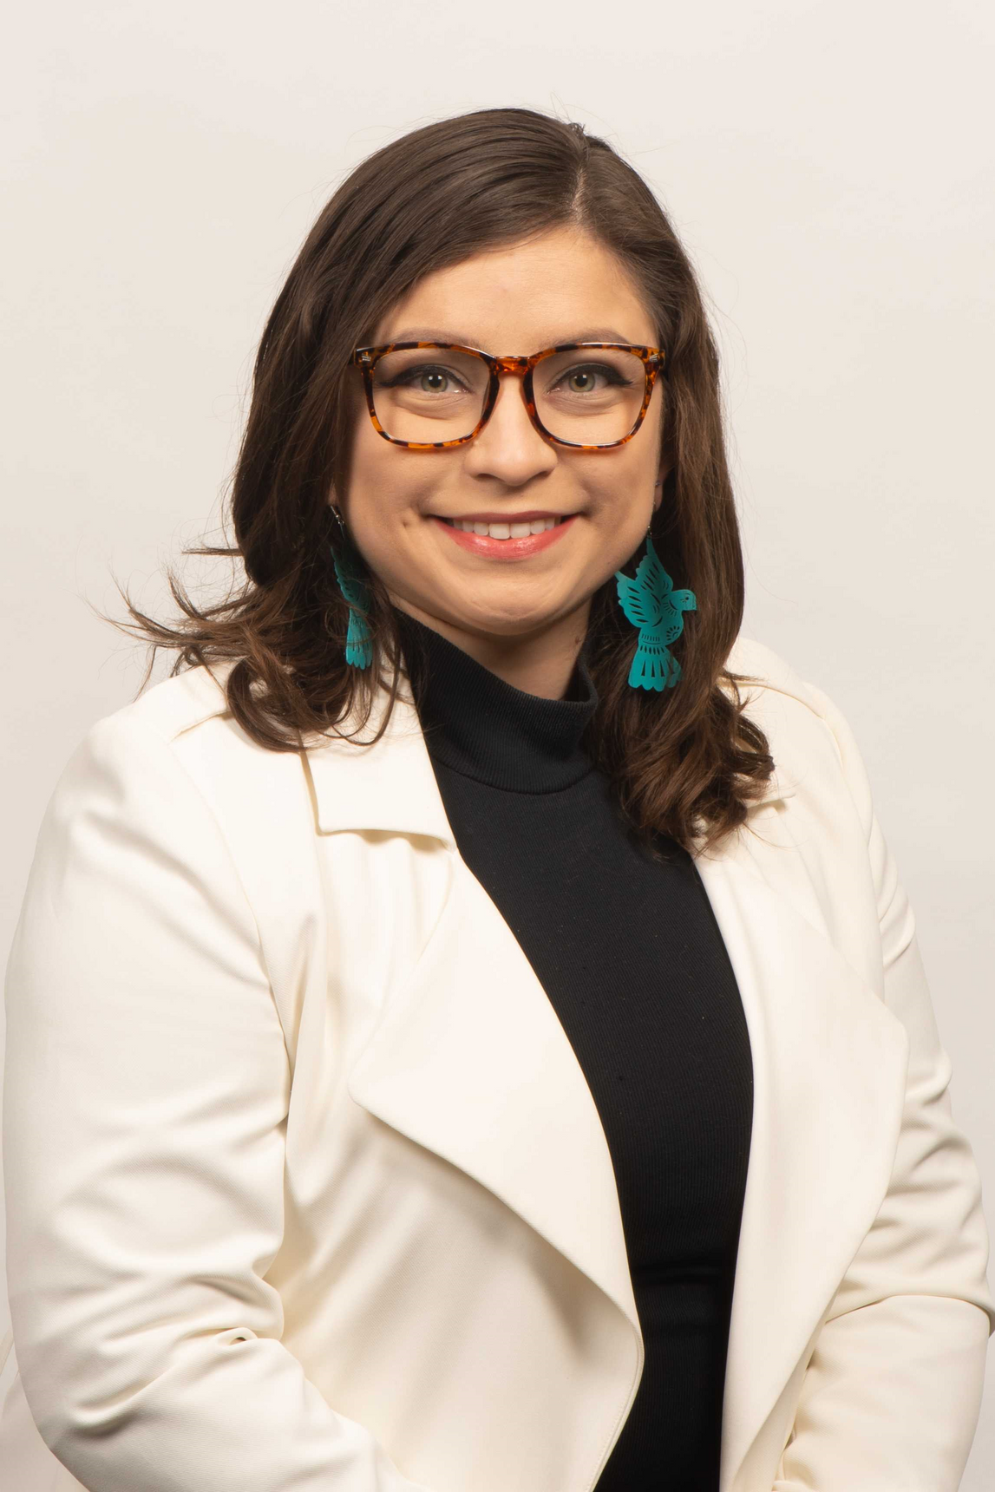
Hello everyone,
I'm Sandy Gonzalez!
I am the first in my family to go to college in the United States and am the oldest daughter of Salvadoran migrants. I have a bachelor's in Spanish Language and Literature with a K-12 educator license, a Latin American Studies minor, and a graduate certificate in ELL/Bilingual Education, from Northern Illinois University. For five years, I taught high school Spanish to native speakers and along the way discovered my passion for helping students through community work. Through all that, I received my master's in Diversity and Equity in Education from the University of Illinois at Urbana-Champaign and am currently working on a doctorate in Educational Administration and Foundations at Illinois State University. When I am not focusing on my Ph.D. program and work, I'm at home with my three cats, my husband, and occasionally fostering kittens. Otherwise, I enjoy digital photography and playing video and board games to de-stress."

Slide 3
Focus for today
WHO IS AN ADULT EDUCATION STUDENT
Defining and reframing who they are.
WHO IS AN ACADEMIC SUPPORT COACH & NAVIGATOR
Outlining the roles specific to Waubonsee Community College (WCC) and how it bridges Adult Education and Academic Support.
HOW WE CAN WORK WITH, FOR, AND ABOUT ADULT EDUCATION STUDENTS
Discussing my experiences at WCC and considerations.

Slide 4
How do you make rice?
Keep this in mind: how does this relate to Adult Education students?

Slide 5
Who is an adult education student

Slide 6
ADULT EDUCATION AND FAMILY LITERACY ACT GRANT PROGRAM
Under the Adult Education and Family Literacy Act, the program of Basic Grants to States is the major source of federal support for basic skills programs. The purpose of the program is to provide educational opportunities below the postsecondary level for individuals 16 or older,
• who are not currently enrolled in school,
• who lack a high school diploma, or
• who lack the basic skills to function effectively in the workplace and in their daily lives.
Instructional services are offered in four program areas: ABE – basic skills instruction below the high school level; ASE – high school level instruction; IELCE – integrated English literacy and civics education; and ELA –
English language acquisition instruction.

Slide 7
Community cultural wealth (YossO, 2005)

Slide 8
Who is an academic support coach & Navigator
Academic Support Coach: Assists students with time management, study skills, executive functioning skills, organization, and other academic skills.
Navigator: are assigned to courses and embedded in the learning management system (Canvas). Supports students by connecting to college and community resources.
*At Waubonsee Community College, all coaches are navigator, but not all navigators are coaches!*

Slide 9
My experiences coaching adult education students
Working with students using a translation app to overcome linguistic barriers.
I've messaged students in Mandarin, Urdu, French despite not knowing those languages to support them.
Adult Education instructors connecting students to me about immigration resources.
I spent an hour and a half with a student who shared their migration story and discussed local lawyers with whom I've had positive interactions.
Coaching students on using the Canvas learning management system.
I held space for student twice a month to learn how to navigate Canvas, especially for those students who are thinking about getting a degree after completing the Adult Education program.

Slide 10
Considerations
Working with, for, and about Adult Education Students
Wrap-around services
More collaboration across divisions and offices
Community services

Slide 11
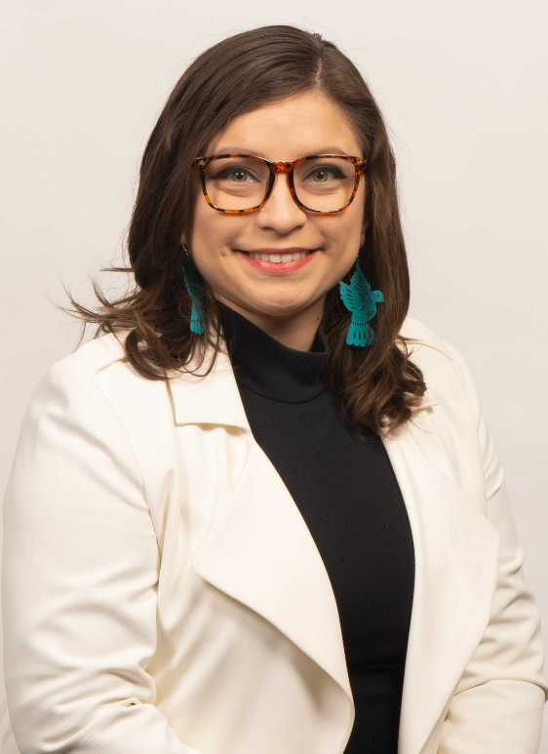
Get in
Touch
Sandy González, M.Ed. (She/Ella)
Academic Support Coach & Navigator
sgonzalez@waubonsee.edu
331-666-1482
bit.ly/wcc-sandy

